Slide 1
Sections 4.1-4.2
Introduction to Probability
Ezra Halleck, City Tech (CUNY), Spring 2023

Slide 2
4.1 Experiment, Outcomes, and Sample Space
Definition
An experiment is a process that, when performed, results in one and only one of many possible observations.
“Many” here just means more than one.
These observations are the outcomes of the experiment.
The collection of all outcomes is a sample space.

Slide 3
Table 4.1 Examples of Experiments, Outcomes, and Sample Spaces
Experiment | Outcomes | Sample Space
Toss a coin once Head, Tail S = {Head, Tail}
Roll a die once 1, 2, 3, 4, 5, 6 S = {1, 2, 3, 4, 5, 6}
Toss a coin twice HH, HT, TH, TT S = {HH, HT, TH, TT}
Play lottery Win, Lose S = {Win, Lose}
Take a test Pass, Fail S = {Pass, Fail}
Select a worker Male, Female S = {Male, Female}
Exercise: Think of the outcomes as variables and classify each one.
Can you come up on your own example of an experiment?

Slide 4
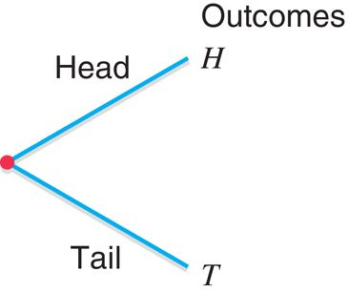
Example 4-1
Tree diagram for the experiment of tossing a coin once.

Slide 5
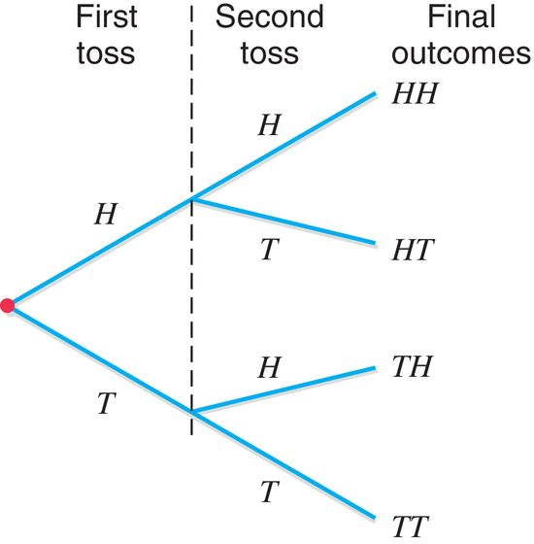
Example 4-2
Tree diagram for the experiment of tossing a coin twice.

Slide 6
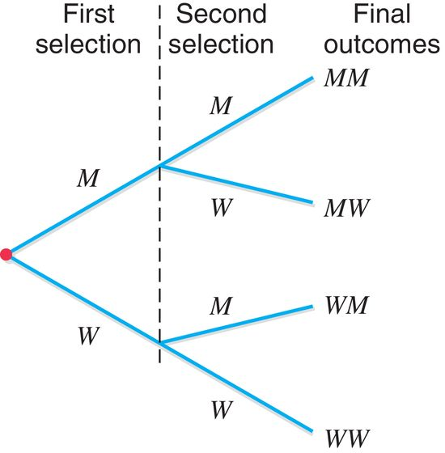
Example 4-3
Randomly select two workers from a company and observe their genders.
Tree diagram for this experiment.

Slide 7
Note how the trees for the last 2 examples have identical structures:

Slide 8
Events: Simple and Compound
Definition
An event is a collection of one or more of the outcomes of an experiment.
An event that consists of a single outcome is simple.
Example: for the experiment of selecting 2 workers and recording their genders, the simple events are
A compound event is a collection of more than one outcome for an experiment.
An example is provided on the next slide.

Slide 9
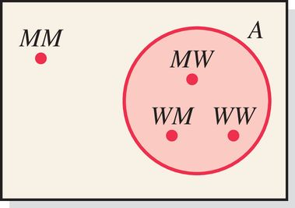
Example of compound event 4-5
Select 2 workers and record their genders.
Let A be the event that at most one man is selected.
Here at most one man means one or no man is selected.
Event A will occur if either no man or one man is selected:
Because event A contains
more than one outcome,
it is a compound event.
Here is its Venn Diagram->

Slide 10
Example 4-6
In a group of college students, some like ice tea and others do not. There is no student in this group who is indifferent or has no opinion. Two students are randomly selected from this group.
How many outcomes are possible? List all the possible outcomes.
Consider the following events. List all the outcomes included in each of these events. Mention whether each of these events is a simple or a compound event.
Both students like ice tea.
At most one student likes ice tea.
At least one student likes ice tea.
Neither student likes ice tea.

Slide 11
Example 4-6: Solution (1 of 6)
Let
  L The event that a student likes ice tea
  N The event that a student does not like ice tea
  LL Both students like ice tea
  LN The first student likes ice tea but the second student does not
  NL The first student does not like ice tea but the second student does
  NN Both students do not like ice tea

Slide 12
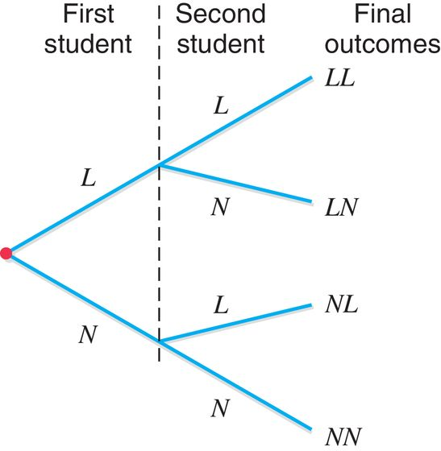
Example 4-6: Solution (2 of 6)
This experiment has four outcomes, which are listed below and shown in Tree figure on the right
LL, LN, NL, NN

Slide 13
Example 4-6: Solution (3 of 6)
(b)
The event both students like ice tea will occur if LL happens. Thus,
Both students like ice tea = {LL}
Since this event includes only one of the four outcomes, it is a simple event.

Slide 14
Example 4-6: Solution (4 of 6)
(b)
The event at most one student likes ice tea will occur if one or none of the two students likes ice tea, which will include the events LN, NL, and NN. Thus,
At most one student likes ice tea = {LN, NL, NN}
Since this event includes three outcomes, it is a compound event.

Slide 15
Example 4-6: Solution (5 of 6)
(b)
The event at least one student likes ice tea will occur if one or two of the two students like ice tea, which will include the events LN, NL, and LL. Thus,
At least one student likes ice tea = {LN, NL, LL}
Since this event includes three outcomes, it is a compound event.

Slide 16
Example 4-6: Solution (6 of 6)
(b)
The event neither student likes ice tea will occur if neither of the two students likes ice tea, which will include the event NN. Thus,
Neither student likes ice tea = {NN}
Since this event includes one outcome, it is a simple event.

Slide 17
4.2 Calculating Probability
Probability is a numerical measure of the likelihood that a specific event will occur.
First Property
The probability of an event always lies in the range 0 to 1:
Second Property
For an experiment, the sum of the probabilities of all simple events (or final outcomes) is always 1:

Slide 18
Conceptual Approaches to Probability 1
Classical Probability
Two or more outcomes that have the same probability of occurrence are said to be equally likely outcomes.
Find the probability of obtaining a head for one toss of a coin.

Slide 19
Example 4-8
Find the probability of obtaining an even number in one roll of a die.
A = an even number is obtained = {2, 4, 6}.
If any one of these three numbers is obtained, event A is said to occur. Hence,

Slide 20
Example 4-9
Jim and Kim have been looking for an apartment to rent.
They like five and two of them are in West Orange, NJ.
They cannot decide which of the five they should rent.
They put five balls 1 through 5 (each # representing an apartment) in a box and ask their daughter to select one.
What is the probability that the selected apartment is in West Orange?
Each ball has the same probability of being selected.
Two of the five homes are in West Orange. Hence,

Slide 21
Conceptual Approaches to Probability 2
Relative Frequency Concept of Probability
Using Relative Frequency as an Approximation of Probability
If an experiment is repeated n times and an event A is observed f times where f is the frequency, then, according to the relative frequency concept of probability:

Slide 22
Example 4-10
10 of the 500 randomly selected cars manufactured at an auto factory are found to be lemons. What is the probability that the next car manufactured at this auto factory is a lemon?
Let n denote the total number of cars in the sample and f the number of lemons in n. Then,
Using the relative frequency concept of probability, we obtain
Car | f | Relative Frequency
Good | 490 | 490 over 500 = .98
Lemon | 10 | 10 over 500 = .02
Blank | n = 500 | Sum = 1.00

Slide 23
Law of Large Numbers (LLN)
Definition
Law of Large Numbers
If an experiment is repeated again and again,
the probability of an event obtained from the relative frequency approaches the actual (or theoretical) probability.

Slide 24
LLN: Simulating the Tosses of a Coin
Number of Tosses | Number of Heads | Number of Tails | P(H) | P(T)
3 | 0 | 3 | .00 | 1.00
8 | 6 | 2 | .75 | .25
25 | 9 | 16 | .36 | .64
100 | 61 | 39 | .61 | .39
1000 | 522 | 478 | .522 | .478
10,000 | 4962 | 5038 | .4962 | .5038
1,000,000 | 500,313 | 499,687 | .5003 | .4997
If the experiment is repeated only a few times, the probabilities obtained may not be close to the actual probabilities.
As the number of repetitions increases, the probabilities of outcomes obtained become very close to the actual probabilities.

Slide 25

Practice 2: When tossing a fair coin, if heads comes up on each of the first 10 tosses, what do you think the chance is that another head will come up on the next toss?
0.5, less than 0.5, or more than 0.5?
The probability is still 0.5; there is still a 50% chance that another head will come up on the next toss:
P(H on 11th toss) = P(T on 11th toss) = 0.5
The coin is not “due” for a tail.
It is often felt that
  random processes are supposed to compensate for whatever happened in the past.
This is just not true; known as the gambler’s fallacy.

Slide 26
Disjoint and non-disjoint outcomes
Disjoint (mutually exclusive) outcomes cannot happen at the same time.
The outcome of a single coin toss cannot be a head and a tail.
A student both cannot fail and pass a class.
A single card drawn from a deck cannot be an ace and a queen.
Non-disjoint outcomes: Can happen at the same time.
A student can get an A in Stats and A in Econ in the same semester.

Slide 27
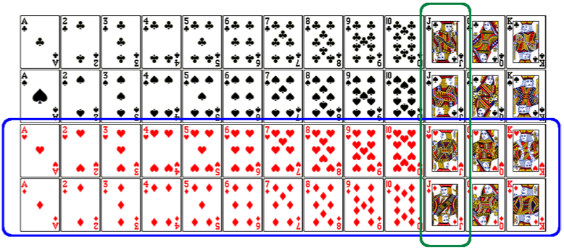
Union of non-disjoint events
What is the probability of drawing a jack or a red card from a well shuffled full deck?
Figure from http://www.milefoot.com/math/discrete/counting/cardfreq.htm

Slide 28
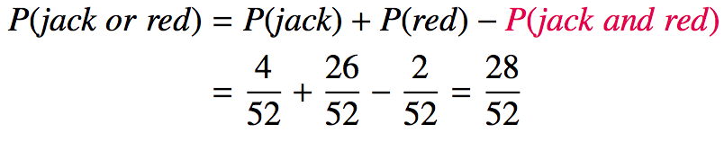
Union of non-disjoint events
What is the probability of drawing a jack or a red card from a well shuffled full deck?
Figure from http://www.milefoot.com/math/discrete/counting/cardfreq.htm

