Slide 1
Statistics Session 21
Sampling Distributions part 2
Ezra Halleck, City Tech (CUNY), Fall 2021

Slide 2
Opening Example
You read about opinion polls in newspapers, magazines, and on the Web every day.
These polls are based on sample surveys.
Have you heard of sampling and nonsampling errors?
It is good to be aware of such errors while reading these opinion poll results.
Sound sampling methods are essential for opinion poll results to be valid and to minimize effects of such errors.

Slide 3
7.2 REVIEW Mean and Standard Deviation of x bar
The mean and standard deviation of the sampling distribution of
are called the mean and standard deviation of
and are
denoted by
respectively.
The mean of the sampling distribution of
is always
equal to the mean of the population. Thus,

Slide 4
Standard error: Standard Deviation of $\overline{x}$
The standard deviation of the sampling distribution of $\overline{x}$ is
$$σ_{\overline{x}}=\frac{σ}{\sqrt{n}}$$
Where:
σ is the standard deviation of the population;
n is the sample size.
Sample size can be no more than 5% of population, i.e.,
$$\frac{n}{N}≤\frac{1}{20}=0.05$$
If proportion is >5%, use correction factor $\sqrt{\frac{N−n}{N−1}}$, .i.e., $σ_{\overline{x}}=\frac{σ}{\sqrt{n}}\sqrt{\frac{N−n}{N−1}}$
$σ_{\overline{x}}$ is known as the Standard Error.

Slide 5
Two Important Observations
1. The spread of the sampling distribution of $\overline{x}$ is smaller than the spread of the corresponding population 𝜎, i.e.
$$σ_{\overline{x}}<σ$$
2. The standard deviation of the sampling distribution of $\overline{x}$ decreases as the sample size increases.

Slide 6
7.3 Review Sampling from a Population That Is Not Normally Distributed
According to the central limit theorem, for a “large” sample size, the sampling distribution $\overline{X}$ is approximately normal, irrespective of the shape of the population distribution.
The mean & standard deviation of the sampling distribution $\overline{X}$ are as we have already stated:
The sample size is usually considered to be “large” if $n≥30,$
another “rule of thumb”.

Slide 7
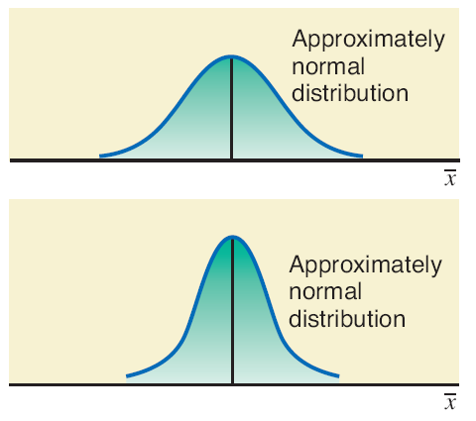
Population Distribution and Sampling Distributions of x bar for nonnormal X
Population
distribution
Sampling
Distribution
$$n=30$$
Sampling
Distribution
$$n=4$$
Sampling
Distribution
$$n=80$$
Sampling
Distribution
$$n=15$$
The vertical lines in the left graphs are used to indicate ${μ_{\overline{x}}}_{}$ and ${μ_{\overline{x}}+σ}_{\overline{x}}$. Note skewing.

Slide 8
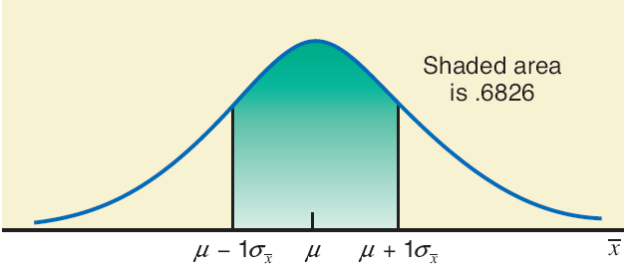
7.4 Applications of the Sampling Distribution of $\overline{x}$
Reminder of empirical rule:
Take all possible samples of the same (large) size from a population and calculate the mean for each of the samples:
~ 68% of the sample means will be within one standard deviation of the population mean.

Slide 9
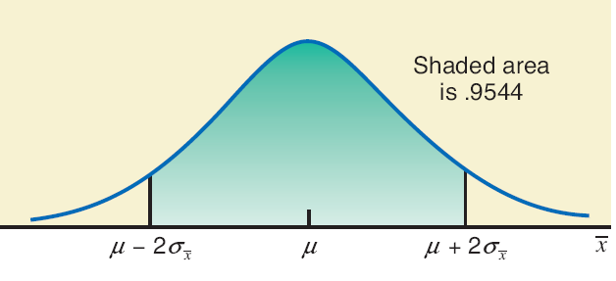
Reminder of empirical rule (cont)
Take all possible samples of the same (large) size from a population and calculate the mean for each of the samples:
~ 95% of the sample means will be within two standard deviations of the population mean.

Slide 10
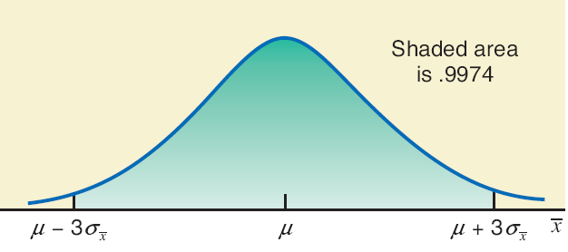
Reminder of empirical rule (cont)
Take all possible samples of the same (large) size from a population and calculate the mean for each of the samples:
~ 99.7% of the sample means will be within three standard deviations of the population mean.

Slide 11
Rice bags example
If the weights of bags of rice are normally distributed with a mean of 32 ounces and a standard deviation of 0.3 ounce, find the probability that the mean weight, $\overline{x}$, of a random sample of 20 bags will be between 31.8 and 31.9 ounces.
Solution: begin by verifying that assumptions for using the CLT have been satisfied:
Since the population from which the sample is taken is normal, the minimal sample size of 30 does not apply.
So, the answer is yes! Here are the sample dist parameters:

Slide 12
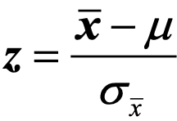
Rice bags solution (cont)
Now find the z values for the interval endpoints using:
For
For
For a sandwich inequality, we find the area up to the right endpoint and subtract the area up to the left endpoint:
Excel work is presented on next slide.

Slide 13
Rice bags Excel work and picture

Slide 14
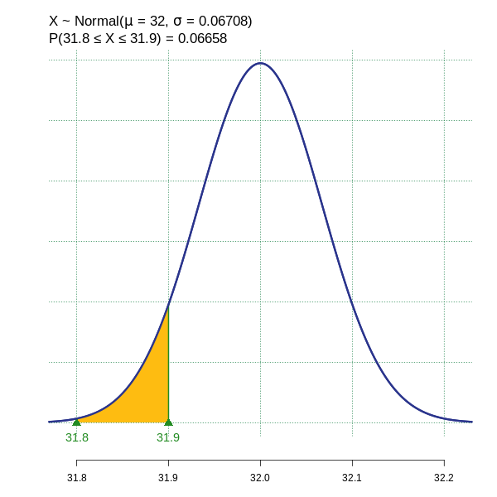
Rice bags: TI84 work and Rguroo picture
Note how this is very similar to what
we have done earlier.

Slide 15
Costs to a bank for servicing checking accounts
According to Moebs Services Inc., an individual checking account at major U.S. banks costs the bank on average $400 per year to service.
Suppose the standard deviation is $30 and that a small branch has 225 such accounts. Let $\overline{x}$ be its average cost to service these accounts.
What is the probability that its average annual cost to service the accounts accounts is less than the population mean by $2.70 or more, i.e, $400 - $2.70?
Solution: The shape of the probability distribution of the population is unknown.
However, since the sample size 225 is sufficiently large (>30), we can apply the CLT:

Slide 16
Costs to bank for checking accounts solution (cont)
Excel:
NORM.S.DIST(-1.35,TRUE)
Thus, chance that the average annual cost of the checking accounts in this sample is less than the population mean by $2.70 or more is .0885.

Slide 17
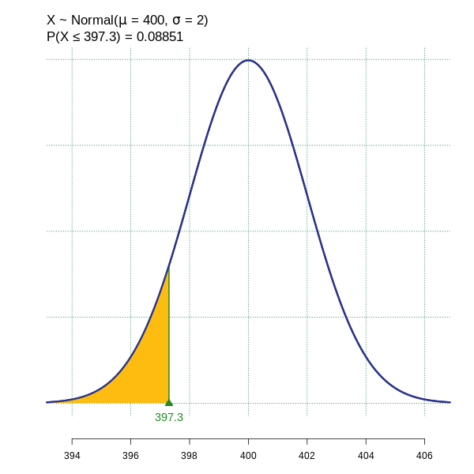
Costs to bank for checking accounts solution (cont)

