Slide 1
Sections 5.2 – 5.3
Probability Distributions of a Discrete Random Variable (DRV)
Mean and Standard Deviation of a DRV
$$C_{x}$$
Ezra Halleck, City Tech (CUNY), Spring 2023

Slide 2
Reminder of Opening Example from part 1
When you purchase a lottery ticket for $5 and you don’t win anything, then your “earnings” are – 5. If you get a $20 prize, then your earnings are 20 – 5 = 15.
Playing the lottery and determining your earnings is an experiment with a numeric outcome and hence is an example of a random variable.

Slide 3
5.2 Probability Distribution of a Discrete Random Variable
A PD of DRV lists all the possible values that the variable can assume and their corresponding probabilities.
Recall the frequency and relative frequency distributions of the number of vehicles owned by families
The distribution consists of the first and third columns.
# Vehicles Owned | Frequency | Rel Frequency
0 | 30 | .015
1 | 470 | .235
2 | 850 | .425
3 | 490 | .245
4 | 160 | .080
Blank | N = 2000 | Sum = 1.000

Slide 4
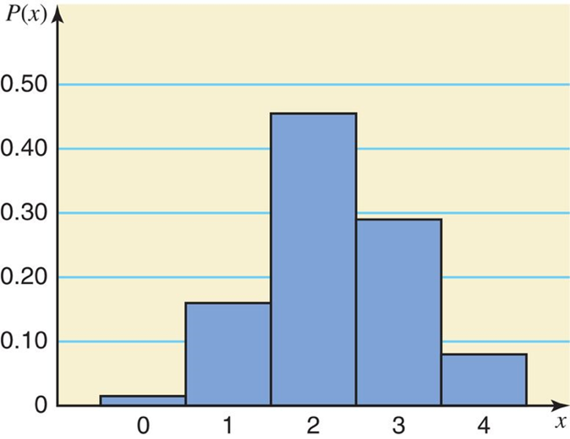
Probability Distribution for # of Vehicles Owned by Families
A bar graph or histogram is the most common way to display the distribution graphically.
How would you describe the shape of the distribution?
Bell shaped? Symmetric? If not, then right or left skewed?
# of Vehicles Owned x | Probability P(x)
0 | .015
1 | .235
2 | .425
3 | .245
4 | .080
Blank | summation P(x) = 1.000.

Slide 5
Recall the two characteristics of any finite or discrete Probability Distribution
1.
2.
In particular, any discrete random variable has these characteristics.

Slide 6
Exercise: Find the probability that a randomly selected family owns
(a) two vehicles?
(b) at least two vehicles?
(c) at most one vehicle?
(d) owns three or
more vehicles?
# of Vehicles Owned x | Probability P(x)
0 | .015
1 | .235
2 | .425
3 | .245
4 | .080
Blank | summation P(x) = 1.000.
Probability that selected family owns:
(a) owns two vehicles = P(2) = .425
(b) at least two vehicles
= P(2 or 3 or 4) = P(2) + P(3) + P(4) = .425 + .245 + .080 = .750
(c) at most one vehicle = P(0 or 1) = P(0) + P(1) = .015 + .235 = .250
(d) owns 3 or more vehicles = P(3 or 4) = P(3) + P(4) = .245 + .080 = .325

Slide 7
Example 5-3
Each of the following tables lists certain values of x and their probabilities. Determine whether or not each table represents a valid probability distribution.
(b)
x | P(x)
2 | .25
3 | .34
4 | .28
5 | .13
(c)
(a)
x | P(x)
0 | .08
1 | .11
2 | .39
3 | .27
x | P(x)
7 | .70
8 | .50
9 | −.20
(a) No, since the sum of all probabilities is not equal to 1.0.
(b) Yes.
(c) No, since one of the probabilities is negative.

Slide 8
Example 5-4
The following table lists the probability distribution of the # of breakdowns per week for a machine (based on past data).
Breakdowns per week | 0 | 1 | 2 | 3
Probability | .15 | .20 | .35 | .30
1. Is this a probability distribution?
2. Find the probability that the # of breakdowns for this machine during a given week is
(a) exactly 2
(b) 0 to 2
(c) more than 1
(d) at most 1

Slide 9
Example 5-4: Solution
Breakdowns per week | 0 | 1 | 2 | 3
Probability | .15 | .20 | .35 | .30
(a) exactly 2
(b) 0 to 2
(c) more than 1
(d) at most 1

Slide 10
Example 5-5: math anxiety
Problem: According to a survey, 60% of all students at a large university suffer from math anxiety.
Two students are randomly selected from this university.
Let x denote the number of students in this sample who suffer from math anxiety. Construct the probability distribution of x.
Solution: Let us define the following two events:
N = the student selected does not suffer from math anxiety M = the student selected suffers from math anxiety
We construct a tree to find the outcomes and their probs
This part does not give a random variable.
Additional processing of information from the tree is needed.

Slide 11
Example 5-5: Tree Diagram

Slide 12
Example 5-5: processing of tree info
From the tree calculations, we gather that
P(0) = P(NN) = .16
P(2) = P(MM) = .36
We conclude that our random variable is the following:
This is an example of a binomial distribution,
which is the topic for the next session.
x | P(x)
0 | .16
1 | .48
2 | .36
Blank | summation P(x) = 1.00.

Slide 13
5.3 Mean and Standard Deviation of a Discrete Random Variable
The mean is the value that is expected to occur per repetition, on average, if an experiment is repeated a large number of times. It is denoted by Greek letter “mu”:
$$μ=E\left[X\right]=\sum_{i=1}^{n}{x_{i}P\left[X=x_{i}\right]}=\sum{x P\left(x\right)}$$
The function notation which uses the letter “E” results from the fact that the mean is often called the
Expected value or Expectation.

Slide 14
Example 5-6
The following table lists # of breakdowns per week and their probabilities for a machine based on past data.
Breakdowns | Probability
0 | .15
1 | .20
2 | .35
3 | .30
x | P(x) | xP(x)
 |  | 0(.15) = .00
 |  | 1(.20) = .20
 |  | 2(.35) = .70
 |  | 3(.30) = .90
Blank | Blank | summation x P(x) = 1.80.
Find the mean # of breakdowns per week for this machine.

Slide 15
Recall Probability Dist for # of Vehicles Owned by Families
# of Vehicles Owned x | Probability P(x)
0 | .015
1 | .235
2 | .425
3 | .245
4 | .080
Blank | summation P(x) = 1.000.

Slide 16
Probability Dist for # of Vehicles Owned by Families
We use TI84 to find the E[X].
Put the data into L1, L2.
Go to stat, calc, 1-var stats.
For frequency, put L2.
Go to calculate and hit enter.
So E[X] is 2.14.
# of Vehicles Owned x | Probability P(x)
0 | .015
1 | .235
2 | .425
3 | .245
4 | .080
Blank | summation P(x) = 1.000.

Slide 17
bad batteries expectation
w | P(w)
0 | $$\frac{ _{3}C_{0} × _{7}C_{2}}{ _{10}C_{2}}=\frac{1∗21}{45}=\frac{7}{15}$$
1 | $$\frac{ _{3}C_{1} × _{7}C_{1}}{ _{10}C_{2}}=\frac{3∗7}{45}=\frac{7}{15}$$
2 | $$\frac{ _{3}C_{2} × _{7}C_{0}}{ _{10}C_{2}}=\frac{3∗1}{45}=\frac{1}{15}$$
2 batteries are selected
from a collection of 10,
3 of which are bad.
Let W denote:
# defective batteries chosen
$$E\left[W\right]=0∗P\left[0\right]+1∗P\left[1\right]+2∗P\left[2\right]$$
$$=0∗ \frac{7}{15} +1∗ \frac{7}{15} + 2∗\frac{1}{15}$$
$$=\frac{0∙7+1∙7+2∙1}{15}=\frac{9}{15}=\frac{3}{5}=0.6$$
In other words, just a little more than half a bad battery.

Slide 18
Rolling a single 6-sided, fair die
x | 1 | 2 | 3 | 4 | 5 | 6
P(x) | $$\frac{1}{6}$$ | $$\frac{1}{6}$$ | $$\frac{1}{6}$$ | $$\frac{1}{6}$$ | $$\frac{1}{6}$$ | $$\frac{1}{6}$$
Outcomes are 1, 2, …, 6 and fair means each outcome is equally likely
So $E\left[X\right]=1∗\frac{1}{6}+2∗\frac{1}{6}+⋯+6∗\frac{1}{6}$
$=\frac{1}{6}\left(1+2+⋯+6\right)$
$=\frac{1}{6}\left[\left(1+6\right)+\left(2+5\right)+\left(3+4\right)\right]$
$=\frac{1}{6}∗\frac{6∗7}{2}=\frac{7}{2}=3.5$
The expectation is a measure of the distribution’s middle.
If distribution is symmetric, as in this case, then middle is easy to find.
1 2 3 4 5 6
⬆

Slide 19
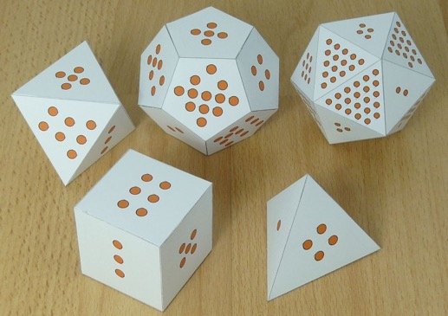
Uniform (generalization of a 6-sided die example)
Let X be a random variable that is equally likely to take on any of the values
1, 2, . . . , n, i.e.,
$$\text{So}\text{, }E\left[X\right]=1∗\frac{1}{n}+2∗\frac{1}{n}+⋯+n∗\frac{1}{n}=\frac{1}{n}\left(1+2+⋯+n\right)=\frac{1}{n}\frac{n\left(n+1\right)}{2}=\frac{n+1}{2}$$
[We factored out 1/n and used identity: $1+2+⋯+n=\frac{n\left(n+1\right)}{2}$]
Since the distribution is symmetric this should not be a surprise.
To find the middle, we can add first and last elements and divide by 2:
$$\frac{\text{last}+\text{first}}{2}=\frac{n+1}{2}$$
n | E[X]
4 | 2.5
6 | 3.5
8 | 4.5
12 | 6.5
20 | 10.5
1 2 3 … n-2 n-1 n
⬆

Slide 20
Example: means of smaller or larger face of roll of 2 dice
[If both dice show the same number, then take this to be the value of either face.]
Here are Excel calculations:
Means for smaller/larger # RV’s are slightly more than 2.5 and slightly less than 4.5.

Slide 21
Baseball World Series length
If the 2 teams in a World Series have the same chance of winning each game, independent of the results of previously played games, then the probabilities that the series will end in 4, 5, 6, or 7 games are:
1/8, 1/4, 5/16, and 5/16
What is expected number of games played in such a series?
The probability distribution is:
So
Thus, the series will last on average about 5.8 games.
x | 4 | 5 | 6 | 7
p(x) | 1/8 | 1/4 | 5/16 | 5/16

Slide 22
Baseball World Series length
x | 4 | 5 | 6 | 7
p(x) | 1/8 | 1/4 | 5/16 | 5/16
Challenge: How were the probabilities calculated?
We designate the teams A and B. The situation is symmetric, so we look at the chance that A wins in a particular # of games and then double.
A must win the last game, and 3 of previous games. That means that for the outcomes 4, 5, 6 and 7, B must win 0, 1, 2 and 3 of those games.
Deciding which of those games B wins leads to the binomial coefficients (combinations) 3nCx0, 4nCx1, 5nCx2, 6nCx3 respectively.
RV outcome | Combination | Experiment Outcome | Chance of each outcome | Half of probability
4 | 3 nCx 0 = 1 | A A A A | 1 out of 16 | 1/16
 | way to put
 | 0 B’s in 3 slots
5 | 4 nCx 1 = 4 | BAAAA | 1 out of 32 | 4/32=1/8
 | ways to | ABAAA
 | put 1 B | AABAA
 | in 4 slots | AAABA
RV Outcome | Combination | Experiment Outcome | Chance of each outcome | Half of probability
6 | 5 nCx 2 = 10 | BBAAAA | 1 out of 64 | 10/64=5/32
 | ways to put | BABAAA
 | 2 B’s in | BAABAA
 | 5 slots | :
 |  | AAABBA
7 | 6 nCx 3 = 20 | BBBAAAA | 1 out of 128 | 20/128=5/32
 | ways to put | BBABAAA
 | 3 B’s in | BBAABAA
 | 6 slots | :
 |  | AAABBBA

Slide 23
Standard Deviation of Discrete Random Variable
The standard deviation of a discrete random variable X measures the spread of its probability distribution:
$σ=\sqrt{\text{Var}\left(X\right)}=\sqrt{\sum{{\left(x−μ\right)}^{2}P(x)}}$ (definition)
$=\sqrt{\sum{x^{2}P(x)}−μ^{2}}$ (property)
Most of the time we will use the property for calculations.

Slide 24
Example 5-7
Baier’s Electronics manufactures computer parts that are supplied to many computer companies.
Two quality control inspectors at Baier’s Electronics check every part for defects before it is shipped.
However, a few defective parts do pass through undetected.
Let x denote the number of defective computer parts in a shipment of 400.
The following table gives the probability distribution of x.
Find the mean and standard deviation.
x | 0 | 1 | 2 | 3 | 4 | 5
P(x) | .02 | .20 | .30 | .30 | .10 | .08

Slide 25
Example 5-7: Solution
x | P(x) | xP(x) | ^{x squared} | x squared p(x),
0 | .02 | .00 | 0 | .00
1 | .20 | .20 | 1 | .20
2 | .30 | .60 | 4 | 1.20
3 | .30 | .90 | 9 | 2.70
4 | .10 | .40 | 16 | 1.60
5 | .08 | .40 | 25 | 2.00
Blank | Blank | summation of P(x) = 2.50. |  | summation of x squared p(x) = 7.70.

Slide 26
Using Excel for 𝜎

Slide 27
Interpretation of the Standard Deviation
The standard deviation of a discrete random variable can be interpreted and used the same way as the standard deviation of a data set that we learned about as part of our study of descriptive statistics.
For the computer part example
among a shipment of 500 parts, 2.5 on average will be defective;
the actual numbers of defective parts will differ from this 2.5 by a little less than 1.2 on average.
If the number of defective parts is more than 2.5, then on average, it will be at 2.5 + 1.2 = 3.7.
If the number of defective parts is less than 2.5, then on average, it will be at 2.5 - 1.2 = 1.3.
1.3 2.5 3.7
1.2 1.2

Slide 28
Recall Probability Dist for # of Vehicles Owned by Families
Let’s use TI84 to find σ = SD[X].
Recall µ= 2.14.
It turns out that the calculator
has already found σ from what we did before.
Interpretation: a random family’s vehicle ownership will be on average about 0.9 units from the mean of 2.1.
# of Vehicles Owned x | Probability P(x)
0 | .015
1 | .235
2 | .425
3 | .245
4 | .080
Blank | summation P(x) = 1.000.

