Slide 1
Sections 4.3.4-4.4
Complement, Intersection, Multiplication Rule
Ezra Halleck, City Tech (CUNY), Spring 2023

Slide 2
Review: Disjoint and non-disjoint outcomes
Disjoint (mutually exclusive) outcomes cannot happen at the same time.
The outcome of a single coin toss cannot be a head and a tail.
A student both cannot fail and pass a class.
A single card drawn from a deck cannot be an ace and a queen.
Non-disjoint outcomes: Can happen at the same time.
A student can get an A in Stats and A in Econ in the same semester.

Slide 3
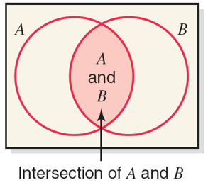
Intersection of Events
Definition
Let A and B be two events defined in a sample space.
The intersection of A and B represents the collection of all outcomes that are common to both A and B and is denoted by
Important note:
Two events are mutually exclusive if and only if their intersection is the empty set.

Slide 4
Example 4-14: Solution
A = {2, 4, 6}; B = {1, 3, 5}; C = {1, 2, 3, 4}
Mutually exclusive events A and B
Mutually nonexclusive events A and C

Slide 5
Marginal Probability
Definition
Marginal probability is the probability of a single event without consideration of any other event.
Blank | In Favor (A) | Against (B) | Total
Male | 15 | 45 | 60
Female | 4 | 36 | 40
Total | 19 | 81 | 100

Slide 6
Conditional Probability
Definition
Conditional probability is the probability that an event will occur given that another has already occurred.
If A and B are two events, then the conditional probability of A given B is written as
Read as
“the probability of A given that B has already occurred”
or
“the probability of A given B” for short.

Slide 7
Example 4-12
Compute the conditional probability P (in favor | male) for the data on 100 employees given in Table 4.5.
Blank | In Favor (A) | Against (B) | Total
Male | 15 | 45 | 60
Female | 4 | 36 | 40
Total | 19 | 81 | 100

Slide 8
Example 4-13
Compute P (female | in favor) the probability of being a woman among those who favor higher salaries for CEO’s.
Blank | In Favor (A) | Against (B) | Total
Male | 15 | 45 | 60
Female | 4 | 36 | 40
Total | 19 | 81 | 100

Slide 9
Independence
Definition
Two events are said to be independent if the occurrence of one does not affect the probability of the occurrence of the other. In other words, A and B are independent events if

Slide 10
Example 4-17
In a survey, 500 adult coffee drinkers were asked whether they drink coffee with or without sugar.
Of these 500 adults:
240 are men
175 drink coffee without sugar
Of the 240 men:
84 drink coffee without sugar.
Are the events drinking coffee without sugar and man independent?

Slide 11
Example 4-17: Solution
An important skill to develop is to be able to create a contingency table using just partial information.
We will also take a frequency contingency table and create a corresponding relative frequency one.
Because these two probabilities are equal:
the 2 events drinking coffee without sugar and man are independent.

Slide 12
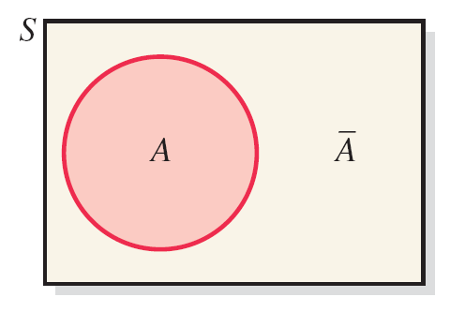
4.3.3 Complement
Definition
The complement of event A, denoted by
and read
as “A bar” or “A complement,” is the event that includes all the outcomes for an experiment that are not in A.
An important formula: $P\left(\overline{A}\right)=1−P(A)$

Slide 13
Example 4-18
In a group of 2000 taxpayers, 400 have been audited by the I R S at least once.
If one taxpayer is randomly selected from this group, what are the two complementary events for this experiment. What are their probabilities?
The two complementary events for this experiment are
# taxpayers not audited $=2000−400=1600.$
Hence, the probabilities of the complementary events are:
Note: $0.8=P\left(\overline{A}\right)=1−P\left(A\right)=1−0.2$

Slide 14
Example 4-19
Of the 500 adults surveyed, 325 drink coffee with sugar. Let A be the event that this adult drinks coffee with sugar.
What is the complement of event A?
What are the probabilities of the two events?
The two complementary events for this experiment are
The probabilities of the complementary events are
$$P\left(\overline{A}\right)=\frac{175}{500}=.35$$
and
Observe that the sum of these two probabilities is 1, which is always the case with two complementary events.
In fact, once we find P(A), we can find $P\left(\overline{A}\right)$:

Slide 15
4.4 Intersection of Events & the Multiplication Rules
In this section, we enlarge our set of probability tools:
Intersection or Joint probability
Multiplication rules:
Only applies to events that are independent.
Uses conditional probability and applies to any pair of events.

Slide 16
Joint Probability
Definition
The probability of the intersection of two events is their joint probability
written as $P\left(A and B\right)$ or $P\left(A∩B\right)$.
If we divide each entry in a contingency table by the grand total, the resulting table has all the joint (interior) and marginal probabilities.
P(men and sugar)
P(men)

Slide 17
Multiplication Rule 1
Multiplication Rule 1
The joint probability for 2 independent events A and B is
$$∗P\left(A and B\right)=P(A)×P(B)$$
In fact, we can use this equation as a test for independence:
The equation* holds if and only if the 2 events are independent.

Slide 18
Example 4-20
An office building has two fire detectors.
Probability is .02 that any fire detector will fail to go off during a fire.
Find probability that both fire detectors will fail to go off in a fire.
Assume that failure to go off is independent.
We define the following two events:
Then, the joint probability of A and B is
Hence, the chance that both detectors fail is 1/2500.
In other words, if there are 2500 fires, the detectors will both fail on average once.

Slide 19
Example 4-21
The probability that a college graduate will find a full-time job within three months after graduation from college is .27.
Three college students, who will be graduating soon, are randomly selected.
What is the probability that all three of them will find full-time jobs within three months after graduation from college?
Let A, B, and C denote the events the first, second, and third student, respectively, finds a full-time job within three months after graduation from college. Hence,

Slide 20
Intersection of Events and the Multiplication Rules
Multiplication Rule 1 is only for 2 independent events.
When we may not have independence, we can use:
Multiplication Rule 2
The joint probability of two dependent events A and B is
Exercise: Suppose we do have independence. Make a substitution in multiplication rule 2 to recover rule 1.

Slide 21
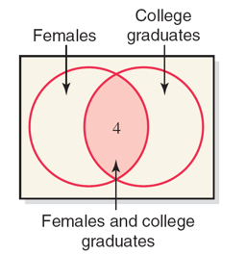
Example 4-22
Blank | College Graduate (G) | Not a College Graduate (N) | Total
Male (M) | 7 | 20 | 27
Female (F) | 4 | 9 | 13
Total | 11 | 29 | 40
If an employee is selected at random,
what is the probability that this employee is
a female and a college graduate?
We can easily calculate this directly: 4/40=10%
As an exercise, we use our new formula:

Slide 22
Example 4-23
In a group of 20 college students:
7 like ice tea and the others do not.
Two students are randomly selected from this group.
Find the probabilities that:
both of the selected students like ice tea.
the first student likes ice tea & the second does not.
An important notes:
you do NOT have independence so that you must use Multiplication Rule 2.
Use the tree as a visualization and organizational tool

Slide 23
Example 4-23: Solution (1 of 3)
From the given information:
P(first student likes ice tea) = 7/20
P(second student likes ice tea ∣ first student likes ice tea)
= 6/19
Thus, the joint probability of the two events is:
P(both students like ice tea)
= P(first student likes ice tea) ×
P(second student likes ice tea ∣ first student likes ice tea)
= (7/20) × (6/19) = .1105

Slide 24
Example 4-23: Solution (2 of 3)
From the given information:
P(1st student likes ice tea) = 7/20
P(2nd student does not like ice tea ∣ 1st student likes ice tea)
= 13/19
Thus, the joint probability of the two events is:
P(1st student likes ice tea and 2nd student does not like it)
= P(1st student likes ice tea) ×
P(2nd student does not like it ∣ 1st student likes ice tea)
= (7/20) × (13/19) = .2395

Slide 25
Example 4-23: Solution (3 of 3)

Slide 26
Another formula for conditional probability
We can rewrite the Multiplication Rule 2 to get another expression for conditional probability:
Calculating Conditional Probability
If A and B are two events, then
given that
and
Exercise: Put the formula into words.
Use “conditioning event” and “joint probability”.
Don’t use A or B!

Slide 27
Example 4-24
The probability that a student from a college is a senior is .20.
The joint probability that a student is a CSC major and a senior is .03.
Find the conditional probability that a student is a CSC major given that the student is a senior.
From the given information,
and
Hence,

Slide 28
Mutually Exclusive Events revisited
The joint probability of mutually exclusive events
is always zero, i.e., if A and B are two mutually exclusive events, then
Consider the following two events for an application filed by a person to obtain a car loan:
What is the joint probability of A and R?
The two events A and R are mutually exclusive. Either the loan application will be approved or it will be rejected. Hence,

