Slide 1
Statistics Session 6
(Simple) Linear Regression
Scatter Diagrams (Plots)
Correlation
Ezra Halleck, City Tech (CUNY), Spring 2023

Slide 2
13.1 Linear Regression: Opening Example
Are the heights and weights of persons related?
Does a person’s weight depend on his/her height?
If yes, what is the change in the weight of a person, on average, for every 1 inch increase in height?
What is this rate of change for National Football League players? (See Case Study 13-1.)

Slide 3
Simple Linear Regression
Definition
A regression model is a mathematical equation that describes the relationship between two or more variables.
A simple regression model includes only two variables: one independent and one dependent.
The dependent or response variable is the one being explained.
The independent or explanatory variable is one that partially explains the variation in the dependent variable.
A model that gives a straight-line relationship between 2 variables is a simple linear regression model.

Slide 4
Figure 13.1 Relationship between Food Expenditure and Income.
(a) Linear Relationship
(b) Nonlinear Relationship

Slide 5
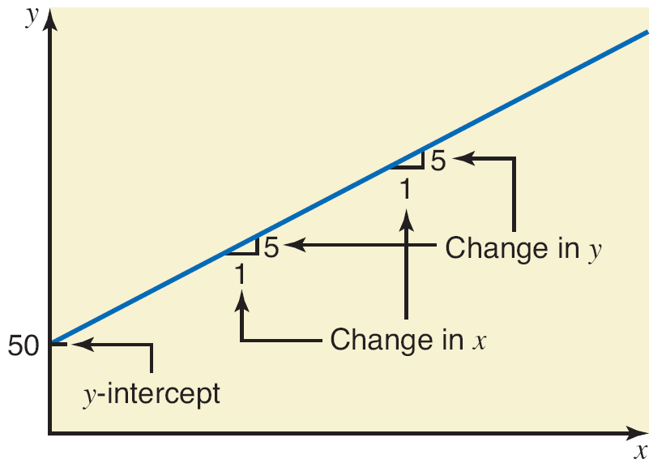
Figure 13.2 Plotting a Linear Equation
For the example, the slope is 5 and the y-intercept is 50.
Note how the x and y scales are different.

Slide 6
Simple Linear Regression Model (1 of 2)
Definition
In the regression model y = A + Bx + ε :
A is the y-intercept or constant term
B is the slope
ε is the random error term.
The dependent and independent variables are y and x, respectively.
A and B are parameters (data taken from a population).

Slide 7
Simple Linear Regression Model (2 of 2)
Definition
In most situations, the parameters A and B are unknown.
In the model
are calculated using
sample data and are the estimates of A and B, respectively.
We will illustrate the calculations and concepts using this “toy” data set:
“We have a pair of observations for each of the seven households. Each pair consists of one observation on income and a second on food expenditure. For example, the first household’s income for the last month was $5500 and its food expenditure was $1400.”
Income | Food Expenditure
55 | 14
83 | 24
38 | 13
61 | 16
33 | 9
49 | 15
67 | 17
We will use income as the independent variable
and food expenditure as the dependent variable.

Slide 8
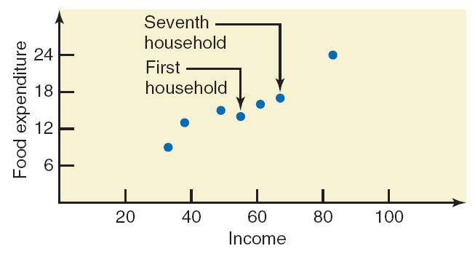
Scatter Diagram
Definition
A plot of paired observations is called a scatter diagram.
Example: Incomes (in hundreds of dollars) and Food Expenditures of Seven Households
Income | Food Expenditure
55 | 14
83 | 24
38 | 13
61 | 16
33 | 9
49 | 15
67 | 17

Slide 9
Scatter Diagram and Straight Lines
Our goal is to find a straight line which
goes in between the plotted points;
typically, ~ ½ the points will be above and ½ below.
Are any of these lines a good fit? Why, why not?

Slide 10
Figure 13.6 Best fit line
Below is the best fit line.
Notice that it does not pass through any of the points (although in general it could).
The standard criterion to choose a line is to choose the one that minimizes the sum of the squares of the errors e.

Slide 11
Error Sum of Squares (SSE)
The error sum of squares, denoted SSE, is
The values of a and b that give the minimum SSE are called the least square estimates of A and B.
The regression line obtained with these estimates is called the least squares line.

Slide 12
The Least Squares Line (1 of 2)
For the least squares regression line
where
${SS}_{xy}=\sum{\left(x−\overline{x}\right)\left(y−\overline{y}\right)}$ and ${SS}_{xx}=\sum{{\left(x−\overline{x}\right)}^{2}}$
SS stands for “sum of squares.”
Note however that there is no square for SSxy.
The formula for $a$ is associated with the fact that the point $\left(\overline{x}, \overline{y}\right)$ always lies on the regression line.

Slide 13
The Least Squares Line (2 of 2)
For the least squares regression line
where
${SS}_{xy}=\sum{\left(x−\overline{x}\right)\left(y−\overline{y}\right)}$ and ${SS}_{xx}=\sum{{\left(x−\overline{x}\right)}^{2}}$
From all those years that you studied algebra:
$m=\frac{y_{2}−y_{1}}{x_{2}−x_{1}}$, so the units for slope are $\frac{y \text{units}}{x \text{units}}$.
The units for $b$ are $\frac{x \text{units} ∗ y \text{units}}{x \text{units}∗x \text{units}}=\frac{x \text{units} ∗ y \text{units}}{x \text{units}∗x \text{units}}$.
So, after cancelation, we see that the units for $b$are correct.

Slide 14
Example 13-1 (1 of 2)
We will later use Excel and TI 84 to find the least squares regression line for the data on incomes and food expenditure on the 7 households.
But in the meantime, here are the results:
Income | Food Expenditure
55 | 14
83 | 24
38 | 13
61 | 16
33 | 9
49 | 15
67 | 17
Thus, our estimated regression model is

Slide 15
Example 13-1 (2 of 2)
Income | Food Expenditure
55 | 14
83 | 24
38 | 13
61 | 16
33 | 9
49 | 15
67 | 17
Our estimated regression model is
The interpretation of the results is important:
The slope ~1/4 means that if a household acquires $4 additional in income, then they will likely spend ~$1 of it on food.
The y-intercept of 1.5 refers to food expenditure with no income, but this is outside of our range and hence is extrapolation, which in general is discouraged.
On the other hand, we are free to predict the food expenditure for a family with income within the range of our data, this is called interpolation.
For instance, for a household with income of $5000 per month, they are likely to spend ~1.5+.25(50)=12.65 or $1,265 of it on food.

Slide 16
Error of Prediction
Note that one of our data pairs is (61,16).
If we put x = 61 into our model:
$\hat{y}$ = 1.505+.2525*61 = 16.9075 or $1690.75.
Our error is: $y−\hat{y}=16−16.9075=−0.9075$ or $−$$90.75.
Income | Food Expenditure
55 | 14
83 | 24
38 | 13
61 | 16
33 | 9
49 | 15
67 | 17

Slide 17
Excel Solution (1 of 2)

Slide 18
Excel Solution (2 of 2)

Slide 19
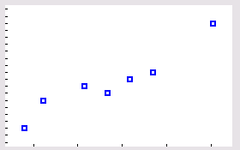
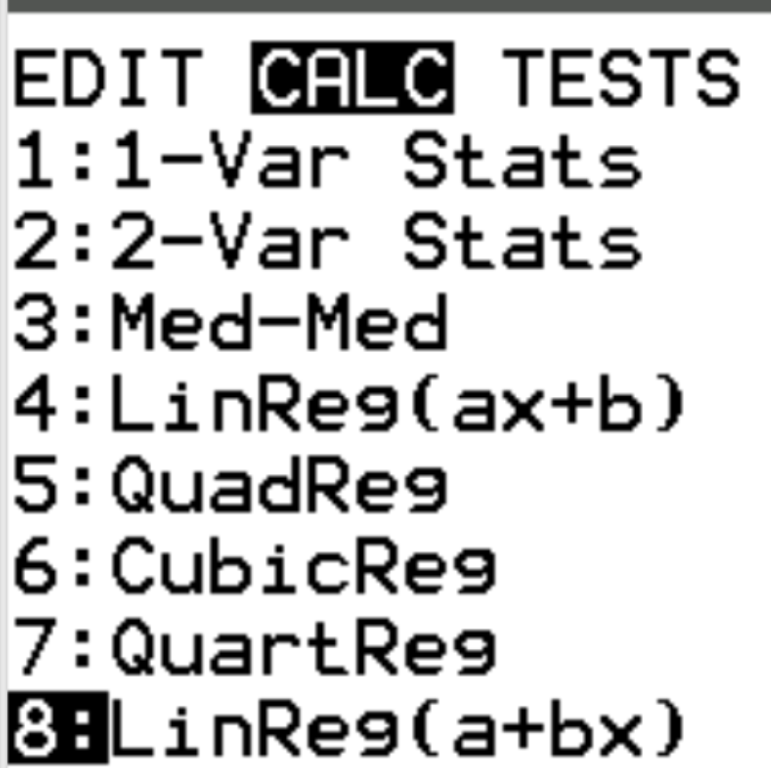
TI 84 solution (1 of 3)
Put in the data into L1 and L2 (stat, EDIT)
Go to zoom, zoomstat and you will see ->
Perform linear regression (stat, CALC, 8).
For Store RegEQ: put in vars,Y-VARS, Function Y1
Go to Calculate and press enter to see the values for a and b on the next slide.

Slide 20
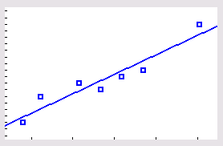
TI 84 solution (2 of 2)
Next, press “graph” to see
the scatter plot now with the
regression line.
We interpret slope $b≅\frac{1}{4}$ as:
if income increases by $4, then on average,
the food expenditure increases by $1.

Slide 21
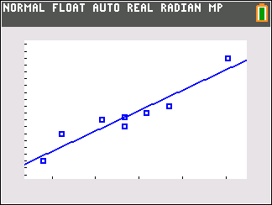
TI 84 solution (3 of 3)
We calculate the error, the difference between actual and predicted values, for data pair (55,14):
Add point (55, Y₁(55)) to the list and show the new graph:
Point with predicted y-value
Note how the actual point is -1.39 units below the predicted point.
Point with actual y-value

Slide 22
Positive and Negative Linear Relationships Between x and y

Slide 23
Case Study 13-1 Regression of Weights on Heights for NFL Players

Slide 24
NFL height vs weight defense analysis
Note how the explanatory and response variables are reversed.

Slide 25
NFL height vs weight position analysis
https://craigmbooth.com/blog/the-height-and-weight-of-every-active-football-player/

Slide 26
Assumptions of the Regression Model
The random error term ε has a mean equal to zero for each x.
The errors associated with different observations are independent.
For any given x, the distribution of errors is normal.
The distribution of population errors for each x has the same (constant) standard deviation, which is denoted

Slide 27
Distribution of Errors around the Population Regression Line

Slide 28
Nonlinear Relationships Between x and y

Slide 29
13.4 Linear Correlation
Linear Correlation Coefficient
Hypothesis Testing About the Linear Correlation Coefficient (not covered for now)

Slide 30
Linear Correlation Coefficient
Linear Correlation Coefficient
The simple linear correlation coefficient, denoted by r, measures the strength of the linear relationship between two variables for a sample and is calculated as
The Roman letter r is for sample data.
The Greek letter for r, 𝛒 “rho”, is used for population data.
The correlation coefficient always lies in range −1 to 1:
$−1≤ρ≤1$ and $−1≤r≤1$.

Slide 31
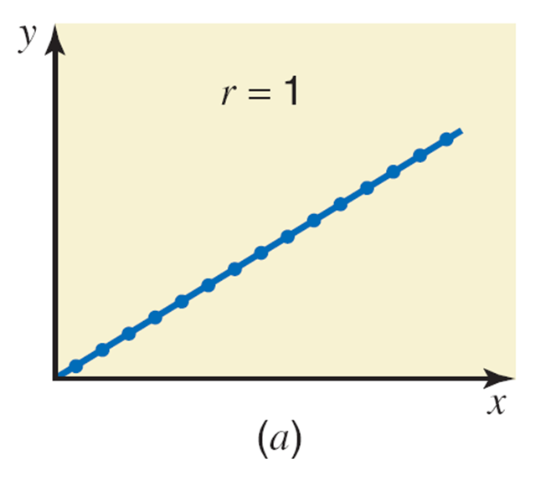
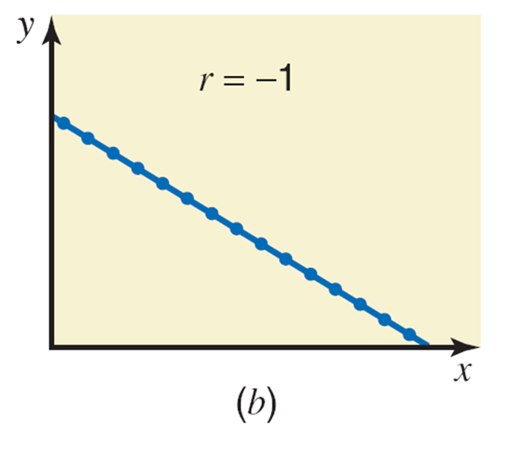
Linear Correlation between Two Variables: Extreme examples
Perfect positive,
Perfect negative,
No correlation,

Slide 32
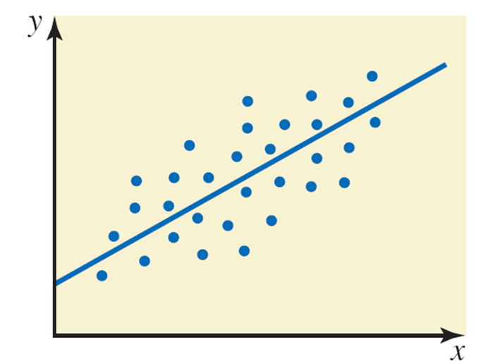
Nonextreme Positive Linear Correlations
(b) Moderately positive linear correlation
(r is around 0.6)

Slide 33
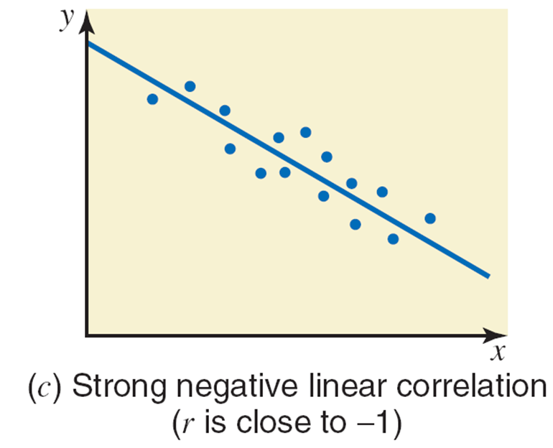
Nonextreme Negative Linear Correlations
(b) Moderately negative linear correlation
(r is around $−$0.6)

Slide 34
Example 13-6
Calculate the correlation coefficient for the example on incomes and food expenditures of seven households.
$r^{2}$, known as the coefficient of determination, is ~90% for this example.
It provides an upper bound (maximum) on the portion of the variation in the response variable due to the explanatory variable.
Go to earlier Excel work for the sum of squares calculations.

Slide 35
TI 84 work for 13.6 (1 of 2)
Using the same procedure for the calculations of a and b, you can find you both r and r².
To do so you need to turn the diagnostics on:
from the home screen, press [2ND] [CATALOG]
in catalog press [ALPHA] [D] to go down to the "D’s”.
scroll down through the list and select the instruction DiagnosticOn
press [ENTER] twice: the display should show DONE.

Slide 36
TI 84 work for 13.6 (2 of 2)
With the data in L1 and L2,
Perform linear regression (stat, CALC, 8).
Go to Calculate and press enter.
Some notes:
b and r are always of the same sign, which indicates whether the trend line is upward or downward from left to right.
r² gives an upper bound for how much of the variation in the response variable comes from the explanatory variable.

Slide 37
Example 13-8 (1 of 2)
A random sample of eight drivers selected from a small town insured with a company and having similar minimum required auto insurance policies was selected.
Driving Experience (years) | Monthly Auto Insurance Premium ($)
5 | 64
2 | 87
12 | 50
9 | 71
15 | 44
6 | 56
25 | 42
16 | 60

Slide 38
Example 13-8 (2 of 2)
Does the insurance premium depend on the driving experience or does the driving experience depend on the insurance premium? Based on your answer, choose appropriate dependent and independent variables
Do you expect a positive or a negative relationship between these two variables?
Plot the scatter diagram and the regression line.
(d) Find the least squares regression line using the SS formulas.
(e) Interpret the meaning of the values of a and b in part d.
(f) Calculate r and r² and interpret.
(g) Predict the monthly auto insurance for a driver with 10 years of driving experience.

Slide 39
Example 13-8: Solution
(a) Based on theory and intuition, we expect the insurance premium to depend on driving experience.
The insurance premium is a dependent variable (variable y)
The driving experience is an independent variable (variable x)
(b) You would hope that the premium will go down as a driver becomes more experienced. However, elderly drivers can cause accidents, so the premium might go up after a certain age.

Slide 40
Scatter Diagram and the Regression Line
(c) The regression line slopes downward from left to right.

Slide 41
Example 13-8: Solution (2 of 3)
(d)

Slide 42
Example 13-8: Solution (3 of 3)
(e) The value of
gives the value of
for
that is, it gives the monthly auto insurance
premium for a driver with no driving experience.
The value of
indicates that, on average,
for every extra year of driving experience, the monthly auto insurance premium decreases by $1.55.

Slide 43
Example 13-8: Solution (1 of 7)
(f)

Slide 44
Example 13-8: Solution (2 of 7)
(f) The value of
indicates that the driving
experience and the monthly auto insurance premium are negatively related. The (linear) relationship is moderately strong.
The value of
states that 59% of the total
variation in insurance premiums might be explained by years of driving experience, and 41% for sure is not.

Slide 45
Example 13-8: Solution (3 of 7)
(g) Using the estimated regression line, we find the predicted value of y for x = 10 is
Thus, the monthly auto insurance premium of a driver with 10 years of driving experience should be ~$60.
Exercise: Put the data into your calculator and reproduce the results in the slides.

