Slide 1
Sections 5.4
Binomial Random Variables
Ezra Halleck, City Tech (CUNY), Spring 2023

Slide 2
Reminder of Opening Example from part 1
When you purchase a lottery ticket for $5 and you don’t win anything, then your “earnings” are – 5. If you get a $20 prize, then your earnings are 20 – 5 = 15.
Playing the lottery and determining your earnings is an experiment with a numeric outcome and hence is an example of a random variable.

Slide 3
5.4 The Binomial Probability Distribution
The Binomial Experiment
The Binomial Probability Distribution & Binomial Formula
Using the Table of Binomial Probabilities
Probability of Success & Shape of the Binomial Distribution
Mean and Standard Deviation of the Binomial Distribution

Slide 4
The Binomial Experiment
Conditions of a Binomial Experiment
A binomial experiment satisfies the following 4 conditions:
There are a fixed number n trials.
Each trial has two possible outcomes.
The probabilities remain constant for each trial.
The trials are independent.

Slide 5
Example 5-9
Consider the experiment consisting of 10 flips of a (fair) coin. Determine whether or not it is a binomial experiment.
There are n=10 trials (flips).
Each trial (flip) has only two possible outcomes: a head and a tail.
The probabilities of obtaining both a head (a success) & a tail (a failure) is $\frac{1}{2}$ for each trial:
The trials (flips) are independent.
Consequently, the experiment of 10 coin flips is binomial.

Slide 6
Example 5-10
Are these experiments binomial?
(a) 75% of students at a college with a large student population use Instagram. A sample of 3 students from this college is selected, and these students are asked whether or not they use Instagram.
(b) In a group of 12 students at a college, 9 use Instagram. 3 students are selected from this group of 12 and are asked whether or not they use Instagram.

Slide 7
Example 5-10: continued
In short “yes” for (a) and “no” for (b).
(a) The key word here is “large” so that we can assume that the probabilities don’t change.
(b) In such a small pool, as students are selected, the probabilities change. This is hypergeometric.
Let's look at each of the four conditions separately:
Both these examples consist of three trials.
Each trial has two outcomes: a student uses Instagram or a student does not use Instagram.
Only for (a) do the probabilities stay constant.
Again only (a) has independence, as what happens in one trial affects what the probabilities are for the next trial in (b).

Slide 8
The Binomial Probability Distribution and Binomial Formula
For a binomial experiment, the probability of exactly x successes in n trials is given by the binomial formula
$$P\left(x\right)= _{n}C_{x} p^{x}q^{n−x}$$
where
n = total number of trials
p = probability of success
q = 1 − p = probability of failure
x = number of successes in n trials
n − x = number of failures in n trials

Slide 9
Example 5-11
75% of students at a college with a large student population use Instagram.
In a group of 12 students at a college, 9 use Instagram.
In each of these scenarios:
3 students are selected and asked whether or not they use Instagram.
What is the probability that exactly two of the 3 selected use Instagram?

Slide 10
Example 5-11: Binomial Solution
Here, we are given that:
n = 3, x = 2, and p = .75
The probability of two successes is denoted by P(x = 2) or P(2)

Slide 11
Example 5-11: Binomial vs Hypergeometric
statistic | binomial | hypergeometric
# “successes” | $$x=2$$
Size of success pool | “large”
Sample size | $$n=3$$
Total size of pool | “large”
Chance of success: | $$p=.75$$
Chance of failure: | $$q=.25$$

Slide 12
Example 5-11: Binomial vs Hypergeometric
statistic | binomial | hypergeometric
# “successes” | $$x=2$$ | $$x=2$$
Size of success pool | “large” | $$r=9$$
Sample size | $$n=3$$ | $$n=3$$
Total size of pool | “large” | $$N=12$$
Chance of success: | $$p=.75$$ | varies
Chance of failure: | $$q=.25$$ | varies

Slide 13
Example 5-11: Binomial vs Hypergeometric
statistic | binomial | hypergeometric
# “successes” | $$x=2$$ | $$x=2$$
Size of success pool | “large” | $$r=9$$
Sample size | $$n=3$$ | $$n=3$$
Total size of pool | “large” | $$N=12$$
Chance of success: | $$p=.75$$ | varies
Chance of failure: | $$q=.25$$ | varies
Probability formula | $$_{n}C_{x} p^{x}q^{n−x}$$
Specific probability | $$_{3}C_{2} {.75}^{2}{.25}^{3−2}$$
Exact answer | $$3∗{\left(\frac{3}{4}\right)}^{2}∗\frac{1}{4}=\frac{27}{64}$$
TI84 Calculator | $$=binompdf(3,.75,2)$$
Decimal answer | 0.42

Slide 14
Example 5-11: Binomial vs Hypergeometric
statistic | binomial | hypergeometric
# “successes” | $$x=2$$ | $$x=2$$
Size of success pool | “large” | $$r=9$$
Sample size | $$n=3$$ | $$n=3$$
Total size of pool | “large” | $$N=12$$
Chance of success: | $$p=.75$$ | varies
Chance of failure: | $$q=.25$$ | varies
Probability formula | $$_{n}C_{x} p^{x}q^{n−x}$$ | $$\frac{ _{r}C_{x} × _{N−r}C_{n−x}}{ _{N}C_{n}}$$
Specific probability | $$_{3}C_{2} {.75}^{2}{.25}^{3−2}$$ | $$\frac{ _{9}C_{2} × _{12−9}C_{3−2}}{ _{12}C_{3}}$$
Exact answer | $$3∗{\left(\frac{3}{4}\right)}^{2}∗\frac{1}{4}=\frac{27}{64}$$ | $$\frac{36 ∗ 3}{2∗11∗10}=\frac{27}{55}$$
TI-84 formula | $$=binompdf(3,.75,2)$$ | $$\frac{ _{9}C_{2}⋅ _{3}C_{1}}{ _{12}C_{3}}$$
Decimal answer | 0.42 | 0.49
Note how the hypergeometric probability is substantially greater.
This discrepancy will lessen with larger pool size.

Slide 15
Example 5-12
At City Delivery, providing high-quality service to customers is the top priority of the management.
City Delivery guarantees a refund of all charges if a package it is delivering does not arrive at its destination within 6 hours.
It is known from past data that despite all efforts, 10% of the packages delivered by this company do not arrive at their destinations on time.
Suppose a company delivers 10 packages through City Delivery.
(a) Find the probability that exactly one of these 10 packages will not arrive at its destination within the 6 hours.
(b) Find the probability that at most one of these 10 packages will not arrive at its destination within the 6 hours.

Slide 16
Example 5-12: Solution
$$P\left(x\right)= _{n}C_{x} p^{x}q^{n−x}$$
x varies
n = total number of packages = 10 p = P(success) = 0.1 q = P(failure) = 1 − 0.1 = 0.9
x = number of successes = 1
x = number of successes = 0 or 1
(a) $P\left(1\right)= _{10}C_{1} ({0.1)}^{1}({0.9)}^{10−1}=10∗0.1∗{0.9}^{9}={0.9}^{9}$
= binompdf(1,0.1,1) $≈$ 0.39 (Using TI84)
(b) $P\left(0\right)= _{10}C_{0} {0.1}^{0}{0.9}^{10−0}=1∗1∗{0.9}^{10}={0.9}^{10}$
Hence $P\left(X≤1\right)=P\left(0\right)+P\left(1\right)$
$$={0.9}^{10}+{0.9}^{9}={0.9}^{9}\left(0.9+1\right)=1.9∗{0.9}^{9}$$
= binomcdf(1,0.1,1) $≈$0.74 (using TI84). Thus, within the 6 hr, there is a 39% chance that exactly 1 of the 10 packages will not arrive & a 74% chance that at most 1 package will not arrive.

Slide 17
Example 5-13
According to a survey, 33% of American workers do not plan to change their jobs in the near future.
Let x denote the number of workers in a random sample of 3 who do not plan to change their jobs in the near future.
Write the probability distribution of x and draw a histogram for this probability distribution.
n = total workers in sample = 3
p = P(worker does not plan to change his/her job) = .33
q = P(a worker does plan to change his/her job) = 1 −.33 = .67

Slide 18
Example 5-13: (2 of 3)

Slide 19
Example 5-13: (3 of 3)
x | P(x)
0 | .3008
1 | .4444
2 | .2189
3 | .0359

Slide 20
Example 5-13: using Excel to make table and graph

Slide 21
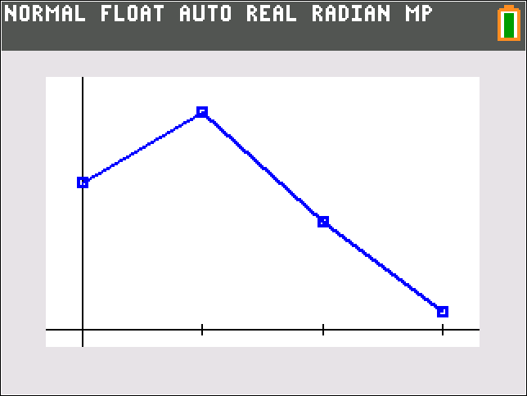
Example 5-13: using TI84 to make table and graph
In L1, put the numbers 0-3.
For L2, go to the top (label) row.
Go to distr (2nd vars), scroll to A:binompdf
Put in the values of n and p. For x, use L1.
Hit enter twice
To get line graph of the distribution,
put in the items as pictured
do zoomstat

Slide 22
Example 5-14
According to a survey, 30% of college students said that they spend too much time on social media.
(The remaining 70% said that they do not spend too much time on social media or had no opinion.)
Suppose this result holds true for the current population of all college students. A random sample of 6 college students is selected.
Find the probability that:
(a) exactly 3 of these 6 college students spend too much time on social media;
(b) at most 2 of these 6 college students spend too much time on social media;
(c) at least 3 of these 6 college students spend too much time on social media.
Let x be the # who say that they spend too much time on social media:
(d) find the probability distribution of x and draw a histogram.

Slide 23
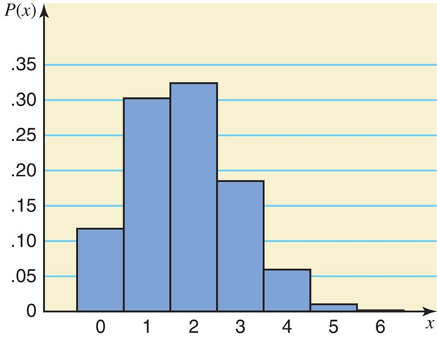
5-14: Probability distribution and histogram
x | P(x)
0 | .1176
1 | .3025
2 | .3241
3 | .1852
4 | .0595
5 | .0102
6 | .0007

Slide 24
Example 5-14: Solution to parts a, b, c
x | P(x)
0 | .1176
1 | .3025
2 | .3241
3 | .1852
4 | .0595
5 | .0102
6 | .0007
(a)
(b)
(c)
Note how (b) and (c) are complements so that we could have just subtracted 1 minus the answer to (b) to get the answer for (c).

Slide 25
Example 5-14: Solution to a, b, c; TI84
x | P(x)
0 | .1176
1 | .3025
2 | .3241
3 | .1852
4 | .0595
5 | .0102
6 | .0007
(a)
(b) Use binomcdf:
(c) Find complement of (b):

Slide 26
Probability of Success and the Shape of the Binomial Distribution
For any number of trials n:
The binomial probability distribution is symmetric if p =.50.
The binomial probability distribution is skewed to the right if p is less than .50.
The binomial probability distribution is skewed to the left if p is greater than .50.

Slide 27
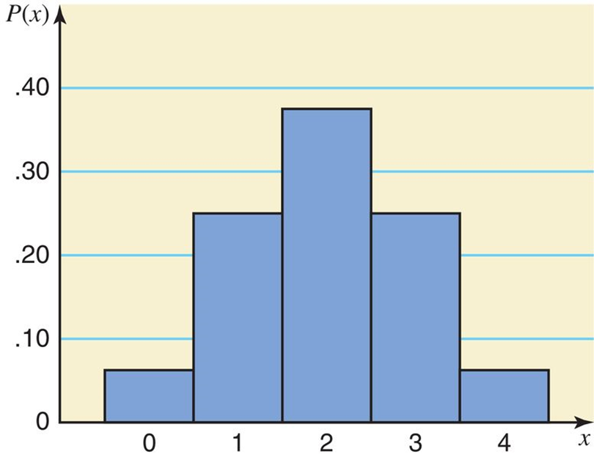
Symmetric binomial (n = 4 and p = .50)
x | P(x)
0 | .0625
1 | .2500
2 | .3750
3 | .2500
4 | .0625

Slide 28
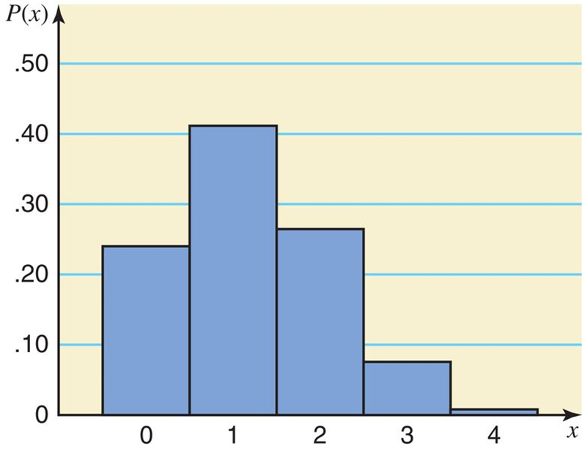
Skewed right binomial (n = 4 and p = .30)
x | P(x)
0 | .2401
1 | .4116
2 | .2646
3 | .0756
4 | .0081

Slide 29
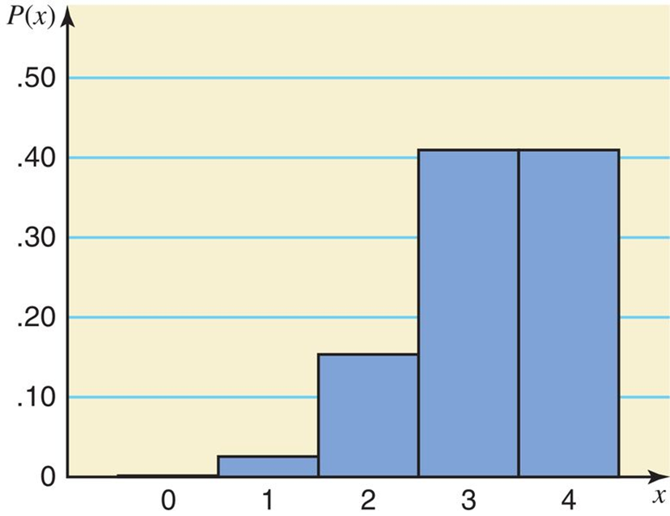
Skewed left binomial (n = 4 and p = .80)
x | P(x)
0 | .0016
1 | .0256
2 | .1536
3 | .4096
4 | .4096

Slide 30
Mean and Standard Deviation of the Binomial Distribution
The mean and standard deviation of a binomial distribution are, respectively,
where n is the total number of trials, p is the probability of success, and q is the probability of failure.

Slide 31
Example 5-15
According to a Pew Research Center survey, 22.8% of U.S. adults do not have a religious affiliation (Time, 5/25/15).
A sample of 50 U.S. adults is randomly selected.
Let x be the number of adults in this sample who do not have a religious affiliation.
Find the mean & standard deviation of the probability distribution of x.
n = 50, p = .228, and q = .772
Using the formulas for the mean and standard deviation:

