Slide 1
Sections 11.1-11.2
Chi-Square Distribution
and
the Goodness of Fit Test
Ezra Halleck, City Tech (CUNY), Spring 2023

Slide 2
Opening Example
Are you a fan of people who work on Wall Street?
Do you think that people who work on Wall Street are as honest and moral as the general public?
In a Harris poll conducted in 2012, 28% of the U.S. adults polled agreed with the statement, “In general, people on Wall Street are as honest and moral as other people.”
68% of the adults polled disagreed with this statement.
For the binomial distribution, the sum of probabilities for the two outcomes always comes to 100%. For polls such as this, we ignored any 3rd category:
refuse to answer, neutral or no opinion
and in our examples, we adjusted the two probabilities proportionately so that they came to 100%.

Slide 3
Opening Example (cont)
Are you a fan of people who work on Wall Street?
Do you think that people who work on Wall Street are as honest and moral as the general public?
In a Harris poll conducted in 2012, 28% of the U.S. adults polled agreed with the statement, “In general, people on Wall Street are as honest and moral as other people.”
68% of the adults polled disagreed with this statement.
This time we keep a 3rd category---refuse to answer, neutral or no opinion---which has a probability of 100% – (28%+68%) = 4%.
The addition of this third category means our previous inferential methods do not apply.
If we conduct a poll today of 300 people and find that 50 agree, 220 disagree and 30 are neutral, have opinions changed?

Slide 4
11.1 The Chi-Square Distribution
The chi-square distribution $χ^{2}$ (read as “kie-square”) has only one parameter called the degrees of freedom (df).
$χ^{2}$ assumes only nonnegative values,
i.e., the curve lies to the right of the vertical axis.
The shape of a chi-square distribution:
for df=2 it is exponential, the curve with the most skewing;
for small df >2, the curve is bell-shaped and highly skewed to the right, less so as the df increases;
for large df, curve is bell-shaped and more symmetric.

Slide 5
Three Chi-Square Distribution Curves
$df−2$ is peak$;$
$df$ is mean;
the median is somewhere in between.

Slide 6
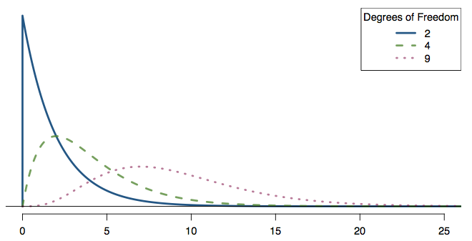
Practice
Which of the following is false?
For the χ² distribution, as the df increases,
all measures of center (mean, median, mode) increase
the variability increases
the shape becomes more skewed (less like a normal)

Slide 7
Practice
Which of the following is false?
For the χ² distribution, as the df increases,
all measures of center (mean, median, mode) increase
the variability increases
the shape becomes more skewed (less like a normal)

Slide 8
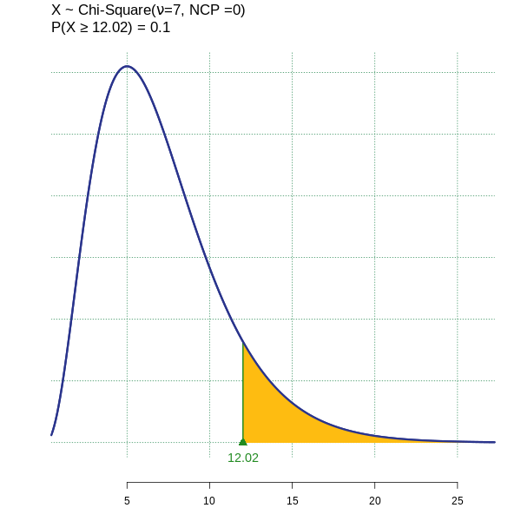
Example of $χ^{2}$: finding area on right
Find the area to the right of $χ^{2}=12.02$ for df = 7.
TI-84: As with the normal
and t distributions, go to
2nd vars (distr).
Select 8: $χ^{2}\text{cdf}\text{(}$ ,
put in lower, upper and df inputs
$χ^{2}$cdf(12.02, 1E99, 7)

Slide 9
Example of $χ^{2}$: input of right probability
Find the value of $χ^{2}$ for 7 degrees of freedom and an area of 0.10 in the right tail of the distribution curve.
TI-84: not available, which means
for the critical value approach
the use of tables or an online tool.
Hence, when performing $χ^{2}$ tests:
use the p-value approach.

Slide 10
11.2 A Goodness-of-Fit Test
Definition
An experiment with the following characteristics is called a multinomial experiment.
The experiment consists of n identical trials (repetitions).
Each trial results in one of k possible outcomes (or categories), where k > 2.
(k = 2 corresponds to a binomial experiment.)
The trials are independent.
The probabilities of the various outcomes remain constant for each trial.

Slide 11
Observed and Expected Frequencies
Definition
The frequency for a category c obtained from the performance of an experiment is the observed frequency O_{c}
The expected frequency E_{c} for a category c, is what we expect to obtain if $H_{0}$ is true.
Often $H_{0}$ is given as a set of expected probabilities ${\{p}_{c}\}$.
Then the expected frequency for a category c is
$$E_{c}=np_{c}$$
where n is the sample size.

Slide 12
Degrees of Freedom for Goodness of Fit Test
In a goodness-of-fit test, the degrees of freedom are
where k is the number of possible outcomes (or categories) for the experiment (and NOT the sample size n!).

Slide 13
Test Statistic for a Goodness-of-Fit Test
The test statistic for a goodness-of-fit test is $χ^{2}$ and its value is calculated as
$$χ^{2}=\sum{\frac{{\left(O_{c}−E_{c}\right)}^{2}}{E_{c}}}$$
where
O_{c} = observed frequency for category c
E_{c} = expected frequency for category c
A chi-square goodness-of-fit test is:
almost always right-tailed.

Slide 14
"abominable", "shocking", "cooked”?
For a multinomial experiment, if the observed is too close to the expected, then suspicion arises. To test such a possibility, we perform a left-tailed test.
The null hypothesis H₀: the experiment did happen.
Some of Mendel’s pea data are suspicious.
https://en.wikipedia.org/wiki/Gregor_Mendel
“One can applaud the lucky gambler;
but when he is lucky again tomorrow,
and the next day, and the following day,
one is entitled to become a little suspicious."

Slide 15
ATM usage by (work) day
A bank has an A T M installed inside a bank, and it is available to customers only from 7 A M to 6 P M Monday - Friday.
The manager wants to investigate if the percentage of transactions made on this A T M is the same for each day.
In one week, she counts the number of transactions made on this A T M on each of the 5 days.
The information she obtains is:
At the 1% level of significance, test whether we can reject
$H_{0}$: # of people who use A T M each of 5 days is the same
Assume that this week is typical (not during a holiday season).
Day | Monday | Tuesday | Wednesday | Thursday | Friday
# of users | 253 | 197 | 204 | 297 | 267

Slide 16
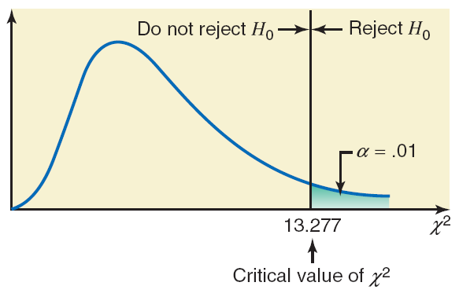
ATM usage by (work) day: Solution (1 of 5)
Step 1:
Step 2: There are 5 categories: 5 days of A T M usage.
Step 3:
Area in the right tail = α = .01
k = number of categories = 5
df = k − 1 = 5 − 1 = 4
The critical value is:
CHISQ.INV(1-0.01,4) [Excel] = 13.277

Slide 17
ATM usage by (work) day: Solution (2 of 5)
Category (Day) | Observed Frequency O | p | Expected Frequency E = np | (O − E) | (O minus E) squared | (O minus E) squared over E(O minus E) squared over E
Monday | 253 | .20 | 1200(.20) = 240 | 13 | 169 | .704
Tuesday | 197 | .20 | 1200(.20) = 240 | −43 | 1849 | 7.704
Wednesday | 204 | .20 | 1200(.20) = 240 | −36 | 1246 | 5.400
Thursday | 279 | .20 | 1200(.20) = 240 | 39 | 1521 | 6.338
Friday | 267 | .20 | 1200(.20) = 240 | 27 | 729 | 3.038
Blank | n = 1200 | Blank | Blank | Blank | Blank | Sum =23.184
Step 4: From the table:
The Excel table has been done horizontally rather than vertically & is live!

Slide 18
ATM usage by (work) day: Solution (3 of 5)
Step 5:
The value of the test statistic
is larger than
the critical value of
So it falls in the rejection region.
Hence, we reject the null hypothesis.
In conclusion, the number of persons who use this A T M is not the same for the 5 days of the week.
[It looks like usage drops off towards the beginning of the week and picks up as the weekend gets closer.]

Slide 19
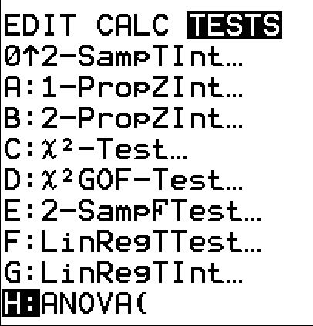
ATM usage by (work) day: Solution (4 of 5)
Performing the test on a TI84
(which means using the p-value approach):
Put the data into the calculator as lists:
The observed as L1 and the expected as L2
Go to stat, tests: select $χ^{2}$GOF–Test
Inputs: Obs: L1, Exp: L2, df: 4

Slide 20
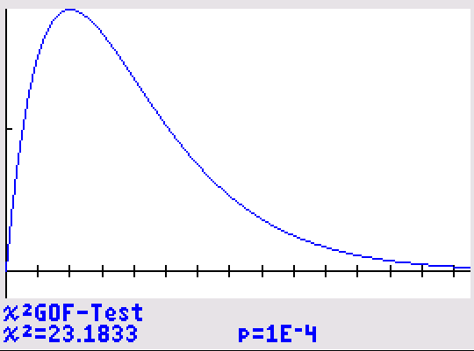
ATM usage by (work) day: Solution (4 of 5)
Performing the test on a TI84 (cont):
The result of “Calculate”:
The p-value given is in
scientific notation ~0.0001
“Draw” shades the area to the
right of the TS as we will see
in the next example.
Here, the TS = 23 is off the scale
(remember that the peak is at df–2 = 2).

Slide 21
Example 11-4 (1 of 7)
In a Gallup poll conducted April 3–6, 2014, Americans aged 18 and older were asked if upper-income people were “paying their fair share in federal taxes, paying too much or paying too little.”
Of the respondents, 61% said too little, 24% said fair share, 13% said too much, and 2% had no opinion (gallup.com).
Assume that these percentages hold true for the entire 2014 population of Americans aged 18 and older.
Recently, 1000 randomly selected Americans aged 18 and older were asked the same question.
The table on the next slide lists the number of Americans in this sample who belonged to each response.

Slide 22
Example 11-4 (2 of 7)
Response | Too Little | Fair Share | Too Much | No Opinion
Frequency | 581 | 256 | 138 | 25
Test at a 2.5% level of significance whether the current distribution of opinions is different from that for 2014.
Step 1:
H₀ : The current percentage distribution of opinions is the same as for 2014.
H₁ : The current percentage distribution of opinions is different from that for 2014.

Slide 23
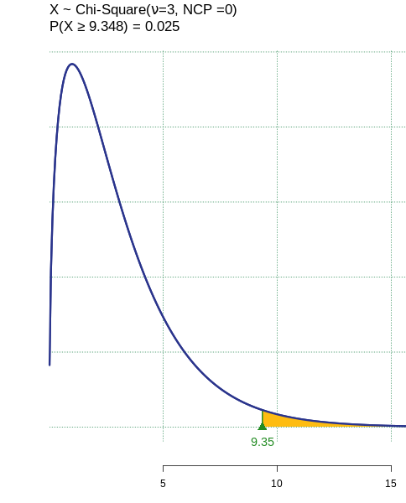
Example 11-4 (3 of 7)
Step 2:
There are 4 categories in this
multinomial experiment
We use the chi-square distribution to make this test.
Step 3:
Area in the right tail = α = .025
k = number of categories = 4
df = k − 1 = 4 − 1 = 3

Slide 24
Example 11-4: Solution (4 of 7)
Step 4: Calculation of the test statistic.
Category (Response) | Observed Frequency O | p | Expected Frequency E = np | (O − E) | (O minus E) squared | (O minus E) squared over E
Too little | 581 | .61 | 1000(.61) = 610 | −29 | 841 | 1.379
Fair share | 256 | .24 | 1000(.24) = 240 | 16 | 256 | 1.067
Too much | 138 | .13 | 1000(.13) = 130 | 8 | 64 | .492
No opinion | 25 | .02 | 1000(.02) = 20 | 5 | 25 | 1.250
Blank | n = 1000 | Blank | Blank | Blank | Blank | Sum = 4.188

Slide 25
Example 11-4: Solution (5 of 7)
Step 5:
The value of the test statistic
is smaller than
the critical value of
It falls in the nonrejection region.
Hence, we fail to reject the null hypothesis.
Thus, we are unable to say that the current percentage distribution of opinions is different from that of 2014.

Slide 26
Example 11-4: Solution (6 of 7)
Performing the test on a TI84:
Put the data into the calculator as lists:
The observed as L1 and the expected as L2
Go to stat, tests: select $χ^{2}$GOF–Test
Inputs: Obs: L1, Exp: L2, df: 3

Slide 27
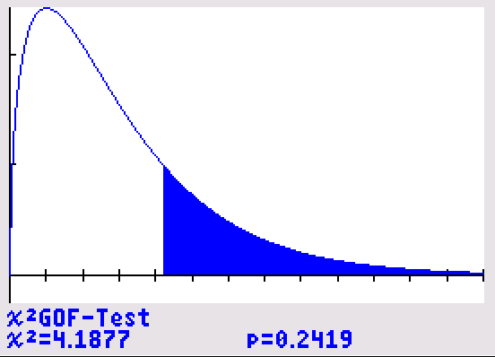
Example 11-4: Solution (7 of 7)
Performing the test on a TI84 (cont):
The result of “Calculate”:
the p-value is ~.24 or 24%
For Draw, the area to the
right of the TS = 4.2 is shaded
(Peak is at df–2 = 1.)

Slide 28
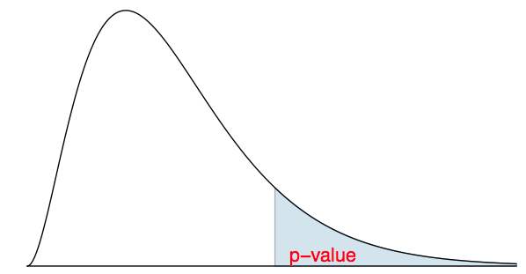
Recap: p-value for a chi-square test
The p-value for a chi-square test is usually defined as the tail area above the calculated test statistic.
This is because the test statistic is always positive, and a higher test statistic means a stronger deviation from the null hypothesis.
An exception is when you also want to see if the fit is too good to be true, such as if you suspect fraud.

Slide 29
Conditions for the chi-square test
We must be performing a multinomial experiment:
Independence: Each case that contributes a count to the table must be independent of all the other cases in the table.
the number of categories must be at least 3 (otherwise, use binomial), which means that df $≥2$
Sample size: Each category must have at least 5 expected cases.

Slide 30
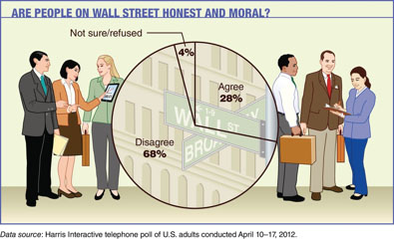
Chapter Opening Example Reappearance
Given the statement, “In general, people on Wall Street are as honest and moral as other people,” a 2012 Harris poll revealed:
28% of the U.S. adults polled agreed;
68% of the adults polled disagreed with this statement;
4% were not sure/refused to answer.
Suppose we conduct a poll today of 300 people & find:
60 agree;
230 disagree;
10 are not sure/refused. Have opinions changed?
Use $α=5\%$.

Slide 31
Chapter Opening
opinion | observed | expected
agreed | 60 | .28*300 = 84
disagreed | 230 | .68*300 = 204
other | 10 | .04*300 = 12
Make a table->
Note that there are more than 2 categories and each expected is at least 5.
Hence conditions are met for using chi-square test.
To perform the test on a TI84, we put the data into L1 - L2.
Calling the test & “Calculate”:
The p-value = 0.005 < 0.05 = $α.$
We conclude:
the opinion proportions regarding the morality of wall-street workers have changed since 2012.

Slide 32
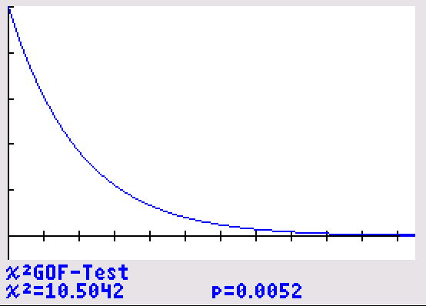
Chapter Opening
opinion | observed | expected
agreed | 60 | .28*300 = 84
disagreed | 230 | .68*300 = 204
other | 10 | .04*300 = 12
Make a table->
Note that there are more than 2 categories and each expected is at least 5.
Hence conditions are met for using chi-square test.
Performing the test on a TI84, we put the data into L1 - L2.
Calling the test & “Draw”->
Note the exponential curve.
The TS is on the scale, but the
area is too small to be seen.
TS = 10.52

