Slide 1
Sections 4.4-4.5
Union of Events and the Addition Rules
Counting Rules, Combinations, and Permutations
Ezra Halleck, City Tech (CUNY), Spring 2023

Slide 2
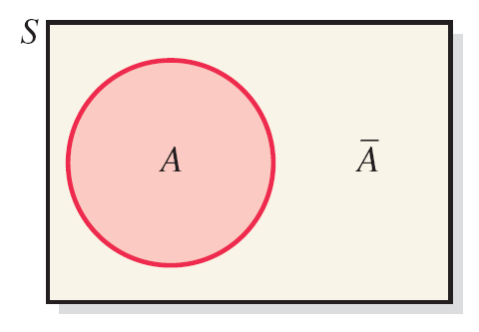
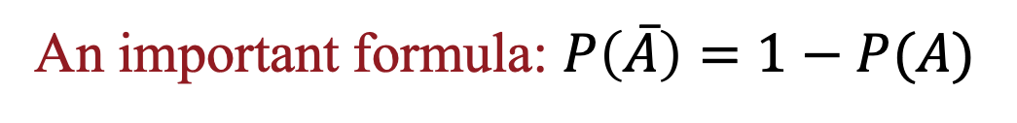
Review: Complement
Definition
The complement of event A, denoted by
and read
as “A bar” or “A complement,” is the event that includes all the outcomes for an experiment that are not in A.
An important formula: $P\left(\overline{A}\right)=1−P(A)$

Slide 3
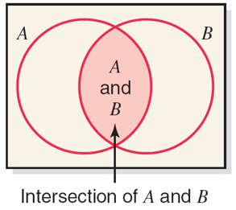
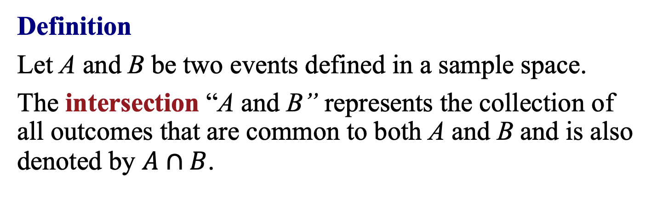
Review: Intersection of Events
Definition
Let A and B be two events defined in a sample space.
The intersection “A and B” represents the collection of all outcomes that are common to both A and B and is also denoted by $A∩B$.
Important note:
Two events are mutually exclusive if and only if their intersection is the empty set.

Slide 4
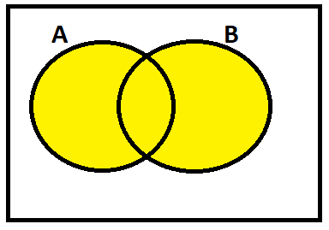
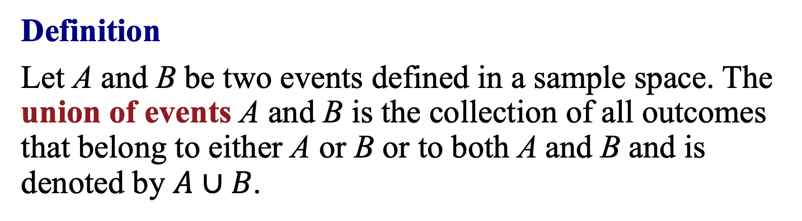
4.5 Union of Events
Definition
Let A and B be two events defined in a sample space. The union of events A and B is the collection of all outcomes that belong to either A or B or to both A and B and is denoted by $A∪B$.

Slide 5
Addition Rules
Union of Two Mutually Exclusive Events
The probability of the union of two mutually exclusive events A and B is
Union of Two Mutually Nonexclusive Events
The probability of the union of two mutually nonexclusive events A and B is
The second rule can be seen as a generalization of the first rule. Why?

Slide 6
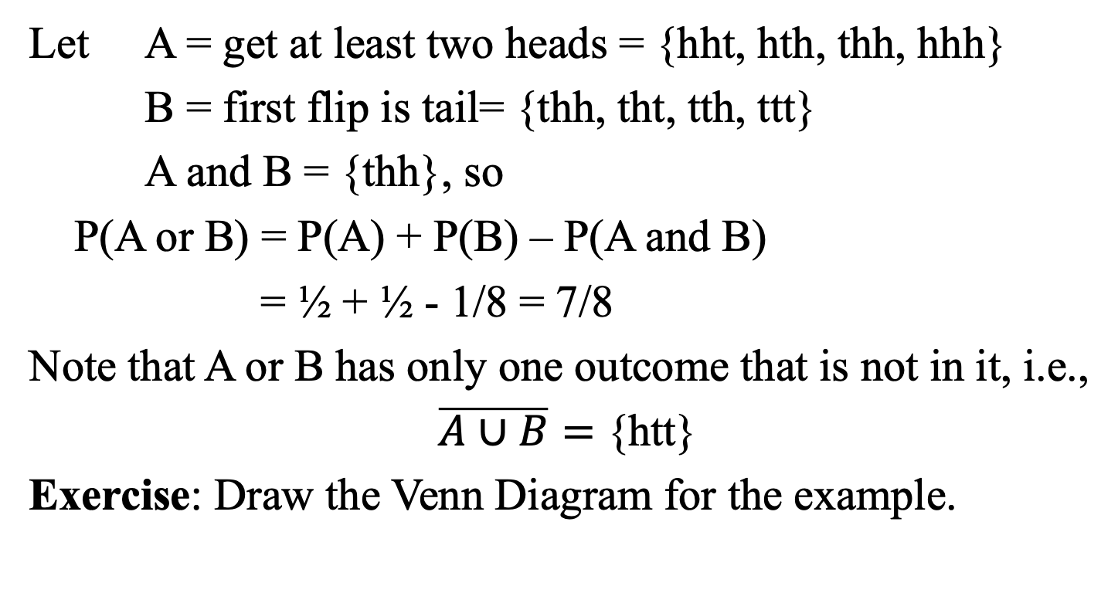
Addition rule : flipping a fair coin 3 times
Let A = get at least two heads = {hht, hth, thh, hhh}
B = first flip is tail= {thh, tht, tth, ttt}
A and B = {thh}, so
P(A or B) = P(A) + P(B) – P(A and B)
= ½ + ½ - 1/8 = 7/8
Note that A or B has only one outcome that is not in it, i.e.,
$\overline{A∪B}=$ {htt}
Exercise: Draw the Venn Diagram for the example.

Slide 7
Example 4-30
Consider the experiment of rolling a die once. What is the probability that a number less than 3 or a number greater than 4 is obtained?

Slide 8
Example 4-30: Solution
The event # less than 3 is obtained happens if either 1 or 2 is rolled on the die,
The event # greater than 4 is obtained happens if either 5 or 6 is rolled on the die.
Note how these two events are mutually exclusive and hence we can use the 1st multiplication rule.
P(# less than 3 is obtained) = 2/6 = 1/3
P(# greater than 4 is obtained) = 2/6 = 1/3
The probability of the union of these two events is:
P(# less than 3 is obtained or # greater than 4 is obtained)
= 1/3 + 1/3 = 2/3 = .67

Slide 9
Example 4-26
All 440 employees of a company were asked what hot drink they like the most. Their responses, tabulated:
Describe the size of the union of the events:
“female”
“likes coffee”.
Blank | Coffee | Tea | Other | Total
Male | 110 | 70 | 110 | 290
Female | 60 | 50 | 40 | 150
Total | 170 | 120 | 150 | 440

Slide 10
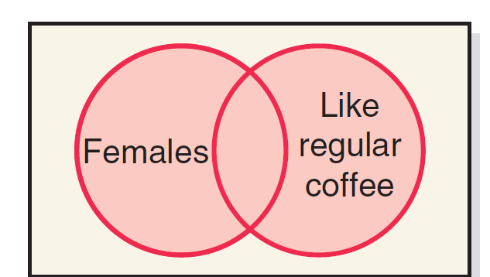
Example 4-26: Solution
There are
150 females
170 who like coffee
60 females who like coffee.
Thus, the number of employees who are either female or like coffee or both is:
Blank | Coffee | Tea | Other | Total
Male | 110 | 70 | 110 | 290
Female | 60 | 50 | 40 | 150
Total | 170 | 120 | 150 | 440
When we add the frequencies for “females” and “like coffee”, we have counted “females” who “like coffee” twice. So we subtract them off.

Slide 11
Example 4-27
A university president has proposed that all students must take a course in ethics as a requirement for graduation.
Three hundred faculty members and students from this university were asked about their opinion on this issue.
Find the probability that a random person from these 300 persons is a faculty member or is in favor of this proposal.
Blank | Favor | Oppose | Neutral | Total
Faculty | 45 | 15 | 10 | 70
Student | 90 | 110 | 30 | 230
Total | 135 | 125 | 40 | 300

Slide 12
Example 4-27: Solution
Blank | Favor | Oppose | Neutral | Total
Faculty | 45 | 15 | 10 | 70
Student | 90 | 110 | 30 | 230
Total | 135 | 125 | 40 | 300
Using the addition rule, we obtain
Note that in last example, we used counts (frequencies), while here we use probabilities.

Slide 13
Example 4-28
In a group of 2500 persons, 1400 are female, 600 are vegetarian, and 400 are female and vegetarian.
What is the probability that a randomly selected person from this group is a male or vegetarian?
Our first step is to create the table and begin to fill it.
Our next step is to complete the table.
Gender\veg | veg | Non veg
female | 400 |  | 1400
male
 | 600 |  | 2500
Gender\veg | veg | Non veg
female | 400 | 1000 | 1400
male | 200 | 900 | 1100
 | 600 | 1900 | 2500

Slide 14
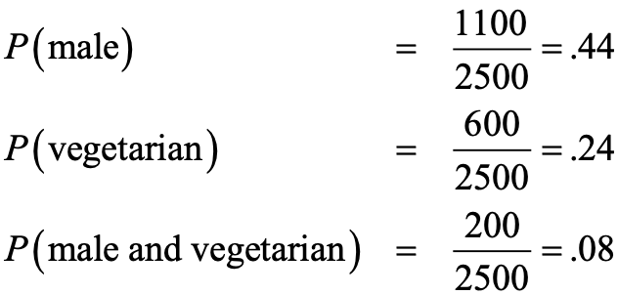
Example 4-28
In a group of 2500 persons, 1400 are female, 600 are vegetarian, and 400 are female and vegetarian.
What is the probability that a randomly selected person from this group is a male or vegetarian?
Gender\veg | veg | Non veg
female | 400 | 1000 | 1400
male | 200 | 900 | 1100
 | 600 | 1900 | 2500
Using the first addition rule, we obtain:

Slide 15
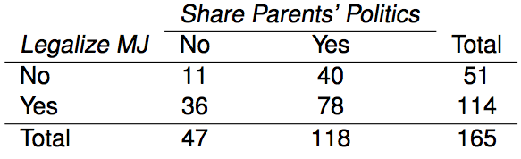
Contingency Table Practice
What is the probability that a randomly sampled student thinks marijuana should be legalized or they agree with their parents' political views?
Hint: there may be more than one correct answer.
(a) (36 + 40 - 78) / 165
(b) (114 + 118 - 78) / 165
(c) (36 + 40 + 78) / 165

Slide 16
Contingency Table Practice solution
What is the probability that a randomly sampled student thinks marijuana should be legalized or they agree with their parents' political views?
Hint: there may be more than one correct answer.
(a) (36 + 40 - 78) / 165
(b) (114 + 118 - 78) / 165
(c) (36 + 40 + 78) / 165
This example illustrates that if you work with the interior (joint) frequencies or probabilities,
the events are mutually exclusive, so only addition is used, no subtraction.

Slide 17
4.6 Counting Rule, Factorials, Combinations, and Permutations
The multiplication principle is fundamental.
Some important considerations are whether:
you have replacement or not;
the elements you are counting are ordered or not.

Slide 18
Counting Rule to Find Total Outcomes
If an experiment consists of three steps and if the first step can result in m outcomes, the second step in n outcomes, and the third in k outcomes, then
One very important part to be aware of us that you are assuming replacement when using this rule.

Slide 19
Example 4-31: Solution
Consider three tosses of a coin. How many total outcomes does this experiment have?
The experiment of tossing a coin three times has three steps: the first toss, the second toss, and the third toss.
Each step has two outcomes: a head and a tail. Thus,
The eight outcomes for this experiment are

Slide 20
Example 4-32
A prospective car buyer can choose between a fixed and a variable interest rate and can also choose a payment period of 36 months, 48 months, or 60 months.
How many total outcomes are possible?
There are
two outcomes (a fixed or a variable interest rate) for the first step;
three outcomes (a payment period of 36 months, 48 months, or 60 months) for the second step.
Hence,

Slide 21
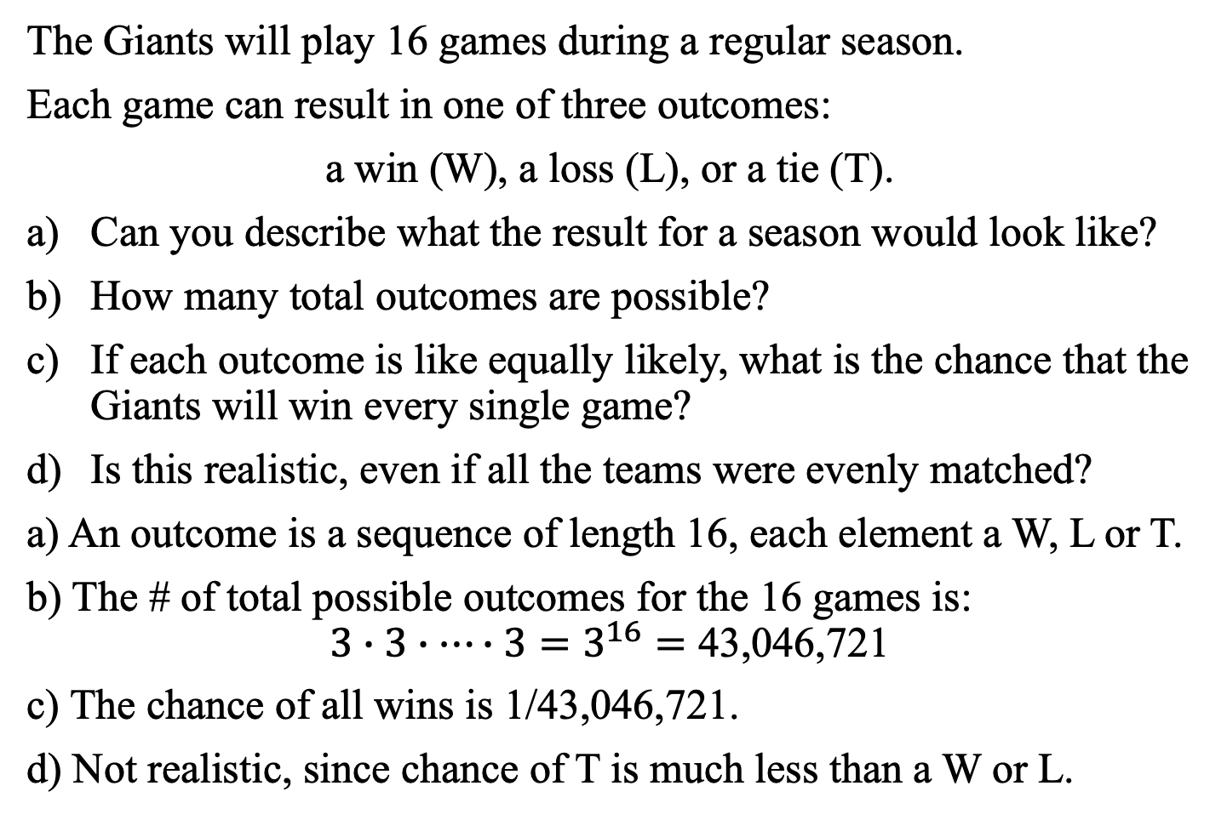
Example 4-33
The Giants will play 16 games during a regular season.
Each game can result in one of three outcomes:
a win (W), a loss (L), or a tie (T).
Can you describe what the result for a season would look like?
How many total outcomes are possible?
If each outcome is like equally likely, what is the chance that the Giants will win every single game?
Is this realistic, even if all the teams were evenly matched?
a) An outcome is a sequence of length 16, each element a W, L or T.
b) The # of total possible outcomes for the 16 games is:
$$3∙3∙⋯∙3=3^{16}=\text{43,046,721}$$
c) The chance of all wins is 1/43,046,721.
d) Not realistic, since chance of T is much less than a W or L.

Slide 22
Factorials
The symbol n!, read as “n factorial,” represents the product of all the integers from n to 1. In other words,
By definition,
Evaluate 7!
Evaluate 10!
Evaluate (12−4)!

Slide 23
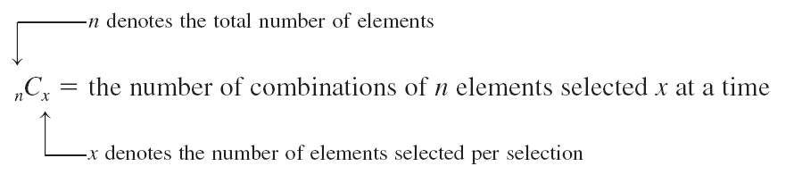
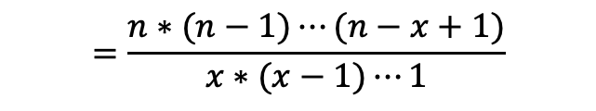
Combinations
A combination is an unordered selection of x elements from a set of n elements.
The total number of combinations is
$$=\frac{n∗(n−1)⋯(n−x+1)}{x∗(x−1)⋯1}$$
which is read as “the number of combinations of n elements selected x at a time.”

Slide 24
Example 4-38
An ice cream parlor has six flavors of ice cream. Kristen wants to buy two flavors of ice cream.
If she randomly selects two flavors out of six, in how many can she do this?
Thus, there are 15 ways for Kristen to select two ice cream flavors out of six.

Slide 25
Example 4-39
Three members of a club of 5 people will be randomly selected to form a committee.
How many different committees are possible?
Thus, there are 10 different committees possible.

Slide 26
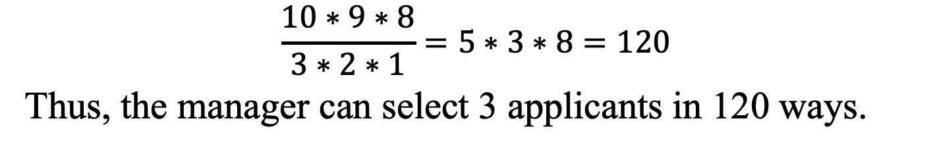
Example 4-40
Marv & Sons advertised to hire a financial analyst. The company has received applications from 10 candidates who seem to be equally qualified.
The company manager has decided to call only 3 of these candidates for an interview.
If she randomly selects 3 candidates from the 10, how many total selections are possible?
$$\frac{10∗9∗8}{3∗2∗1}=5∗3∗8=120$$
Thus, the manager can select 3 applicants in 120 ways.

Slide 27
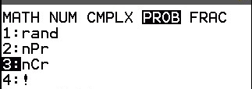
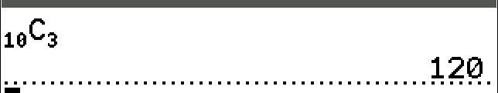
Example 4-40 using a TI84
Marv & Sons has received applications from 10 candidates.
The manager has decided to call only 3 of these candidates.
She randomly selects 3 candidates from the 10.
In a TI84, go to math, prob
[On an older model, put in the
value of “n” first.]
Select “3:nCr”
Put in the “n” and “x” (r), and press enter to get answer.
Thus, the manager can select 3 applicants in 120 ways.

Slide 28
Case Study 4-2 Probability of Winning a Mega Millions Lottery Jackpot
Number of white balls matched | Number of gold balls matched | Prize | Number of white balls matched | Number of gold balls matched | Prize
5 | 1 | Jackpot | 3 | 0 | $5
5 | 0 | $1,000,000 | 2 | 1 | $5
4 | 1 | $5,000 | 1 | 1 | $2
4 | 0 | $500 | 0 | 1 | $1
3 | 1 | $50 | Blank | Blank | Blank
The white balls are numbered 1, …, 70.
The gold mega balls are numbered 1, …, 25.
The highest jackpot was $1.5 billion in 2018.

Slide 29
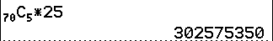
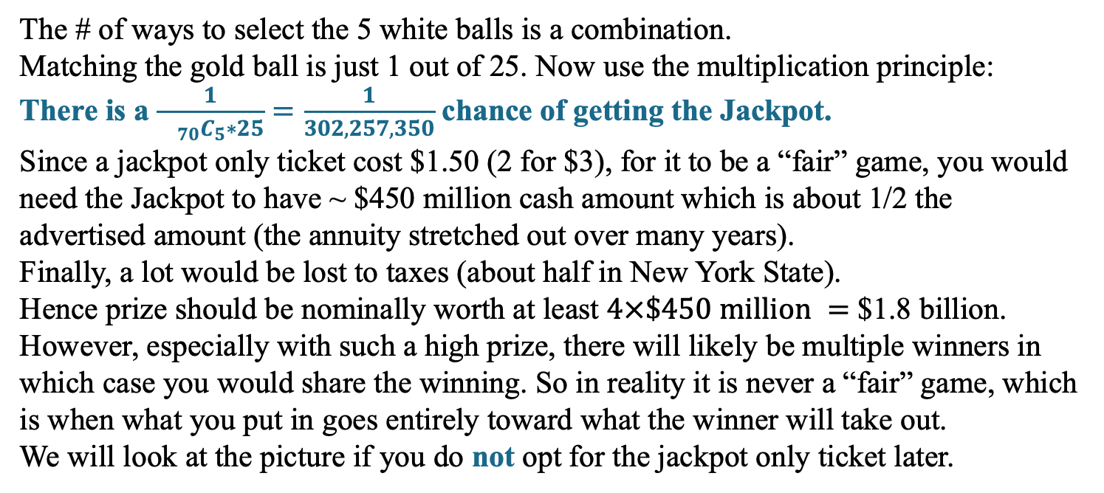
Winning a Mega Millions Lottery Jackpot
Number of white balls matched | Number of gold balls matched | Prize
5 | 1 | Jackpot
The white balls are numbered 1, …, 70.
The gold mega balls are numbered 1, …, 25.
The # of ways to select the 5 white balls is a combination.
Matching the gold ball is just 1 out of 25. Now use the multiplication principle:
There is a $\frac{1}{{}_{70}C_{5}∗25}=\frac{1}{302,257,350}$ chance of getting the Jackpot.
Since a jackpot only ticket cost $1.50 (2 for $3), for it to be a “fair” game, you would need the Jackpot to have ~ $450 million cash amount which is about 1/2 the advertised amount (the annuity stretched out over many years).
Finally, a lot would be lost to taxes (about half in New York State).
Hence prize should be nominally worth at least $4×\$450 million =$ $1.8 billion.
However, especially with such a high prize, there will likely be multiple winners in which case you would share the winning. So in reality it is never a “fair” game, which is when what you put in goes entirely toward what the winner will take out.
We will look at the picture if you do not opt for the jackpot only ticket later.

Slide 30
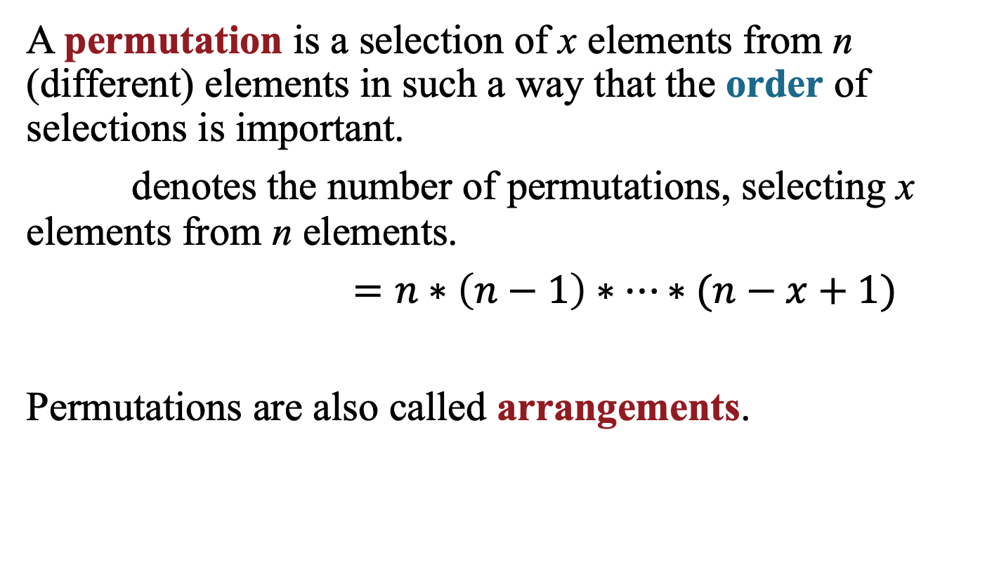
Permutations
A permutation is a selection of x elements from n (different) elements in such a way that the order of selections is important.
denotes the number of permutations, selecting x elements from n elements.
$=n∗\left(n−1\right)∗⋯∗(n−x+1)$
Permutations are also called arrangements.

Slide 31
Example 4-41 officers in a club
A club has 20 members. They are to select three office holders for next year:
president, secretary, and treasurer.
They select these office holders by drawing 3 names randomly from the names of all members.
The first person selected becomes the president;
the second is the secretary;
the third one takes over as treasurer.
Thus, the order in which 3 names are selected from the 20 names is important.
Find the # of possible outcomes in this selection process.

Slide 32
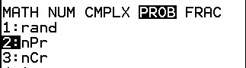
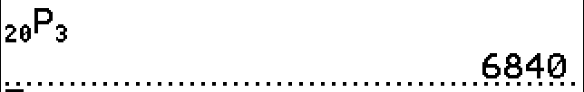
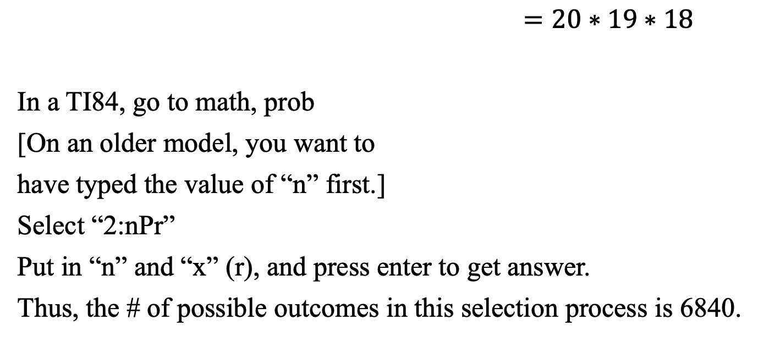
Example 4-41: Solution
$=20∗19∗18$
In a TI84, go to math, prob
[On an older model, you want to
have typed the value of “n” first.]
Select “2:nPr”
Put in “n” and “x” (r), and press enter to get answer.
Thus, the # of possible outcomes in this selection process is 6840.

Slide 33
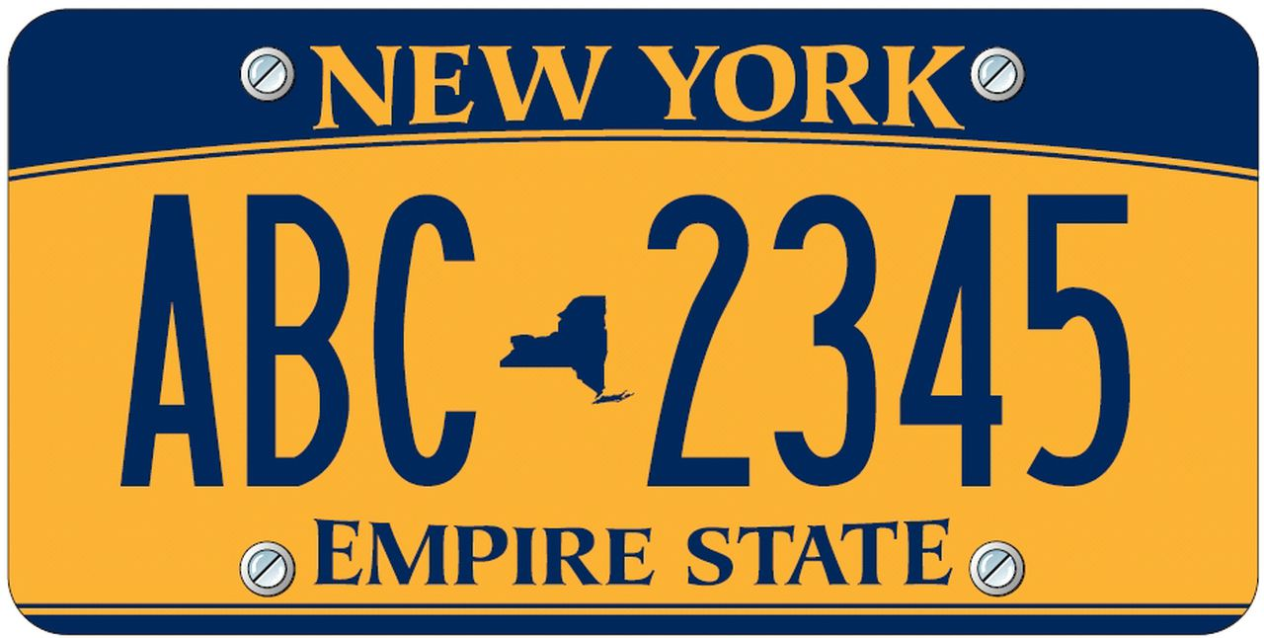
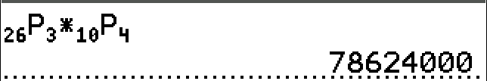
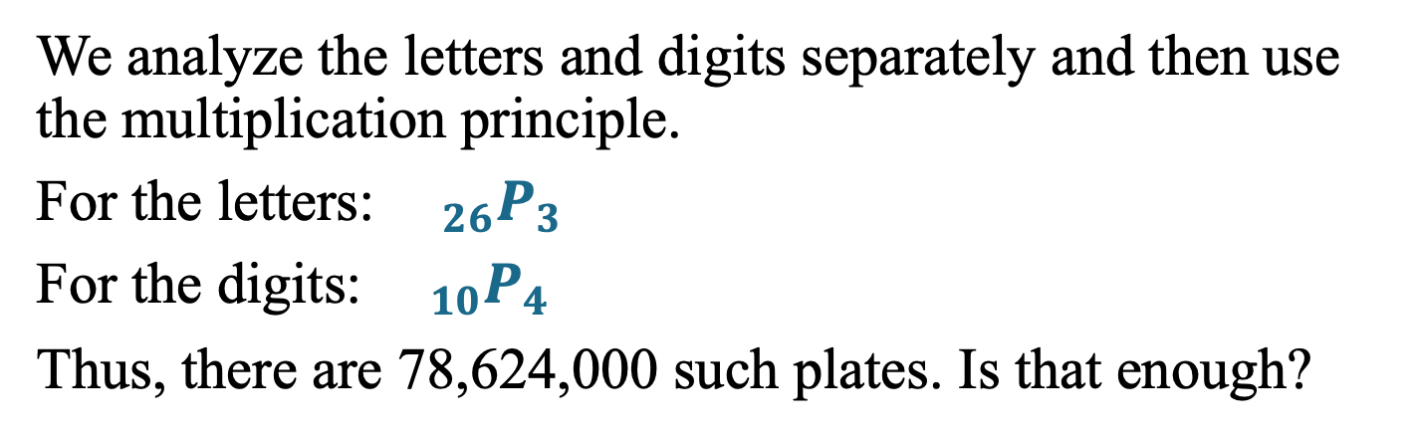
NYS license plates without repeats
A general NYS license plate has 3 letters followed by 4 digits.
How many such license plates are there without repeated letters or digits?
We analyze the letters and digits separately and then use the multiplication principle.
For the letters: ${}_{26}P_{3}$
For the digits: ${}_{10}P_{4}$
Thus, there are 78,624,000 such plates. Is that enough?

Slide 34
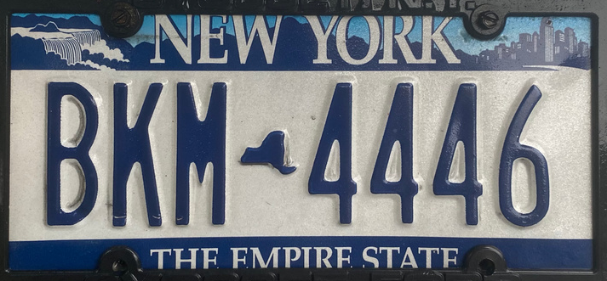
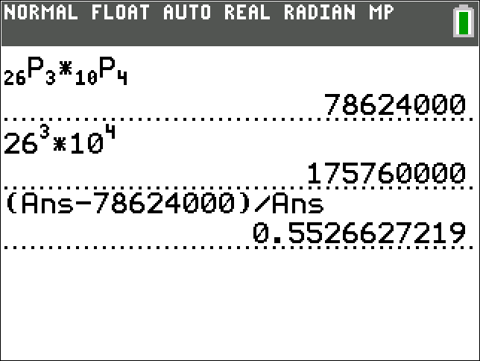
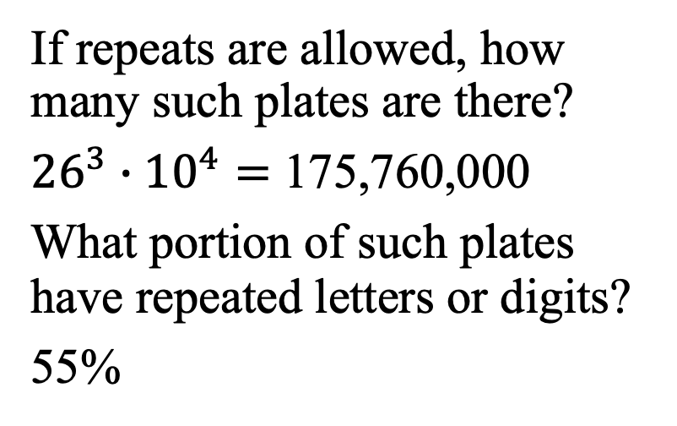
NYS license plates with repeats
A general NYS license plate has 3 letters followed by 4 digits.
There are 78,624,000 such license plates without repeated letters or digits.
If repeats are allowed, how many such plates are there?
${26}^{3}∙{10}^{4}=$ 175,760,000
What portion of such plates have repeated letters or digits?
55%

Slide 35
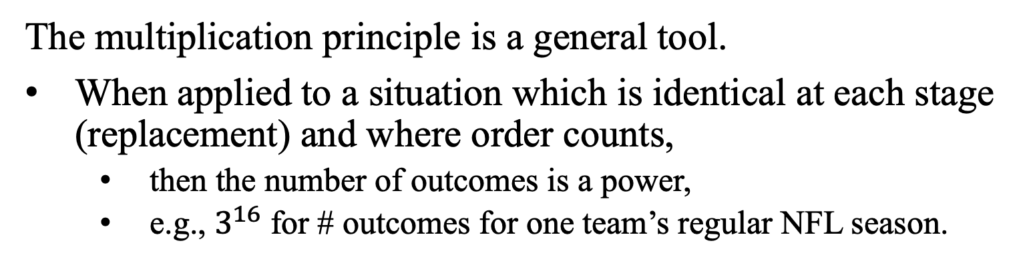
Section summary
The multiplication principle is a general tool.
When applied to a situation which is identical at each stage (replacement) and where order counts,
  then the number of outcomes is a power,
  e.g., $3^{16}$ for # outcomes for one team’s regular NFL season.
When replacement is not happening, then we have:
a combination if order is not important,
e.g., forming of a committee of a given size;
a permutation when order is important,
e.g., the number or letter portion of license plates without repeats allowed.

