Slide 1
Sections 6.2-6.3
Normal Random Variables:
Standardizing and applications
Ezra Halleck, City Tech (CUNY), Spring 2023

Slide 2
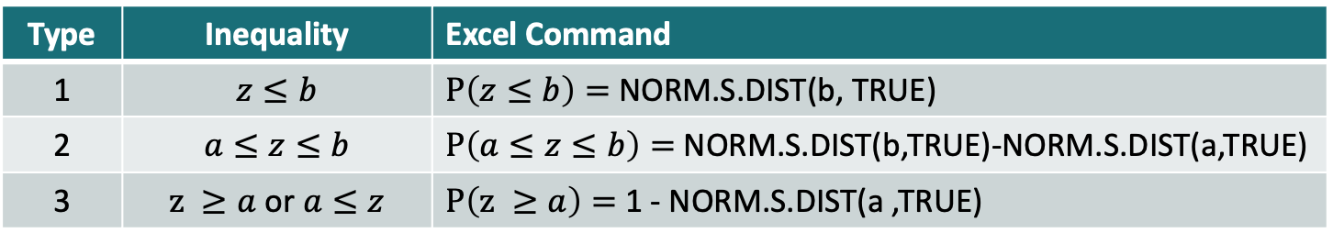
Summary of inequalities & Excel commands
Type | Inequality | Excel Command
1 | $$z≤b$$ | $P\left(z≤b\right)=$NORM.S.DIST(b, TRUE)
2 | $$a≤z≤b$$ | $P\left(a≤z≤b\right)=$NORM.S.DIST(b,TRUE)-NORM.S.DIST(a,TRUE)
3 | $z ≥a$ or $a≤z$ | $P\left(z ≥a\right)=$1 - NORM.S.DIST(a ,TRUE)

Slide 3
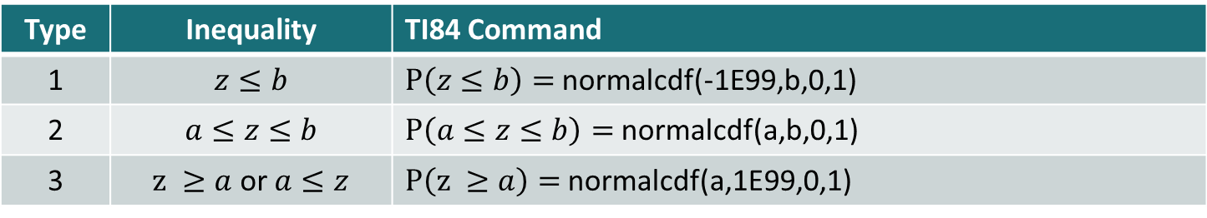
Summary of inequalities & TI84 commands
Type | Inequality | TI84 Command
1 | $$z≤b$$ | $P\left(z≤b\right)=$normalcdf(-1E99,b,0,1)
2 | $$a≤z≤b$$ | $P\left(a≤z≤b\right)=$normalcdf(a,b,0,1)
3 | $z ≥a$ or $a≤z$ | $P\left(z ≥a\right)=$normalcdf(a,1E99,0,1)
Type 1
Type 2
Type 3

Slide 4
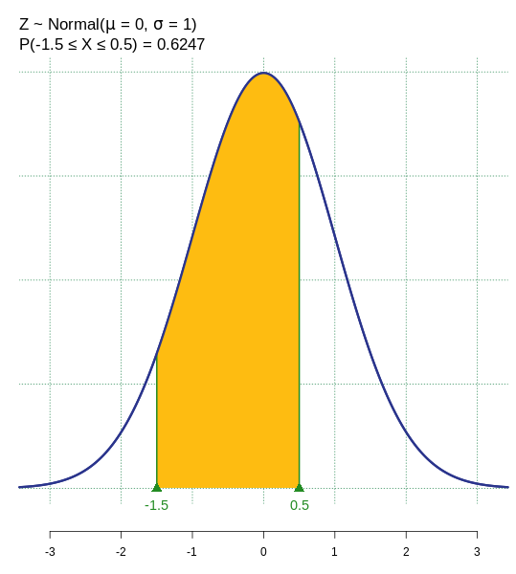
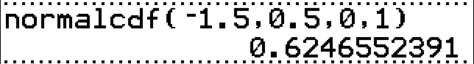
Type 2 (sandwich inequality) example
Find the chance that a value in the standard normal distribution is between -1.5 and 0.5 to nearest %.
Using Excel:
P(-1.5 < Z < 0.5) = NORM.S.DIST(0.5, TRUE) - NORM.S.DIST(-1.5, TRUE)
Using a TI84, Go to distr (2nd vars)
Select normalcdf
Put in the lower, upper. And skip to paste.
Hence, the chance that a value is between -1.5 and 0.5 is is 62%.

Slide 5
6.2 Standardizing a Normal Distribution
Converting an x Value to a z Value
For a normal random variable x, a particular value of x can be converted to its corresponding z value by using the formula
where μ and σ are the mean and standard deviation of the normal distribution of x, respectively.

Slide 6
Type 1 Example for nonstandard normal
Let X have a normal distribution with a mean of 50 and a standard deviation of 10.
Convert the following x values to z values and find the probability to the left of these points.
(a) x = 55
(b) x = 35

Slide 7
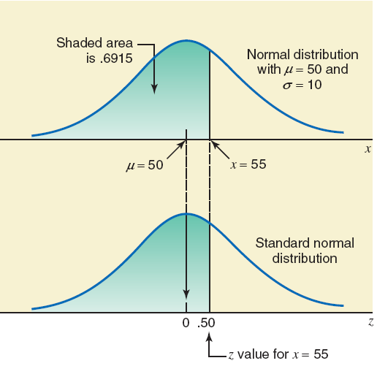
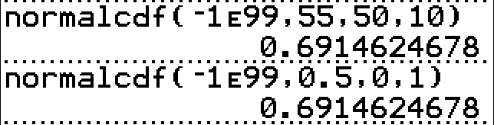
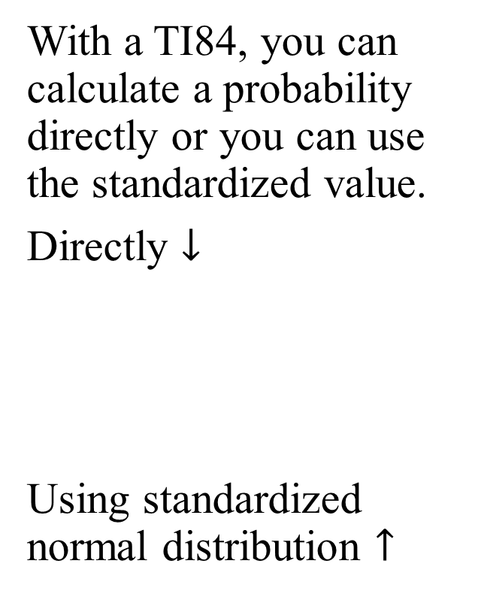
Graphs for a) and calculator approaches
With a TI84, you can calculate a probability directly or you can use the standardized value.
Directly $↓$
Using standardized normal distribution $↑$

Slide 8
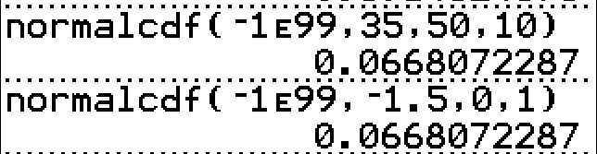
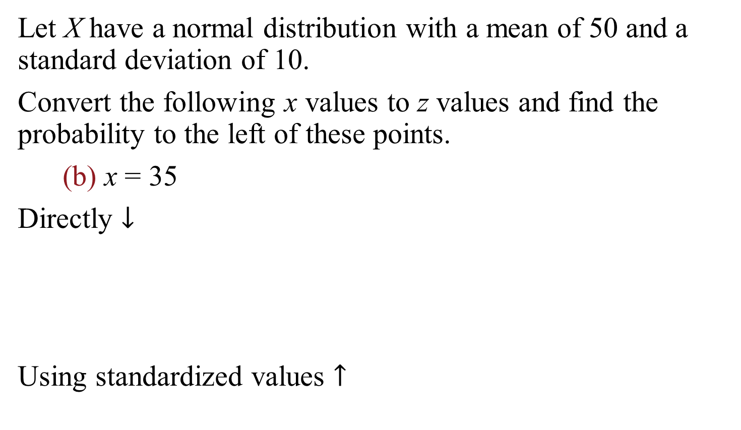
Type 1 Example for nonstandard normal
Let X have a normal distribution with a mean of 50 and a standard deviation of 10.
Convert the following x values to z values and find the probability to the left of these points.
(b) x = 35
Directly $↓$
Using standardized values $↑$

Slide 9
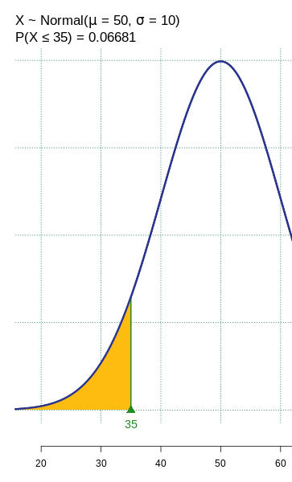
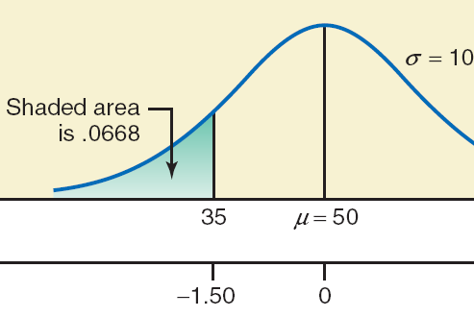

Graphs for b)
X ∼ Normal(μ = 50, σ = 10)
The probability that X is below 35
= P(X ≤ 35) = 0.06681
-1.5

Slide 10
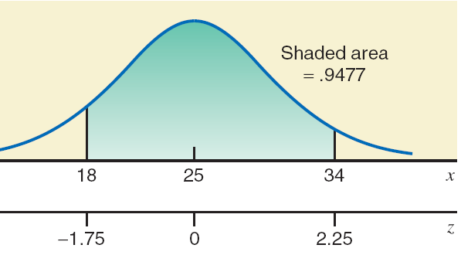
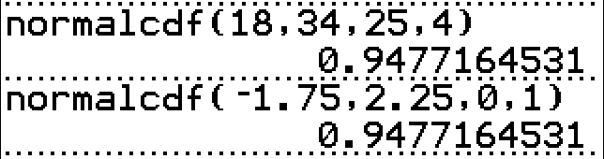
Type 2 Example for nonstandard normal
Let X be a continuous random variable that is normally distributed with mean 25 and standard deviation 4.
To nearest %, find chance that an outcome is between x = 18 and x = 34.
For x = 18:
For x = 34:
So, chance that an outcome is between x = 18 and x = 34 is 95%.

Slide 11
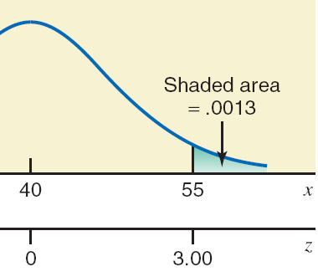
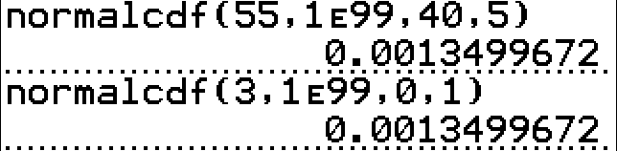

Type 3 Example with TI84
Let x be a normal random variable with its mean equal to 40 and standard deviation equal to 5. Find P (x > 55).
Directly $↓$
Using standardized val $↑$

Slide 12
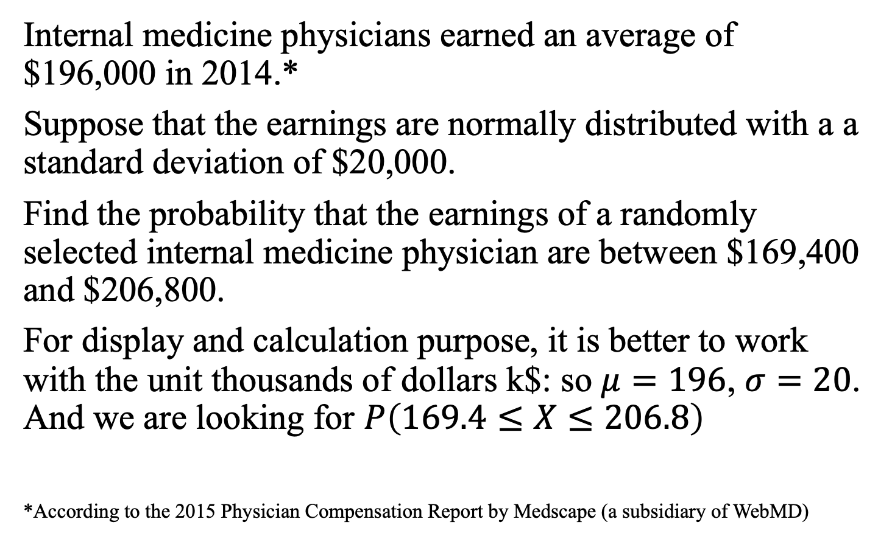
6.3 Applications of the Normal Distribution
Internal medicine physicians earned an average of $196,000 in 2014.*
Suppose that the earnings are normally distributed with a a standard deviation of $20,000.
Find the probability that the earnings of a randomly selected internal medicine physician are between $169,400 and $206,800.
For display and calculation purpose, it is better to work with the unit thousands of dollars k$: so $μ=196$, $σ=20$. And we are looking for $P\left(169.4≤X≤206.8\right)$
*According to the 2015 Physician Compensation Report by Medscape (a subsidiary of WebMD)

Slide 13
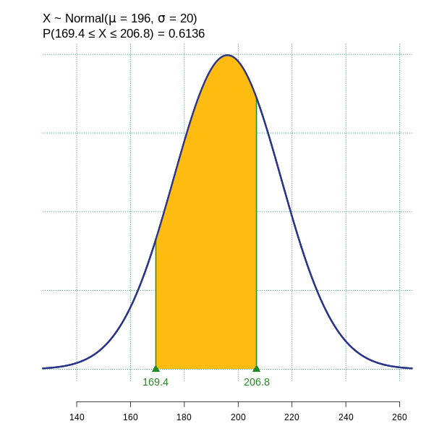
Internal medical physician earnings
X ∼ Normal(μ = 196, σ = 20)
The probability that X is between 169.4 and 206.8 = P(169.4 ≤ X ≤ 206.8) = 0.6136
Hence, a randomly selected internal medical physician has a 61% chance of earning between $169,400 and $206,800.

Slide 14
Beverage example
Geiser drinks makes an orange flavored seltzer.
The filling machines are adjusted to pour 12.01 oz into each 12-ounce bottle.
However, the actual amount in each bottle is not exactly 12.01 oz; it varies.
The actual amount has a normal distribution with a mean of 12.01 ounces and a standard deviation of .015 ounce.
What is the chance that a random bottle has less than 12 oz?

Slide 15
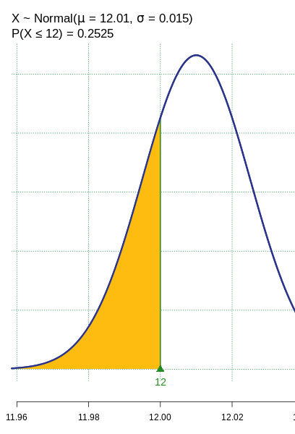
Beverage example solution
X ∼ Normal(μ = 12.01, σ = 0.015)
The probability that X is below 12
= P(X ≤ 12) = 0.2525.
Hence, the chance that a random bottle has less than 12 oz is 25%.

Slide 16
tire lifetimes example
The life of a certain automobile tire is normally distributed with mean 35,000 (=35k) miles and standard deviation 5000 (=5k) miles.
What proportion of tires last between 30,000 (30k) and 40,000 (40k) miles? (i.e., P{|Z | < 1})
What proportion of such tires last over 40,000 miles (40k)? (P{Z >1})
What proportion last over 50,000 miles (=50k)?(P{Z >3})
If the tire is in working condition after 40,000 miles (=40k), what is the conditional probability that it will still be working after an additional 10,000 miles (=10k)?
(i.e., P{Z >3}/ P{Z >1})
We can use the percentages from the empirical rule to answer these questions:
The chance of being within one standard deviation of the mean is 68%.
The chance of being beyond one standard deviation on one side is (100-68)/2%=16%
The chance of being within 3 standard deviations is 99.7%. Hence, the chance of being beyond three standard deviations on one side is (100-99.7)/2% = 0.15%
We have the ingredients from parts c and b: P{Z >3}/ P{Z >1} = 0.15%/16% ~ 1%
Exercise: answer each of the questions using complete sentences.

