Slide 1
Statistics Session 3
Stem and Leaf Displays
Summation Notation
Measures of Central Location
Ezra Halleck, City Tech (CUNY), Spring 2023

Slide 2
Review: important Shapes of Histograms
Symmetric (about the center)
Skewed (right or left)
Uniform or Rectangular

Slide 3
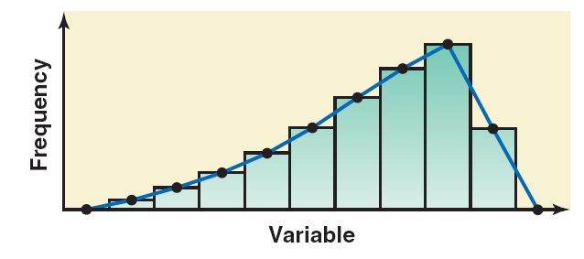
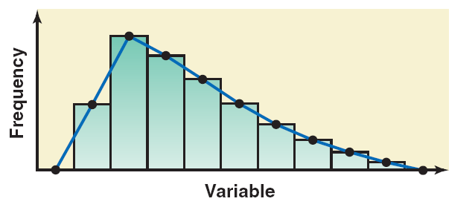
Symmetric Bimodal (sum of 2 bells Unimodal (bell-shaped) with different centers)
Skewed: Left
Right

Slide 4
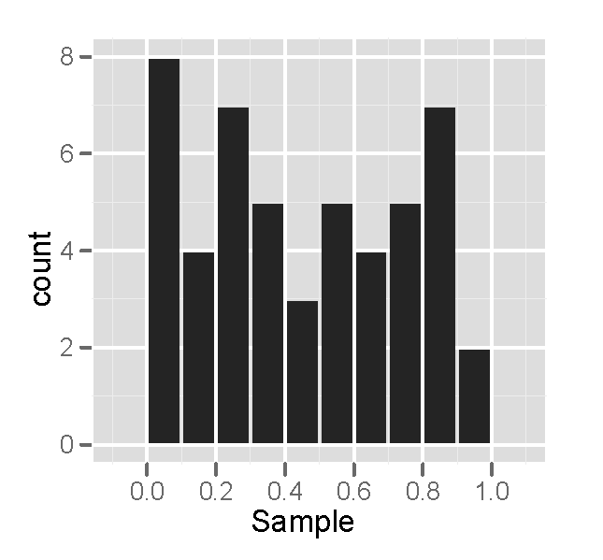
A Histogram for a Uniform Distribution
Theoretical;
In practice
The underlying distribution can be smooth, but a relatively small sample will appear jagged due to random variation.
For a concrete example, roll a die 50 times, make a tally and then graph results.

Slide 5
Practice
Which of these variables do you expect to be uniformly distributed?
(a) heights of adult females
(b) salaries of a random sample of people from North Carolina
(c) house prices
(d) birthdays of classmates (day of the month)

Slide 6
Practice
Which of these variables do you expect to be uniformly distributed?
(a) heights of adult females
(b) salaries of a random sample of people from North Carolina
(c) house prices
(d) birthdays of classmates (day of the month)

Slide 7
Practice
Which of these variables do you expect to be skewed right?
(a) heights of adult females
(b) salaries of a random sample of people from North Carolina
(c) house prices
(d) birthdays of classmates (day of the month)

Slide 8
Practice
Which of these variables do you expect to be skewed right?
(a) heights of adult females
(b) salaries of a random sample of people from North Carolina
(c) house prices
(d) birthdays of classmates (day of the month)

Slide 9
Practice
Which of these variables do you expect to be symmetric?
(a) heights of adult females
(b) salaries of a random sample of people from North Carolina
(c) house prices
(d) birthdays of classmates (day of the month)

Slide 10
Practice
Which of these variables do you expect to be symmetric?
(a) heights of adult females
(b) salaries of a random sample of people from North Carolina
(c) house prices
(d) birthdays of classmates (day of the month)

Slide 11
2.3 Stem-and-Leaf Displays
Definition
In a stem-and-leaf display of quantitative data, each value is divided into two portions–a stem and a leaf.
The leaves for each stem are shown separately.

Slide 12
Example 2-8
The following are the scores of 30 college students on a statistics test:
75 | 52 | 80 | 96 | 65 | 79 | 71 | 87 | 93 | 95
69 | 72 | 81 | 61 | 76 | 86 | 79 | 68 | 50 | 92
83 | 84 | 77 | 64 | 71 | 87 | 72 | 92 | 57 | 98
Construct a stem-and-leaf display.

Slide 13
Example 2-8: Solution (1 of 2)
To construct a stem-and-leaf display for these scores, we split each score into two parts.
The first part contains the first digit, the stem.
The second part contains the second digit, the leaf.
Because all the scores lie in range 50 to 98, the stems are:
5, 6, 7, 8, and 9

Slide 14
Figure 2.15 Stem-and-Leaf Display

Slide 15
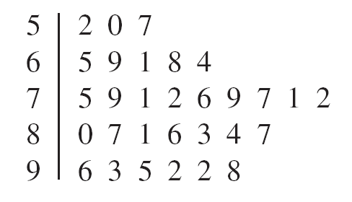
Example 2-8: Solution (2 of 2)
After we have listed the stems, we read the leaves for all scores and record them next to the corresponding stems on the right side of the vertical line:
To complete diagram, we optionally put each row of leaves in order.

Slide 16
Figure 2.17 Ranked Stem-and-Leaf Display of Test Scores
Is there an advantage of a stem-and-leaf display over a histogram?
We do not lose information on individual observations; in other words, from the diagram we could reproduce the original dataset.
We note that the sorting could have been done prior to separating the leaves from the stems.

Slide 17
Example 2-9
The following data give the monthly rents paid by a sample of 30 households selected from a small town.
880 | 1081 | 721 | 1075 | 1023 | 775 | 1235 | 750 | 965 | 960
1210 | 985 | 1231 | 932 | 850 | 825 | 1000 | 915 | 1191 | 1035
1151 | 630 | 1175 | 932 | 1100 | 1140 | 750 | 1140 | 1370 | 1280
Construct a stem-and-leaf display for these data.
This is a step up in difficulty from the first example: the stems are from 6-13.

Slide 18
Example 2-9: Solution
Figure 2.18 Stem-and-Leaf Display of Rents
Optional step not shown is to put each row of leaves in order.

Slide 19
Example 2-10: combining bins in pairs
The following stem-and-leaf display is prepared for the number of hours that 25 students spent working on computers during the last month.
Exercise:
Create a display with half the number of stems by joining categories. Use “*” to be able to separate the leaves that have one stem from the leaves that have the other stem.

Slide 20
Example 2-10 answer
The number of hours that 25 students spent working on computers during the last month:
Is there an advantage to displaying fewer bins (stems)?
While finer detail has been lost, we gain a clearer overall picture of the shape.

Slide 21
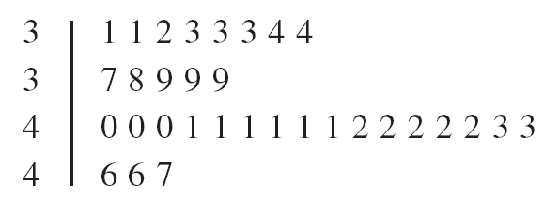
Example 2-11: separating bins in two
Consider the following stem-and-leaf display:
Use the split stem procedure, to provide finer detail.
Would a 5 leaf appear in the top or bottom row for its stem?
A 5 would be in the bottom row for its stem.

Slide 22
2.4 Dotplots
Definition
Values that are very small or very large relative to the majority of the values in a data set are called outliers or extreme values.

Slide 23
Example 2-12
A statistics class that meets once a week at night from 7:00 PM to 9:45 PM has 33 students. The following data give the ages (in years) of these students. Create a dotplot for these data and provide an analysis.
34 | 21 | 49 | 37 | 23 | 22 | 33 | 23 | 21 | 20 | 19
33 | 23 | 38 | 32 | 31 | 22 | 20 | 24 | 27 | 33 | 19
23 | 21 | 31 | 31 | 22 | 20 | 34 | 21 | 33 | 27 | 21

Slide 24
Example 2-12: Solution (1 of 2)
Step1. Draw a horizontal line with numbers that cover the given data as shown in Figure 2.22
Step 2. Place a dot above the value on the numbers line that represents each of the ages listed above. After all the dots are placed, Figure 2.23 gives the complete dotplot.

Slide 25
Example 2-12: Solution (2 of 2)
As we examine the dotplot of Figure 2.23, we notice that there are two clusters (groups) of data. Eighteen of the 33 students (which is almost 55%) are 19 to 24 years old, and 10 of the 33 students (which is about 30%) are 31 to 34 years old. There is one student who is 49 years old and is an outlier.

Slide 26
1.7 Summation Notation
Suppose a sample consists of five books, and the prices of these five books are $175, $80, $165, $97, and $88
The variable price of a book: x

Slide 27
Summation Notation
Adding the prices of all five books gives

Slide 28
Example 1-3
Annual salaries (in thousands of dollars) of four workers are 75, 90, 125, and 61, respectively. Find
(a)
(b)
(c)

Slide 29
Example 1-3: Solution (1 of 2)
(a)
(b) Note that
is the square of the sum of all x values.
Thus,

Slide 30
Example 1-3: Solution (2 of 2)
(c) The expression
is the sum of the squares of x
values. To calculate
we first square each of the
x values and then sum these squared values. Thus,

Slide 31
“Hand” solution for problem 1.7 #39
1.39 A car was filled with 16 gallons of gas on seven occasions. The number of miles that the car was able to travel on each tankful was 387, 414, 404, 396, 410, 422, and 414. Let x denote the distance traveled on 16 gallons of gas. Find:
a. ∑x b. (∑x)² c. ∑x²

Slide 32
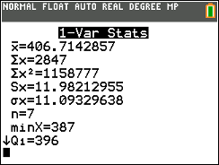
TI84 stat tool approach for problem 1.7 #39
1.39 A car was filled with 16 gallons of gas on seven occasions. The number of miles that the car was able to travel on each tankful was 387, 414, 404, 396, 410, 422, and 414. Let x denote the distance traveled on 16 gallons of gas. Find: a. ∑x b. (∑x)² c. ∑x²
Put data in as L1 (stat, EDIT)
Find the 1 variable statistics (stat, CALC, CALCULATE)
Square the Σx [(,vars,Statistics, Σ,enter,),x²]
What are advantages/disadvantages for the TI84 stat tool and “hand” solutions?

Slide 33
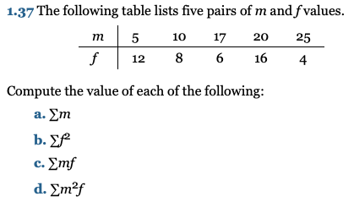
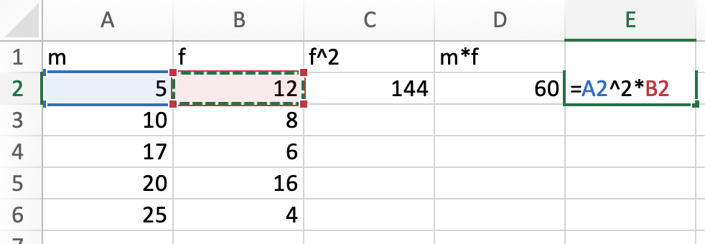
Problem 1.7 #37 using Excel
Best done using a spreadsheet.
Put data in vertically.
Create columns f^2, m*f, m^2*f.
The 1st row has the labels.
Put the appropriate formulas into the 2nd row.

Slide 34
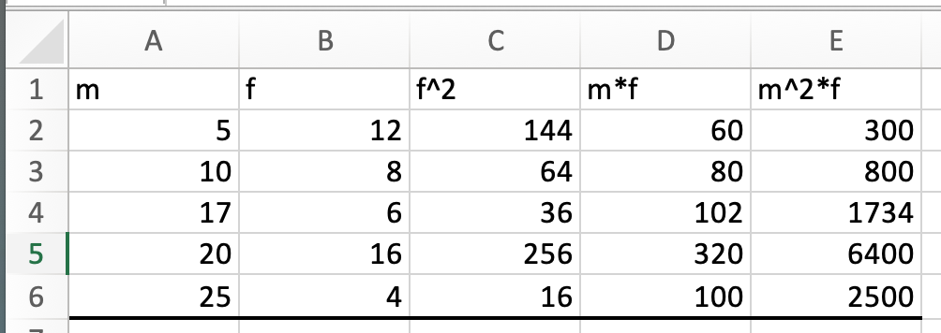
Problem 1.37 using Excel (cont)
Best done using a spreadsheet.
Put data in vertically.
Create columns f^2, m*f, m^2*f.
The 1st row has the labels.
Put the appropriate formulas into the 2nd row.
Select 2nd row cells with formulas.
Grab fill handle in lower right: pull down to apply formulas to the other rows.
Put in horizontal line at bottom.
Select the cells below this line.
Use ∑ “autosum” (in home menu) to get the sums of each column.

Slide 35
Example 1-4
The following table lists four pairs of m and f values:
m | 12 | 15 | 20 | 30
f | 5 | 9 | 10 | 16
Compute the following:
(a)
(c)
(b)
(d)

Slide 36
Example 1-4: Hand Solution
Here it is in a flash:
Can anyone spot a typo?

Slide 37
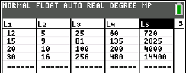
Example 1-4: TI 84 Solution
Put data into L₁ and L₂ (stat, edit)
Move cursor to L₃ in the label row: put in L₁, x².
Move cursor to L₄ in the label row: put in L₁, $×$, L₂.
Move cursor to L₅ in the label row: put in L₁, x², $×$, L₂

Slide 38
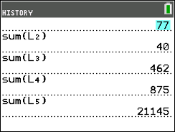
Example 1-4: TI 84 Solution (cont)
To get sums of each column:
“quit” (2nd mode)
Type list (2nd stat), MATH, “sum(” ,“enter”.
Then L₁, “)” and “enter” to get the first sum.
Do entry (2nd enter)
Replace L₁ with L₂, to get 2nd sum.
Repeat with L₃, L₄ and L₅.
(I had to scroll up when finished to get the top one as it had become hidden.)

Slide 39
Doing table calculations with Excel
m | f | f^2 | mf | m^2 f
12 | 5 | =B2^2 | =A2*B2 | =A2^2*B2
15 | 9 | =B3^2 | =A3*B3 | =A3^2*B3
20 | 10 | =B4^2 | =A4*B4 | =A4^2*B4
30 | 16 | =B5^2 | =A5*B5 | =A5^2*B5
=SUM(A2:A5) | =SUM(B2:B5) | =SUM(C2:C5) | =SUM(D2:D5) | =SUM(E2:E5) | sums
The hidden formulas are shown in table above.
Table below is live. Right click to open in Excel.
Put in the formulas just in the first row, then ”fill down”.

Slide 40
3.1 Measures of Center for Ungrouped Data
Mean
Median
Mode
Relationships among the Mean, Median, and Mode

Slide 41
3.1 Opening Example
Do you know there can be a big difference in the starting salaries of college graduates with different majors?
In 2013,
engineering majors had an average starting salary of $62,600
business majors $55,100,
math and science majors $43,000,
humanities and social science majors $38,000
See Case Study 3–1 for more details.

Slide 42
Figure 3.1
Reminder that the shape of this distribution is
skewed to the right, which is characteristic of income distributions.

Slide 43
Mean
The mean for ungrouped data is obtained by dividing the sum of all values by the number of values in the data set. Thus,
Mean for population data:
Mean for sample data:
Where
is the sum of all values;
N is the population size;
n is the sample size;
µ is the population mean;
$\overline{x}$ is the sample mean.

Slide 44
Example 3-1
Company | Revenue (billions of dollars)
Apple | 266
AT&T | 171
Walmart | 514
Exxon Mobil | 290
Ford Motor | 160
General Electric | 120
Citigroup | 97
Alphabet | 137
Amazon.com | 233
Microsoft | 110
The table lists the total revenues (rounded to billions of dollars) of 10 U.S. companies for the year 2018 (Fortune.com, August 2019).
Find the mean of 2018 revenue for these 10 companies.

Slide 45
Example 3-1: Solution
Σ x = x₁ + x₂ + x₃ + x₄ + x₅ + x₆ + x₇ + x₈ + x₉ + x₁₀
Σx = 266 + 171 + 514 + 290 + 160 + 120 + 97 + 137 + 233 + 110 = 2098
Thus, the average revenue of these 10 companies was around $210 billion in 2018.

Slide 46
Example 3-1A:2014 Profits of 10 U.S. Companies
Company | Profits (million of dollars)
Apple | 37,037
AT&T | 18,249
Bank of America | 11,431
Exxon Mobil | 32,580
General Motors | 5346
General Electric | 13,057
Hewlett-Packard | 5113
Home Depot | 5385
IBM | 16,483
Wal-Mart | 16,022
Find the mean of 2014 profits for these 10 companies (fortune.com).

Slide 47
Example 3-1A: Solution
Thus, in 2014, these 10 companies earned an average of
~$16 billion profits.

Slide 48
Example 3-2
The following are the ages (in years) of all eight employees of a small company:
Find the mean age of these employees.
The population mean is
Thus, the mean age of the employees of this company is a little more than 45 years.

Slide 49
Example 3-3
Following are the list prices of eight homes randomly selected from all homes for sale in a city:
$245,670 | 176,200 | 360,280 | 272,440
450,394 | 310,160 | 393,610 | 3,874,480
Note that the price of the last house is $3,874,480, which is an outlier. Show how the inclusion of this outlier affects the value of the mean.

Slide 50
Example 3-3: Solution (1 of 2)
If we do not include the price of the most expensive house (the outlier), the mean of the prices of other 7 homes is:

Slide 51
Example 3-3: Solution (2 of 2)
Now, to see the impact of the outlier on the value of the mean, we include the price of the most expensive home and find the mean price of eight homes. This mean is
Thus, when we include the price of the most expensive home, the mean more than doubles, as it increases from $315,536.29 to $760,404.25.

Slide 52
Recall the opening example: 2013 Average Starting Salaries for Selected Majors
How do you think the data was collected?

Slide 53
Median (1 of 2)
Definition
The median is the value that divides a data set that has been ranked in increasing order in two equal halves.
If the data set has
an odd number of values
the median is given by the value of the middle term in the ranked data set;
an even number of values
the median is given by the average of the two middle values in the ranked data set.

Slide 54
Table 3.2 Compensations of 11 Female CEOs
Company & C E O | 2014 Compensation (million of dollars)
General Dynamics, Phebe Novakovic | 19.3
GM, Mary Barra | 16.2
Hewlett-Packard, Meg Whitman | 19.6
I B M, Virginia Rometty | 19.3
Lockheed Martin, Marillyn Hewson | 33.7
Mondelez, Irene Rosenfeld | 21.0
PepsiCo, Indra Nooyi | 22.5
Sempra, Debra Reed | 16.9
T J X, Carol Meyrowitz | 28.7
Yahoo, Marissa Mayer | 42.1
Xerox, Ursula Burns | 22.2
Find the median of their compensation..
The compensation of Carol Meyrowitz of T J X is for the fiscal year ending in January 2015.

Slide 55
Example 3-4: Solution
To calculate the median, we perform the following two steps.
Step 1: We put the given data into increasing order:
16.2 16.9 19.3 19.3 19.6 21.0 22.2 22.5 28.7 33.7 42.1
Step 2: There are 11 data values. The 6th value divides these 11 values in 2 equal parts. Hence, the 6th value gives the median as shown below:
Thus, the median of 2014 compensations for these 11 female C E Os is $21.0 million.

Slide 56
Example 3-5
The following data give the cell phone minutes used last month by 12 randomly selected persons.
230 | 2053 | 160 | 397 | 510 | 380
263 | 3864 | 184 | 201 | 326 | 721
Find the median for these data.
Step 1: We put given data in increasing order:
160 184 201 230 263 326 380 397 510 721 2053 3864
Step 2: The division of the 12 data values in 2 equal parts falls between the 6th and 7th values.
Step 3: median is the average of the 6th and 7th values.

Slide 57
Example 3-5 continued
Thus, the median cell phone minutes used last month by these 12 persons was 353.
Notice the 2 outliers in this data set.
The advantage of using the median as a measure of central tendency is that it is not influenced by outliers.
Consequently, the median is preferred over the mean as a measure of center for data sets that contain outliers.

Slide 58
Case Study 3-2 Education Level and 2014 Median Weekly Earnings

Slide 59
Case Study 3-2A Median Prices of Homes in Selected Metro Areas
Source: www.Kiplinger.com

Slide 60
Mode
The mode is the value or values that occur with the highest frequency in a data set.
The following data give the speeds (in miles per hour) of eight cars that were stopped on I-95 for speeding violations:
Find the mode.
In this data set, 74 occurs twice and each of the remaining values occurs only once.
Because 74 occurs with the highest frequency, it is the mode. Therefore,

Slide 61
Example 3-9 (Data set with Three Modes)
The ages of 10 randomly selected students from a class are 21, 19, 27, 22, 29, 19, 25, 21, 22 and 30 years, respectively.
Find the mode.
This data set has three modes: 19, 21 and 22.
Each of these values occurs with a (highest) frequency 2.

Slide 62
Mode advantage
One advantage of the mode is that it can be calculated for both kinds of data–quantitative and qualitative,
whereas the mean and median can be calculated for only quantitative data.
Example: The status of five students who are members of the student senate at a college are senior, sophomore, senior, junior, and senior, respectively. Find the mode.
Because senior occurs more frequently than the other categories, it is the mode for this data set. We cannot calculate the mean and median for this data set.

Slide 63
Mode shortcoming and Uni, Bi and Multimodal
A major shortcoming of the mode is that a data set may have none or more than one mode,
whereas it will have only one mean and only one median.
Unimodal: A data set with only one mode.
Bimodal: A data set with two modes.
Multimodal: A data set with more than two modes.
The mode is a more useful notion for grouped data.
Also, in practice for a value or interval to be one of the modes, it doesn’t have to be greater than all other values, it just must be bigger than the values or intervals nearby.

Slide 64
Trimmed Mean
After we drop k% of the values from each end of a ranked Data set, the mean of the remaining values is called the k% trimmed mean.
To calculate the trimmed mean
first we rank the given data in increasing order.
Then drop k% of the values from each end of the ranked data where k is any positive number, such as 5% or 10%.
Find mean of the (100-2k)% remaining data.

Slide 65
Example 3-11
The data give the money spent (in dollars) on books during 2015 by 10 students selected from a small college.
Calculate the trimmed mean.
First we rank the given data:
Calculate the 10% trimmed mean.
Hence, we drop one value from each end of the ranked data. After we drop the two values, one from each end, we are left with the following eight values:

Slide 66
Example 3-11 (cont)
After dropping 10% of the values from each end of the ranked data for this example, we found that the remaining students spent an average of $1535.63 on books in 2015.
In this data set, $87 and $5403 are outliers.
So, to get a good sense of what most students averaged,
we used the trimmed mean.

Slide 67
Weighted Mean (1 of 2)
When different values of a data set occur with different frequencies, that is, each value of a data set is assigned different weight, then we calculate the weighted mean:
Denote the variable by x and the weights by w.
Add all the weights and denote this sum by ∑w.
Multiply each value of x by the corresponding value of w.
The sum of the resulting products gives ∑xw.
Dividing ∑xw by ∑w gives the weighted mean.
Often the weight w is the frequency f.

Slide 68
Example 3-12
Maura bought gas for her car four times during June 2015:
10 gallons at a price of $2.60 a gallon,
13 gallons at a price of $2.80 a gallon,
8 gallons at a price of $2.70 a gallon,
15 gallons at a price of $2.75 a gallon.
What is average price that Maura paid for gas during June 2015?

Slide 69
Example 3-12 “hand” solution
Price (in dollars) x | Gallons of Gas w | xw
2.60 | 10 | 26.00
2.80 | 13 | 36.40
2.70 | 8 | 21.60
2.75 | 15 | 41.25
blank | summation w = 46 = 46. xw | summation x w = 125.25
In June 2015, Maura paid an average of $2.72 a gallon for gas.

Slide 70
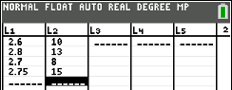
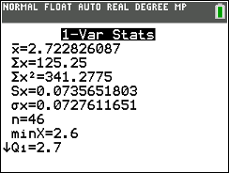
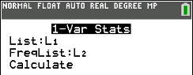
Example 3-12 TI 84 solution
Go to stat, edit, put in prices as L₁ and # of gallons purchased (the “weights”) as L₂:
Result:
Go to stat, calc, 1-var, put in L1 and L2 as inputs, move down to “Calculate” and press enter.
Note that the average is Σx/n

Slide 71
Example 3-12 Excel solution
Create columns for price x, gas w and x*w.
The 1st row has the labels.
Put the appropriate formula =A2*B2 into C2.
Select C2.
Grab fill handle in lower right: pull down to apply formula to the other rows.
Put in horizontal line at bottom.
Select the cells in columns B and C below this line.
Use ∑ “autosum” (in home menu) to get the sums of columns B and C.
Average is the ratio of the column C total and the column B total.

Slide 72
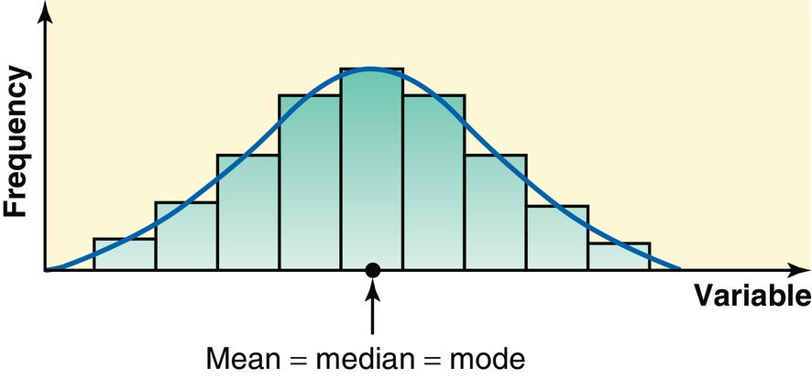
Relationships Among the Mean, Median, and Mode
For a symmetric histogram and frequency distribution with one peak, the values of the mean, median, and mode are identical, and they lie at the center of the distribution.

Slide 73
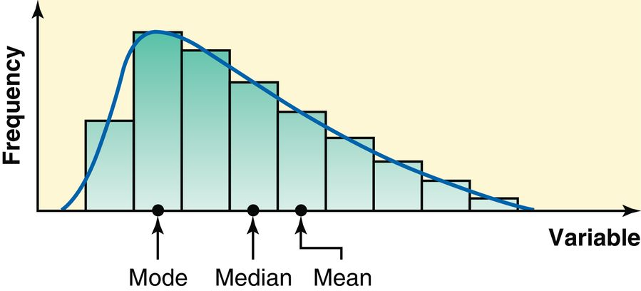
Relationships Among the Mean, Median, and Mode
For a histogram and a frequency distribution curve skewed to the right, the value of the mean is the largest, that of the mode is the smallest, and the value of the median lies between these two.
The value of the mean is the largest because it is sensitive to outliers that occur in the right tail (pull it to the right).

Slide 74
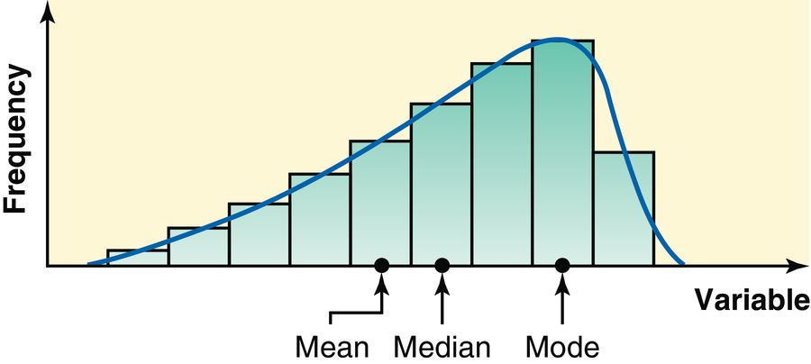
Relationships Among the Mean, Median, and Mode
If a histogram and a frequency distribution curve are skewed to the left, the value of the mean is the smallest and that of the mode is the largest, with the value of the median lying between these two.
In this case, the outliers in the left tail pull the mean to the left.

