Slide 1
Statistics Session 2
Introduction to Statistics II
Ezra Halleck, City Tech (CUNY), Fall 2021

Slide 2
Review: Statistics and Types of Statistics
Statistics is
the science of collecting, analyzing, presenting, and interpreting data, as well as of making decisions based on such analyses.
You can separate into 2 jobs
Descriptive: methods for organizing, displaying, and describing data
by using tables, graphs, and summary measures.
Inferential: methods that use sample results to help make decisions or predictions about a population.

Slide 3
1.2 Basic Terms
Definition
An element or member of a sample or population is
a specific subject or object;
about which information is collected.
For example: a person, firm, item, state, or country.
Can you think of other examples of members that might be part of a study?

Slide 4
Basic Terms (cont.)
Definition
A variable is a characteristic under study that assumes different values for different elements.
In contrast to a variable, the value of a constant is fixed.
Examples of variables could be
a person’s height, weight, age or health;
a firm’s earning, financial health, number of employees;
a state’s education level, poverty index, infrastructure.
Come up with variables for your examples of members.

Slide 5
Basic Terms (end)
Definition
The value of a variable for an element is called an observation or measurement.
A data set is a collection of observations on one or more variables.
A data set is often presented in the form of a spreadsheet (Excel) or a data frame (R).
It is not uncommon nowadays to work with datasets with
dozens of variables
100’s, 1000’s or even millions of observations.

Slide 6
Table 1.1 Total Wealth of the World’s Ten Richest People (source: Forbes)
name | net worth | age | source | country
Jeff Bezos | $193.5 B | 57 | Amazon | United States
Elon Musk | $185.7 B | 50 | Tesla, SpaceX | United States
Bernard Arnault | $177.1 B | 72 | LVMH | France
Mark Zuckerberg | $134.0 B | 37 | Facebook | United States
Bill Gates | $132.1 B | 65 | Microsoft | United States
Larry Page | $123.1 B | 48 | Google | United States
Sergey Brin | $118.8 B | 48 | Google | United States
Larry Ellison | $116.3 B | 77 | software | United States
Warren Buffett | $103.9 B | 91 | Berkshire Hathaway | United States
Steve Ballmer | $96.1 B | 65 | Microsoft | United States

Slide 7
Quantitative Variables
Definition
A variable that can be measured numerically is called a quantitative variable.
The data collected on a quantitative variable are called quantitative data.
People or other living thing examples: height, weight for;
Country, state or other geographical entity:
portion in poverty, uninsured, underinsured, unemployed, “discouraged”
level of income inequality:
90th percentile/10th percentile

Slide 8
For wealth table: what are the numeric variables?
name | net worth | age | source | country
Jeff Bezos | $193.5 B | 57 | Amazon | United States
Elon Musk | $185.7 B | 50 | Tesla, SpaceX | United States
Bernard Arnault | $177.1 B | 72 | LVMH | France
Mark Zuckerberg | $134.0 B | 37 | Facebook | United States
Bill Gates | $132.1 B | 65 | Microsoft | United States
Larry Page | $123.1 B | 48 | Google | United States
Sergey Brin | $118.8 B | 48 | Google | United States
Larry Ellison | $116.3 B | 77 | software | United States
Warren Buffett | $103.9 B | 91 | Berkshire Hathaway | United States
Steve Ballmer | $96.1 B | 65 | Microsoft | United States
Note how one is given with decimals: it is continuous numeric.
The other is given as an integer; it is discrete numeric.

Slide 9
Discrete vs Continuous
Definition
A variable whose values are countable is discrete.
In other words, a discrete variable can assume only certain values with no intermediate values.
A variable that can assume any numerical value over an interval (or intervals) is continuous.
Classify the other numeric variables we have discussed:
height, weight (if rounded to nearest inch, lb): discrete
portion in poverty, etc, income inequality: continuous

Slide 10
Qualitative or Categorical Variable
Definition
A variable that cannot assume a numerical value but can be classified into two or more nonnumeric categories is a qualitative or categorical variable.
The data collected on such a variable are called qualitative data.
If the variable is a yes or no, then it is binary.
If the categories have an intrinsic order, then it is ordinal.
Otherwise, it is said to be nominal.
Come up with examples each of these subtypes.

Slide 11
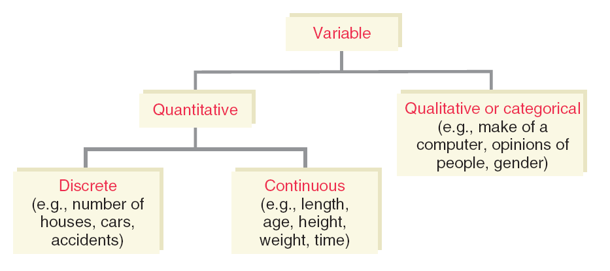
Figure 1.1 Types of Variables
Binary
Quantitative
Discrete (age in years at previous birthday)
Continuous (height, not rounded)
Qualitative or Categorical
Binary (married, not married)
Nominal (color of a car)
Ordinal (education achieved: elementary, high school, etc)

Slide 12
1.4 Cross-Section Versus Time-Series Data
Data collected on different elements at the same point in time or for the same period of time are cross-section data.
Example is the wealth table (current as of 8/29/21)
Data collected on the same element for the same variable at different points in time or for different periods of time are called time-series data.
Example is the average tuition and fees on next slide.

Slide 13
Table 1.3 Average Tuition and Fees in 2014 Dollars at Four-Year Public Institutions
Years | Tuition and Fee (Dollars)
1974–75 | 2469
1984–85 | 2810
1994–95 | 4343
2004–05 | 6448
2014–15 | 9139
Source: The College Board.

Slide 14
1.5 Population Versus Sample
Definition
A population consists of all elements – individuals, items, or objects – whose characteristics are being studied.
The population on which the study will make conclusions is the target population.
The portion of the population selected for actual measurements is referred to as a sample.

Slide 15
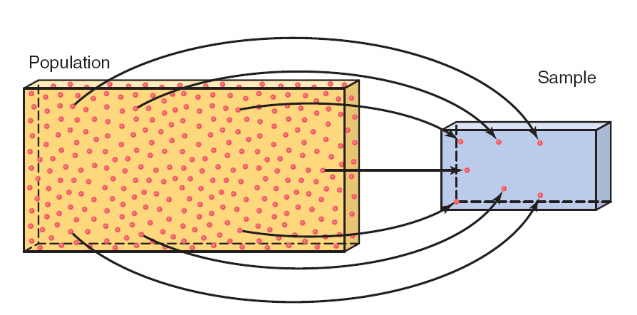
Figure 1.2 Population and Sample

Slide 16
Population Versus Sample
Definition
A survey that includes every member of the population is called a census.
The technique of collecting information from a portion of the population is called a sample survey.

Slide 17
Representative Sample
Definition
A sample that represents the characteristics of the population as closely as possible is called a representative sample.

Slide 18
Random Sample
Definition
A random sample is a sample drawn in such a way that each member of the population has the same chance of being selected. [Also called a simple random sample.]
In a non-random sample, some members of the population may not have any chance of being selected in the sample.

Slide 19
Sampling Error Versus Nonsampling Error
Definition
The sampling error is the difference between
the result obtained from a sample survey;
the result that would have been obtained if the whole population had been included in the survey.
Errors that occur in the collection, recording, and tabulation of data are nonsampling errors or biases.

Slide 20
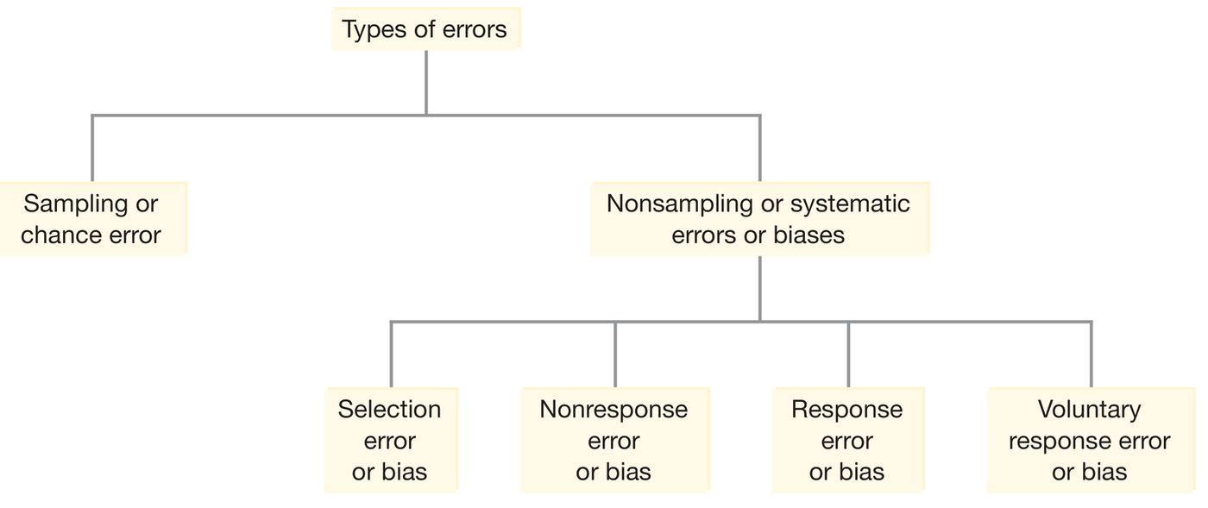
Figure 1.3 Types of Errors

Slide 21
Selection error or bias
The sampling is not representative of the population.

Slide 22
Nonresponse Error
Many of the people included in the sample do not respond to a survey, e.g., not answering a call.

Slide 23
Response Error
People included in the survey do not provide correct answers, e.g., in regards drug or alcohol consumption.

Slide 24
Voluntary Response Error
A survey is conducted where people are invited to respond to a questionnaire online.
A famous example is the Literary digest who called an election for the Republican Presidential candidate in 1936 when in fact it was easily won by the Democrat (FDR).

Slide 25
Non-simple Random Sampling Techniques
In a stratified random sample, first divide population into subpopulations (strata):
select sample from each of the strata;
In cluster sampling:
Divide population into (often geographical) groups called clusters;
Take a sample of clusters that is representative of the population;
[Optional: Take a SRS from each of the selected clusters].
In both cases, the final step is to join all samples into a single set.

