Slide 1
Statistics Session 27
Chi-Square Tests: Goodness of Fit
Ezra Halleck, City Tech (CUNY), Fall 2021

Slide 2
Opening Example
Are you a fan of people who work on Wall Street?
Do you think that people who work on Wall Street are as honest and moral as the general public?
In a Harris poll conducted in 2012, 28% of the U.S. adults polled agreed with the statement, “In general, people on Wall Street are as honest and moral as other people.”
68% of the adults polled disagreed with this statement.
Note the third category: refuse to answer, neutral or no opinion of 100%- (28%+68%) = 4%.
The addition of this third category means our previous inferential methods do not apply.
If we conduct a poll today of 300 people and find that 50 agree, 320 disagree and 30 are neutral, have opinions changed?

Slide 3
11.1 The Chi-Square Distribution
Definition
The chi-square distribution has only one parameter called the degrees of freedom (df).
The shape of a chi-square distribution curve is
bell-shaped and highly skewed to the right for small df (except for df=2 which looks exponential);
bell-shaped but more symmetric for large df.
The entire chi-square distribution curve lies to the right of the vertical axis.
The chi-square distribution assumes nonnegative values:
denoted by $χ^{2}$ (read as “kie-square”).

Slide 4
Three Chi-Square Distribution Curves
$df−2$ is peak$;$
$df$ is mean;
the median is somewhere in between.

Slide 5
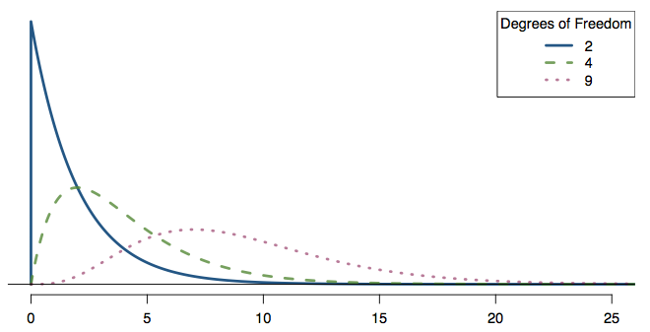
Practice
Which of the following is false?
As the df increases,
the center of the χ² distribution increases as well
the variability of the χ² distribution increases as well
the shape of the χ² distribution becomes more skewed (less like a normal)

Slide 6
Practice
Which of the following is false?
As the df increases,
the center of the χ² distribution increases as well
the variability of the χ² distribution increases as well
the shape of the χ² distribution becomes more skewed (less like a normal)

Slide 7
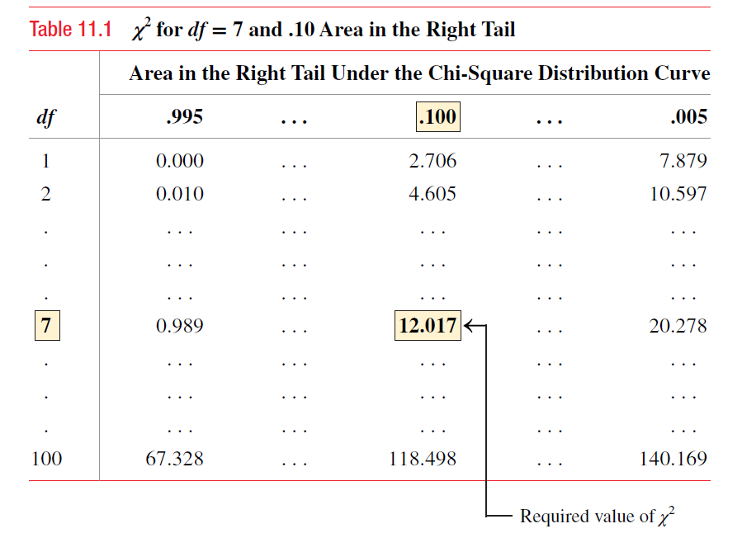
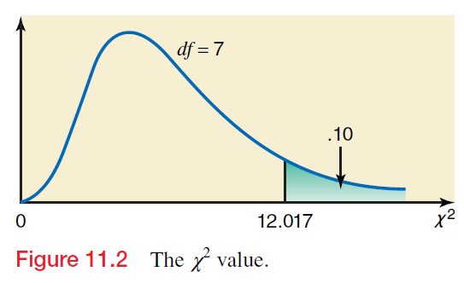
Example of $χ^{2}$: input of right probability
Find the value of $χ^{2}$ for 7 degrees of freedom and an area of 0.10 in the right tail of the distribution curve.
Observe that the area under the pdf in a $χ^{2}$ distribution is right-tailed.

Slide 8
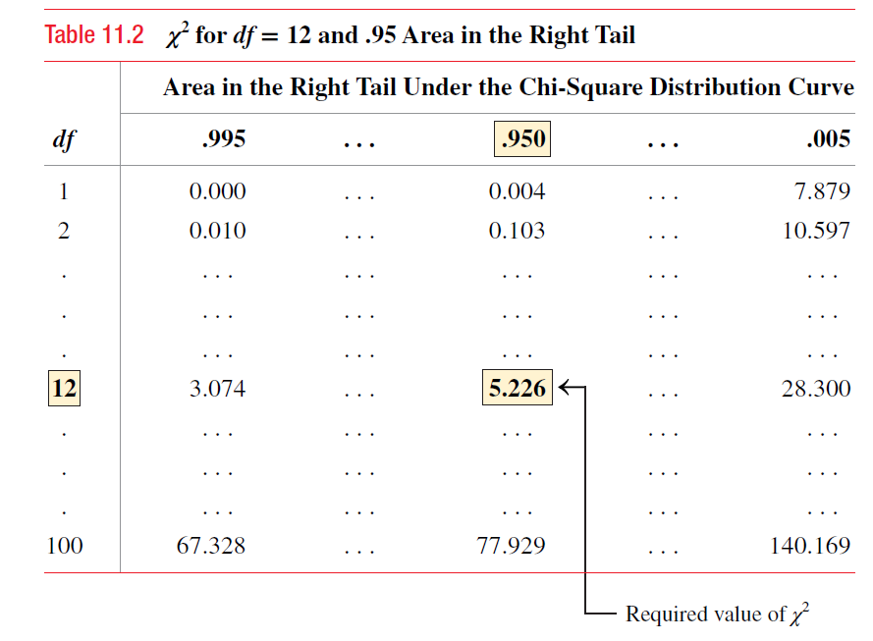
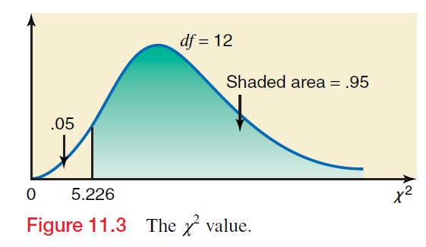
Example of $χ^{2}$: input of left probability
Find the value of $χ^{2}$ for 12 degrees of freedom and an area of 0.05 in the left tail of the distribution curve.
Recall that the area under the $χ^{2}$ distribution is right tailed. In order to find left-tail area, we should calculate
$$left tail=1−right tail$$

Slide 9
11.2 A Goodness-of-Fit Test
Definition
An experiment with the following characteristics is called a multinomial experiment.
The experiment consists of n identical trials (repetitions).
Each trial results in one of k possible outcomes (or categories), where k > 2.
The trials are independent.
The probabilities of the various outcomes remain constant for each trial.

Slide 10
Observed and Expected Frequencies
Definition
The frequencies obtained from the performance of an experiment are the observed frequencies (denoted by O).
The expected frequencies (denoted by E), are those that we expect to obtain if $H_{0}$ is true.
The expected frequency for a category is obtained as
$$E=np$$
where:
n is sample size;
p is probability an element belongs to category if $H_{0}$ is true.

Slide 11
Test Statistic for a Goodness-of-Fit Test
The test statistic for a goodness-of-fit test is
and its
value is calculated as
where
O = observed frequency for a category
E = expected frequency for a category = np
A chi-square goodness-of-fit test:
always right-tailed!

Slide 12
Conditions for the chi-square test
Independence: Each case that contributes a count to the table must be independent of all the other cases in the table.
Sample size: Each particular scenario (i.e. cell) must have at least 5 expected cases.
df > 1: Degrees of freedom must be greater than 1.
Failing to check conditions may unintentionally affect test's error rates.

Slide 13
ATM usage by (work) day
A bank has an A T M installed inside a bank, and it is available to customers only from 7 A M to 6 P M Monday - Friday.
The manager wants to investigate if the percentage of transactions made on this A T M is the same for each day.
In one week, she counts the number of transactions made on this A T M on each of the 5 days.
The information she obtains is:
At the 1% level of significance, test whether we can reject
$H_{0}$: # of people who use A T M each of 5 days is the same
Assume that this week is typical (not during a holiday season).
Day | Monday | Tuesday | Wednesday | Thursday | Friday
# of users | 253 | 197 | 204 | 297 | 267

Slide 14
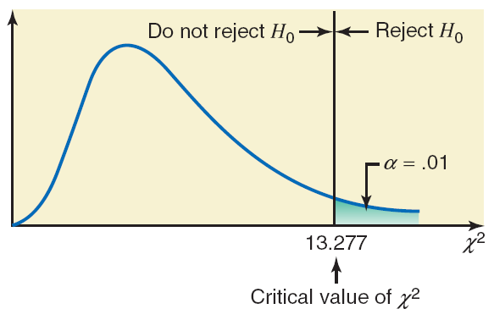
ATM usage by (work) day: Solution (1 of 3)
Step 1:
Step 2: There are 5 categories: 5 days of A T M usage.
Step 3:
Area in the right tail = α = .01
k = number of categories = 5
df = k − 1 = 5 − 1 = 4
The critical value is:
$χ_{crit}^{2}$= 13.277 (from chart)

Slide 15
ATM usage by (work) day: Solution (2 of 3)
Category (Day) | Observed Frequency O | p | Expected Frequency E = np | (O − E) | (O minus E) squared | (O minus E) squared over E(O minus E) squared over E
Monday | 253 | .20 | 1200(.20) = 240 | 13 | 169 | .704
Tuesday | 197 | .20 | 1200(.20) = 240 | −43 | 1849 | 7.704
Wednesday | 204 | .20 | 1200(.20) = 240 | −36 | 1246 | 5.400
Thursday | 279 | .20 | 1200(.20) = 240 | 39 | 1521 | 6.338
Friday | 267 | .20 | 1200(.20) = 240 | 27 | 729 | 3.038
Blank | n = 1200 | Blank | Blank | Blank | Blank | Sum =23.184
Step 4: From the table:
The Excel table has been done horizontally rather than vertically & is live!

Slide 16
ATM usage by (work) day: Solution (3 of 3)
Step 5:
The value of the test statistic
is larger than
the critical value of
It falls in the rejection region.
Hence, we reject the null hypothesis.
We state that the number of persons who use this A T M is not the same for the 5 days of the week.
It looks like usage drops off towards the beginning of the week and picks up as the weekend gets closer.

Slide 17
Example 11-4 (1 of 2)
In a Gallup poll conducted April 3–6, 2014, Americans aged 18 and older were asked if upper-income people were “paying their fair share in federal taxes, paying too much or paying too little.”
Of the respondents, 61% said too little, 24% said fair share, 13% said too much, and 2% had no opinion (gallup.com).
Assume that these percentages hold true for the 2014 population of Americans aged 18 and older.
Recently, 1000 randomly selected Americans aged 18 and older were asked the same question.
The table on the next slide lists the number of Americans in this sample who belonged to each response.

Slide 18
Example 11-4 (2 of 2)
Response | Too Little | Fair Share | Too Much | No Opinion
Frequency | 581 | 256 | 138 | 25
Test at a 2.5% level of significance whether the current distribution of opinions is different from that for 2014.
Step 1:
H₀ : The current percentage distribution of opinions is the same as for 2014.
H₁ : The current percentage distribution of opinions is different from that for 2014.

Slide 19
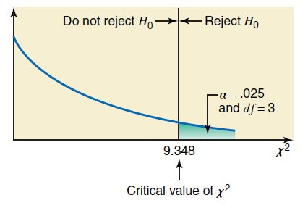
Example 11-4 (3 of 2)
Step 2:
There are 4 categories
Multinomial experiment
We use the chi-square
distribution to make this test.
Step 3:
Area in the right tail = α = .025
k = number of categories = 4
df = k − 1 = 4 − 1 = 3

Slide 20
Table 11.4 Calculating the Value of the Test Statistic
Category (Response) | Observed Frequency O | p | Expected Frequency E = np | (O − E) | (O minus E) squared | (O minus E) squared over E
Too little | 581 | .61 | 1000(.61) = 610 | −29 | 841 | 1.379
Fair share | 256 | .24 | 1000(.24) = 240 | 16 | 256 | 1.067
Too much | 138 | .13 | 1000(.13) = 130 | 8 | 64 | .492
No opinion | 25 | .02 | 1000(.02) = 20 | 5 | 25 | 1.250
Blank | n = 1000 | Blank | Blank | Blank | Blank | Sum = 4.188

Slide 21
Example 11-4: Solution (4 of 5)
Step 4:
All the required calculations to find the value of the test
statistic
are shown in Table 11.4.

Slide 22
Example 11-4: Solution (5 of 5)
Step 5:
The value of the test statistic
is smaller than
the critical value of
It falls in the nonrejection region.
Hence, we fail to reject the null hypothesis.
We state that the current percentage distribution of opinions is the same as for 2014.

Slide 23
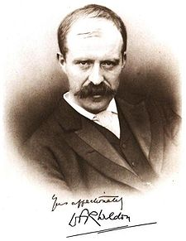
Weldon's dice
Walter Frank Raphael Weldon (1860 - 1906), was an English evolutionary biologist and a founder of biometry.
He was a founding editor of Biometrika, with Francis Galton and Karl Pearson.
In 1894, he rolled 12 dice 26,306 times, and recorded #of 5s or 6s
(which he considered to be a “success”).
He observed that 5s or 6s occurred more often than expected.
Pearson hypothesized that this was due to construction of dice:
inexpensive dice have hollowed-out pips;
the face with 6 pips is lighter than its opposing face, which has only 1 pip (opposing faces sum to 7).

Slide 24
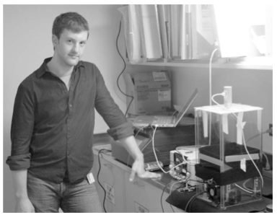
Labby's dice
In 2009, Zacariah Labby (U of Chicago), repeated Weldon's experiment using a homemade dice-throwing, pip counting machine. www.youtube.com/watch?v=95EErdouO2w
The rolling-imaging process took about 20 seconds per roll.
Each day there were ~150 images to process manually.
At this rate Weldon's experiment was repeated in a little more than six full days. galton.uchicago.edu/about/docs/labby09dice.pdf

Slide 25
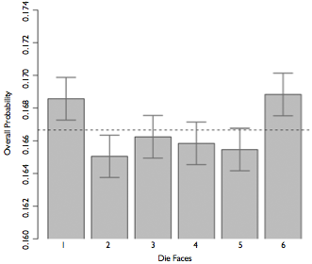
Labby's dice (cont.)
Labby did not actually observe the same phenomenon that Weldon observed (higher frequency of 5s and 6s).
Automation allowed Labby to collect more data than Weldon did in 1894.
Instead of recording "successes" and "failures", Labby recorded the individual number of pips on each die.

Slide 26
Expected counts
Labby rolled 12 dice 26,306 times. If each side is equally likely to come up, how many 1s, 2s, ..., 6s would he expect to have observed?
1/6
12/6
26,306 / 6
12 x 26,306 / 6

Slide 27
Expected counts
Labby rolled 12 dice 26,306 times. If each side is equally likely to come up, how many 1s, 2s, ..., 6s would he expect to have observed?
1/6
12 / 6
26,306 / 6
12 x 26,306 / 6 = 52,612

Slide 28
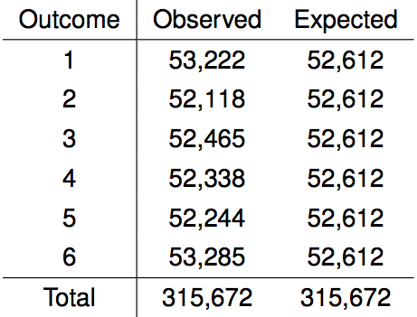
Summarizing Labby's results
The table below shows the observed and expected counts from Labby's experiment.
At a first glance, does there appear to be an inconsistency between the observed and expected counts.

Slide 29
Labby's dice (cont)
The research question is:
Do these data provide convincing evidence of an inconsistency between the observed and expected counts?
The hypotheses are:
H₀: There is no inconsistency between the observed and the expected counts. (The observed counts follow the same distribution as the expected counts.)
H₁: There is an inconsistency between the observed and the expected counts. (The observed counts do not follow the same distribution as the expected counts, i.e., there is a bias in which side comes up on the roll of a die.)
We calculate a test statistic of χ² = 24.67.
$df=k−1=6−1=5$

Slide 30
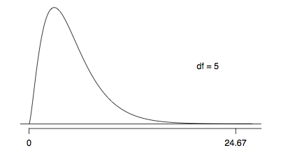
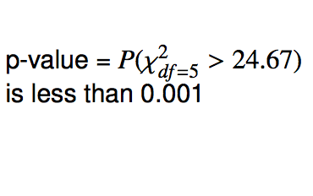
Finding a p-value for a chi-square test
The p-value for a chi-square test is defined as the tail area above the calculated test statistic.

Slide 31
Conclusion of the hypothesis test
We calculated a p-value less than 0.001.
At 5% significance level, what is the conclusion of the hypothesis test?
Reject H₀, the data provide convincing evidence that the dice are fair.
Reject H₀, the data provide convincing evidence that the dice are biased.
Fail to reject H₀, data provide convincing evidence that the dice are fair.
Fail to reject H₀, data provide convincing evidence that dice are biased.

Slide 32
Conclusion of the hypothesis test
We calculated a p-value less than 0.001.
At 5% significance level, what is the conclusion of the hypothesis test?
Reject H₀, the data provide convincing evidence that the dice are fair.
Reject H₀, data provide convincing evidence that the dice are biased.
Fail to reject H₀, data provide convincing evidence that the dice are fair.
Fail to reject H₀, data provide convincing evidence that dice are biased.

Slide 33
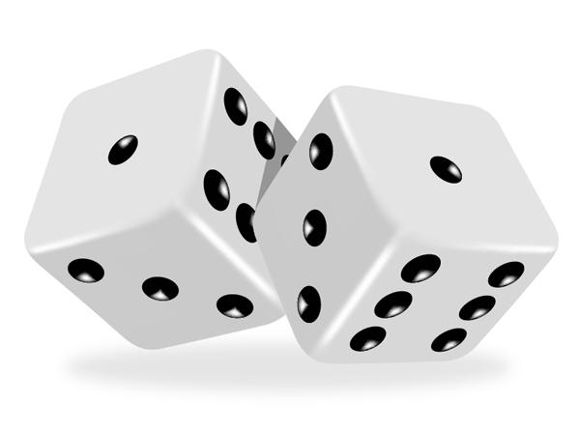
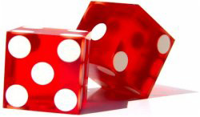
Turns out...
The 1-6 axis is consistently shorter than the other two (2-5 and 3-4), thereby supporting the hypothesis that the faces with one and six pips are larger than the other faces.
Pearson's claim that 5s and 6s appear more often due to the carved-out pips is not supported by these data.
Dice used in casinos have flush faces, where the pips are filled in with a plastic of the same density as the surrounding material and are precisely balanced.

Slide 34
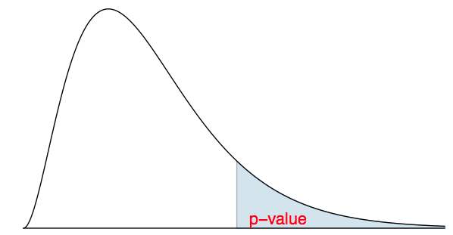
Recap: p-value for a chi-square test
The p-value for a chi-square test is defined as the tail area above the calculated test statistic.
This is because the test statistic is always positive, and a higher test statistic means a stronger deviation from the null hypothesis.

