Slide 1
Statistics Session 19
Sampling Distributions part 1
Ezra Halleck, City Tech (CUNY), Fall 2021

Slide 2
7.1 Sampling Distribution Sampling Error Nonsampling Errors
Population Probability Distribution
Sampling Distribution

Slide 3
Population Probability Distribution
Definition
The population probability distribution is the probability distribution of the population data.
Suppose there are only five students in an advanced statistics class and the midterm scores of these five students are:
Let X denote the score of a student.

Slide 4
Frequency and Probability Tables
x | f | Relative Frequency
70 | 1 | 1 over 5 = .20
78 | 1 | 1 over 5 = .20
80 | 2 | 2 over 5 = .40
95 | 1 | 1 over 5 = .20
Blank | N = 5 | Sum = 1.00
x | P(x)
70 | .20
78 | .20
80 | .40
95 | .20
Blank | Sum of p of x = 1.00

Slide 5
Sampling Distribution
Definition
The probability distribution of the sampling mean values $\overline{x}$, denoted by $\overline{X},$ is an example of a sampling distribution.
As a table, it lists the various values that the $\overline{x}$can take and the probability of each value.
Sampling distributions for the probability distribution of other sample statistics such as the standard deviation are often also considered.

Slide 6
Sampling Distribution: midterm scores
Reconsider the population of midterm scores of 5 students.
Consider all possible samples of three scores each that can be selected, without replacement, from that population.
The total number of possible samples is
Assign A, B, C, D, and E to the scores of the 5 students:
Then, the 10 possible samples of three scores each are
ABC, ABD, ABE, ACD, ACE, ADE, BCD, BCE, BDE, CDE

Slide 7
All Possible Samples and Their Means When the Sample Size Is 3
Sample | Scores in the Sample | X bar
ABC | 70,78,80 | 76.00
ABD | 70,78,80 | 76.00
ABE | 70,78,95 | 81.00
ACD | 70,80,80 | 76.67
ACE | 70,80,95 | 81.67
ADE | 70,80,95 | 81.67
BCD | 78,80,80 | 79.33
BCE | 78,80,95 | 84.33
BDE | 78,80,95 | 84.33
CDE | 80,80,95 | 85.00

Slide 8
Frequency and Relative Frequency Distributions of x bar When the Sample Size is 3
x bar | f | Relative Frequency
76.00 | 2 | 2 /10 = .20
76.67 | 1 | 1 /10 = .10
79.33 | 1 | 1 /10 = .10
81.00 | 1 | 1/10 = .10
81.67 | 2 | 2 /10 = .20
84.33 | 2 | 2 /10 = .20
85.00 | 1 | 1/10 = .10
$$\overline{x}$$ | $$P\left(\overline{x}\right)$$
76.00 | .20
76.67 | .10
79.33 | .10
81.00 | .10
81.67 | .20
84.33 | .20
85.00 | .10
Blank | Sum of p of x bar = 1.00

Slide 9
Sampling Error and Nonsampling Errors
Definition
Sampling error is the difference between the value of a sample statistic and the value of the corresponding population parameter. In the case of the mean,
assuming that the sample is random and no nonsampling error has been made.
The errors that occur in the collection, recording, and tabulation of data are called nonsampling errors.

Slide 10
Reasons for Occurrence of Nonsampling Errors
If a sample is nonrandom (and, hence, most likely nonrepresentative), the sample results may be too different from the census results.
The questions may be phrased in such a way that they are not fully understood by the members of the sample or population.
The respondents may intentionally give false information in response to some sensitive questions.
The poll taker may make a mistake and enter a wrong number in the records or make an error while doing data entry.

Slide 11
Our example of test scores
Consider the population of five scores once again. Suppose the sample of three scores selected from the population 70, 80, and 95. Find the sampling error.
That is, the mean score estimated from the sample is 1.07 higher than the mean score of the population.
Note that this difference occurred due to chance—that is, because we used a sample instead of the population.

Slide 12
Sampling Error and Nonsampling Errors
Now suppose, when we select the sample of three scores, we mistakenly record the second score as 82 instead of 80.
As a result, we calculate the sample mean as
The difference between this sample mean and 𝜇 is
This difference does not represent the sampling error.
Only 1.07 of this difference is due to the sampling error.
0.66, the remaining portion, is the nonsampling error.

Slide 13
7.2 Mean and Standard Deviation of $\overline{x}$
The mean and standard deviation of the sampling distribution of
are called the mean and standard deviation of
and are
denoted by
respectively.
The mean of the sampling distribution of
is always
equal to the mean of the population. Thus,

Slide 14
Standard Deviation of x bar
The standard deviation of the sampling distribution of $\overline{x}$ is
$$σ_{\overline{x}}=\frac{σ}{\sqrt{n}}$$
Where:
σ is the standard deviation of the population;
n is the sample size.
This applies to the situation when the sample size is no more than 5% of the population size N, i.e.,
$$\frac{n}{N}≤\frac{1}{20}=0.05$$
If not, use the correction factor $\sqrt{\frac{N−n}{N−1}}$, .i.e., $σ_{\overline{x}}=\frac{σ}{\sqrt{n}}\sqrt{\frac{N−n}{N−1}}$

Slide 15
Two Important Observations
1. The spread of the sampling distribution of $\overline{x}$ is smaller than the spread of the corresponding population 𝜎, i.e.
$$σ_{\overline{x}}<σ$$
2. The standard deviation of the sampling distribution of $\overline{x}$ decreases as the sample size increases.

Slide 16
Wage Example at a Large Company
The mean wage for all 5000 employees who work at a large company is $27.50 and the standard deviation is $3.70.
Let $\overline{x}$ be the mean wage per hour for a random sample of certain employees selected from this company. Find the mean and standard deviation of $\overline{x}$ for a sample size of
30
75
200
For all the sample sizes:
For $σ_{\overline{x}}$, the sample sizes are such that $\frac{n}{N}≤0.05$

Slide 17
7.3 Shape of the Sampling Distribution $\overline{X}$
We consider separately the following two cases.
The population from which samples are drawn has:
a normal distribution;
a distribution that is not normal.

Slide 18
Normal population distribution and shape of sampling distribution.
If the population from which the samples are drawn is normally distributed,
then the sampling distribution will be normally distributed as well, regardless of the sample size.
Note how the spread decreases a n increases.
For $n=4$, the spread is half the original.
Population
distribution
Sampling
Distribution
$$n=2$$
Sampling
Distribution
$$n=4$$

Slide 19
Physician Example Revisited
American Internal medicine physicians earned an average of $196,000 in 2014.*
Suppose that X, the earnings of the internal medicine physicians, are approximately normally distributed with a mean of $196,000 and a standard deviation of $20,000.
Let $\overline{X}$ denote the sampling distribution. Given the following samples sizes, note the shape of the resulting distributions and calculate their parameters:
(a) 16 (b)50 (c)1000
The shape is normal regardless of the sample size.
The means are the same as the population mean, namely $196,000.
Here is first $σ_{\overline{x}}$done “by hand”:
*2015 Physician Compensation Report by Medscape (a subsidiary of WebMD)

Slide 20
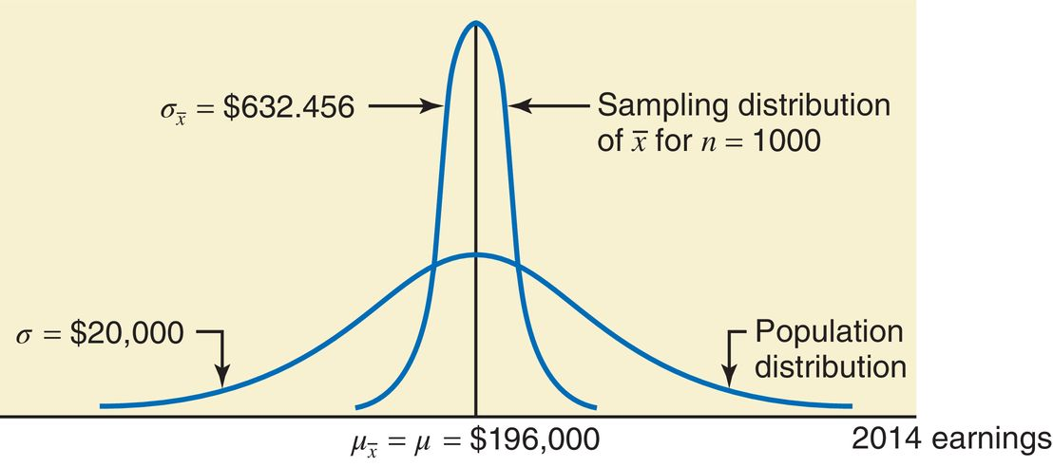
Graphs for 2 physician earnings sampling distributions
$2,830
50

Slide 21
Sampling from a Population That Is Not Normally Distributed
According to the central limit theorem, for a “large” sample size, the sampling distribution $\overline{X}$ is approximately normal, irrespective of the shape of the population distribution.
The mean & standard deviation of the sampling distribution $\overline{X}$ are as we have already stated:
The sample size is usually considered to be “large” if $n≥30,$
another “rule of thumb”.

Slide 22
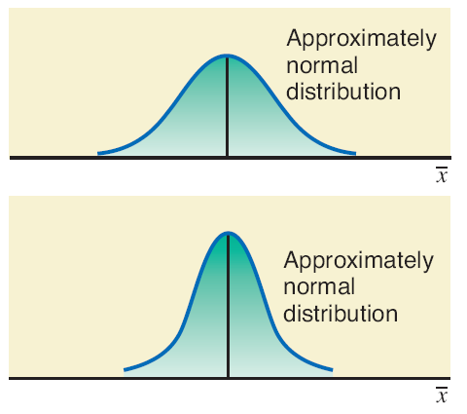
Population Distribution and Sampling Distributions of x bar for nonnormal X
Population
distribution
Sampling
Distribution
$$n=30$$
Sampling
Distribution
$$n=4$$
Sampling
Distribution
$$n=80$$
Sampling
Distribution
$$n=15$$
The vertical lines in the left graphs are used to indicate ${μ_{\overline{x}}}_{}$ and ${μ_{\overline{x}}+σ}_{\overline{x}}$. Note skewing.

Slide 23
Rent Example
The mean rent paid by all tenants in a small city is $1550 with a standard deviation of $225.
However, the population distribution of rents for all tenants in this city is skewed to the right.
Calculate the mean and standard deviation of $\overline{X}$ and describe the shape when the sample size is (a) 30 (b) 100
For both sample sizes:
For $n=30$:
For $n=100$:
For both sample sizes, the sampling distributions are approximately normal. What about for $n=15$?

Slide 24
Rent Example Graphs

