Slide 1
Statistics Session 17
Normal Random Variable
Ezra Halleck, City Tech (CUNY), Fall 2021

Slide 2
6.3 Applications of the Normal Distribution
Internal medicine physicians earned an average of $196,000 in 2014.*
Suppose that the earnings are normally distributed with a a standard deviation of $20,000.
Find the probability that the earnings of a randomly selected internal medicine physician are between $169,400 and $206,800.
For display and calculation purpose, it is better to work with the unit thousands of dollars k$: so $μ=196$, $σ=20$. And we are looking for $P\left(169.4≤X≤206.8\right)$
*According to the 2015 Physician Compensation Report by Medscape (a subsidiary of WebMD)

Slide 3
Beverage example
Geiser drinks makes an orange-flavored seltzer.
The filling machines are adjusted to pour 12.01 oz into each 12-ounce bottle.
However, the actual amount in each bottle is not exactly 12.01 oz; it varies.
The actual amount has a normal distribution with a mean of 12.01 ounces and a standard deviation of .015 ounce.
What is the chance that a random bottle has less than 12 oz?

Slide 4
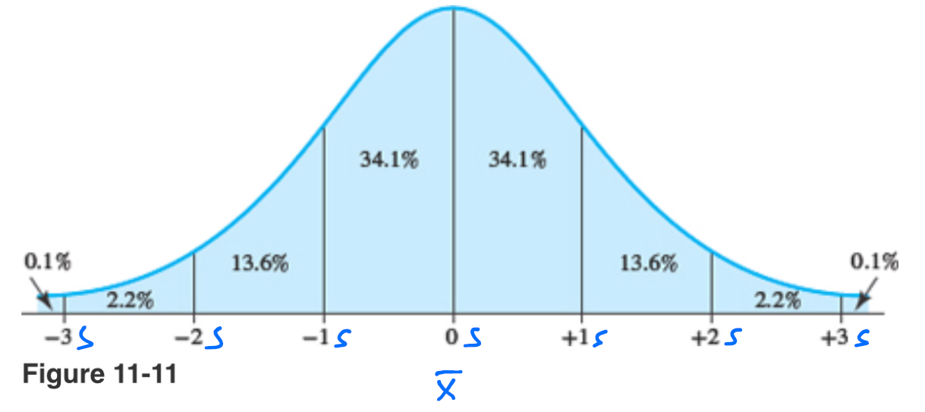
Empirical Rule

Slide 5
tire lifetimes example
The life of a certain automobile tire is normally distributed with mean 35,000 (=35k) miles and standard deviation 5000 (=5k) miles.
What proportion of tires last between 30,000 (30k) and 40,000 (40k) miles? (i.e., P{|Z | < 1})
What proportion of such tires last over 40,000 miles (40k)? (P{Z >1})
What proportion last over 50,000 miles (=50k)?(P{Z >3})
If the tire is in working condition after 40,000 miles (=40k), what is the conditional probability that it will still be working after an additional 10,000 miles (=10k)?
(i.e., P{Z >3}/ P{Z >1})
We can use the percentages from the empirical rule to answer these questions:
The chance of being within one standard deviation of the mean is 68%.
The chance of being beyond one standard deviation on one side is (100-68)/2%=16%
The chance of being within 3 standard deviations is 99.7%. Hence, the chance of being beyond three standard deviations on one side is (100-99.7)/2% = 0.15%
We have the ingredients from parts c and b: P{Z >3}/ P{Z >1} = 0.15%/16% ~ 1%
Exercise: answer each of the questions using complete sentences.

Slide 6
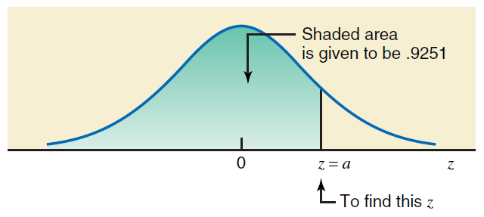
6.4 Determining Z and X values when Area Under the Normal Curve is Known
$$Z= invNorm\left(area, μ, σ\right)$$
$$Z= invNorm\left(0.9251, 0, 1\right)$$
$$Z=1.440238268…$$

Slide 7
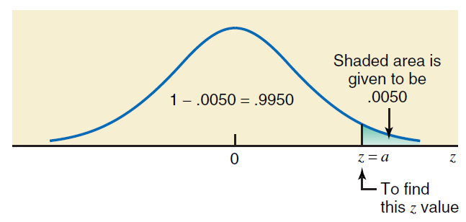
6.4 Determining Z and X values when Area Under the Normal Curve is Known
$$Z= invNorm\left(area, μ, σ\right)$$
$Z= invNorm\left(1−.0050, 0, 1\right)$ = $invNorm\left(.9950, 0, 1\right)$
$$Z=2.575829303…$$

Slide 8
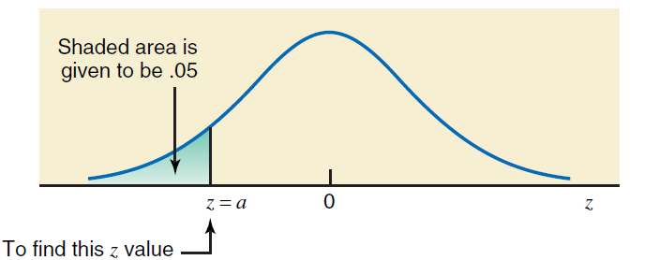
6.4 Determining Z and X values when Area Under the Normal Curve is Known
$$Z= invNorm\left(area, μ, σ\right)$$
$$Z= invNorm\left(.050, 0, 1\right)$$
$$Z=−1.644853626…$$

Slide 9
Finding the X value when the Z is known.
Recall: $Z=\frac{X−μ}{σ}$
$$→Zσ=X−μ$$
$$∴X=μ+Zσ$$

Slide 10
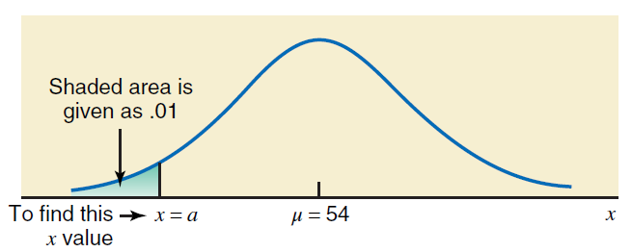
$$Z=invNorm\left(.01 , 0 , 1\right)=−2.326347877…$$
$$X=μ+Zσ=5+54(−2.326347877) ≈35.3… months≈35 months$$
$$X=invNorm\left(.01 , 54 , 8\right)≈35.3… months≈35 months$$

Slide 11
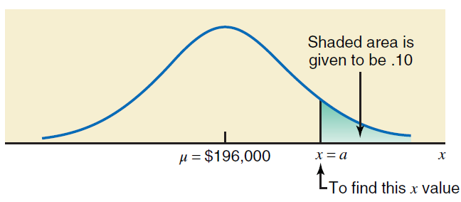
$$Z=invNorm\left(1−.1 , 0 , 1\right)=invNorm\left(.9, 0 , 1\right)=1.281551567…$$
$$X=μ+Zσ=196000+20000\left(1.281551567\right)≈\$221,631.03$$
$$X=invNorm\left(.9 , 196000, 20000\right)≈\$221,631.03$$

