Slide 1
Statistics Session 15
Continuous Random Variables
Ezra Halleck, City Tech (CUNY), Fall 2021

Slide 2
Opening Example
Have you ever participated in a road race?
If you have, where did you stand in comparison to the other runners?
For an open (mostly amateur) race, the time taken to finish a road race varies tremendously. What factors contribute to this large spread?
Case Study 6–1 is the distribution of times for runners who completed the Manchester (Connecticut) Road Race in 2014.

Slide 3
6.1 Continuous Probability Distribution and The Normal Probability Distribution
Height of a Female Student (inches) x | f | Relative Frequency
60 to less than 61 | 90 | .018
61 to less than 62 | 170 | .034
62 to less than 63 | 460 | .092
63 to less than 64 | 750 | .150
64 to less than 65 | 970 | .194
65 to less than 66 | 760 | .152
66 to less than 67 | 640 | .128
67 to less than 68 | 440 | .088
68 to less than 69 | 320 | .064
69 to less than 70 | 220 | .044
70 to less than 71 | 180 | .036
N = 5000 | Sum = 1.0

Slide 4
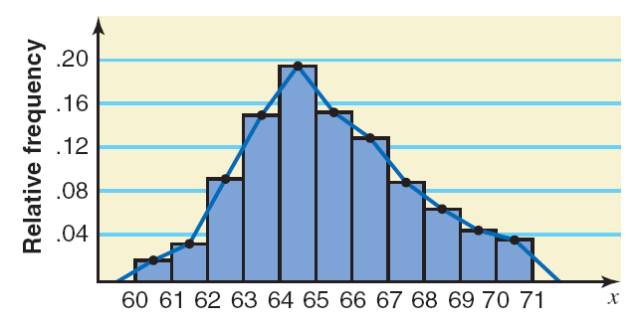
Histogram and Polygon for Female Student Heights
The polygonal line if smoothed is our first probability density function (PDF).
The probability for an interval can be found by finding the area under the portion of the curve which is above the interval in question.
What can you say about the shape of this distribution?

Slide 5
the Probability Density Function (PDF)
Two characteristics
The probability that x assumes a value in any interval lies in the range 0 to 1.
The total probability for all the (mutually exclusive) intervals within which x can assume values is 1.0.

Slide 6
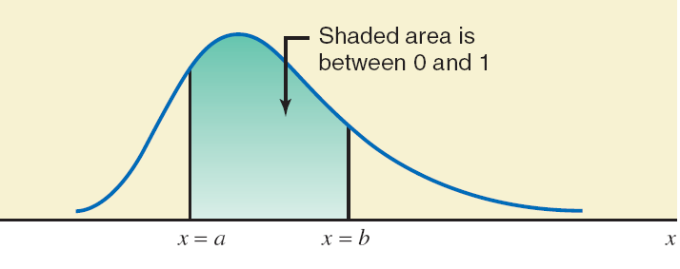
the Probability Density Function (PDF)
Two characteristics
The probability that x assumes a value in any interval lies in the range 0 to 1. Pictorially,
  the PDF is a curve which stays on or above the x-axis;
  the probability corresponds to the area under the PDF within that interval.

Slide 7
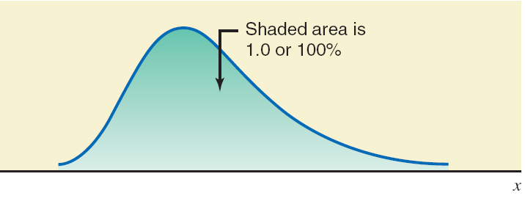
the Probability Density Function (PDF)
Two characteristics
The probability that x assumes a value in any interval lies in the range 0 to 1.
The total probability for all the (mutually exclusive) intervals within which x can assume values is 1.0. Pictorially,
  the area underneath the “entire” PDF function is 1.

Slide 8
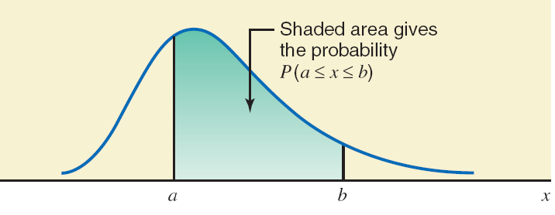
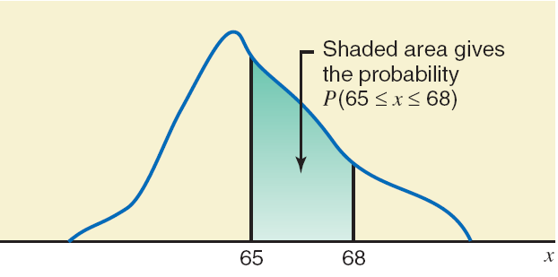
Area under the PDF as Probability
Probability that female student height lies in interval 65-68

Slide 9
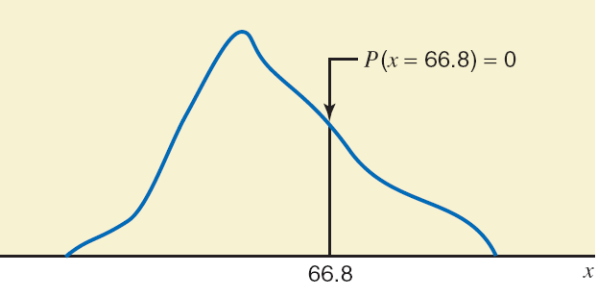
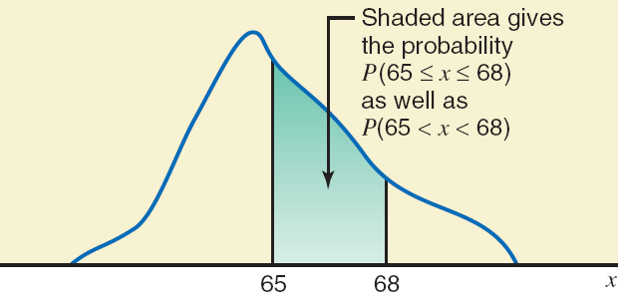
The Probability of a Single Value of x is Zero
We note that this a theoretical point.
In actuality, all data have some level of precision.
Due to this rounding, boundary inclusions/exclusions are in fact important.
Hence, probability 65 – 68 including boundary and excluding boundary are the same.

Slide 10
Case Study 6-1 Distribution of Time Taken to Run a Road Race
Class | Frequency | Relative Frequency | Class | Frequency | Relative Frequency
20<=X<25 | 53 | .0045 | 70<=X<75 | 230 | .0197
25<=X<30 | 246 | .0211 | 75<=X<60 | 176 | .0151
30<=X<35 | 763 | .0653 | 80<=X<65 | 186 | .0159
35<=X<40 | 1443 | .1235 | 85<=X<90 | 130 | .0111
40<=X<45 | 1633 | .1398 | 90<=X<95 | 113 | .0097
45<=X<50 | 1906 | .1632 | 95<=X<100 | 90 | .0077
50<=X<55 | 2164 | .1852 | 100<=X<105 | 33 | .0028
55<=X<60 | 1418 | .1214 | 105<=X<110 | 36 | .0031
60<=X<65 | 672 | .0575 | 110<=X<110 | 9 | .0008
65<=X<70 | 380 | .0325 | 115<=X<120 | 1 | .0001
 |  |  |  |  | 1

Slide 11
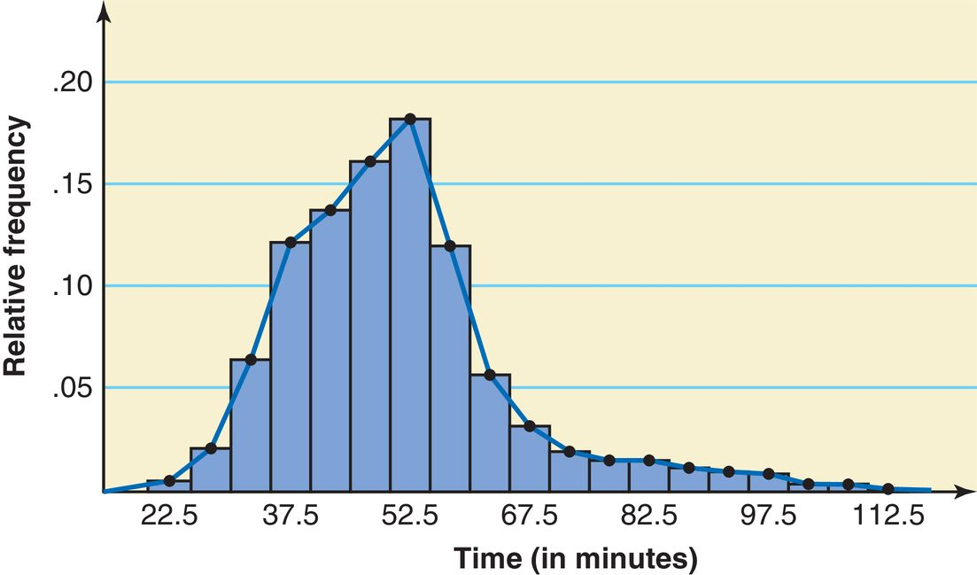
Histogram and Polygon for the Road Race Data
What can you say about the shape of this distribution?

Slide 12
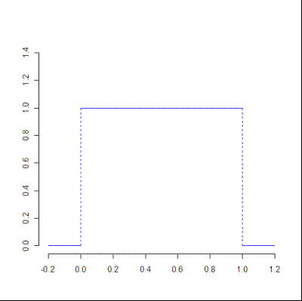
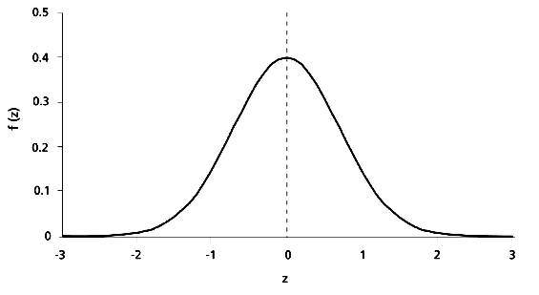

Density function $f(x)$ examples
Standard normal
“Standard” uniform

Slide 13
How to find a continuous probability
Graph the density function
Mark the event on the x-axis (an interval or union of intervals)
Draw vertical lines to mark the boundaries of the event
Shade under the curve within these lines above the event
Find area of your shaded region.
Label the probability on graph.

Slide 14
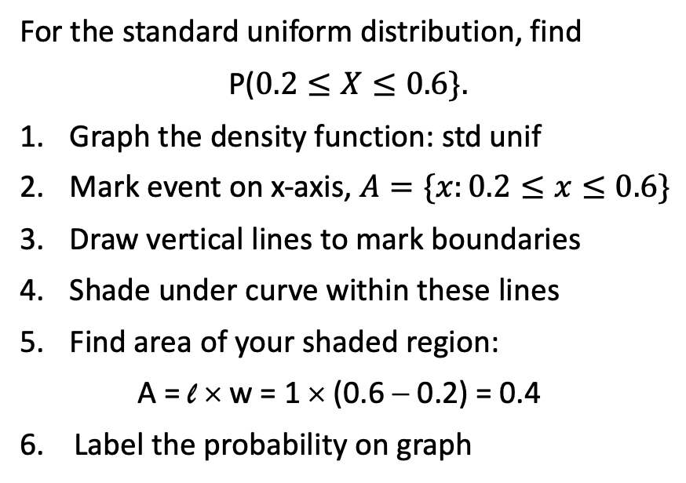

Example of probability calculation
For the standard uniform distribution, find
P($0.2≤X≤0.6\}.$
Graph the density function: std unif
Mark event on x-axis, $A=\{x:0.2≤x≤0.6\}$
Draw vertical lines to mark boundaries
Shade under curve within these lines
Find area of your shaded region:
A = l × w = 1 × (0.6 − 0.2) = 0.4
6. Label the probability on graph
P(A) = $P(0.2≤X≤0.6)$ = 0.4 = 40%

Slide 15
Exercise: Suppose that the density function is the uniform distribution with footprint [1,5], i.e., a horizontal line between
x = 1 and x = 5 with a uniform height h and 0 everywhere else.
  What is the height h? Hint: total area under curve is 1.
  What is the probability that an outcome is between 2 and 3?
  What is the probability that an outcome is > 3.5?

Slide 16
Exercise: Suppose that the density function is the uniform distribution with footprint [1,5], i.e., a horizontal line between
x = 1 and x = 5 with a uniform height h and 0 everywhere else.
  What is the height h? Hint: total area under curve is 1.
  L*w = h*(5-1) = 4h = 1 so h = 1/4

Slide 17
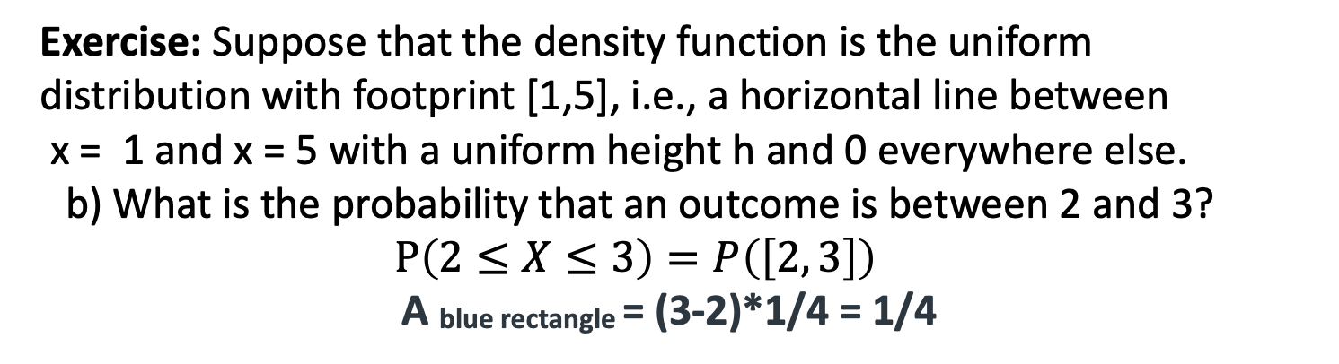
Exercise: Suppose that the density function is the uniform distribution with footprint [1,5], i.e., a horizontal line between
x = 1 and x = 5 with a uniform height h and 0 everywhere else.
  b) What is the probability that an outcome is between 2 and 3?
  $$P\left(2≤X≤3\right)=P\left(\left[2, 3\right]\right)$$
A _{blue rectangle} = (3-2)*1/4 = 1/4

Slide 18
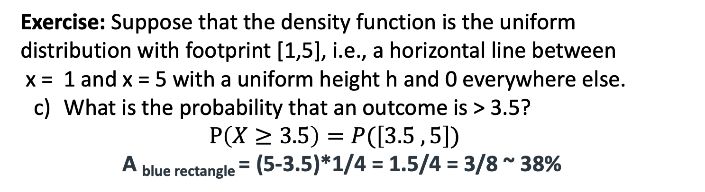
Exercise: Suppose that the density function is the uniform distribution with footprint [1,5], i.e., a horizontal line between
x = 1 and x = 5 with a uniform height h and 0 everywhere else.
  What is the probability that an outcome is > 3.5?
  $$P\left(X≥3.5\right)=P(\left[3.5 ,5\right])$$
  A _{blue rectangle} = (5-3.5)*1/4 = 1.5/4 = 3/8 ~ 38%

Slide 19
Meeting-up Example: You are to meet a friend at 2 p.m. However, while you are always exactly on time, your friend is always late and indeed will arrive at the meeting place at a time uniformly distributed between 2 and 3 p.m. Find the probability that you will have to wait
(a) At least 30 minutes
(b) Less than 15 minutes
(c) Between 10 and 35 minutes

Slide 20
Meeting-up Example: You are to meet a friend at 2 p.m. However, while you are always exactly on time, your friend is always late and indeed will arrive at the meeting place at a time uniformly distributed between 2 and 3 p.m. Find the probability that you will have to wait
(a) At least 30 minutes | The height of the
(b) Less than 15 minutes | rectangle is
(c) Between 10 and 35 minutes | 1/60 ~ 0.017

Slide 21
Meeting-up Example: You are to meet a friend at 2 p.m. However, while you are always exactly on time, your friend is always late and indeed will arrive at the meeting place at a time uniformly distributed between 2 and 3 p.m. Find the probability that you will have to wait
(a) At least 30 minutes | P(X ≥ 30) = P([30, 60])
A _{blue rectangle} = | (60-30)/60 = 1/2

Slide 22
6.2.4. You are to meet a friend at 2 p.m. However, while you are always exactly on time, your friend is always late and indeed will arrive at the meeting place at a time uniformly distributed between 2 and 3 p.m. Find the probability that you will have to wait
(b) Less than 15 minutes | P(X ≤ 15) = P([0, 15])
A _{blue rectangle} = | (15-0)/60 = ¼ = 25%

Slide 23
Meeting-up Example: You are to meet a friend at 2 p.m. However, while you are always exactly on time, your friend is always late and indeed will arrive at the meeting place at a time uniformly distributed between 2 and 3 p.m. Find the probability that you will have to wait
(c) Between 10 and 35 minutes | P(10 ≤ X ≤ 35) = P([10, 35])
A _{blue rectangle} = | (35-10)/60 = 25/60 = 5/12 ~ 42%

Slide 24
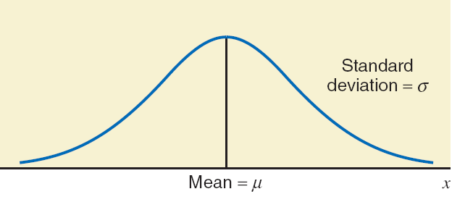

Normal Probability Distribution
A normal probability distribution, when plotted, gives a bell-shaped curve such that:
The total area under the curve is 1.0.
The curve is symmetric about the mean.
The two tails of the curve extend indefinitely.
$$μ+σ$$

Slide 25

Normal Probability Distribution
Its variability is measured by the standard deviation σ, which can be found by:
finding the distance (along the x-axis)
from the peak to where the nature of the curve changes (from being an “upside-down parabola” to “exponential decay”).
$$μ+σ$$
$$σ$$

Slide 26
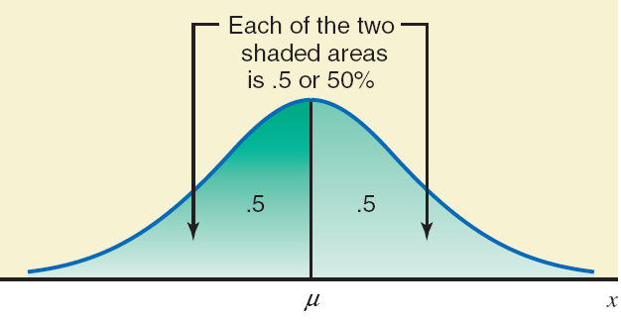
A Normal PDF has area underneath of 1 and is Symmetric about the Mean

Slide 27
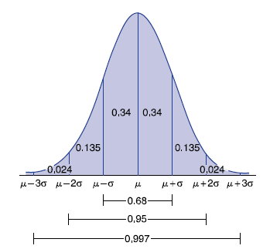
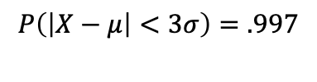


The area under the PDF & empirical rule
Many applications amount to finding the area under different parts of the curve.
68% of the area is within one SD of the mean:
$$P\left(\left|X−μ\right|<σ\right)=.68$$
        95% of the area is within two SD of the mean:
$$P\left(\left|X−μ\right|<2σ\right)=.95$$
99.7% of the area is within three SD of the mean:
$$P\left(\left|X−μ\right|<3σ\right)=.997$$

Slide 28
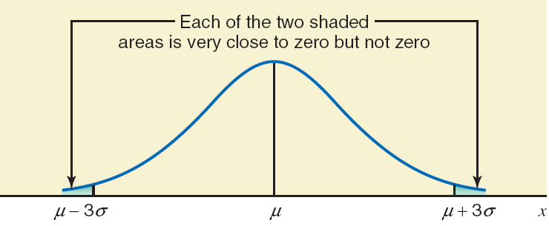
Areas Beyond Mu, Plus or Minus 3 Sigma

Slide 29
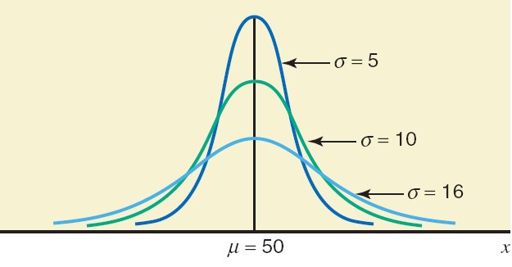
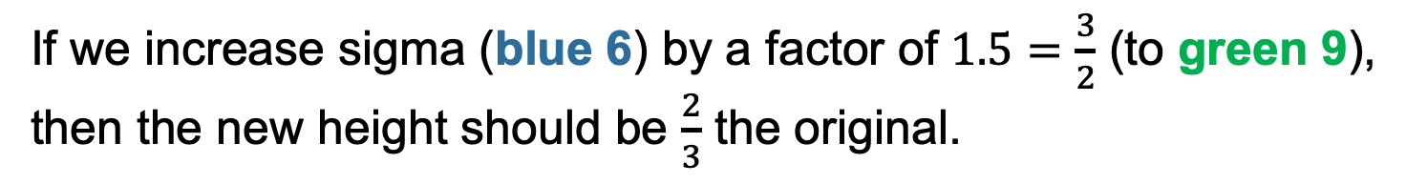


The height of the peak of a normal PDF is inversely proportional to its sigma
$$σ=6$$
$$σ=9$$
If we increase sigma (blue 6) by a factor of $1.5=\frac{3}{2}$ (to green 9),
then the new height should be $\frac{2}{3}$ the original.

Slide 30



The spread of a normal PDF is directly proportional to its sigma
$$σ=6$$
$$σ=9$$
$$μ+σ$$
$$μ+σ$$
So if we increase sigma by a factor of $1.5=\frac{3}{2}$,
then the spread should be 50% more than the original.

Slide 31
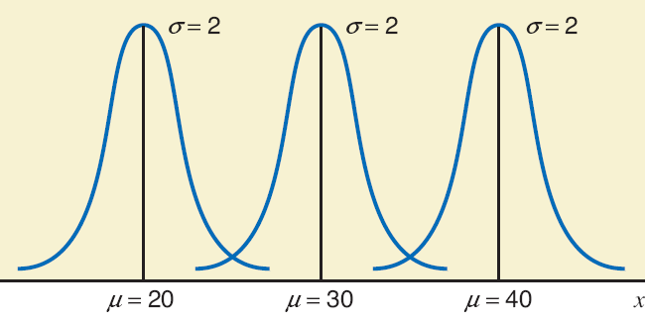
Changing the mean shifts center but not does not affect shape/spread.

Slide 32
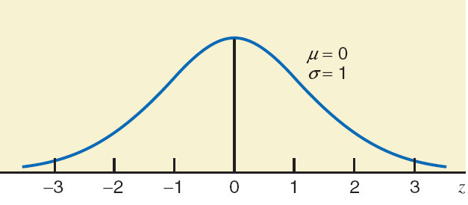
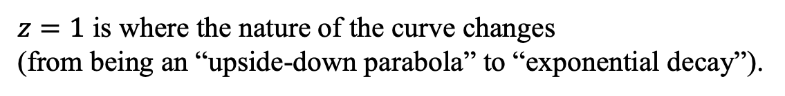
Standard Normal Distribution
Definition
The normal distribution with μ = 0 and σ = 1 is called the standard normal distribution.
$z=1$ is where the nature of the curve changes
(from being an “upside-down parabola” to “exponential decay”).

Slide 33
Z Values or Z Scores
Definition
The units marked on the horizontal axis of the standard normal curve are denoted by z and are called the z values or z scores.
A specific value of z gives the distance between the mean and the point represented by z in terms of the standard deviation.

Slide 34
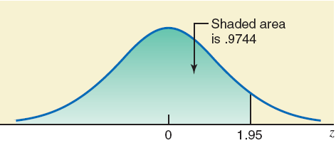
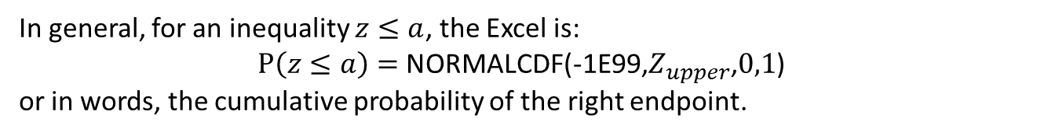
Example 6-1
Find the area under the standard normal curve to the left of z = 1.95.
The calculator command is
NORMALCDF(-1E99,1.95,0,1)
In general, for an inequality $z≤a$, the Excel is:
$P\left(z≤a\right)=$NORMALCDF(-1E99,$Z_{upper}$,$0,1$)
or in words, the cumulative probability of the right endpoint.

Slide 35
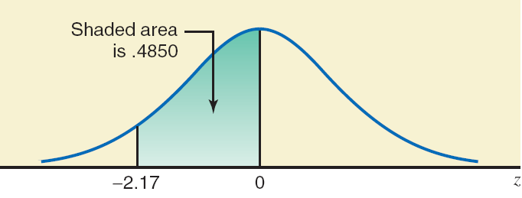
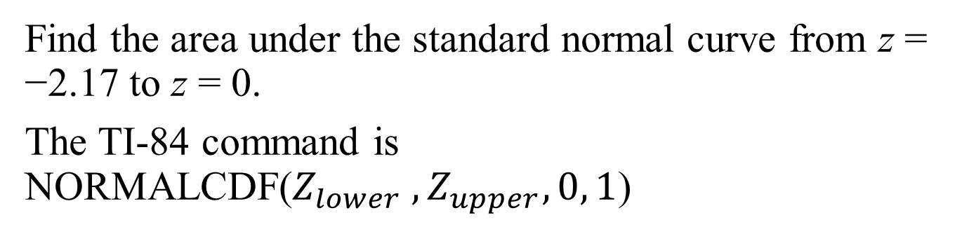
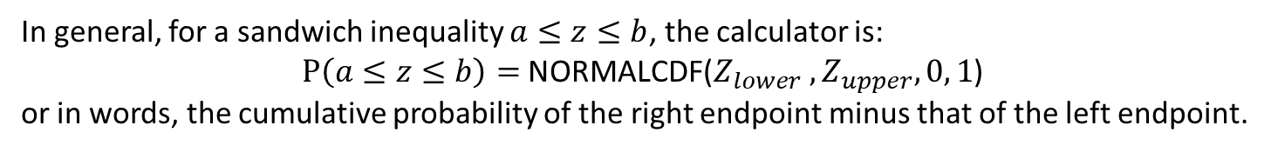
Example 6-2
Find the area under the standard normal curve from z = −2.17 to z = 0.
The TI-84 command is NORMALCDF($Z_{lower} ,Z_{upper}, 0, 1$)
In general, for a sandwich inequality $a≤z≤b$, the calculator is:
$P\left(a≤z≤b\right)=$NORMALCDF($Z_{lower} ,Z_{upper}, 0, 1$)
or in words, the cumulative probability of the right endpoint minus that of the left endpoint.

Slide 36
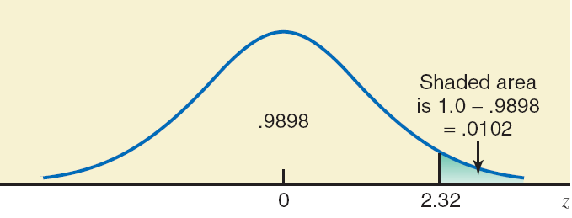
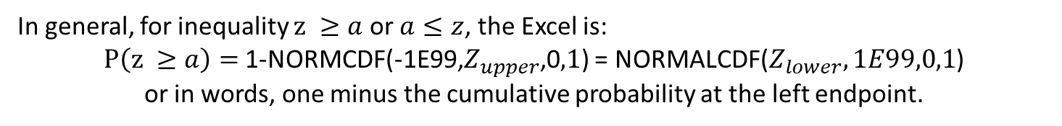
Example 6-3
Find the area to the right of z = 2.32 to the nearest ten thousandth (4 decimal places).
First find the area to the left of z = 2.32.
Then subtract this area from 1.0:
1-NORMALCDF(-1E99,2.32,0,1) = 0.010170439
Rounding we get 0.0102.
In general, for inequality $z ≥a$ or $a≤z$, the Excel is:
$P\left(z ≥a\right)=$1-NORMCDF(-1E99,$Z_{upper}$,0$,1$) = NORMALCDF($Z_{lower},1E99,0,1$)
or in words, one minus the cumulative probability at the left endpoint.

Slide 37
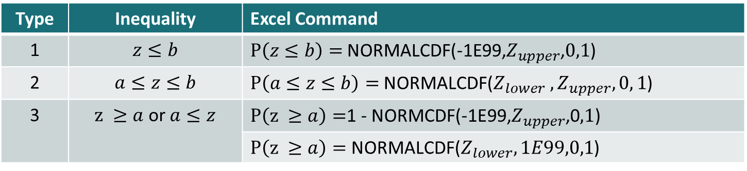
Summary of inequalities & Calculator commands
Type | Inequality | Excel Command
1 | $$z≤b$$ | $P\left(z≤b\right)=$NORMALCDF(-1E99,$Z_{upper}$,$0,1$)
2 | $$a≤z≤b$$ | $P\left(a≤z≤b\right)=$NORMALCDF($Z_{lower} ,Z_{upper}, 0, 1$)
3 | $z ≥a$ or $a≤z$ | $P\left(z ≥a\right)=$1 - NORMCDF(-1E99,$Z_{upper}$,0$,1$)
 |  | $P\left(z ≥a\right)=$ NORMALCDF($Z_{lower},1E99,0,1$)

Slide 38
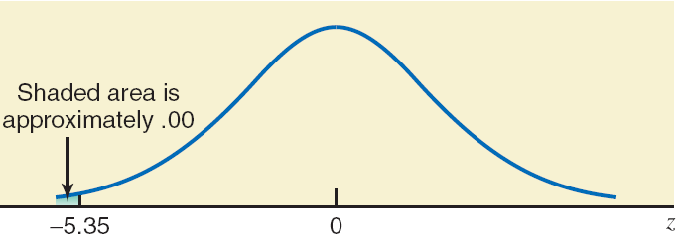
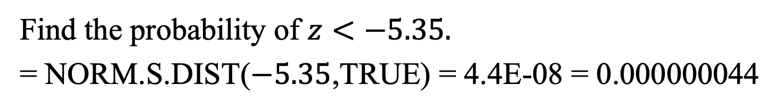
Example 6-5
4E-08
4E-08
Find the probability of $z<−5.35.$
= NORM.S.DIST($−5.35$,TRUE) = 4.4E-08 = 0.000000044

