Slide 1
Statistics Session 13
Random Variables part 2
Ezra Halleck, City Tech (CUNY), Fall 2021

Slide 2
Reminder of Opening Example from part 1
When you purchase a lottery ticket for $5 and you don’t win anything, then your “earnings” are – 5. If you get a $20 prize, then your earnings are 20 – 5 = 15.
Playing the lottery and determining your earnings is an experiment with a numeric outcome and hence is an example of a random variable.

Slide 3
5.2 Probability Distribution of a Discrete Random Variable
A PD of DRV lists all the possible values that the variable can assume and their corresponding probabilities.
Recall the frequency and relative frequency distributions of the number of vehicles owned by families
The distribution consists of the first and third columns.
# Vehicles Owned | Frequency | Rel Frequency
0 | 30 | .015
1 | 470 | .235
2 | 850 | .425
3 | 490 | .245
4 | 160 | .080
Blank | N = 2000 | Sum = 1.000

Slide 4
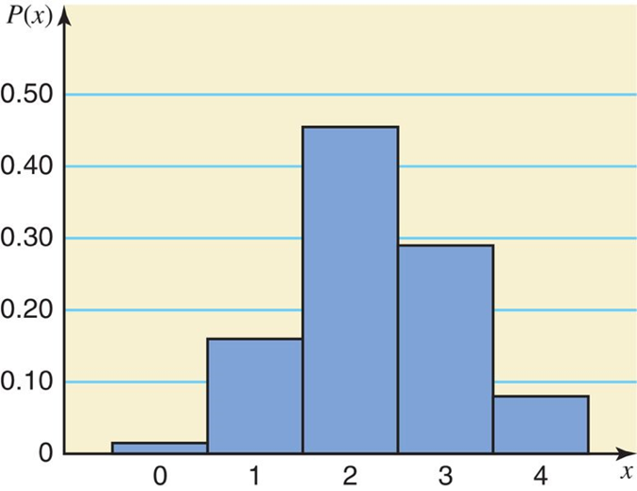
Probability Distribution for # of Vehicles Owned by Families
A bar graph or histogram is the most common way to display the distribution graphically.
How would you describe the shape of the distribution?
Bell shaped? Symmetric? If not, then is right or left skewed.
# of Vehicles Owned x | Probability P(x)
0 | .015
1 | .235
2 | .425
3 | .245
4 | .080
Blank | summation P(x) = 1.000.

Slide 5
Recall the two characteristics of any finite or discrete Probability Distribution
1.
2.
In particular, any discrete random variable has these characteristics.

Slide 6
Exercise: Find the probability that a randomly selected family owns
(a) two vehicles?
(b) at least two vehicles?
(c) at most one vehicle?
(d) owns three or
more vehicles?
# of Vehicles Owned x | Probability P(x)
0 | .015
1 | .235
2 | .425
3 | .245
4 | .080
Blank | summation P(x) = 1.000.
Probability that selected family owns:
(a) owns two vehicles = P(2) = .425
(b) at least two vehicles
= P(2 or 3 or 4) = P(2) + P(3) + P(4) = .425 + .245 + .080 = .750
(c) at most one vehicle = P(0 or 1) = P(0) + P(1) = .015 + .235 = .250
(d) owns 3 or more vehicles = P(3 or 4) = P(3) + P(4) = .245 + .080 = .325

Slide 7
Example 5-3
Each of the following tables lists certain values of x and their probabilities. Determine whether or not each table represents a valid probability distribution.
(b)
x | P(x)
2 | .25
3 | .34
4 | .28
5 | .13
(c)
(a)
x | P(x)
0 | .08
1 | .11
2 | .39
3 | .27
x | P(x)
7 | .70
8 | .50
9 | −.20
(a) No, since the sum of all probabilities is not equal to 1.0.
(b) Yes.
(c) No, since one of the probabilities is negative.

Slide 8
Example 5-4
The following table lists the probability distribution of the # of breakdowns per week for a machine (based on past data).
Breakdowns per week | 0 | 1 | 2 | 3
Probability | .15 | .20 | .35 | .30
1. Is this a probability distribution?
2. Find the probability that the # of breakdowns for this machine during a given week is
(a) exactly 2
(b) 0 to 2
(c) more than 1
(d) at most 1

Slide 9
Example 5-4: Solution
Breakdowns per week | 0 | 1 | 2 | 3
Probability | .15 | .20 | .35 | .30
(a) exactly 2
(b) 0 to 2
(c) more than 1
(d) at most 1

Slide 10
Example 5-5: math anxiety
Problem: According to a survey, 60% of all students at a large university suffer from math anxiety.
Two students are randomly selected from this university.
Let x denote the number of students in this sample who suffer from math anxiety. Construct the probability distribution of x.
Solution: Let us define the following two events:
N = the student selected does not suffer from math anxiety M = the student selected suffers from math anxiety
We construct a tree to find the outcomes and their probs
This part does not give a random variable.
Additional processing of information from the tree is needed.

Slide 11
Example 5-5: Tree Diagram

Slide 12
Example 5-5: processing of tree info
From the tree calculations, we gather that
P(0) = P(NN) = .16
P(2) = P(MM) = .36
We conclude that our random variable is the following:
This is an example of a binomial distribution,
which is the topic for the next session.
x | P(x)
0 | .16
1 | .48
2 | .36
Blank | summation P(x) = 1.00.

Slide 13
5.3 Mean and Standard Deviation of a Discrete Random Variable
The mean is the value that is expected to occur per repetition, on average, if an experiment is repeated a large number of times. It is denoted by Greek letter “mu”:
$$μ=E\left[X\right]=\sum_{i=1}^{n}{x_{i}P\left[X=x_{i}\right]}=\sum{x P\left(x\right)}$$
The function notation with E comes from $μ$ often being called the Expected value or Expectation.

Slide 14
Example 5-6
The following table lists # of breakdowns per week and their probabilities for a machine based on past data.
Breakdowns | Probability
0 | .15
1 | .20
2 | .35
3 | .30
x | P(x) | xP(x)
 |  | 0(.15) = .00
 |  | 1(.20) = .20
 |  | 2(.35) = .70
 |  | 3(.30) = .90
Blank | Blank | summation x P(x) = 1.80.
Find the mean # of breakdowns per week for this machine.

Slide 15
bad batteries expectation
w | P(w)
0 | $$\frac{ _{3}C_{0} × _{7}C_{2}}{ _{10}C_{2}}=\frac{1∗21}{45}=\frac{7}{15}$$
1 | $$\frac{ _{3}C_{1} × _{7}C_{1}}{ _{10}C_{2}}=\frac{3∗7}{45}=\frac{7}{15}$$
2 | $$\frac{ _{3}C_{2} × _{7}C_{0}}{ _{10}C_{2}}=\frac{3∗1}{45}=\frac{1}{15}$$
2 batteries are selected
from a collection of 10,
3 of which are bad.
Let W denote:
# defective batteries chosen
$$E\left[W\right]=0∗P\left[0\right]+1∗P\left[1\right]+2∗P\left[2\right]$$
$$=0∗ \frac{7}{15} +1∗ \frac{7}{15} + 2∗\frac{1}{15}$$
$$=\frac{0∙7+1∙7+2∙1}{15}=\frac{9}{15}=\frac{3}{5}=0.6$$
In other words, just a little more than half a bad battery.

Slide 16
Rolling a single 6-sided, fair die
x | 1 | 2 | 3 | 4 | 5 | 6
P(x) | $$\frac{1}{6}$$ | $$\frac{1}{6}$$ | $$\frac{1}{6}$$ | $$\frac{1}{6}$$ | $$\frac{1}{6}$$ | $$\frac{1}{6}$$
Outcomes are 1, 2, …, 6 and fair means each outcome is equally likely
So $E\left[X\right]=1∗\frac{1}{6}+2∗\frac{1}{6}+⋯+6∗\frac{1}{6}$
$=\frac{1}{6}\left(1+2+⋯+6\right)$
$=\frac{1}{6}\left[\left(1+6\right)+\left(2+5\right)+\left(3+4\right)\right]$
$=\frac{1}{6}∗\frac{6∗7}{2}=\frac{7}{2}=3.5$
The expectation is a measure of the distribution’s middle.
If distribution is symmetric, as in this case, then middle is easy to find.
1 2 3 4 5 6
⬆

Slide 17
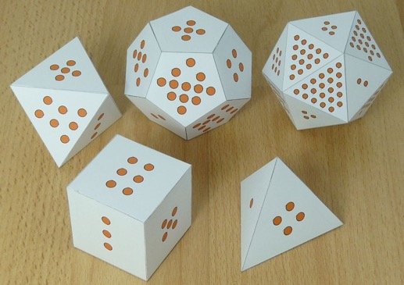
Uniform (generalization of a 6-sided die example)
Let X be a random variable that is equally likely to take on any of the values
1, 2, . . . , n, i.e.,
$$\text{So}\text{, }E\left[X\right]=1∗\frac{1}{n}+2∗\frac{1}{n}+⋯+n∗\frac{1}{n}=\frac{1}{n}\left(1+2+⋯+n\right)=\frac{1}{n}\frac{n\left(n+1\right)}{2}=\frac{n+1}{2}$$
[We factored out 1/n and used identity: $1+2+⋯+n=\frac{n\left(n+1\right)}{2}$]
Since the distribution is symmetric this should not be a surprise.
To find the middle, we can add first and last elements and divide by 2:
$$\frac{\text{last}+\text{first}}{2}=\frac{n+1}{2}$$
n | E[X]
4 | 2.5
6 | 3.5
8 | 4.5
12 | 6.5
20 | 10.5
1 2 3 … n-2 n-1 n
⬆

Slide 18
Case Study 5-1 All State Lottery

Slide 19
Variance of a Discrete Random Variable
The variance of a discrete random variable X is a steppingstone for finding the standard deviation:
$$σ^{2}=\text{Var}\left(X\right)=E\left[{\left(X−μ\right)}^{2}\right]=\sum{{\left(x−μ\right)}^{2}P(x)}$$
Using the definition of expectation & taking square root:

Slide 20
Standard Deviation of Discrete Random Variable
The standard deviation of a discrete random variable X measures the spread of its probability distribution:
$σ=\sqrt{\text{Var}\left(X\right)}=\sqrt{\sum{{\left(x−μ\right)}^{2}P(x)}}$ (definition)
$=\sqrt{\sum{x^{2}P(x)}−μ^{2}}$ (property)
Most of the time we will use the property for calculations.

Slide 21
Example 5-7
Baier’s Electronics manufactures computer parts that are supplied to many computer companies.
Two quality control inspectors at Baier’s Electronics check every part for defects before it is shipped.
However, a few defective parts do pass through undetected.
Let x denote the number of defective computer parts in a shipment of 400.
The following table gives the probability distribution of x.
Find the mean and standard deviation.
x | 0 | 1 | 2 | 3 | 4 | 5
P(x) | .02 | .20 | .30 | .30 | .10 | .08

Slide 22
Example 5-7: Solution
x | P(x) | xP(x) | ^{x squared} | x squared p(x),
0 | .02 | .00 | 0 | .00
1 | .20 | .20 | 1 | .20
2 | .30 | .60 | 4 | 1.20
3 | .30 | .90 | 9 | 2.70
4 | .10 | .40 | 16 | 1.60
5 | .08 | .40 | 25 | 2.00
Blank | Blank | summation of P(x) = 2.50. |  | summation of x squared p(x) = 7.70.

Slide 23
Using Excel for 𝜎

Slide 24
Example 5-8
Loraine Corporation is planning to market a new makeup product. According to the analysis done by the finance department of the company, Loraine Co. will earn an annual profit of $4.5 million if this product has high sales. If sales are mediocre, then annual profit be $1.2 million. If sales are low, the company stands to lose $2.3 million per year. The probability of these three scenarios is 0.32, 0.52, and 0.17, respectively.
Let x be the annual profits (in millions of dollars) from this company. Write the probability distribution of x?
Find the mean and standard deviation of x.

Slide 25
Interpretation of the Standard Deviation
The standard deviation of a discrete random variable can be interpreted and used the same way as the standard deviation of a data set that we learned about as part of our study of descriptive statistics.
For the computer part example
among a shipment of 500 parts, 2.5 on average will be defective;
the actual numbers of defective parts will differ from this 2.5 by a little less than 1.2 on average.
If the number of defective parts is more than 2.5, then on average, it will be at 2.5 + 1.2 = 3.7.
If the number of defective parts is less than 2.5, then on average, it will be at 2.5 - 1.2 = 1.3.
1.3 2.5 3.7
1.2 1.2

Slide 26
A lawyer charges a fixed fee of $2000 or takes a contingency fee of $8000 if she wins the case (and $0 if she loses).
She estimates that her probability of winning is 0.3.
Determine the expectation and standard deviation of her fee if
(a) She takes the fixed fee.
(b) She takes the contingency fee.
(c) Do you think the lawyer’s fee structure is fair? Explain.
(a) (b)
See the Excel file for the formulas of the calculations for (b).
(c) Yes, people generally expect higher compensation if there is risk or uncertainty.
Fixed | X | 2000
 | P(X) | 1
 | E[X] | 2000
 | SD[X] | 0
Contigency fee | X | 8000 | 0
 | P(X) | 0.3 | 0.7
 |  | 2400 | 0
 | E[X] | 2400
 | (X-𝜇)^2 | 31360000 | 5760000
 | P(X) | 0.3 | 0.7
 |  | 9408000 | 4032000
 | V[X] | 13440000
 | SD[X] | 3666.061

