Slide 1
Statistics Session 3
Organizing and Graphing Data
Ezra Halleck, City Tech (CUNY), Fall 2021

Slide 2
2.1 Organizing and Graphing Qualitative Data
Definition
Data recorded in the sequence in which they are collected and before they are processed or ranked are raw data.

Slide 3
Table 2.1 Ages of 50 Students
21 | 19 | 24 | 25 | 29 | 34 | 26 | 27 | 37 | 33
18 | 20 | 19 | 22 | 19 | 19 | 25 | 22 | 25 | 23
25 | 19 | 31 | 19 | 23 | 23 | 23 | 19 | 23 | 26
22 | 28 | 21 | 20 | 22 | 22 | 21 | 20 | 19 | 21
25 | 23 | 23 | 37 | 27 | 23 | 21 | 25 | 21 | 24

Slide 4
Table 2.2 Status of 50 Students
J | F | SO | SE | J | J | SE | J | J | J
F | F | J | F | F | F | SE | SO | SE | J
J | F | SE | SO | SO | F | J | F | SE | SE
SO | SE | J | SO | SO | J | J | SO | F | SO
SE | SE | F | SE | J | SO | F | J | SO | SO

Slide 5
Organizing and Graphing Qualitative Data
Frequency Distributions
Relative Frequency and Percentage Distributions
Graphical Presentation of Qualitative Data

Slide 6
Table 2.3 Worries About Not Having Enough Money to Pay Normal Monthly Bills

Slide 7
Frequency Distributions
Definition
A frequency distribution of a qualitative variable lists all categories and the number of elements that belong to each of the categories.

Slide 8
Example 2-1
A sample of 30 persons who often consume donuts were asked what variety of donuts is their favorite. The responses from these 30 persons are as follows:
glazed | filled | other | plain | glazed | other
frosted | filled | filled | glazed | other | frosted
glazed | plain | other | glazed | glazed | filled
frosted | plain | other | other | frosted | filled
filled | other | frosted | glazed | glazed | filled
Construct a frequency distribution table for these data.

Slide 9
Table 2.4 Frequency Distribution of Favorite Donut Variety
Donut Variety | Tally | Frequency (f)
Glazed | 8 tally marks | 8
Filled | 7 tally marks | 7
Frosted | 5 tally marks | 5
Plain | 3 tally marks | 3
Other | 7 tally marks | 7
Blank | Blank | Sum = 30

Slide 10
Relative Frequency and Percentage Distributions
Calculating Relative Frequency of a Category
Calculating Percentage

Slide 11
Table 2.5: relative frequency and percentage distributions for the data in Table 2.4.
Donut Variety | Relative Frequency | Percentage
Glazed | 8 over 30 = .267 | .267(100) = 26.7
Filled | 7 over 30 = .233 | .233(100) = 23.3
Frosted | 5 over 30 = .167 | .167(100) = 16.7
Plain | 3 over 30 = .100 | .100(100) = 10.0
Oilier | 7 over 30 = .233 | .233(100) = 23.3
Blank | Sum = 1.000 | Sum = 100%
Note how the frequencies 8, 7, 5, 3 and 7 appear as the numerators of the fractions in the middle column.

Slide 12
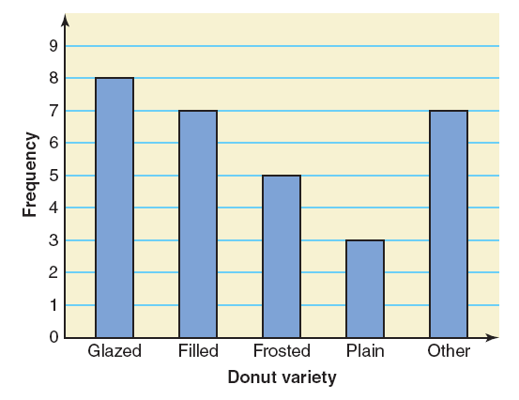
Graphical Presentation of Qualitative Data (1 of 3)
A graph made of bars whose heights represent the frequencies of respective categories is a bar graph.
Figure 2.1 Bar Graph
for Table 2.4:

Slide 13
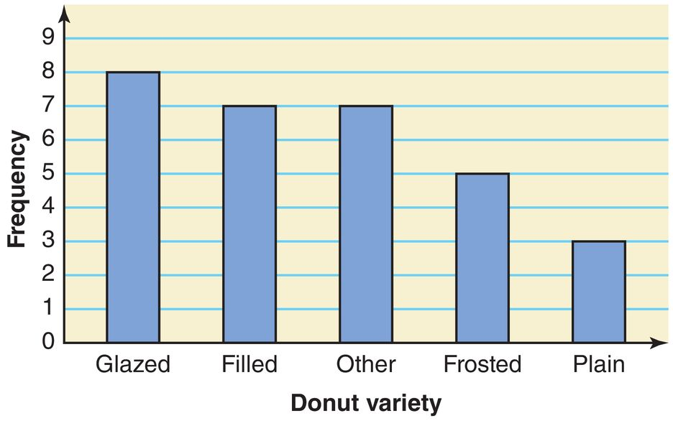
Graphical Presentation of Qualitative Data (2 of 3)
A Pareto chart is a bar graph with bars arranged by their heights in descending order:
the bar with the largest height appears first;
subsequent bars are arranged in descending order;
bar with smallest height appears last.
Figure 2.2
Pareto Chart
for Table 2.4

Slide 14
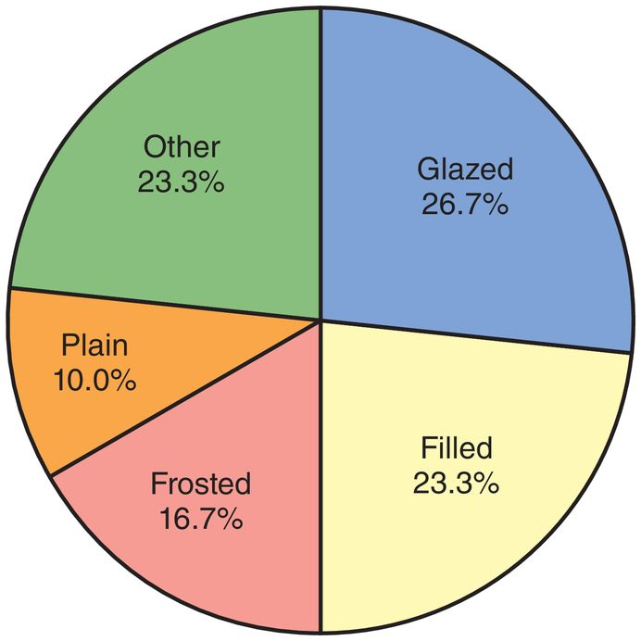
Graphical Presentation of Qualitative Data (3 of 3)
A pie chart is a circle divided into portions that represent relative frequencies or percentages of a population or sample belonging to different categories.
Figure 2.2 Pie Chart
for Percentage Distribution
of Table 2.5:

Slide 15
2.2 Organizing and Graphing Quantitative Data
Frequency Distribution Tables
Often data are put into classes or bins.
Graphing Grouped Data
Often in the form of a histogram, a bar graph with no gaps.

Slide 16
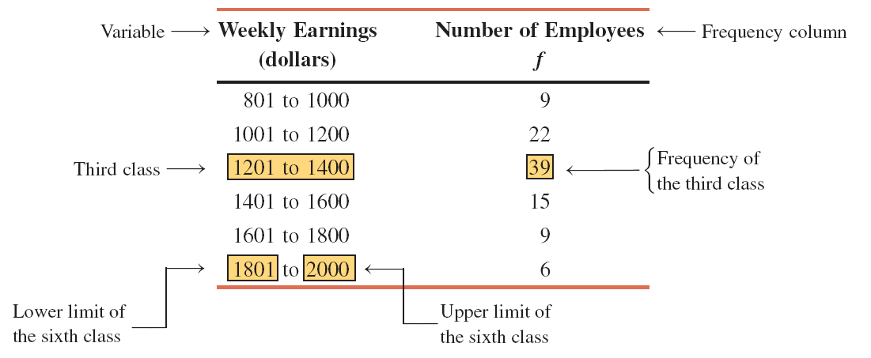
Table 2.6 Earnings of employees in a Company
This 2 to 1 ratio for the top earners to the bottom earners is uncommon in the US.
More typical is for the top executives to have salaries, 100’s or even 1000’s of times that of their lowest paid workers.

Slide 17
Frequency Distributions for Quantitative Data
A frequency distribution for quantitative data lists
all classes and the # of values that belong to each class.
The data presented in this table are said to be grouped.

Slide 18
Frequency Distributions for Quantitative Data (cont)
Finding Class Width
Calculating Class Midpoint or Mark
Calculation of Class Width

Slide 19
Class Widths and Class Midpoints for Table 2.6
Class Limits | Class Width | Class Midpoint
801 to 1000 | 200 | 900.5
1001 to 1200 | 200 | 1100.5
1201 to 1400 | 200 | 1300.5
1401 to 1600 | 200 | 1500.5
1601 to 1800 | 200 | 1700.5
1801 to 2000 | 200 | 1900.5

Slide 20
Example 2-3
The following is a fragment of table giving the value (in million dollars) of each of the 30 baseball teams (source: Forbes Magazine, April 13, 2015).
Construct a frequency distribution table. Note the min and max for this fragment.
Value Team | Value (millions of dollars)
Kansas City Royals | 700
Los Angeles Angels of Anaheim | 1300
Los Angeles Dodgers | 2400
Miami Marlins | 650
Milwaukee Brewers | 875
Minnesota Twins | 895
New York Mets | 1350
New York Yankees | 3200
Oakland Athletics | 725
Philadelphia Phillies | 1250
Pittsburgh Pirates | 900

Slide 21
Example 2-3: Solution
The minimum value is 605 (Tampa Bay Rays, not in fragment);
the maximum value is 3200 (New York Yankees).
We group these data using six classes of equal width. Then,
We round this approximate width to a convenient number, say 450.
The lower limit of the first class can be taken as 605 or any # < 605.
For readability, we take 601 as the lower limit of the first class.
Then our classes are:
601–1050, 1051–1500, 1501–1950, 1951–2400, and 2851–3300

Slide 22
Table 2.8 Frequency Distribution for the Values of Baseball Teams, 2015
Value of a Team (in million$) | Tally | Number of Teams (f)
601–1050 | 16 tally marks | 16
1051–1500 | 9 tally marks | 9
1551–1950 | 1 tally mark | 1
1951–2400 | 3 tally marks | 3
2401–2850 | Blank | 0
2851–3300 | 1 tally mark | 1
Blank | Blank | Summation of f = 30

Slide 23
Relative Frequency and Percentage
Example 2.4
Calculate the relative frequencies and percentages for Table 2.8.

Slide 24
Example 2-4: Solution
Relative Frequency and Percentage Distribution for the Values of Baseball Teams, 2015
Value of a Team (in million $) | Relative Frequency | Percentage
601-1050 | 16 over 30 = .533 | 53.3
1051- 1500 | 9 over 30 = .300 | 30.0
1501-1950 | 1 over 30 = .033 | 3.3
1951-2400 | 3 over 30 = .100 | 10.0
2401-2850 | 0 over 30 = .000 | 0.0
2851-3300 | 1 over 30 = .033 | 3.3
Blank | Sum = 1.000 | Sum = 100%
Note how the frequencies 16, 9, 1, 3, 0 and 1 appear as the numerators of the fractions in the middle column.

Slide 25
Graphing Grouped Data: histogram
A histogram is a graph in which classes are marked on the horizontal axis and
the frequencies
relative frequencies
or percentages
are represented by the heights of the bars.
Unlike a bar graph for categorical data,
in a histogram: the bars are drawn adjacent to each other.

Slide 26
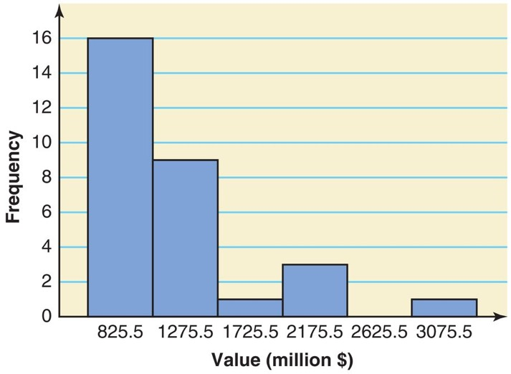
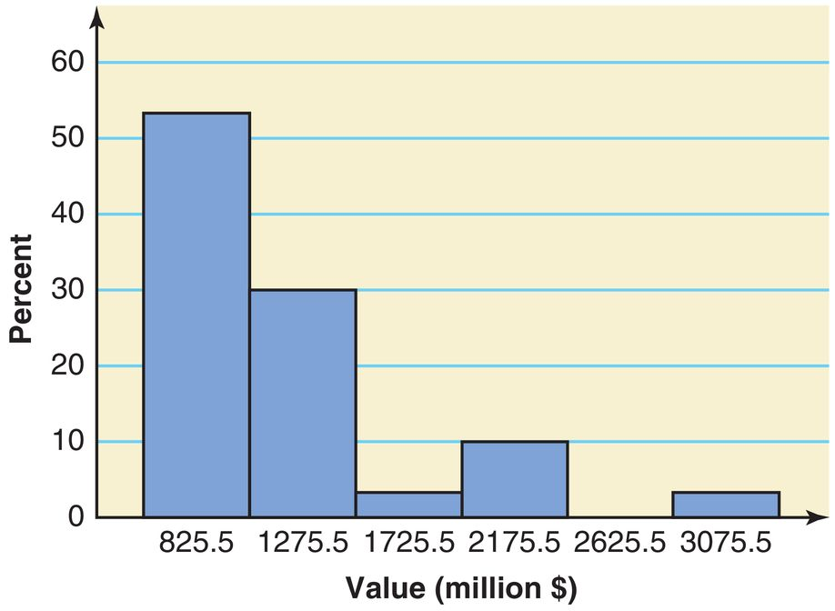
Histograms for Table 2.8
Frequency
Percentage
Note how the bars are labeled with the midpoints.
Alternatively, we can label using the intervals (as done on next slide);
Or the boundaries are labeled instead (as done by Rguroo).

Slide 27
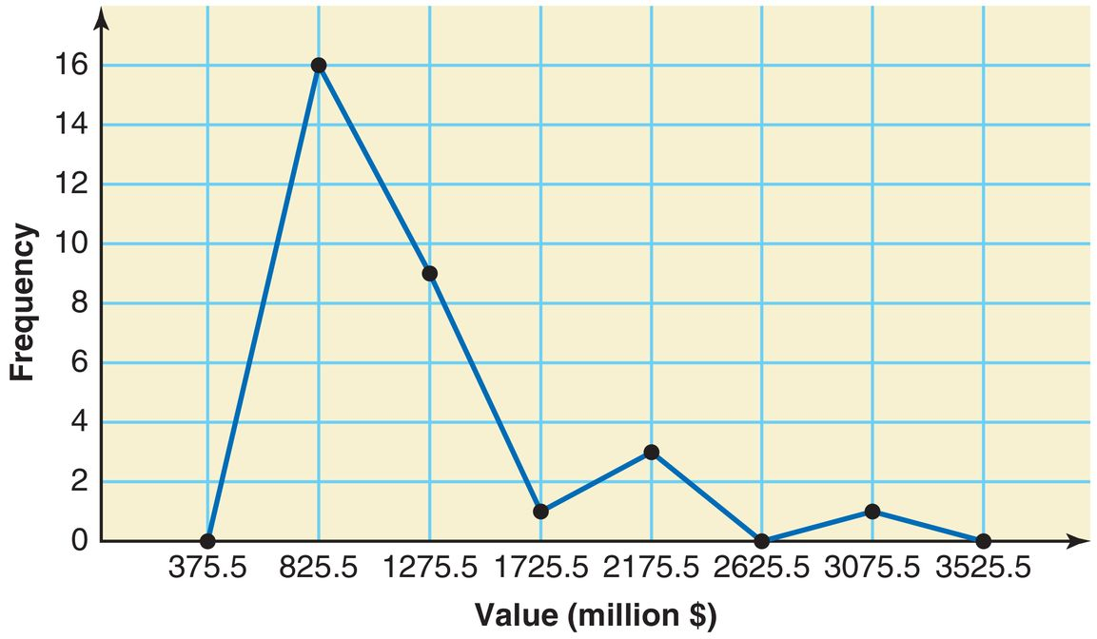
Graphing Grouped Data: polygon
A graph formed by joining the midpoints of the tops of successive bars in a histogram with straight lines is a polygon.
Figure 2.6 Frequency Polygon for Table 2.8
An empty bin has been added to each end so that the graph starts and ends on the x-axis.

Slide 28
Example 2-6
The administration in a large city wanted to know the distribution of vehicles owned by households in that city.
A sample of 40 randomly selected households from this city produced the following data on the number of vehicles owned:
5 | 1 | 1 | 2 | 0 | 1 | 1 | 2 | 1 | 1
1 | 3 | 3 | 0 | 2 | 5 | 1 | 2 | 3 | 4
2 | 1 | 2 | 2 | 1 | 2 | 2 | 1 | 1 | 1
4 | 2 | 1 | 1 | 2 | 1 | 1 | 4 | 1 | 3
Construct a frequency distribution table for these data using single-valued classes.

Slide 29
Example 2-6: Solution
Table 2.12 Frequency Distribution of Vehicles Owned
Vehicles Owned | Number of Households (f)
0 | 2
1 | 18
2 | 11
3 | 4
4 | 3
5 | 2
Blank | Summation of f = 40
The observations assume only six distinct values:
0, 1, 2, 3, 4 and 5.
Each of these six values is used as a class in the frequency distribution in Table 2.12.

Slide 30
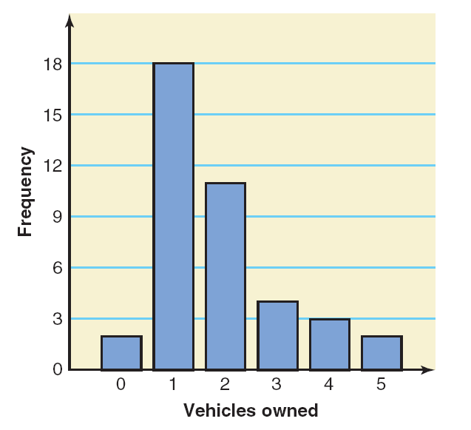
Figure 2.8 Bar Graph for Table 2.12
Since each bin represents a single outcome as opposed to a range of outcomes, we place gaps between the bars.

Slide 31
Cumulative Frequency Distributions
A cumulative frequency distribution gives the total # of values that fall below the upper boundary of each class.
Using Table 2.8, reproduced here, prepare a cumulative frequency distribution for the values of the baseball teams.
Value of a team (in million $) | # of Teams (f)
601–1050 | 16
1051–1500 | 9
1051–1950 | 1
1951–2400 | 3
2401–2850 | 0
2851–3300 | 1
Class Limits | Cumulative Frequency
601–1050 | 16
601–1500 | 16 + 9 = 25
601–1950 | 16 + 9 + 1 = 26
601–2400 | 16 + 9 + 1 + 3 = 29
601–2850 | 16 + 9 + 1 + 3 + 0 = 29
601–3300 | 16 + 9 +1 + 3 + 0 + 1 = 30

Slide 32
Cumulative Relative Frequency and Percentage
We can represent the cumulative distribution using Relative Frequency and Percentage:

Slide 33
Cumulative relative frequency and percentage distributions for the values of the baseball teams.
Class Limits | Cumulative Relative Frequency | Cumulative Percentage
601-1050 | 16 over 30 = .5333 | 53.33
601-1500 | 25 over 30 = .8333 | 83.33
601-1950 | 26 over 30 = .8667 | 86.67
601-2400 | 29 over 30 = .9667 | 96.67
601-2850 | 29 over 30 = .9667 | 96.67
601-3300 | 30 over 30 = 1.000 | 100.00
Note how the cumulative frequencies 16, 25, 26, 29, 29 and 30 appear as the numerators of the fractions in the middle column.

Slide 34
Some important Shapes of Histograms
Symmetric (about the center)
Skewed (right or left)
Uniform or Rectangular

Slide 35
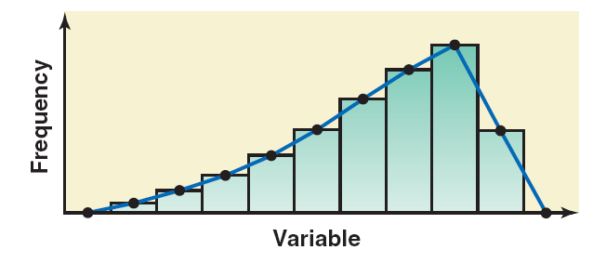
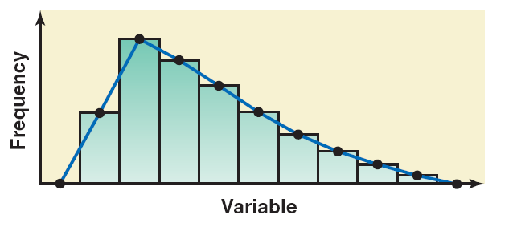
Symmetric
Left
Right

Slide 36
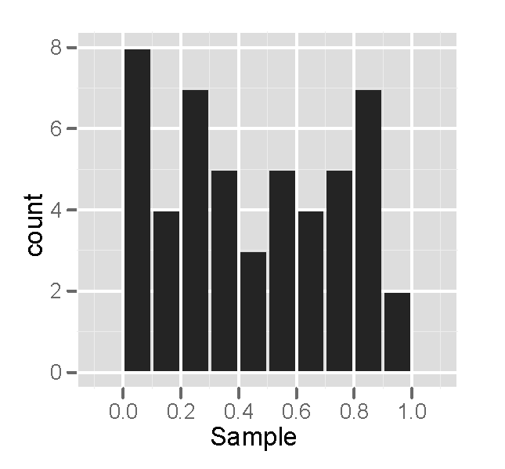
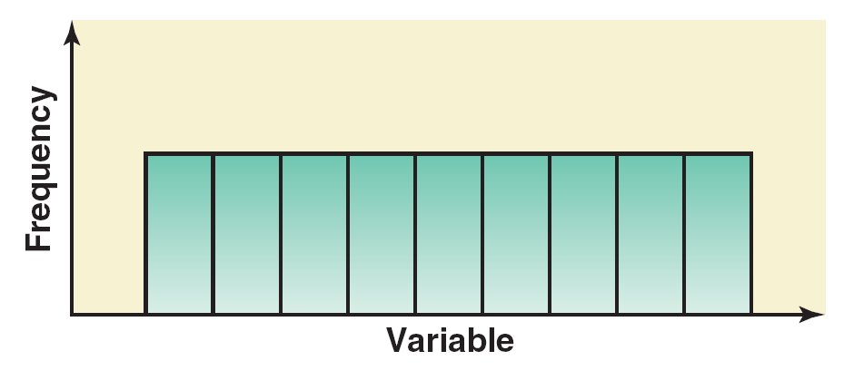
A Histogram for a Uniform Distribution
Theoretical;
In practice
The underlying distribution can be smooth, but a relatively small sample will appear jagged due to random variation.
For a concrete example, roll a die 50 times, make a tally and then graph results.

Slide 37
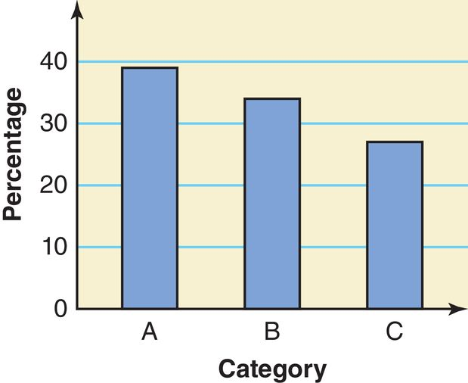
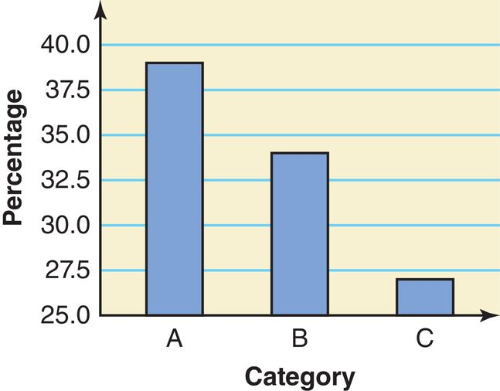
Bar Graph Truncation: considered poor practice!
without Truncation of the Vertical Axis
with Truncation of the Vertical Axis
Why do you think this is discouraged?

