Slide 1
Team 5 Case Studies

Slide 2
CASE STUDY PROPOSAL DEBORA TANNENBAUM – TEAM 5
Fence: tensioned wire and wood posts

Slide 3
Case study Proposal Jeffrey Rodriguez
Steel and Metal Wire Fence

Slide 4
Case Study proposal syndi wilkinson
Drainage

Slide 5
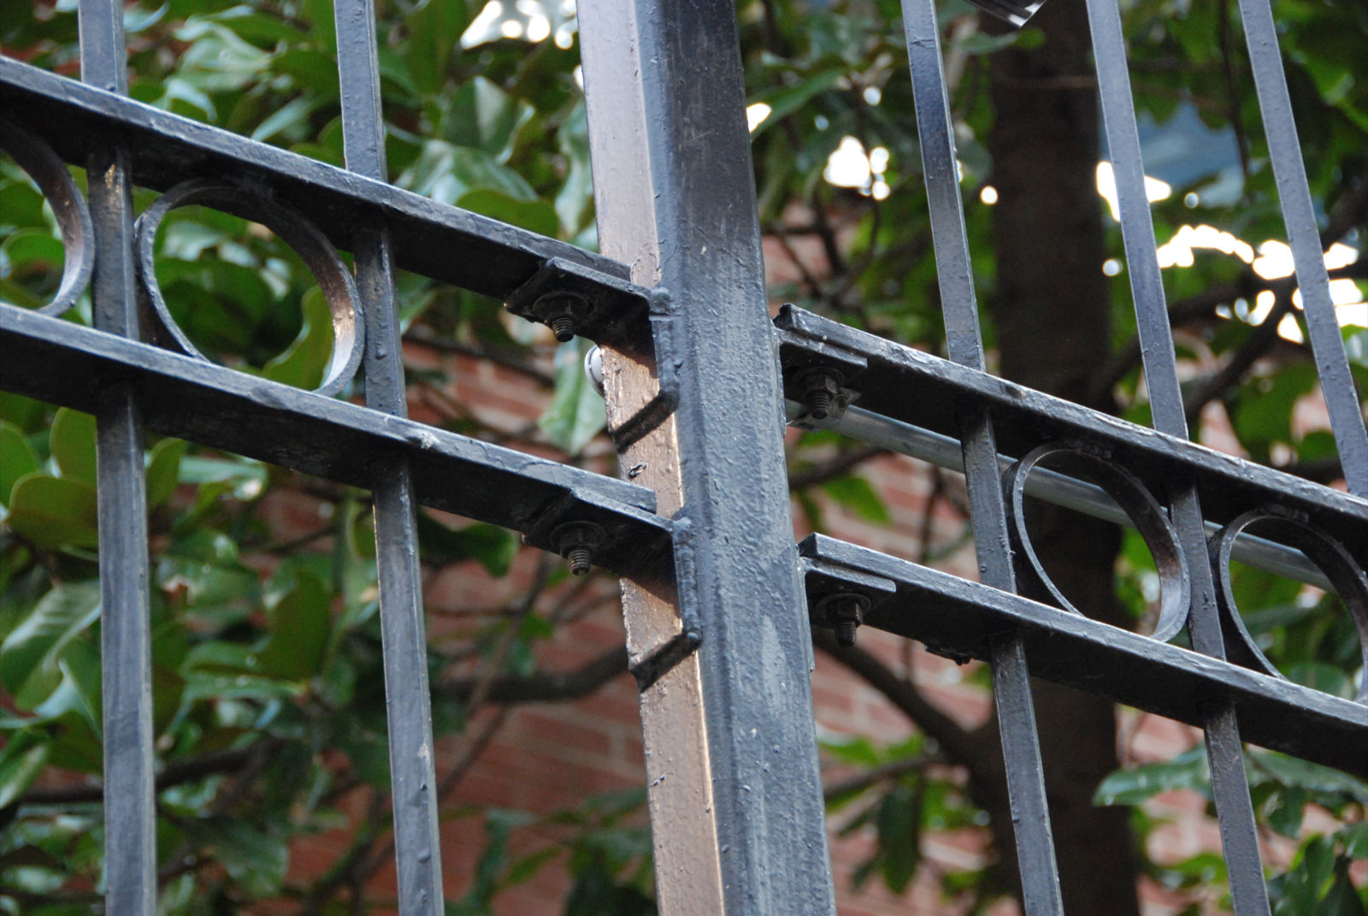
CASE STUDY PROPOSAL NITA VELASQUEZ

