Slide 1
Thyroid Diseases and Their Pharmacological Treatment
Hypothyroidism
Hyperthyroidism
Goiter
Hashimoto Thyroiditis
Graves’ Disease
Presented by
Janet Shor
and Lashana Jones
Den 2315 Fall 2012

Slide 2
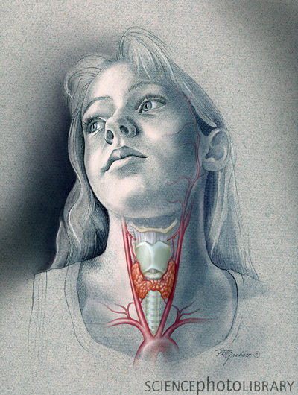
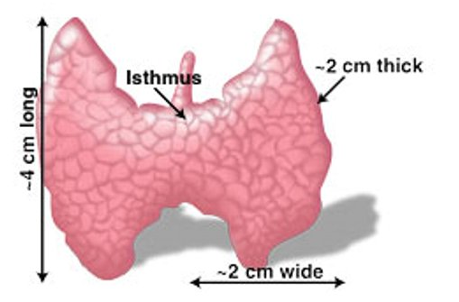
Thyroid Gland
Helps regulate the body’s temperature organs to
work properly
Produces a thyroid hormones
triiodothyronine (T3) and
thyroxine (T4), responsible
for the body’s metabolism
Normal thyroid gland
http://www.becomehealthynow.com/popups/thyroid_anatomy.htm
http://www.sciencephoto.com/media/316491/enlarge

Slide 3
What is Hypothyroidism?
Condition in which the thyroid gland does not produce enough of the thyroxine (T4) hormone.

Slide 4
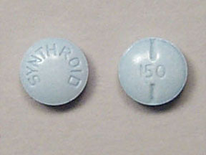
The most common medication to treat hypothyroidism is levonthyroxine.
Brand name Synthroid
No significant effect on dental treatment.
MOA: Synthetic hormone binding to the thyroid receptor proteins in the cell nucleus. It has metabolic effects that impact growth, development and metabolism.

Slide 5
Hyperthyroidism
The opposite of hypothyroidism is hyperthyroidism, in which the thyroid gland produces too much of its hormone.

Slide 6
Treated with radioactive iodine, surgery or anti-thyroid drugs
Surgery – part or whole gland may be removed
Anti-thyroid drugs : Methimazole, and Potassium Iodine
Metabolized in liver, excreted through the kidneys
MOA: The radioactive particles destroy the follicular cells of the thyroid

Slide 7
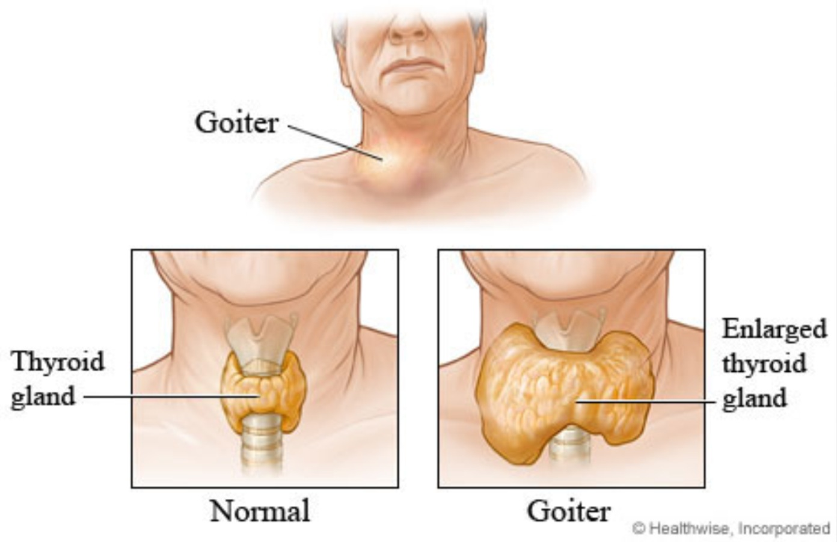
What Is a Goiter?
A goiter is an abnormal enlargement of the thyroid gland.

Slide 8
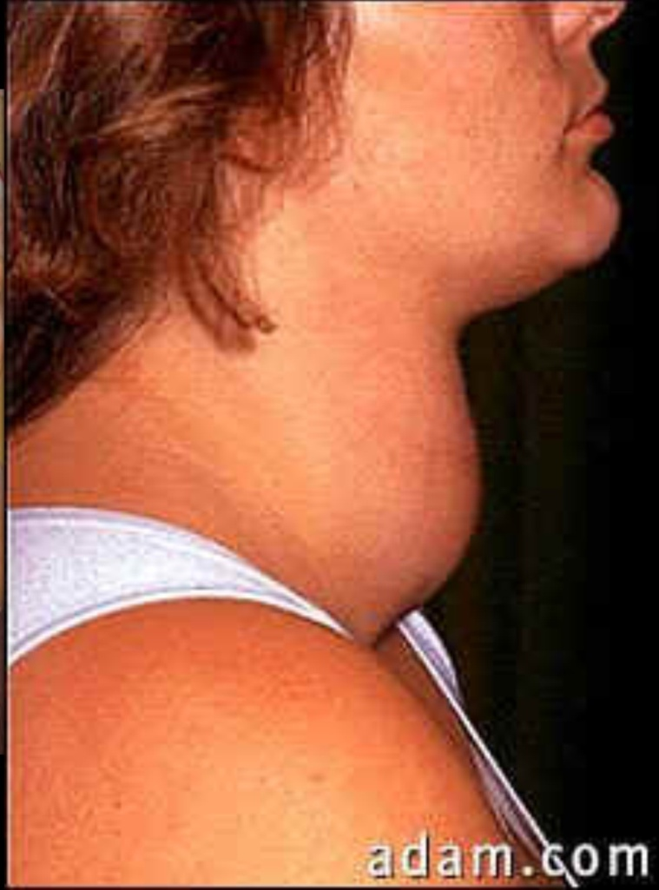
Causes of a Goiter
The most common cause of a goiter is iodine deficiency.

Slide 9
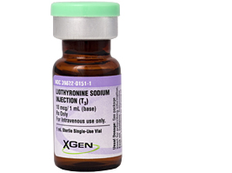
Medication for goiter is Synthroid
Used as a replacement or supplemental therapy in hypothyroidism and management of nontoxic goiter.
No significant effect on dental treatment.

Slide 10
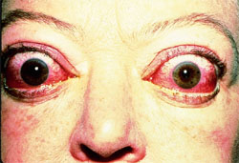
Hashimoto’s Thyroditis and Graves Disease
Body’s immune system attacks the thyroid gland
Graves’ Disease is caused by antibodies over-stimulating the thyroid (hyperthyroidism)
Whereas in Hashimoto’s Thyroiditis the antibodies cause inflammation of the gland, damaging cells often leads to an under active thyroid gland (hypothyroidism).
"inflammation of the eyes in Graves’ Disease"

Slide 11
Impact on Dental Hygiene Care
If on EO/IO you palpate an enlarged thyroid gland what do you suggest to your patient?
If your patient takes levonthyroxine what should you take to a consideration while planning the treatment?
What should you see if you suspect the person is suffering from Graves Disease?

Slide 12
Resources
C. Harold, M. Timothy, W. Richard, (2012). Drug Information, Handbook for Dentistry (18th edition). USA
Martini and Nath, (2009) , Fundamentals of anatomy and physiology (8th addition). USA
M. Mumtaz, L. Lin, K.Hui , A. Sharifuddin, M. Khir , (2007) Radioiodine I-131 For The Therapy Of Graves’ Disease
http://endo.endojournals.org/content/148/12/5724
http://www.ncbi.nlm.nih.gov/pubmedhealth/PMH0000686/
http://www.thyroid.org/what-is-hyperthyroidism
http://wichitafallsthyroiddoc.com/
http://www.bioline.org.br/request?mj09004
http://www.mayoclinic.com/health/hashimotos-disease/DS00567

