Slide 1
Diabetes Hypertension and Heart Disease in African Americans
LOUISE S. CHARLES
PROFESSOR COVERT
SOCIOLOGY OF URBAN POVERTY

Slide 2
Diabetes Hypertension and Heart Disease in African Americans
Diabetes, hypertension, and heart disease are just a few of the major health issues affecting people of the African diaspora particularly those living in underprivileged or impoverished neighborhoods. Racial disparities have affected modalities of care delivery, health maintenance, and disease management in patients with diabetes, hypertension, and heart disease among African-Americans. There is an increased prevalence in these diseases among black Americans as opposed to whites.

Slide 3
Diabetes Hypertension and Heart Disease in African Americans
There is a direct relationship between diabetes, hypertension and heart disease but the causes are complex:
High levels of blood glucose causes damage to nerves and blood vessels which can cause heart disease
Increased blood glucose levels in diabetics affects the inflammatory response of the lining of arteries and make them more susceptible to formation of atherosclerotic plaque
Increased blood viscosity in diabetics causes blood cells to clump together forming clots which can occlude the arteries supplying blood to the heart ultimately resulting in heart attacks

Slide 4
Diabetes Hypertension and Heart Disease in African Americans
Hypertension or high blood pressure is the most common cardiovascular disorder which results from too much force pushing blood against the arterial walls. This increased pressure damages the integrity of arteries causing heart disease.
Hypertension is a major cause of heart attacks
According to web md, in the united states alone, more than 30% of American adults have high blood pressure. Web md also states that high blood pressure is more likely in people who have a family history of high blood pressure, heart disease, or diabetes, are African Americans, are over weight, not physically active, and eat foods high in saturated fats or salt.

Slide 5
Diabetes Hypertension and Heart Disease in African Americans
According to the American heart association (aha), the prevalence of high blood pressure in African Americans is among the highest in the world.
the aha states that high blood pressure affects more than 40 percent of African Americans.
It also develops earlier in life in blacks as opposed to whites and is usually more severe
Because there is sometimes no symptoms, it is called the “silent killer”.
It is of paramount importance to have your blood pressure checked regularly in order to decrease the risk of developing further complications.

Slide 6
Diabetes Hypertension and Heart Disease in African Americans
The underprivileged are less likely to seek treatment as a result of their socio-economic status. Many of them have no health insurance and often use the emergency room as a substitute for the doctor’s office with the end result being no follow-up care. Often time there is knowledge deficit about the disease process and reluctance to seek out information for fear of embarrassment.

Slide 7
Diabetes Hypertension and Heart Disease in African Americans
According to Lekan, there are disparities occurring in many forms and at different levels of care. Upcoming research is giving more attention to environmental, social, and economic factors such as poverty, discrimination, and segregation which have contributed to stress and negative health outcomes in African American women.The sojourner Syndrome framework was developed by Mullings for a community based research program that examined the social components of health disparities among African American women. It was an attempt to explain the injustices and inequalities suffered by women. It was designed to further elaborate on the intermingling of race, class, and gender and their relationship with negative health outcomes.

Slide 8
Diabetes Hypertension and Heart Disease in African Americans
There are a lack of relevant and culturally proficient resources for African-Americans in under-served areas. Healthier food choices are often expensive and in limited supply. Supermarkets serving the underprivileged offer foods with high sodium and sugar content at cheaper prices. This negates a positive and healthy lifestyle thus enabling poorer disease management. Hospitals in poorer neighborhoods often lack vital resources necessary for the treatment of patients requiring emergent treatment for complications from heart attacks, hypertension, and diabetes. The life expectancy of the geriatric population has been increasing over the past decades and as such it is a struggle them to survive with these co-morbidities.

Slide 9
Diabetes Hypertension and Heart Disease in African Americans
Our nation’s healthcare system in still far off in finding solution towards elimination of racial disparities in treatment modalities and delivery of care for patients with diabetes, hypertension and cardiovascular disease.
The role of the registered nurse as educator and advocate is of paramount importance in guiding and enlightening clients about disease prevention and health maintenance.

Slide 10
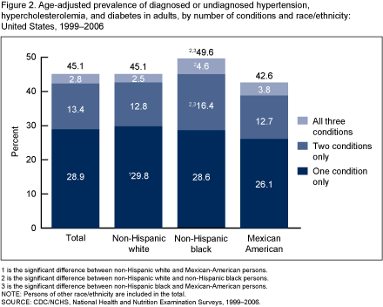
Diabetes Hypertension and Heart Disease in African Americans

Slide 11
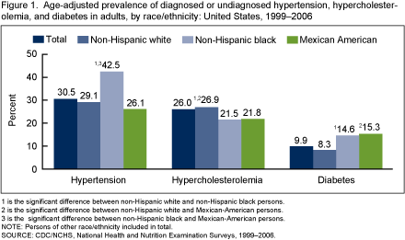
Diabetes Hypertension and Heart Disease in African Americans

Slide 12
Diabetes Hypertension and Heart Disease in African Americans
references
Elgie McFayden, J. (2009). Key Factors Influencing Health Disparities Among African-Americans. Race, Gender & Class, 120-132.
Michele Hesler, D. M. (Nov., 2003). Racial Disparities in Diabetes Care Processes, Outcomes, and Treatment Intensity. Medical Care, Vol. 41, No. 11, 1221-1232.
Morbidity and Mortality Weekly Report, V. 5. ((January 14, 2005), pp. 1-3). Health Disparities Experienced by Black or African Americans -United States . Center for Disease Control & Prevention (CDC).
http://www.cdc.gov/nchs/data/databriefs/db36.htm
http://www.heart.org/idc/groups/heart-public/@wcm/@hcm/documents/downloadable/ucm_300463.pdf
http://www.webmd.com/hypertension-high-blood-pressure/guide/understanding-high-blood-pressure-basics?page=5
http://www.scai.org/Print.aspx
Deborah Lekan, M. R. (2009). Sojourner Syndrome and Health Disparities in African American Women. Advances in Nursing Science, 307-321.

