Slide 1
Community Based Behavioral Health Home for Adolescent
Oasis Transitional Home
New York City College of Technology
Sarah Ycaza
Jason Nelson
Leon Antoine
Leadership and Management of Patient Care
NUR 3110
Professor Thomas
June 24, 2015

Slide 2


Oasis Transitional Home for Adolescence
Our mission is to provide a transitional home to equip adolescence with the tools they need to overcome significant behavioral mental health issues affecting their daily lives; until relocated to a supportive and nurturing environment.

Slide 3


Objectives
We strive to provide adolescence with the skills to successfully overcome mental and emotional issues.
Recognizing their daily challenges, we endeavor to equip our staff with the required skill set to reach their potential.
Upholding the view that children belong in a loving and supportive environment, we seek to provide them with the support and structure to thrive and develop successfully into adulthood.

Slide 4
Organizational Chart
CEO
Chief Psychiatric Officer
House Resident Manager (RN)
Business Manager/ Booker
House Keeper
Case Manager
RN/LPN
Dietary Worker
Driver
Group/ Activities Coordinator
Chaplin
Recreational Therapists
Crisis Support Team Workers(MHW)
Community Advisory Board
Security Officer

Slide 5
Meetings
Ad Hoc meeting:
addressing crisis debriefing and contingency planning would be held ad lib, as the need arises.
Standing Committees:
Team Leaders will meet weekly.
The Board of Stakeholders will hold quarterly meetings.
Family Council will meet weekly.
Am and PM Time Out Huddles will be planned.

Slide 6

Management Style
We recognize that the changing management challenges dictates the leadership style. However the predominant style of management would be democratic. This would foster:
ownership
Inclusiveness in decision making
Greater autonomy and cooperation
Reduce potential for conflict.

Slide 7
Capital Budget OTHA
Capital Budget | Annually $ | Annually Total $
Current Asset
Petty Cash |  | 12,000
Fixed Assets
Furniture and Fixtures |  | 50,000
Vehicles (vans) |  | 80,000
Equipment
Instruments | 12,000
Computers | 27,000
Appliances | 10,000
Total Asset |  | 191,000

Slide 8
OPERATIONAL BUDGET | Operational Expenses | Annual $ | Monthly $ | Weekly $ | Minimal Annual Variance $ | Maximum Annual Variance $
Management and Operations
Insurance: | Vehicle | 7,200.00 | 600.00 | 138.46 | 6,480.00 | 7,920.00
 | Personal Liability | 6,000.00 | 500.00 | 115.00 | 5,400.00 | 6,600.00
 | Employee Health | 12,000.00 | 1,000.00 | 230.77 | 10,800.00 | 13,200.00
 | Renters | 6,000.00 | 500.00 | 115.38 | 5,400.00 | 6,600.00
 | Telephone | 3,600.00 | 300.00 | 69.23 | 3,240.00 | 3,960.00
 | Office Stationary | 300.00 | 25.00 | 5.77 | 270.00 | 330.00
 | Postage | 120.00 | 10.00 | 2.31 | 108.00 | 132.00
 | Stationary | 2,400.00 | 200.00 | 46.15 | 2,160.00 | 2,640.00
Total |  | 37,620.00 | 3,135.00 | 723.46 | 33,858.00 | 41,382.00
Utilities | Water | 9,000.00 | 750.00 | 173.08 | 8,100.00 | 9,900.00
 | Light | 12,000.00 | 1,000.00 | 230.77 | 10,800.00 | 13,200.00
 | Gas | 24,000.00 | 2000.00 | 461.54 | 21,600.00 | 26,400.00
Total |  | 45,000.00 | 3750.00 | 865.38 | 40,500.00 | 49,500.00
In-service Training | Training and Promotional | 12,000.00 12,000.00 | 1,000.00 1,000.00 | 230.77 230.77 | 10,800.00 10,800.00 | 13,200.00 13,200.00
Total |  | 24,000.00 | 2,000.00 | 461.54 | 21,600.00 | 26,400.00

Slide 9
OPERATIONAL BUDGET Cont. | Operational Expenses | Annual $ | Monthly $ | Weekly $ | Minimal Annual Variance $ | Maximum Annual Variance $
Contract Services | Auditing | 3,000.00 |  | 3,000.00 | 2,700.00 | 3,300.00
 | Consultant | 30,00.00 | 2,500.00 | 576.92 | 27,000.00 | 33,000.00
 | Staff Training | 6,000.00 | 500.00 | 115.38 | 5,400.00 | 6,600.00
 | Laundry | 15,600.00 | 1,300.00 | 300.00 | 14,040.00 | 17,160.00
Total |  | 54,600.00 | 4,300.00 | 3,992.31 | 49,140.00 | 60,060.00
Client Consumables | Clothing | 12,000.00 | 1,000.00 | 230.77 | 10,800.00 | 13,200.00
 | Dietary Supplies | 150,000.00 | 12,500.00 | 2,884.62 | 135,000.00 | 165,000.00
 | Tutoring Services | 12,000.00 | 1,000.00 | 230.77 | 10,800.00 | 13,200.00
 | Books and Subscription | 5,250.00 | 437.50 | 100.96 | 4,725.00 | 5,775.00
 | Medical Supplies | 6,500.00 | 541.67 | 125.00 | 5,850.00 | 7,150.00
 | Entertainment/ Recreation | 15,600.00 | 1,300.00 | 300.00 | 14,040.00 | 17,160.00
 | Housekeeping Supplies | 6,000.00 | 500.00 | 115.38 | 5,400.00 | 6,600.00
Total |  | 207,350.00 | 17,279.17 | 3,987.50 | 186,615.00 | 228,085.00

Slide 10
OPERATIONAL BUDGET Cont. | Operational Expenses | Annual $ | Monthly $ | Weekly $ | Minimal Annual Variance $ | Maximum Annual Variance $
Equipment Expenses | Small Equipment Replacement | 300.00 | 25.00 | 5.77 | 270.00 | 330.00
 | General Maintenance | 3,000.00 | 250.00 | 57.69 | 2,700.00 | 3,300.00
Total |  | 3,300.00 | 275.00 | 63.46 | 2,970.00 | 3,630.00
Depreciation | Furniture and Fixtures | 5,000.00 | 416.67 | 96.15 | 4,500.00 | 5,500.00
 | Vehicles | 8,000.00 | 666.67 | 153.85 | 7,200.00 | 8,800.00
 | Computers | 2,700.00 | 225.00 | 51.92 | 2,430.00 | 2,970.00
 | Instruments | 1,200.00 | 100.00 | 23.08 | 1,080.00 | 1,320.00
Total | Appliances | 1,000.00 21,200.00 | 83.33 1,491.67 | 19.23 344.23 | 900.00 16,110.00 | 1,100.00 19,690.00
Total Expenses |  | 375,170.00 | 31,014.17 | 10,157.12 | 348,453.00 | 425,887.00

Slide 11
Personnel Budget: Salary
Salary Workers | Monthly $ | Annual Salary $ | Number of Employed | Annual Total $
CEO | 8,333.33 | 100,000.00 | 1 | 100,000.00
Business Manager/ Accountant | 5,833.33 | 70,000.00 | 1 | 70,000.00
Environmental Supervisor/Support Services | 5,833.33 | 70,000.00 | 1 | 70,000.00
Program Director Case Manager House Resident Manager | 6,250.00 6,250.00 6,250.00 | 75,000.00 75,000.00 75,000.00 | 3 | 225,000.00
Psychiatric Director | 7,500.00 | 90,000.00 | 1 | 90,000.00
Total Salaries |  |  |  | 555,000.00
Allowed Total Salaries and Wages |  |  |  | 1,966,080.00

Slide 12
Personnel Budget | Hourly $ | Weekly $ | Annually $ | Hired | Annual Total $
LPN | 23.00 | 920.00 | 47,840.00 | 3 | 143520.00
House Keeper | 15.00 | 600.00 | 31,200.00 | 1 | 31,200.00
Cook | 18.00 | 720.00 | 37,440.00 | 1 | 37,440
Driver | 15.00 | 600.00 | 31,200.00 | 1 | 31,200
Security | 15.00 | 600.00 | 31,200 | 2 | 62,400
Recreational Therapist | 23.00 | 920.00 | 47,840.00 | 3 | 143,520
Psychotherapist | 35.00 | 350.00 | 18,200.00 | 1 | 93,600.00
Mental Health Workers Total Wages | 15.00 | 600.00 | 31,200.00 | 3 | 63,600.00 561,080

Slide 13
Income and Expenditure Statement
Income
Medicaid
Donations
Others
Expenditure/Expenses
Operational Expenses $375,170.00
Expenditure (fixed assets) $179,000.00
Salaries and Wages $1,116,080.00
Projected Expenditure Year 1 $1,670,250.00
Real Base Pricing

Slide 15
OTHA Funds Flow Statement
Income Statement
Income: |  | Minimum Occupancy | Monthly Income | Maximum Occupancy
 | Medicaid | $331,200.00 |  | $496,800.00
 | Donations/Grants | $94,687.00 |  | $70,913.00
 |  |  | Annual Income
 | Medicaid | 3,974,400.00 |  | 5,961,600.00
 | Donations/Grants | 1,136,244.00 |  | 850,956.00

Slide 16
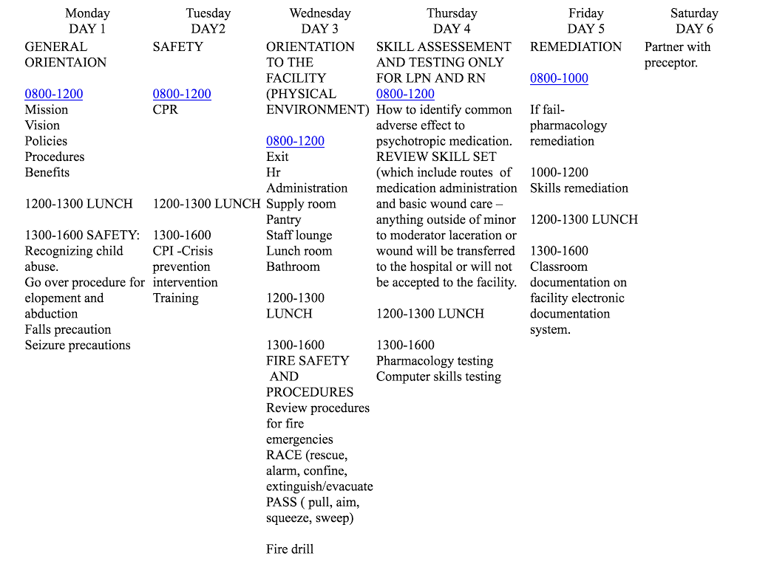
Oasis Transitional Home
New Staff Orientation

Slide 17
Current Staff:
Development and Training
Continuous retraining
In-service
Workshop
Conference
Re-evaluation of competency and skills every six months
Provide employee with the option of tuition reimbursement for job related studies with a two year contract.

Slide 18

Management Theory for Employee Evaluation
Human relation theory- emphasizes a need for team work, support and effective staff relationships.
It states that productivity is directly related to relationships.
Employees will be encouraged and motivated to feel that their role is significant; and if their role is significant they will be more inclined to do it which then increases output.

Slide 19

Data for Evaluation Tool
Attendance- showing up for assigned shift, punctuality, tardiness, attending mandatory meetings
General performance- complete tasks on time, stress level, universal protocol, infection control, patient safety, review records for previous disciplinary actions against employee
Documentation- Completeness and accuracy
Medication administration- time of administration, 1 hour before and 1 hour after, competency (did the RN document refusal of medication? Why did the patient refuse the medication? What did the nurse do to convince client to take medication?)
Professional growth- improvement of competency from initial employment, perusing higher education, and certifications

Slide 20
Data for Evaluation Tool cont.
Interaction/communication with each other, clients, and management- effective communication with peers, conflict and conflict resolution, safe practice and effective teaching
Client satisfaction- ensuring positive client feedback
Debrief after evaluation- to commend on areas of strength and correct or prevent areas of weakness.

Slide 21
Data Will be Gathered by:
Random or scheduled observation - to collect data on general performance, professional growth, interaction/communication with each other, clients, and management
Peer evaluation - to provide a more accurate analysis of each others’ work
Individual self assessment- to have employee evaluate their own performance, strengths, weaknesses, stress level and factors influencing possible lack of performance.
Interview employees- this provides direct feedback, open dialogue that allows us to come up with an individualized action plan.
Checking attendance logs for time in and time out and missed shifts
Analyze patient satisfaction surveys to evaluate patient satisfaction

Slide 22
Overcoming Resistance to Cross-training
To overcome resistance to cross training and unit transfer we would use the Rational-empirical approach.
Education is the key.
This approach uses knowledge to encourage change. Once workers understand the merits of change for the organization or understand the meaning of the change to them as individuals and the organization as a whole, they will change.
This approach stresses training and communication

Slide 23
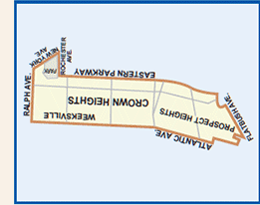
Brooklyn Community District 8
Crown Heights
One of the fastest growing neighborhood and remains one of the most populated according to land mass (1.6 sq. mi.)
Economic and culturally diverse community
There is a growing need for mental health services among children and adolescence
Concerns: treatment and counselling for bereavement issues, societal stress, low self esteem, sexual abuse recovery, depression, anger problem and newly diagnoses of mental illness.

Slide 24
Crown Heights:
Total Population 97,317
Ages 10-19 12,522
Challenges of the Community
High poverty rate among minorities
Foreign born residents
Unemployment
Overcrowded schools
Lack of medical services and hospital coverage
Large scale development projects: racial make-up is bound to rapidly change

Slide 25
Community Outreach
Marketing data and analysis begins with the analysis of potential needs, wants and beliefs, problems, concerns and behaviors.
Community assessment helps to uncover not only needs and resources, but the underlying culture and social structure that will help to address the community's needs and utilize its resources
The emphasis is not on profit making but on service delivery.
Promote services to schools, hospitals, shelters and other residential housing services in the community.
Communication within the community to verify effective services.
Influence the community’s perception of health and mental illness and facilitate behavioral changes.
Reassure that services are extended, accessible and accommodating to all.

Slide 26

Gathering Data
General survey of the population: emphasis on needs, concerns and utilization of mental health services
Dispatching detailed and highly customized questionnaires via mail, email or door to door approach.
Interviews with community board, local government, public health officials and community activists.
Attend and participate community district meeting.
Research: SAMHSA, NBHQF, CMS, Geographic Information Systems, Public Health Records and Archived Data

Slide 27
Environmental Forces
External Environmental Forces
Internal Environmental Forces
Competition
Healthcare Trends
Economic Factor
Educational/Knowledge/Media
Social Factors
Provider/Employee Job Satisfaction
Attitudes, Beliefs and Core Values
Financial Resources
The Work Environment/Stressors
Education

Slide 28

Quality Indicators
Quality indicators support accountability for funding, delivery, effectiveness, and improvement of adolescent mental health services.
Prevalent indicators of events e.g. self harm, harm to others
Appropriateness of medication use
Client occurrence of falls with or without injury
Psychiatric physical/sexual assault rate
Restraints Prevalence
Monitoring: Monthly
Reporting: Quarterly

Slide 29
Stakeholders:
Client
Providers
Payer (Insurance)
Community
Legislators and Regulatory Bodies

Slide 30
We conducting stakeholders assessments to better understand the broader needs, concerns and how well our service is received.
Client: Services to offer a wide variety of options for mental health coverage that can be customized to their specific needs. They want the organization to fund the majority of the cost to health insurance
Providers: Want to provide the best service using the most accurate and newest technology.
Payer: Want services and providers to follow a clear, evidenced based, diagnostic plan and reach accurate diagnoses and treatment plan.
Community: The reputation of a credible up to date service that is resourceful and enhances the development of the community.
Legislators and Regulatory Bodies: Involved in making care more cost effective because some may believe that the tariff of healthcare do not match the cost of providing services

Slide 31
Computerized Services
There is an increase demand for integration of technology, interactive software, and computerized system to manage the information of a booming healthcare industry. Federal government has now mandated computerized patient records.
Stakeholders are reassured that the new computerized service will provide greater flexibility, easy access to pertinent information e.g. medical history, discharge plans, medication regimen etc.
A computerized residential facility is cost effective: reduces transcript cost, eliminate hand written notes, save on stationary supplies.
May lower the number of malpractice claims as a result of improvement through documentation that fosters effective client care handling, precludes the likelihood of medication errors.
Provide promise for real time point of care information. Timely data analysis of client’s history and conditions are readily accessible via computers providing a quick yet prudent cost effective approach to budget tracking, securing patient outcome and privacy.
The Health Management technologist is responsible for the explanation of EHR features.
Rooms that were used for filing and paper storage are redesigned as server rooms and WIFI access points.
A downtime box will be available in the event of an emergency.

Slide 32
Request for Proposal Contents
Official Proposal Request.doc
Overview of Oasis Transitional Home for Adolescence.
Scope of Project
Statement of Purpose
Milestones
Submission Instructions
Compilation Instructions
Vendor Information
Functional System Requirements
Pricing/Preparation Cost
Terms and Condition
Acceptance or Rejection
Contract Provisions

Slide 33

Nurse Manager’s Responsibilities : Ethical
Moral thinking and ethical awareness are aspects of competent nursing.
Ethical responsibilities are not only to the client but also to the nursing staff.
Warrant and facilitate a safe and ethical working environment in which quality care can be given to the client.
Treat with dignity and respect; ensure veracity and trust.
Advocacy
Gain competence in ethics and law.
Organize meetings allowing a collaborative approach to ethical decision making

Slide 34
Nurse Manager’s Responsibilities: Financial
Have a basic understanding of how revenue flow into and out of the organization.
Develop a practical annual budget for the unit inclusive of volume revenue, personnel, supplies and capital environment.
Monthly reports of budgetary variances and review end of year data with finance personnel.
Ensure proper efficient operations and monitor trends regarding staff, material and supply usage.
Communicate economic management expectations and outcomes to staff and stakeholders.

Slide 35
Sample Revenue Cycle:
Client Admitted
Client Receives services and third party payer is billed for services
Payment collected and contractual allowanced deducted
Pay for employee salaries, supplies and medications
Treat more clients

Slide 36
Nurse Manager’s Responsibilities: Legal
Liability exists due to his/her role as a Nurse Manager.
Overall duty is to prevent injury to the client.
Supervision must be constant, active and consistent with Nurse Manager’s standard of care and practice.
Develop and implement client care policies and procedures consistent with standards of practice.
Keep pace with current advances in care and technology as well as regulatory and legal requirements.

Slide 37
Nurse Manager’s Responsibilities: Political
Develop an understanding, along with knowledge of the policy-making process: laws and health policy, and the political forces that governs it.
Translate and promote organizational goals to frontline staff and remove barriers that could hinder performance.
Establish collaborative relationships with policy makers and administration to advocate: client, staff and unit needs.
Demonstrate professional competence and accountability.
Exercise power appropriately.

Slide 38

Nurse Manager’s Responsibilities: Professional
Supervising:
Command Central
Making assignments
Set schedules
Disciplinary Action
Mentoring/Coaching
Feedback and support
Offer insight and expertise
Staff educational, professional and development growth
Conflict Management
Set the stage and expectations for excellence, explaining and outlining guidelines
Defusing conflicts before it harms the team and hinder client care

Slide 39
Nurse Manager’s Responsibilities: Professional
Work Environment
Ensure well functioning wok environment
Communication
Ensuring a two way flow of communication between staff and upper management
Role Model
Continue with own professional development through attendance at seminars, participate in continuing education courses, obtain additional degrees/certifications and establish networking contacts with other nurse managers for personal and professional support.

Slide 40
References
Brooklyn Community District 8 - New York City Department of City Planning. (2014). Retrieved June 18, 2015, from http://www.nyc.gov/html/dcp/html/neigh_info/bk08_info.shtml
Brent, N. (2013). What is a Nurse Manager’s Liability for Patient Care? Retrieved June 23, 2015, from http://www.cphins.com/blog/post/what-is-a-nurse-managers-liability-for-patient-care
Carroll, P. (2006). Nursing Leadership and Management A Practical Guide. Clifton Park, New York: Thomson Delmar Learning.
Cole, G., David, H., & Nilka, R. (n.d.). Internal and External Factors that Encourage or Discourage Health-Relevant Behaviors. Centers for Disease Control and Prevention. Retrieved June 6, 2015, from http://www.orau.gov/cdcynergy/soc2web/Content/activeinformation/resources/Health_Behavior_Factors.pdf
Curran, C., & Totten, M. (2010). Mission, Strategy, and Stakeholders. Nursing Economics, 28(2), 116-8. Retrieved June 8, 2015, from Medscape.
Marquis, B., & Huston, C. (2012). Leadership and Management Tools for the New Nurse: A Case study Approach (7th ed.). Philadelphia: Wolters Kluwer Health/Lippincott Williams & Wilkins.
Montalvo, I. (2007). The National Database of Nursing Quality Indicators (NDNQI). OJIN: The Online Journal of Issues in Nursing, 12(3). Retrieved June 6, 2015, from http://www.nursingworld.org/MainMenuCategories/ANAMarketplace/ANAPeriodicals/OJIN/TableofContents/Volume122007/No3Sept07/NursingQualityIndicators.aspx
Mosadeghrad, A. (2014). Factors Influencing Healthcare Service Quality. IJHPM: International Journal of Health Policy and Management, 3(2), 77-89. doi:10.15171/ijhpm.2014.65
National Behavioral Health Quality Framework. (2014, October 30). Retrieved June 18, 2015, from http://www.samhsa.gov/data/national-behavioral-health-quality-framework
Toren, O., & Wagner, N. (2010). Applying an Ethical Decision-making Tool to a Nurse Management Dilemma. Nurse Ethics, 17(3), 393-402. Retrieved June 20, 2015, from PubMed.
Waxman, K. (2008). Leadership Dimensions and Processes. A Practical Guide to Finance and Budgeting: Skills for Nurse Managers (2nd ed., pp. 1-9). Danvers, MA: HCPro.

