Slide 1
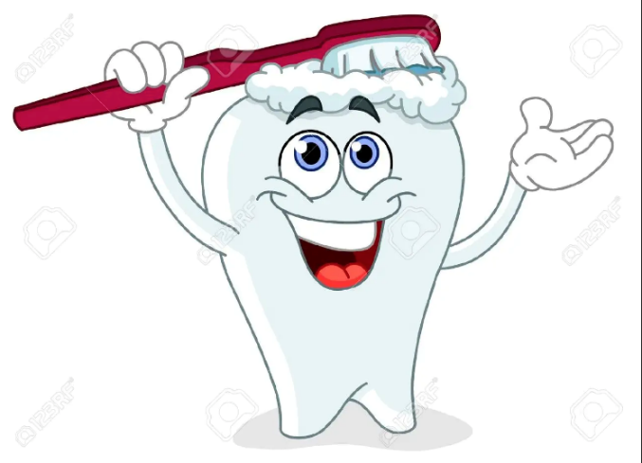
Toothbrushing

Slide 2
What is a dental plaque?

Slide 3
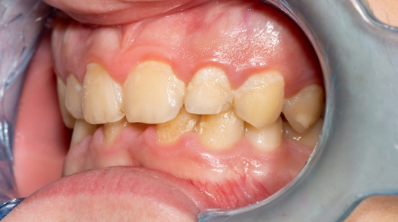
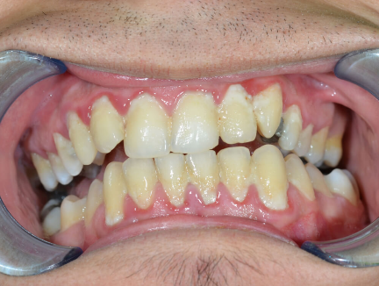

Slide 4
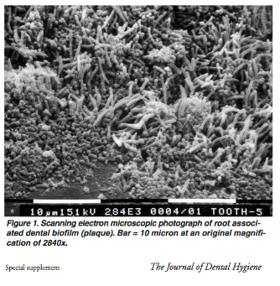
Dental Plaque
Is a sticky film that continuously forms from a combination of saliva, food and fluids as well as the bacteria deposits those substances create.

Slide 5
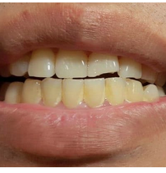
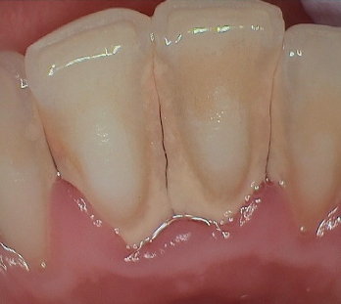
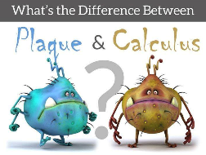
Plaque vs Calculus What’s th difference?

Slide 6
What is gingival inflammation?

Slide 7
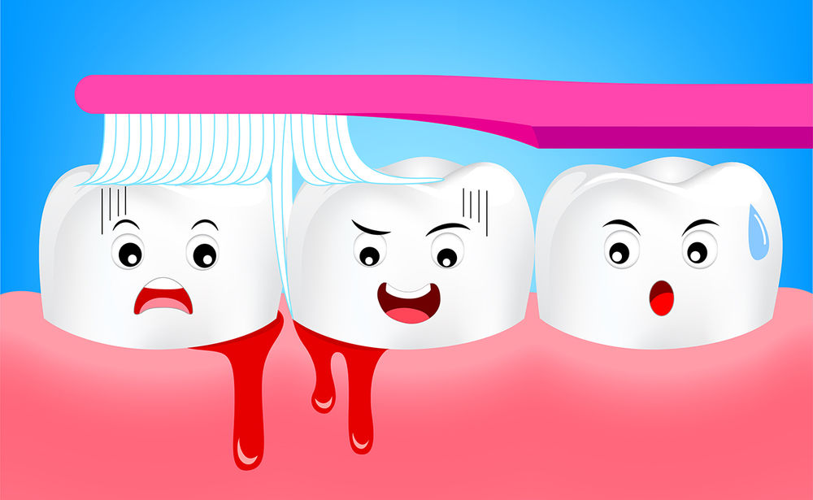
Gingival inflammation known as “Gingivitis” occurs when substances derived from microbial plaque accumulate at the gum line or beneath it. Healthy gums are pink and firm. If your gums become red, puffy/swollen, or blood starts appearing in the sink when you’re brushing your teeth, chances are that you have gingivitis. These are all signs that proper oral care is needed.

Slide 8
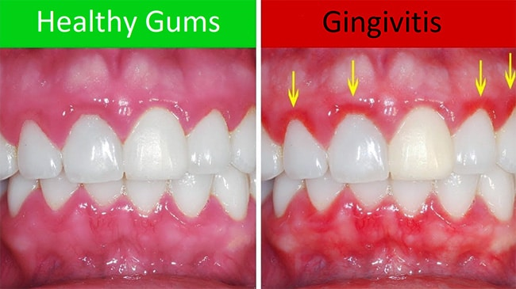
Common as it may seem to be, it’s never natural to see bleeding gums when brushing or flossing. You may think that you’re just brushing too hard, but frequent gum bleeding is a likely sign that you have gingivitis. As plaque and tartar stay on your teeth, the gingiva becomes more irritated, causing your gums to become swollen, red, inflamed. These conditions cause gums to bleed easily, especially while brushing or flossing. According to the ADA, bleeding gums caused by gingivitis are completely reversible. Brushing twice daily, flossing, and using an oral rinse, are important steps to help stop bleeding gums and reverse gingivitis.

Slide 9
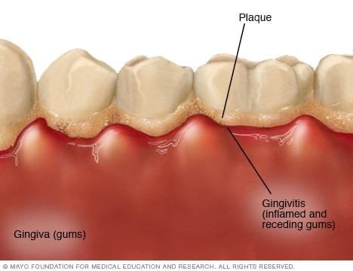
If the conditions in the mouth aren’t addressed, the symptoms of gingivitis may get worse and progress to periodontitis. Pain when chewing, sensitivity to hot and cold, receding gums, and loose teeth are all signs of more advanced gum disease like moderate or advanced periodontitis.

Slide 10
Why do we want to reduce Gingivitis?
- Gingivitis, if left untreated results in a more serious form of gum disease. This is called periodontitis and it’s defined as chronic inflammation that causes the destruction of bone and supporting tissues surrounding your teeth, which can eventually lead to tooth loss.
- Tooth loss is NOT an inevitable part of aging, but it is up to us and how well we manage and maintain our oral health.
- Dental plaque is a major risk factor for developing gum disease. Both Gingivitis and Periodontitis caused by plaque buildup is preventable.
- Chronic inflammation of the gums can lead to other health complications if it’s not addressed early on.

Slide 11
Mouth-Body Connection
- Gum disease associated with inflammation has been proven to worsen or increase the risk of developing other health complications.
- The mouth is the gateway to the body- an unhealthy mouth contains “bad” bacteria which can enter the blood stream, where the bacteria can spread and cause disease in other parts of the body.

Slide 12
Mouth-Body Connection Continued
Gum disease is a risk factor in itself for increasing the chance and severity of health problems including heart disease, heart attack, high blood pressure, stroke, diabetes, Alzheimer's, dementia and even infertility.
- Oral health and overall health are one in the same- improving gum health can have a positive impact on overall health and wellness.

Slide 13
The Oral Microbiome
The oral microbiome is a community of micro-organisms that are found in the mouth.
Every time you eat or drink, it directly impacts the oral microbiome.
Again, if you brush incorrectly or not enough, your allowing food to stay on the teeth, and over time the oral microbiome may be introduced to new and harmful bacteria thus making it imbalanced.
Proper brushing will stop harmful bacteria from proliferating and potentially causing gingivitis.
This same bacteria enters the body.

Slide 14
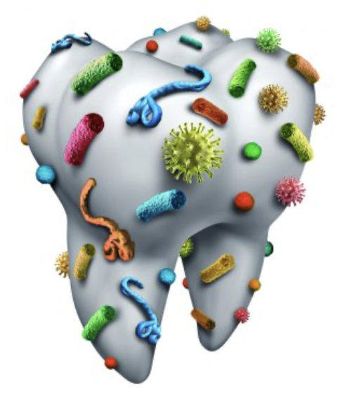
How the Immune System Plays a Role
Without proper brushing to remove plaque, our immune system is triggered to respond (inflammation). This is the immune system trying to kill off the disease-causing bacteria.
The immune system can only work so hard- if the available immune cells like antibodies and WBC’s are fighting off a bacterial infection in the mouth, there will be fewer cells to fight infections through out the rest of the body.
The bacteria associated with gingivitis and inflammation will likely weaken the overall immune response, and the body will likely have a harder time protecting you from certain other viruses and bacteria.

Slide 15
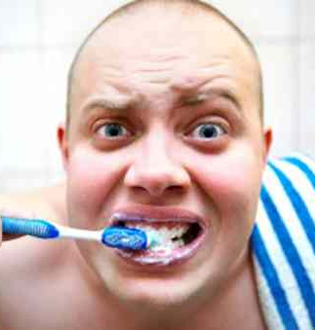
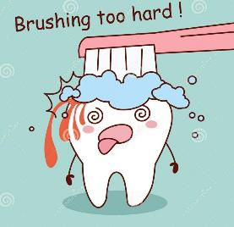
Common mistakes of toothbrushing
Not brushing along the gums ⇒ gums inflammation, caries, tartar build – up.
Brushing teeth less than 2 min ⇒ not enough time to clean all teeth.
Skipping brushing, brushing once a day ⇒ bacteria layer is hardening.
Brushing toot aggressively ⇒ wearing of enamel.

Slide 16
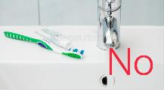
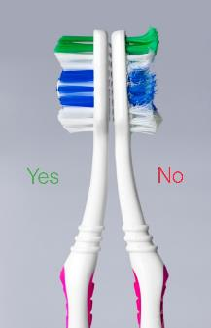
Common mistakes of toothbrushing
Storing toothbrush laying down ⇒ bacteria accumulation.
Not changing toothbrush often ⇒ bacteria accumulation.
Using medium or hard toothbrush ⇒wearing of enamel.
Brushing right after acidic food or vomiting ⇒ wearing of enamel.

Slide 17
Modified Bass Teeth-brushing Technique

Slide 18
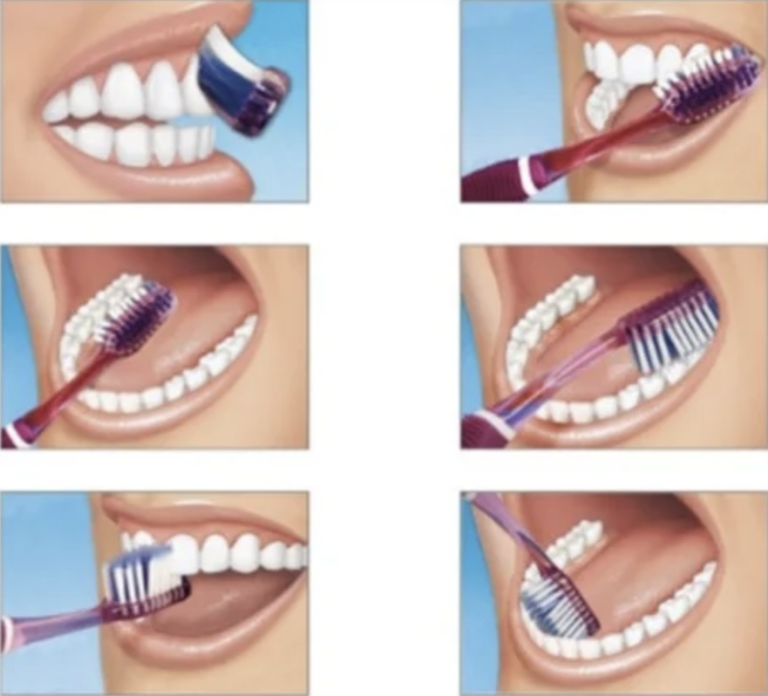
This method is effective for removing plaque at the gingival margins and controlling plaque that leads to periodontal disease and dental caries.
This technique is recommended by the most dental Associations worldwide and performed by:
Place you toothbrush at a 45-degree angle to your gum line.
Brush 2 teeth at a time using gentle wiping strokes 5 - 10 times.
Brush each tooth well and at the end sweep bristles out the gum line.
Move your toothbrush ahead to one tooth and repeat.
Don’t forget to brush all of your teeth and all surfaces in this way - including the outer, inner and top surfaces of all teeth.

Slide 19
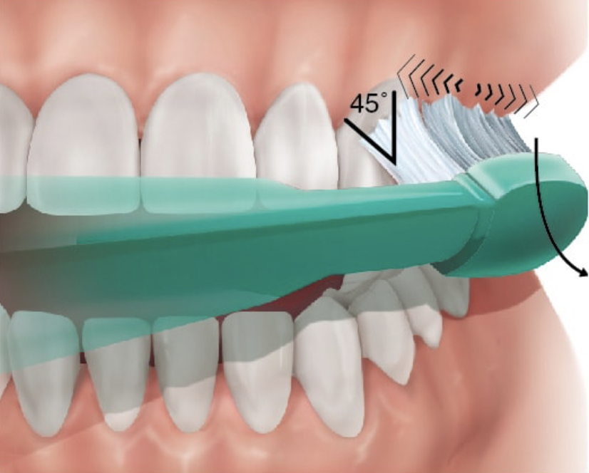
Advantages:
Effective method of removing plaque from the tooth surface and from the sulcus;
Good interproximal and gingival cleaning;
Good gingival stimulation. Your gums will stop bleed after a week of using this technique correctly;
Easy to learn.
Indication:
Routine home oral hygiene measure.
Intrasulcular cleaning.
Disadvantages:
Overzealous brushing may convert very short strokes into scrub technique and cause injury to the gingival margin.
Will need some time to adapt brain and hand to the new toothbrushing method.

Slide 20
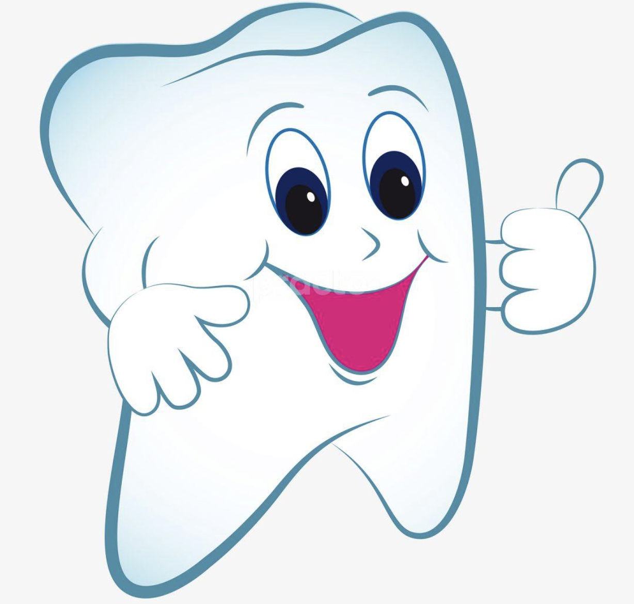
Do not forget:
Timing is everything. Brush your teeth for 2 min to complete. Not brushing for a long enough as bad as no brushing at all.
Brush 2x/day. Brushing once a day allows for plaque build up to occur leaving your mouth susceptible to disease and for problems like bad breath to occur.
Flossing is as important as brushing and should not be forgotten. Flossing can help remove food particles and other debris trapped between the teeth and in the gums that cannot be removed by simply brushing.
Avoid eating too many sugary foods or drinking too many sugary drinks. These types of foods can promote bacteria growth in your mouth and cause plaque decay as well.

