Slide 1
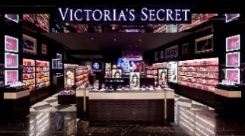
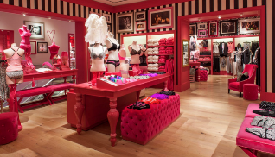
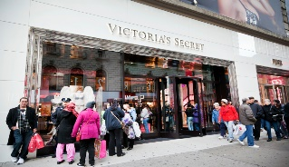
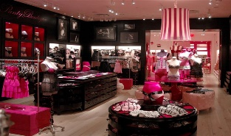
Kelly Valladares

Slide 2
Table of Contents
History
Target Market
SWOT analysis
Omni channel analysis
Recommendations
Conclusion

Slide 3
History
L Brands
L Brands was found in 1963 by Leslie Wexner
VS
Wexner turned lingerie into a necessity
VS
Acquired Victoria’s Secret in 1982
First established in 1977 by Roy Raymond
Targeted towards men
Top leading lingerie retailer in 80 countries
1995 first fashion show in New York

Slide 4
Target Market
Working middle class women
Middle income – makes between 40,500 and $122,000
Has the Victoria’s Secret Angel card
Confident, sexy, sophisticated, fashion foward
Figure 1. Elsa Hosk

Slide 5
SWOT Analysis
Strengths
Skilled associates through training
Large customer base
International brand presence
Weaknesses
Limited size selection
High attrition rate in workforce
Limited product range
Opportunities
Opening up new markets
due to government agreement
Growing online presence
Related Diversification
Threats
High competitive environment
Currency fluctuations
Changing consumer buying behavior

Slide 6
Omni Channel Analysis
Direct Marketing Electronic Retailing
-Direct Mail -Website
-Commercials -Mobile App

Slide 7
Recommendations
Be more inclusive to their target market to represent company values
Update in technology and remodel website
Bring swim line back
Use money from Henri Bendel’s closing to fully support the company
For Business Inquiries please contact KellyValladares@BUSanalyst.com

