Slide 1
Drugs, and violent crimes of African Americans living in NYC
By Kevin Ruiz

Slide 2
My Topic
My topic is about drugs, and violent crimes of African Americans living in NYC. Being part of the NYPD is my future goal, that’s why I picked my topic on this. I’ve notice in the streets that African Americans are getting pulled, and officers disrespecting their right.

Slide 3
Violent Crime in NYC
the NYPD has been taking statistics of violent crimes in NYC of African Americans. They arrested 223 African Americans In the first half of 2013, most of the arrest were for shooting. Whites, and Hispanics were the least arrested in the first half of 2013. The NYPD has made a primary target on blacks, because of the increase of their arresting.

Slide 4
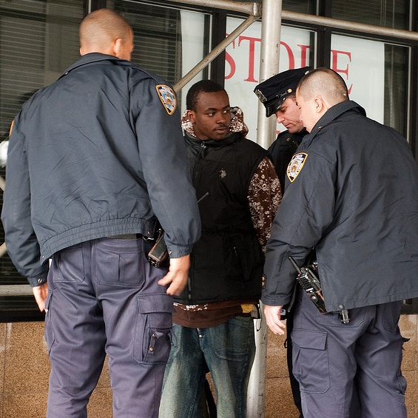
Officers arresting an African American

Slide 5
Drugs In NYC
Africans Americans were considered to have the most arrest in new York city, however whites had
The most arrest of drugs in 2013. Hispanic, and African Americans had the least arrest for drugs, they had 40%,
And Whites had 60%. The police commissioner Raymond Kelly made a bad statement about African
Americans, he said “ I want the NYPD to check on African Americans In buses, Subways, & etc”
People are saying its unfair, he should do the same to whites, and Hispanics not only on African Americans

Slide 6
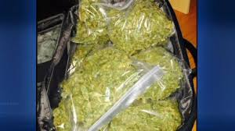
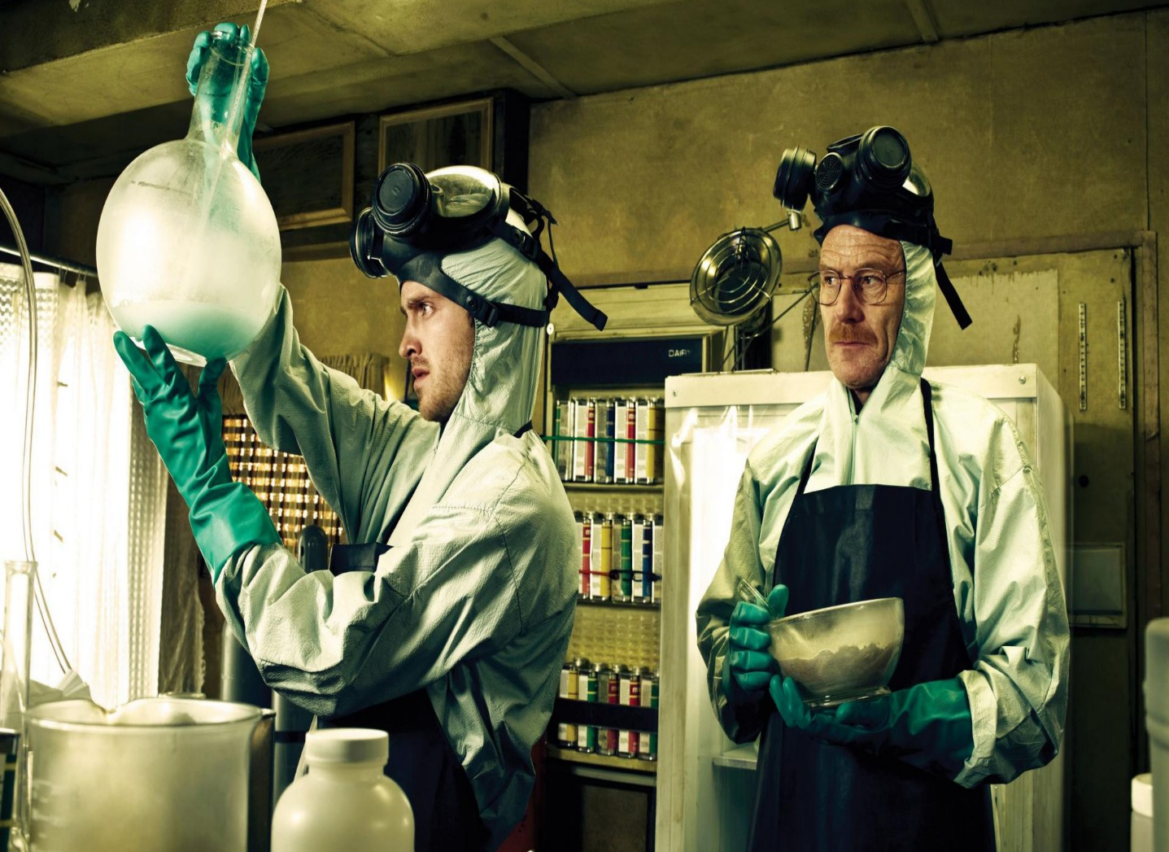
Drugs that were found in NYC

Slide 7
Bibliography
“Race matters” May 23 2013 article http://bossip.com/777917/race-matters-nypd-data-shows-white-people-are-more-likely-to-carry-drugs-and-guns-than-blacks-and-latinos/
“NYC commissioner insinuates African Americans” May 2 2013 ttp://www.blackbluedog.com/2013/05/news/nyc-police-commissioner-insinuates-more-african-americans-should-be-stopped-and-frisked/
NYPD Uncovers alarming African American crime statistics http://reagancoalition.com/articles/2013/nypd-statistics-show-gun-crime-most-heavily-linked-to-black-people.html

