Slide 1

Diet Soda and Diabetes
Jolanta Moscicki
Karolina Maksymiuk
Cathy Chen
Veronica Garcia

Slide 2

Introduction
As Americans become knowledgeable about the effects sugar has in our body , more are consuming diet sweetener beverages. But now studies have shown that both regular sugar and diet drinks increase risk of developing diabetes.

Slide 3
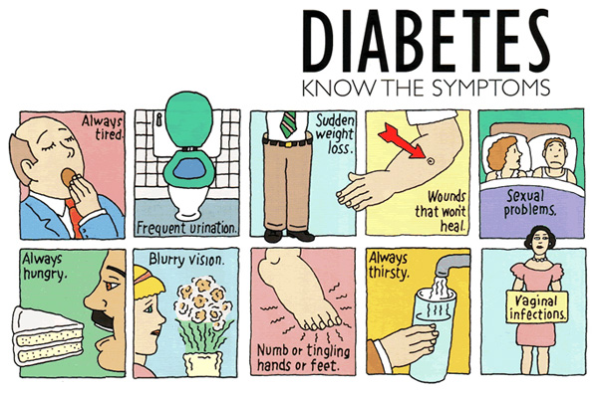
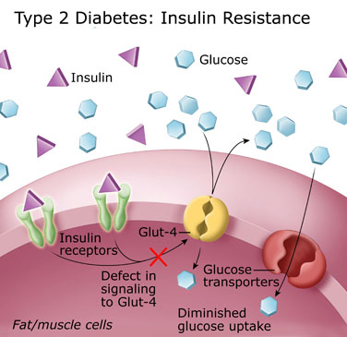
What is Diabetes?
Diabetes is a chronic disease in which high blood glucose levels can cause defects in the body’s ability to produce and/or use insulin.
It is classified into:
Type 1- body does not produce insulin
Type 2 (most common) body does not produce enough insulin or cells ignore insulin

Slide 4
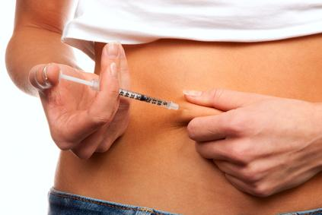
Statistics
According to the ADA there are total of 25.8 million children and adults in the United States with diabetes
1.9 million new cases of diabetes are diagnosed in people aged 20 years and older in 2010
Lastly, diabetes contributed to a total of 231,404 deaths in US each year

Slide 5
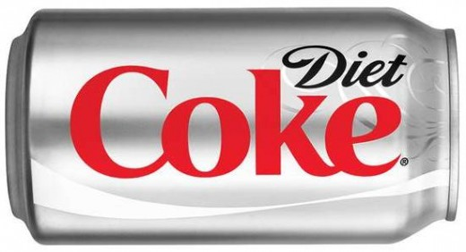
Diet Coke
Diet coke is produced by The Coca-Cola Company and was first introduced in the United States on August 9, 1982, as the first new brand since 1886 to use the Coca-Cola trademark. It became the largest-selling low-calorie soft drink in the United States.

Slide 6
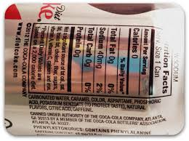
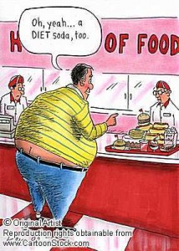
Ingredients Of Diet Coke
Diet Coke contains:
Carbonated Water
Caramel Color
Aspartame
Phosphoric Acid
Potassium Benzoate
Natural flavors
Citric acid
Caffeine

Slide 7
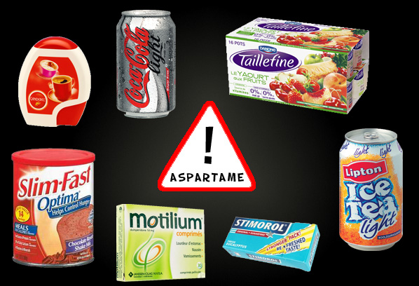
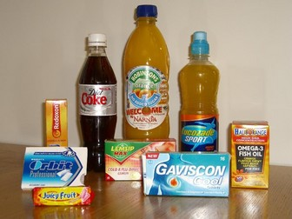
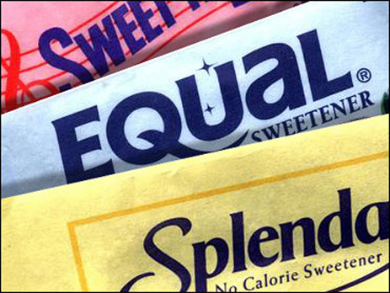
Artificial sweetener
Aspartame
The word’s most popular artificial sweetener.
Introduced in the 80’s by Monsanto Corp. and approved by the US FDA.
Sold commercially under names like NutraSweet, Equal, Spoonful, aspartame can be found in more than 6,000 products, including:
Diet sodas, juice drinks, and flavored waters
Chewing gum
Table-top sweeteners
Diet and diabetic foods
Breakfast cereals, such as Fiber One
Fiber supplements
Jams and Sweets
In vitamins, as well as prescription and over the-counter drugs such as Alka Seltzer Plus, and some Tylenol medications.

Slide 8
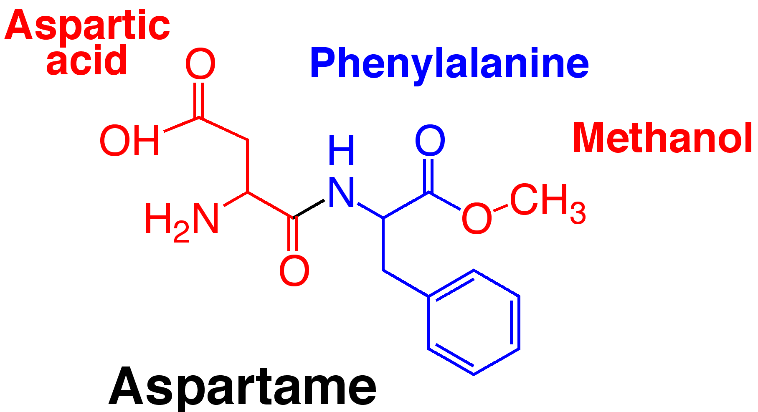
What is Aspartame?
The scientific name for aspartame is 1-aspartyl 1 phenylalanine methyl ester. It has three components:
Phenylalanine (50%)
aspartic acid (40%)
methanol (wood alcohol) 10%
These two amino acids are harmless when consumed as part of natural unprocessed foods. However when they are chemically manipulated and consumed out of the normal ratios to other amino acids, they can cause problems in the physiology of your brain. Our body initially breaks down the ester link between the two amino acids to turn them into free amino acids. Our body doesn’t recognize phenylalanine and aspartic acid in their free form and this is first step to health problems.
It is found naturally in some of the foods we eat; however, it is never bound to amino acids in nature, as it is as an ingredient in aspartame. In nature, for example, methanol is bound to pectin. Pectin is a fiber which allows the methanol to pass through your body without being metabolized and converted to formaldehyde , a toxin which is used in paint remover and embalming fluid. It can accumulate in our cells . The formaldehyde binds to our fat cells and acts as a preservative for body fat and shows up as EXCESS WEIGHT & CELLULITE on your hips, thighs, and abdomen.

Slide 9

Adverse Reactions to Aspartame
Seizures
There are over 900 published studies on the health hazards of aspartame.
Migraine Headaches
Seizures - In 1992, the United States Air Force issued a warning to pilots to avoid products containing aspartame because it has been linked to seizures , dizziness, sudden memory loss and gradual loss of vision.
Depression
Visual Changes- Formaldehyde is known to cause retinal damage, and methanol poisoning can lead to changes in your vision and blindness.
Brain Cancer
Weight Gain - products marketed as “reduced calorie,” “sugar-free,” and “diet” can actually sabotage our weight control efforts. The two main ingredients of aspartame, phenylalanine and aspartic acid, stimulate the release of insulin and leptin -- hormones which instruct your body to store fat. A large intake of phenylalanine can drive down your serotonin levels. Serotonin is the neurotransmitter that tells you when you’re full. A low level of serotonin can bring on food cravings which can lead to weight gain.

Slide 10
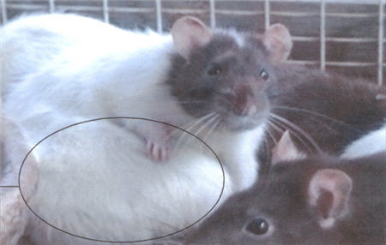
Animal studies
Animal studies showed that artificial sweeteners can cause body weight gain which is itself a risk factor in developing diabetes.
Rats fed with artificial sweetener increased calorie intake, body weight and adiposity.

Slide 11
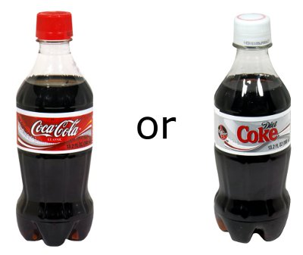
French research
According to French researchers ,drinking a 12 oz can of diet soda per week can increase risk of Type 2 diabetes by 33%

Slide 12

How can diet drinks make the problem worse
If they are calorie-free?
They stimulate appetite for sweet foods at subsequent meals
Those who choose diet drinks tend to drink twice as many of them as those who choose regular soda
Aspartame causes a rise in the insulin level

Slide 13
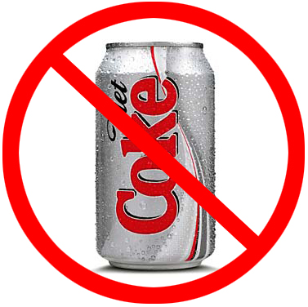
Conclusion
In conclusion, diet soda consumption may result in overconsumption, increased body weight, metabolic dysfunction and eventual diabetes.

Slide 14
References:
http://www.diabetes.org/diabetes-basics/diabetes-statistics/
http://www.huffingtonpost.com/2013/02/11/diet-soda-diabetes-risk-type-2-artificially-sweetened-sugar_n_2663247.html
http://en.wikipedia.org/wiki/Diet_Coke
http://www.dietcoke.com
http://lostinthebambooforest.blogspot.com
http://bestmeal.info/food/aspartame.shtml
http://shine.yahoo.com/healty-living/study-diet-soda-increases-risk-diabetes-why-still-192600358.html

