Slide 1

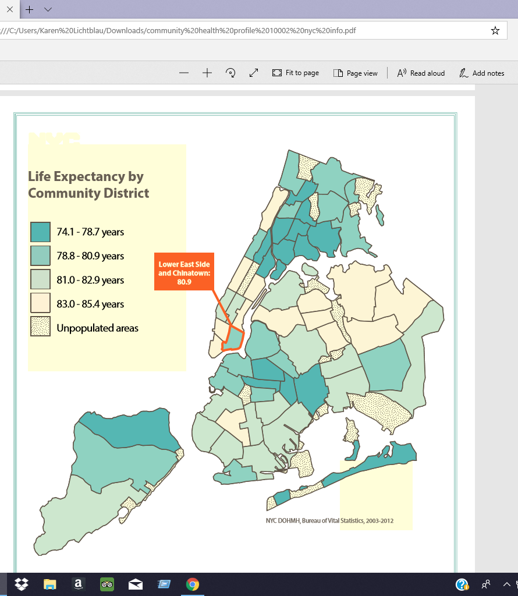
LOWER EAST SIDE
ZIP CODE 10002
COMMUNITY SURVEY OF THE

Slide 2
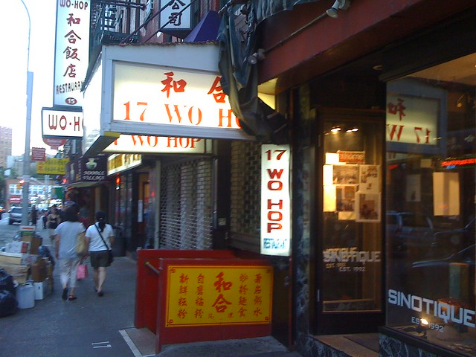
CHINATOWN – MOTT STREET
43% OF POPULATION
This Photo by Unknown Author is licensed under CC BY-SA-NC

Slide 3
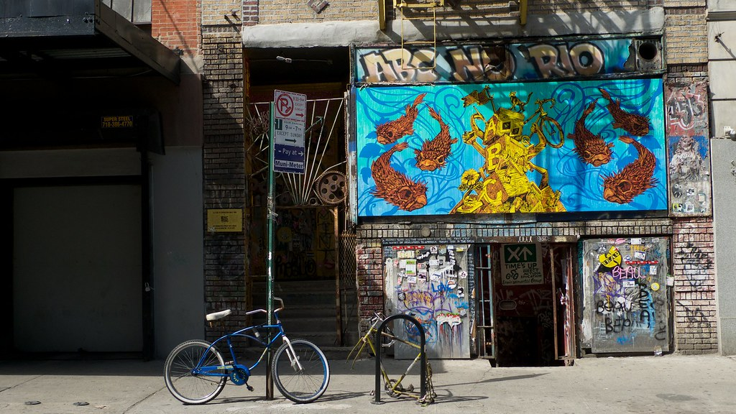
Latino Poetry Center -26%OF POPULATION
This Photo by Unknown Author is licensed under CC BY-SA-NC

Slide 4
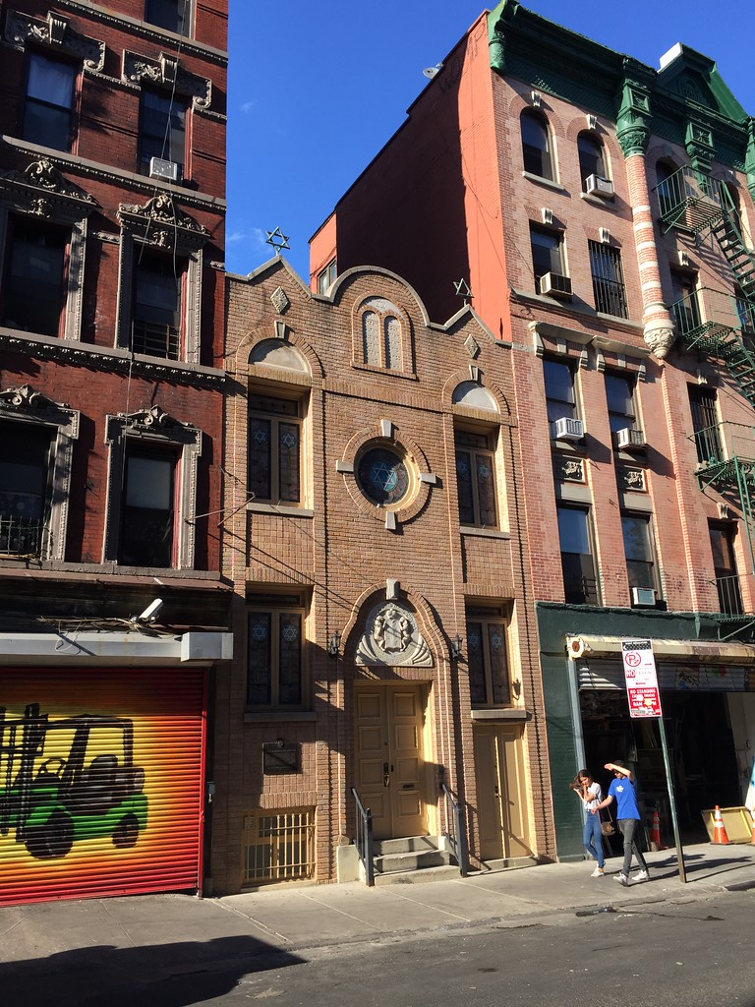
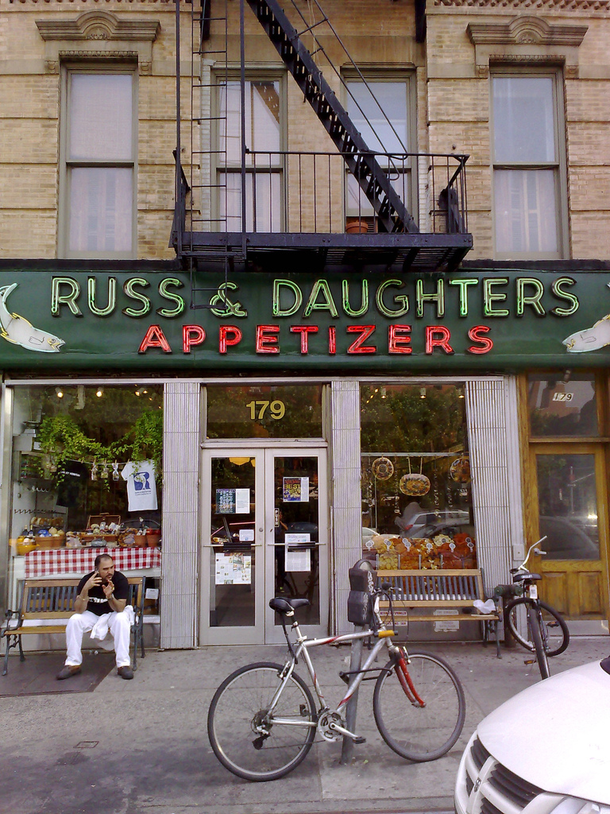
Jewish Synagogue and Restaurant – 15% Of Population
This Photo by Unknown Author is licensed under CC BY-ND
This Photo by Unknown Author is licensed under CC BY-SA

Slide 5

BASICS
.9 –SQUARE-MILE AREA IN SOUTHEAST CORNER OF MANHATTAN
BOUNDED BY EAST RIVER, HOUSTON STREET and THE BOWERY
POPULATION DENSITY OF 90,000 PEOPLE/SQ. MILE
3 NEIGHBORHOODS: CHINATOWN, LOISAIDA, LOWER EAST SIDE
MOSTLY RESIDENTIAL with FOOD PURVEYANCE as largest industry

Slide 6
FUNCTIONAL GEOGRAPHY
½ MILE TO NEAREST SUBWAY FOR MANY RESIDENTS
47% USE SUBWAY TO COMMUTE TO WORK
TRANSPORT VOID FILLED BY WALKING, CYCLING, BUSES
31- MINUTE AVERAGE COMMUTE TO WORK

Slide 7
POPULATION STATISTICS/HOUSING
87,000 RESIDENTS, 53% FEMALE, 47% MALE
AVERAGE AGE IS 41; LARGEST AGE COHORTS ARE 20-60 YEARS OLD
67% ARE SINGLE; 33% ARE MARRIED/COHABITING
ONLY 25% OF HOUSEHOLDS CONTAIN CHILDREN
81% OF CHILDREN ELIGIBLE FOR FREE LUNCH
87% ARE RENTERS; MOST IN PRE-1939 HOUSING, 1-BEDROOM APARTMENTS
OWNED RESIDENCES ARE CO-OPS/CONDOMINIUMS
AVERAGE HOME PRICE IS $535,000; HIGHEST IS 3 MILLION
HOUSING COSTS HIGHER THAN NYS AVERAGE BUT LOWER THAN NEIGHBORING ZIP CODES

Slide 8
EDUCATION/INCOME/EMPLOYMENT
69% HAVE HIGH SCHOOL DIPLOMA
48% HAVE COLLEGE AND ABOVE
47% HAVE INCOME BELOW NYS MEDIAN
26% LIVE BELOW POVERTY LINE
6.8% UNEMPLOYMENT HIGHER THAN NYS AVERAGE

Slide 9
STRENGTHS
STRONG SENSE OF COMMUNITY – 18 HOUSES OF WORSHIP;DOZENS OF ETHNIC ORGANIZATIONS
RICH CULTURAL DYNAMIC - 4 MUSEUMS, 3 ETHNIC PERFORMANCE SPACES,MYRIAD OF EHTNIC RESTURANTS/MARKETS
LEMONADE FROM LEMONS - USE DISTANCE FROM SUBWAY TO ADVANTAGE; WALKING, CYCLING, SCOOTING YIELD LOWER OBESITY RATE AND LONGER LIFESPAN THAN NYC AVERAGE
93 % OF ELIGIBLE WORKERS GO OUT TO WORK EACH DAY
VARIED ETHNIC GROUPS CO-EXIST WELL – NON-FATAL ASSAULT RATE 1/3 LOWER THAN CITY AVERAGE

Slide 10
WEAKNESSES/AREAS FOR IMPROVEMENT
HIGHER HOUSING COSTS AND LOWER INCOME LEAD TO UNFULFILLED BASIC NEEDS – FOOD, CLOTHING, ETC.
NO INPATIENT FACILITIES YIELD RISK FOR POORER OUTCOMES FOR EMERGENCIES FOR FRAIL IN HEALTH
UNDOCUMENTED IMMIGRANT POPULATION FROM CARIBBEAN AND ASIA YIELDS HIGHER RISK FOR HUNGER FOR THOSE NOT ELIGIBLE FOR BENEFITS

Slide 11
PLAN FOR IMPROVEMENT
EVIDENCE-BASED NEEDS ASSESSMENT FOR FOOD, CLOTHING, SHELTER, MEDICAL CARE, ENVIRONMENTAL DAMAGE
PARTNER UNIVERSITIES SUCH AS CITY TECH WITH COMMUNITY/RELIGIOUS LEADERS FOR INFORMATION GATHERING
LIAISE WITH LOCAL, STATE, FEDERAL OFFICIALS FOR GRANTS/FUNDING
SEEK OUT EDUCATIONAL FUNDING TO RAISE EDUCATION/INCOME LEVELS
COORDINATE PLAN AMONG FOOD PURVEYORS FOR SYSTEMATIC DISTRIBUTION OF UNUSED FOODSTUFFS TO NEEDY
EVALUATION VIA CRITICAL PATH METHOD IN CONJUNCTION WITH COMMUNITY BOARD.

Slide 12
Karen Lichtblau
New York City College of Technology - NUR 4110 – Spring 2019

