Slide 1
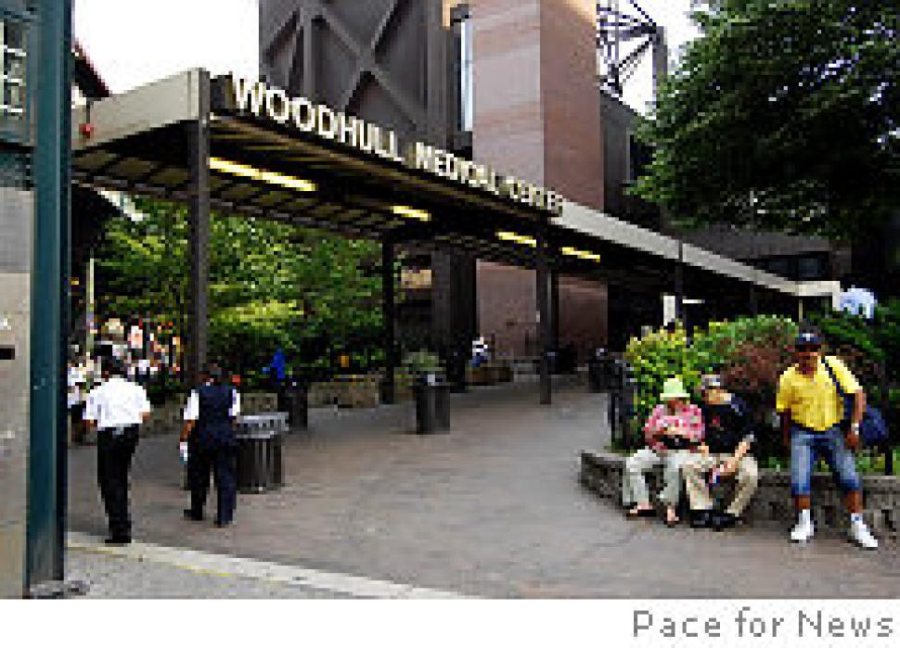
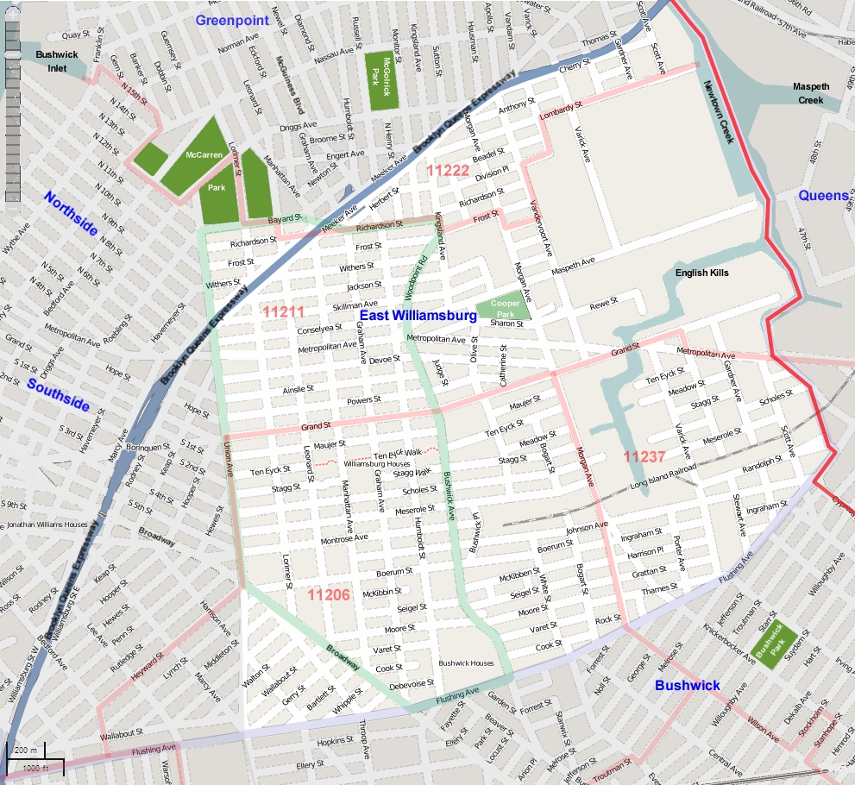
Prevention and Maintenance of Diabetes in the Community of 11206
Community Service Learning Project
Kathleen Cruz  Zippora James  Kristine Lauriello
Sonam Wangmo  Lizet Rodriguez  Deanna Scarlett
Danny Tam  Erica Williams

Slide 2
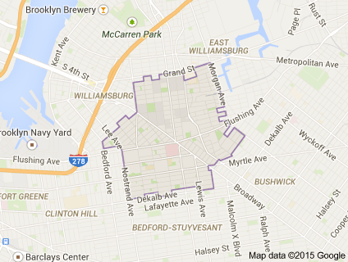
Demographics
Woodhull Medical Center lies within the zip code 11206 in Brooklyn, NY.
The neighborhood is also known as East Williamsburg.
There are about 81,677 people living in this neighborhood.
43% are Hispanic, 42.3% are White, 28.3% are Black, 5.5% are Asian, 0.9% are Indian/Native American.

Slide 3
Why Diabetes?
Diabetes is our leading Health objective because we found that there is an increasing number of people living and being diagnosed with Diabetes in the Woodhull Area.
We set out to address and treat the community using the 5 components of the Heath Alliance Model for Community Health Nursing:
The Voice of the Client
Expertise of the Provider
Community-Based needs
Systems of care management
Resource Allocation concerns

Slide 4
Demographics
The number of people living in Bushwick and Williamsburg (zip code 11206) in 2010 was 81,677.
Morbidity and mortality is decreased 10%
Annual death rate is 15%
Poverty rate is 38%
Age range:
33% are 17 years old or older
25% have a college education
47.6% of residents are men and 52.4% are female

Slide 5
Demographics, cont.
Unemployment rate is 10.6%
Majority of the population are Hispanic, 53%
White 4%
Black 37%
Asian 3%

Slide 6
Environmental Concerns
The major environmental-related health problems in the zip code of 11206 are:
Asthma
Emergency room (ER) visits among youth and adults are 270.2 per 10,000 residents in 2012
Heat stress
Emergency room (ER) visits are 15.5

Slide 7
Health Related Facilities
Woodhull Medical Center has served North Brooklyn for the past twenty-five years
Serves zip code 11206
Offers various specialties:
Adult medicine
ER
Geriatrics
Pediatrics
Women’s Health
The New York Department of Health and Mental Hygiene location in Fort Greene, Brooklyn, offers this community free immunizations for adults and children, as well as, STD testing.

Slide 8
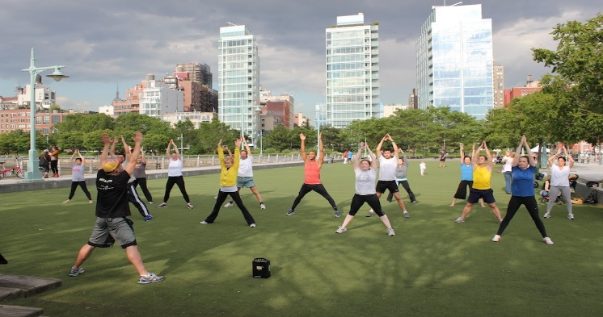
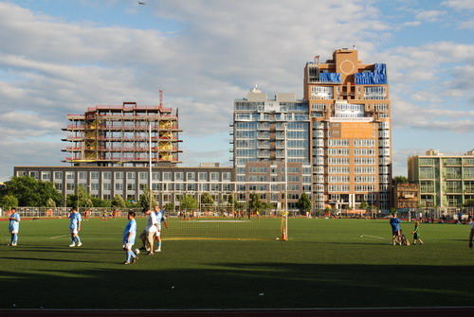
Aesthetics
There are ten NYC parks within or nearby
Baseball fields
Handball courts
Playgrounds
McCarren Park Recreation Center offers music festivals and concerts
There are over 39 different galleries within North Brooklyn (Williamsburg, Greenpoint & Bushwick).
Traditional art
Fine art
Photography
Paintings
Other types of visual art

Slide 9
Care Management Techniques
Care management techniques for includes helping the community with what is necessary and lacking in the neighborhood and this provides information on what improvements are desirable to meet the community needs.
There are ten health care goals geared toward helping the community of 11206 (New York City Department of Health and Mental Hygiene, 2006).
1. Have regular doctor, 2. Be tobacco free, 3.Keep your heart healthy, 4. Know HIV status, 5. Get help for depression, 6. Be free from alcohol & drugs, 7. Get checked for cancer, 8. Get immunizations, 9. Make home safe & healthy, 10. Have healthy baby (New York City Department of Health and Mental Hygiene, 2006).

Slide 10
Influences on Resource Allocation
Many factors influence decisions on resource allocation including:
government funding
patterns of insurance coverage
values and beliefs of the population
and the reliance on influence of special interest groups
every community determines how it allocates resources (Holzemer, S., & Klainberg, M, 2014., p67).
Woodhull Medical Center (WMC) is a part of NYC Health and Hospitals Corporation and provides primary service care for Williamsburg, Bushwick and Bedford-Stuyvesant neighborhoods in which there are 403,135 primary care residents living in these areas; it is located in a federally designated primary care Health Professional Shortage Area (HPSA) and provides primary service care to zip code 11206 (Woodhull Medical Center Community Health Needs Assessment, 2013).

Slide 11
Assessment of Community 11206
Diabetes is one of the leading causes of death in the Bushwick and Williamsburg communities
Contributing Factors:
Poverty rate
Education
Culture
Availability and accessibility
Environmental

Slide 12
Nursing Diagnoses
Risk for disturbed sensory perception
Risk for infection
Knowledge deficit
Powerlessness

Slide 13
Planning and Implementation
Presentation on diabetes – April 29, 2015 for both groups
Four topics:
Information on diabetes
Risk factors and signs and symptoms of hypo/hyperglycemia
Discuss complications of the disease
Teach diet, exercise and use of medications
Goals – enhance knowledge and awareness

Slide 14
Implementation
Permission and approval from site managers
Flyers given to site managers
Language barrier – needed translator
Poster board presentation
Pre/Posttest with 4 questions in a yes/no format
Williamsburg Community Center - question and answer portion after presentation
Pamphlets

Slide 15
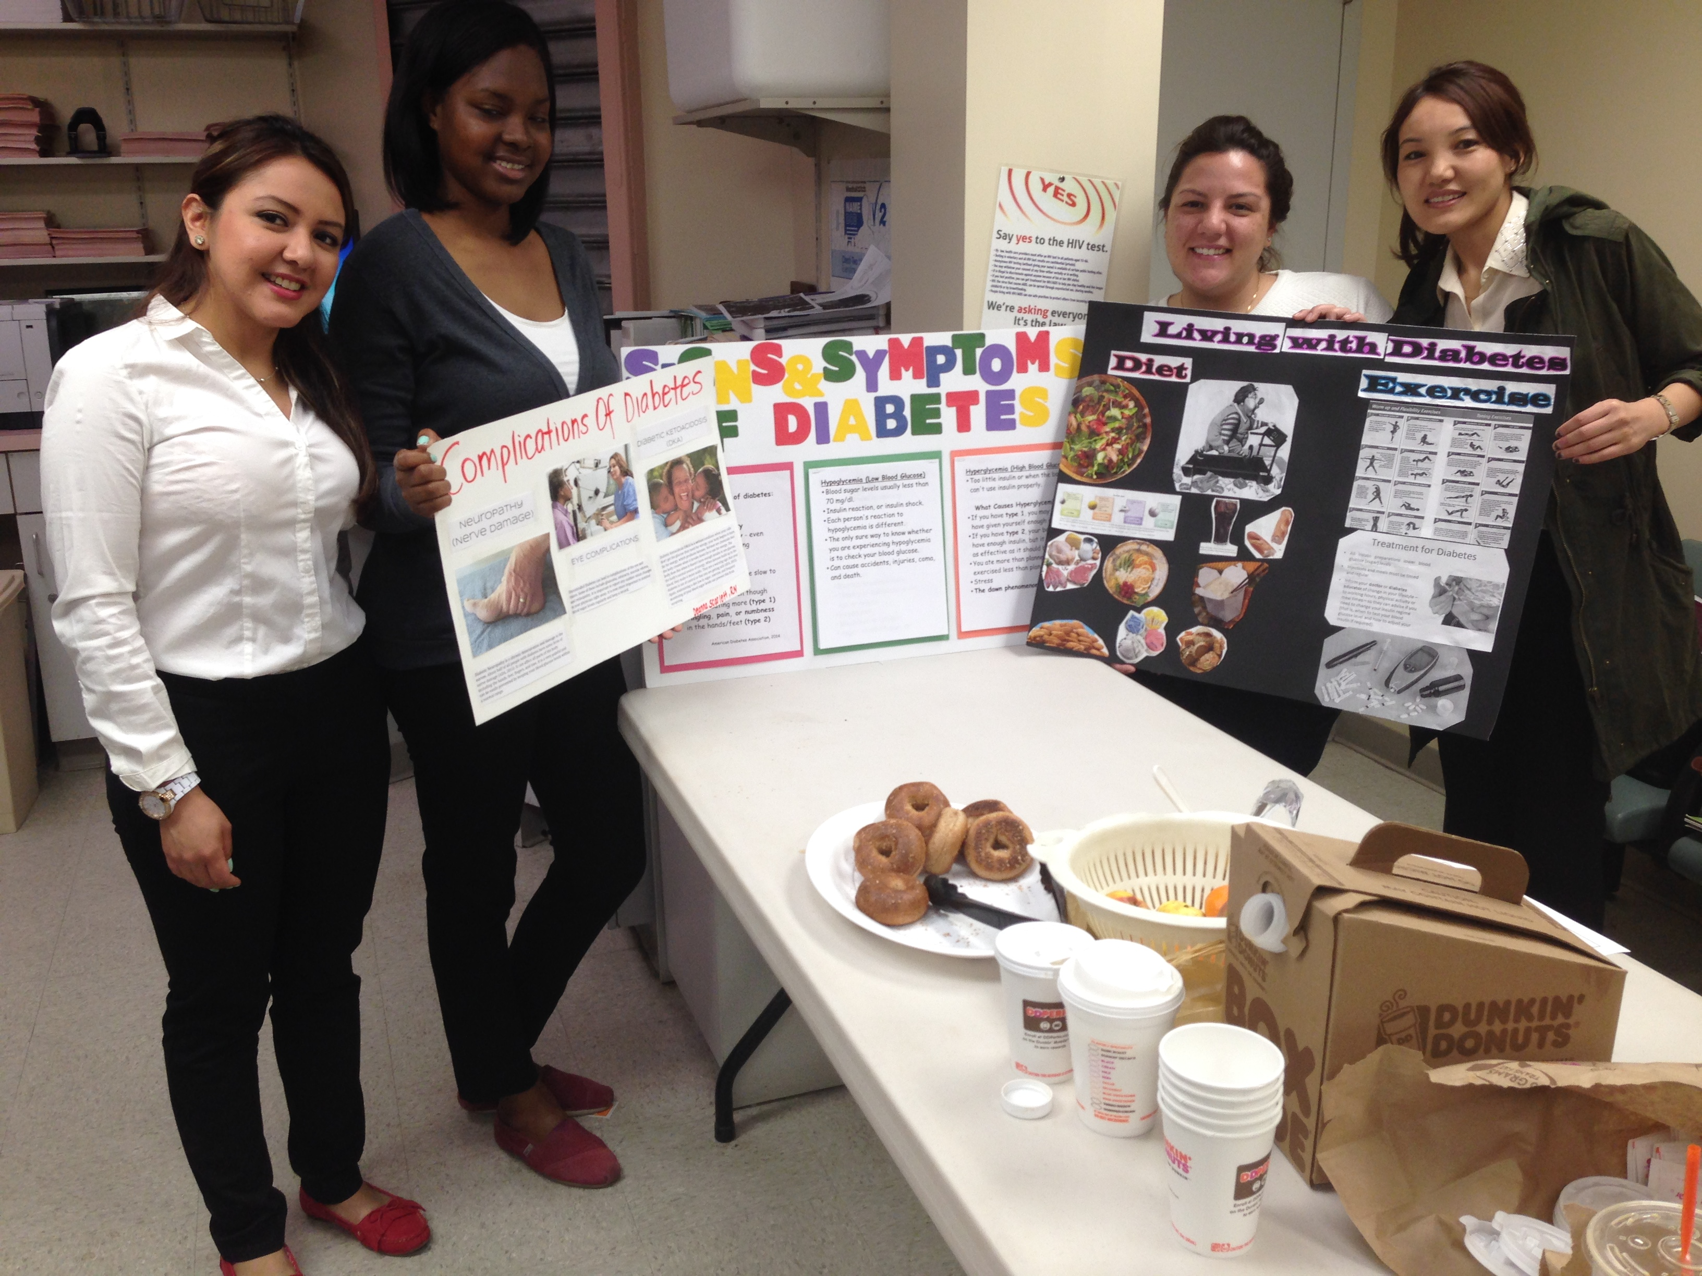
Community Presentations

Slide 16
Evaluation
1. Goals Wanted to Accomplish
Assess community's knowledge about diabetes
Define diabetes, discuss different types of diabetes, the risk factors, and recognizing signs and symptoms of the disease
Discuss chronic complications of diabetes and what to do to prevent them
Discuss diabetes treatments (diet, exercise, medications) and encourage the audience to do A1c as well as finger sticks
Recognize signs and symptoms of hypo/hyperglycemia and what to do prevent those problems
Provide patient teaching to the community in a language that they understood with the help of appropriate visual aids and a translator if needed
Provide information where they can get additional information about diabetes

Slide 17
Evaluation, cont.
2. Process of Goal Setting
Group collectively decided on objectives
Research topic online using various websites
Collect brochures, booklets relating to diabetes and share with group members
Attend Diabetes Health Fair at Jacob Javits Center to get additional information
Collaborate with staff at Woodhull Medical Center and its affiliates to get permission to use venues for presentation
Advertise presentation using word of mouth and flyers
Use colorful pictures or drawings relevant to the topic to enhance learning
Develop Pre/post- test in English and Spanish

Slide 18
Evaluation, cont.
3. Goals Accomplished
Received permission to use the Woodhull Geriatric Wellness Center and Williamsburg Community Center
20-22 patients showed up for the presentation at Woodhull Geriatric Wellness Center
9 staff members for the presentation at Williamsburg Community Center
Patients did pre-test prior to presentation
Patients were very engaged and asked questions during presentations
Staff and patients expressed gratitude after presentations
Provided information about diabetes, exercises, etc.

Slide 19
Evaluation, cont.
4. Benefit of the project to Zip Code 11206
Increased awareness about diabetes disease and how to better manage it
Members of the community know where to access help or where to refer their loved ones who have diabetes
Members of the community can teach other members of the community

