Slide 1
The Role of Fat
Notes:
Your introductory or title slide should convey the overall “feeling” and focus of your presentation. For instance, I typically present about small-business trends, new business ideas, growth opportunities or other positive trends. In this sample presentation, I’m talking about new business ideas, so I used a sun graphic in this slide template to convey a positive feeling. Personalize this slide template with your company’s logo.
To add a logo to all slides, place it on the Slide Master. To access the Slide Master, on the Themes tab of the Ribbon, click Edit Master and then click Slide Master.
Disclaimer: You understand that Microsoft does not endorse or control the content provided in the following presentation. Microsoft provides this content to you for informational purposes only; it is not intended to be relied upon as business or financial advice. Microsoft does not guarantee or otherwise warrant the accuracy or validity of this information and encourages you to consult with a business or financial professional as appropriate.
RIEVA LESONSKY
Founder and President, GrowBiz Media
Rieva Lesonsky is founder and president of GrowBiz Media, a content and consulting company specializing in covering small businesses and entrepreneurship. A nationally known speaker and authority on entrepreneurship, Lesonsky has been covering America’s entrepreneurs for nearly 30 years. Before co-founding GrowBiz Media, Lesonsky was Editorial Director of Entrepreneur Magazine.

Slide 2
Overweight subjects  Prevalence of Moderate & Severe Periodontitis
Patients with Obesity
⬇ use Interdental Brushes on Daily basis
Tooth Brushing Frequency
Flossing Frequency
Interdental Brushes
Missing teeth
Influence by gender
Men – Tooth Brushing Frequency
Women – Interdental Aids
Notes:
I like to speak spontaneously, so I use PowerPoint as an outline to keep me on track. It’s best to keep your PowerPoint text brief, simply reinforcing key points you will talk about at more length. You can use this slide template to convey a series of steps or related points in a short format.

Slide 3
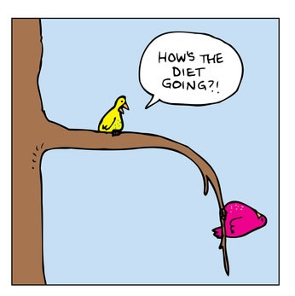
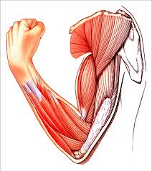
What Happens?
Resistin Serum from adipose tissues
Gram (-) Anaerobic Bacteria
Inflammation and Tissue Destruction
High Waist Circumference related to Periodontitis
Fat Metabolism
may play Key Role
Low Skeletal
Muscle Percentage
Research Facts
Where Fat?
How Fat?
http://www.doctorramey.com/resisting-insulin-resitancemetabolic-syndrome/
https://www.studyblue.com/notes/note/n/muscle-tissue/deck/12021078
Upper Body Fat
Notes:
A plain old bulleted list can get boring, so use graphics to liven it up. An image that conveys what you’re saying in visual format (like this diagram) can reinforce your ideas in the audience’s mind.

Slide 4
Connection
Obesity + Periodontal Disease
Poor Oral Hygiene
Education Level
Genetic Tendency
Tobacco and Alcohol
Young Adults
Diabetes
Notes:
I often use color and graphics to add excitement to a presentation. Just because it’s about business doesn’t mean it has to be staid—you need movement, energy and color, as in this slide template. Use this slide template to illustrate relationships or processes. In this slide, I used it to show how demographic trends create a new consumer group and what products that group purchases. You could also use it to illustrate your sales cycle or relationships among departments in your company.

Slide 5
Obesity is related to
Periodontal Disease
TNF-a
Leptin
Inflammation
BMI correlated to development of Periodontitis
Notes:
Insert a chart in this slide template to illustrate your topic visually, then use bullets or color to call out key findings or points from your chart in a brief format.

Slide 6
Factors
Oral Hygiene
BMI Related
Age Related
Education Level
Obesity & Periodontal Disease
Variation in strength of periodontitis-obesity relation
Obesity in young Adult Females and males predisposes to Periodontal Disease
Periodontal Disease Prevalent in Young Adults and Females
Notes:
This slide template can show steps, stages or how various elements or factors combine to make one key result or goal. For instance, you could show how various departments in your business work together to make the sale, how key customer groups will all purchase your product, or how different funding sources will provide the total you need. This slide template also makes an excellent concluding slide for your presentation, enabling you to graphically sum up your key points into one final whole.

Slide 7
Predisposition
Low Bone Mass
Periodontal Disease
Obesity
Bone Mineral Density
Soft tissue Attachment Loss
Osteoporosis
Tooth Loss

Slide 8
Tooth Brushing Frequency

Slide 9
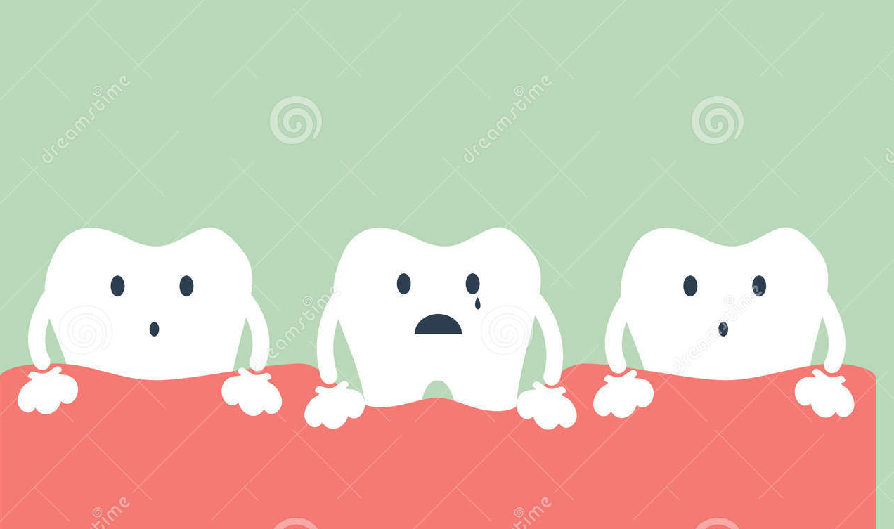
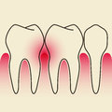
Research Findings
Protein
Deprivation
http://www.esrf.eu/news/general-old/general-2010/sleeping-sickness-drugs/sleeping-sickness-drugs
Degeneration of Connective Tissue
http://www.dreamstime.com/stock-illustration-tooth-periodontal-disease-dental-cartoon-vector-image60351547
Osteoporosis of Alveolar Bone
Changes in Periodontium
http://www.draxelrad.com/osteoporosis-drugs-and-dental-treatment-part-2/
http://www.dreamstime.com/royalty-free-stock-images-periodontal-disease-light-gray-background-image31022359

Slide 10
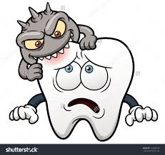
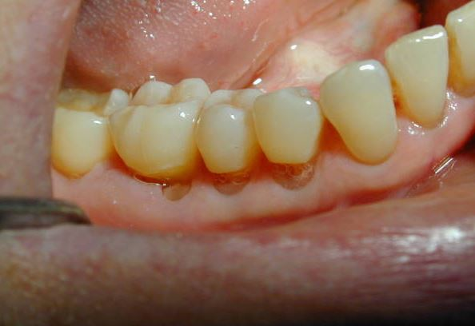
Gingival Inflammation
Protein Deficiency & Destructive Effects of:
Bacterial Plaque
Occlusal Trauma
http://www.shutterstock.com/s/tooth+cavity/search-vectors.html
Initiation of Gingival Inflammation Depends on Plaque !
More vulnerable to Breakdown
http://www.juniordentist.com/abfraction-of-tooth.html

