Slide 1
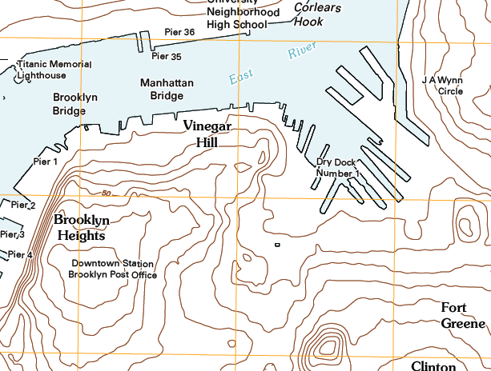
Downtown Brooklyn Study
Downtown Brooklyn Study
Prof. Paul King
Fall 2012
Site Planning ARCH 1250
Section 9576.AM Section 9577.PM

Slide 2
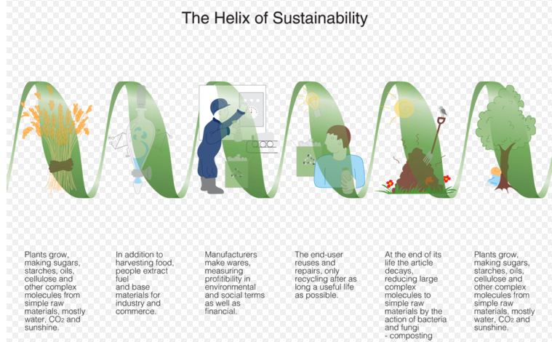
Downtown Brooklyn Study
Downtown Brooklyn Study
Team member 1
Team member 2
Team member 3
Team member 4
SUSTAINABILITY

Slide 3
You Chapter Outline and Menu
MY TEAM
MY TEAM TOPIC
MY TEAM MAP
PHOTOS & VIDEO
INVENTORY
ASSETS
LIABILITIES
DESIGN STRATEGIES
CIRCULATION STRATEGY
CLIMATE STRATEGY
OUR NEXT STEP …
Your chapter first page must use the vertical spine that says “Downtown Brooklyn Study”. Each team must modify the opening page to include their team members, title and an appropriate graphic (see my examples). I provided samples for the Sustainability & Land Use /Zoning teams. (These two teams may not use my images – but must replace these with their own)
Create an updated menu that matches your team outline – make sure all of your slides are up to date
Remember to be careful not to duplicate things – if you can explain something with one image then do so.
Images need titles or explanation –
Your presentation must make sense – good beginning middle and end – and clear conclusions & recommendations.
All members of the team must be part of the presentation – so think this out. It may or may not make sense for you to present the part you worked on.

Slide 4
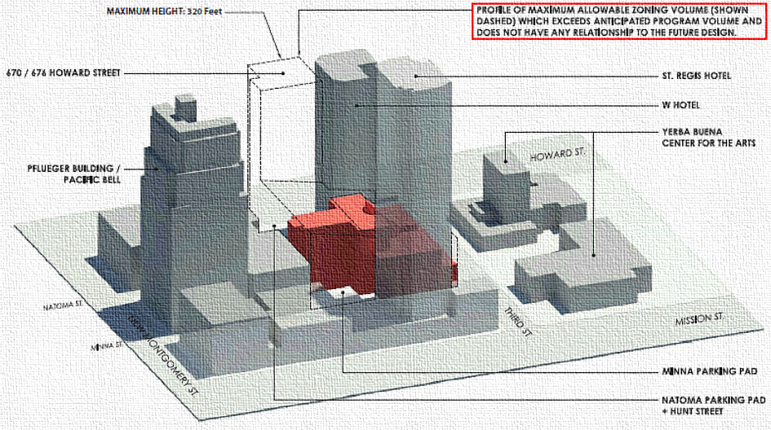
Downtown Brooklyn Study
Downtown Brooklyn Study
Team member 1
Team member 2
Team member 3
Team member 4
Land Use / Zoning

