Slide 1
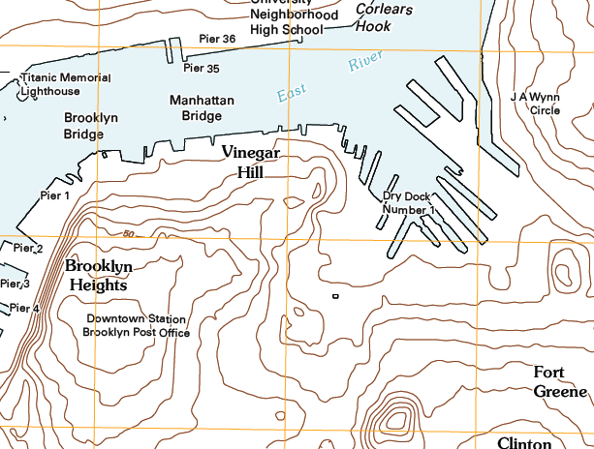
Downtown Brooklyn Study
Downtown Brooklyn Study

Slide 2
MY TEAM
MY TEAM
MY TEAM TOPIC
MY TEAM MAP
PHOTOS & VIDEO
INVENTORY
ASSETS
LIABILITIES
DESIGN STRATEGIES
CIRCULATION STRATEGY
CLIMATE STRATEGY
OUR NEXT STEP …
Include team photos, names and contact information including email addresses that can be shared with the class
Notes on presentation:
You may create additional slides but remember you will have only 8 minutes total to present. If you have supplementary info you want to include for reference you can add an appendix section.
Remember to update your menu when you are done for any new slides.

Slide 3
MY TEAM TOPIC
MY TEAM
MY TEAM TOPIC
MY TEAM MAP
PHOTOS & VIDEO
INVENTORY
ASSETS
LIABILITIES
DESIGN STRATEGIES
CIRCULATION STRATEGY
CLIMATE STRATEGY
OUR NEXT STEP …
This is your teams topic or focus, Climate, History, Circulation, Openspace, Land Use/Zoning, or Sustainability.
Consider a bullet point list of critical sub-topics for your area of focus.

Slide 4
MY TEAM MAP
MY TEAM
MY TEAM TOPIC
MY TEAM MAP
PHOTOS & VIDEO
INVENTORY
ASSETS
LIABILITIES
DESIGN STRATEGIES
CIRCULATION STRATEGY
CLIMATE STRATEGY
OUR NEXT STEP …
Identify on a map the key elements your team will talk about during the presentation. You may need more than one map to talk about your presentation.
For example you may have one to identify where your key photos are taken, one for liabilities, one for assets, one for design strategies, etc.
The order of the slides may change – for example you may have a map for teach sub-topic (inventory, assets, liabilities, etc)

Slide 5
PHOTOS & VIDEOS
MY TEAM
MY TEAM TOPIC
MY TEAM MAP
PHOTOS & VIDEO
INVENTORY
ASSETS
LIABILITIES
DESIGN STRATEGIES
CIRCULATION STRATEGY
CLIMATE STRATEGY
OUR NEXT STEP …
Insert a collage or relevant photos from the field trip.
Try to stay focused on your groups topic.
Organize these into related groups and create more than one slide as needed.
You can also insert videos or links to online videos your team has posted.

Slide 6
INVENTORY
MY TEAM
MY TEAM TOPIC
MY TEAM MAP
PHOTOS & VIDEO
INVENTORY
ASSETS
LIABILITIES
DESIGN STRATEGIES
CIRCULATION STRATEGY
CLIMATE STRATEGY
OUR NEXT STEP …
Inventory items your team has observed
Try to stay focused on your groups topic.
Remember our goal is to improve the downtown waterfront and your analysis should be based upon this.
An inventory is a list without an opinion of the value.

Slide 7
ASSETS
MY TEAM
MY TEAM TOPIC
MY TEAM MAP
PHOTOS & VIDEO
INVENTORY
ASSETS
LIABILITIES
DESIGN STRATEGIES
CIRCULATION STRATEGY
CLIMATE STRATEGY
OUR NEXT STEP …
Assets your team has observed
Try to stay focused on your groups topic.
Remember our goal is to improve the downtown waterfront and your analysis should be based upon this.
For assets the goal is to take advantage and maximize their value.

Slide 8
LIABILITIES
MY TEAM
MY TEAM TOPIC
MY TEAM MAP
PHOTOS & VIDEO
INVENTORY
ASSETS
LIABILITIES
DESIGN STRATEGIES
CIRCULATION STRATEGY
CLIMATE STRATEGY
OUR NEXT STEP …
Liabilities your team has observed
Try to stay focused on your groups topic.
Remember our goal is to improve the downtown waterfront and your analysis should be based upon this.
For Liabilities your goal is to minimize the negative impact of liabilities.

Slide 9
DESIGN STRATEGIES
MY TEAM
MY TEAM TOPIC
MY TEAM MAP
PHOTOS & VIDEO
INVENTORY
ASSETS
LIABILITIES
DESIGN STRATEGIES
CIRCULATION STRATEGY
CLIMATE STRATEGY
OUR NEXT STEP …
Brainstorm on possible design strategies – be imaginative.
One idea per teammate is required
Try to stay focused on your groups topic.
Remember our goal is to improve the downtown waterfront and your design strategies should respond to this.

Slide 10
CIRCULATION STRATEGIES
MY TEAM
MY TEAM TOPIC
MY TEAM MAP
PHOTOS & VIDEO
INVENTORY
ASSETS
LIABILITIES
DESIGN STRATEGIES
CIRCULATION STRATEGY
CLIMATE STRATEGY
OUR NEXT STEP …
Stay focused on your groups topic and consider how it might be used to positively affect circulation around and to the Brooklyn waterfront.

Slide 11
CLIMATE STRATEGIES
MY TEAM
MY TEAM TOPIC
MY TEAM MAP
PHOTOS & VIDEO
INVENTORY
ASSETS
LIABILITIES
DESIGN STRATEGIES
CIRCULATION STRATEGY
CLIMATE STRATEGY
OUR NEXT STEP …
Stay focused on your groups topic and consider how it might be used to positively affect microclimate around and to the Brooklyn waterfront.

Slide 12
OUR NEXT STEPS . . .
MY TEAM
MY TEAM TOPIC
MY TEAM MAP
PHOTOS & VIDEO
INVENTORY
ASSETS
LIABILITIES
DESIGN STRATEGIES
CIRCULATION STRATEGY
CLIMATE STRATEGY
OUR NEXT STEP …
Stay focused on your groups topic and consider what your next step in research and team work will be.
Consider identifying tasks and assigning these to specific teammates.
Consider setting team deadlines for finding and sharing different information.
Identify your teams meeting method & schedule outside of class time for the rest of the semester.
You must meet at least once a week as a min

Slide 13
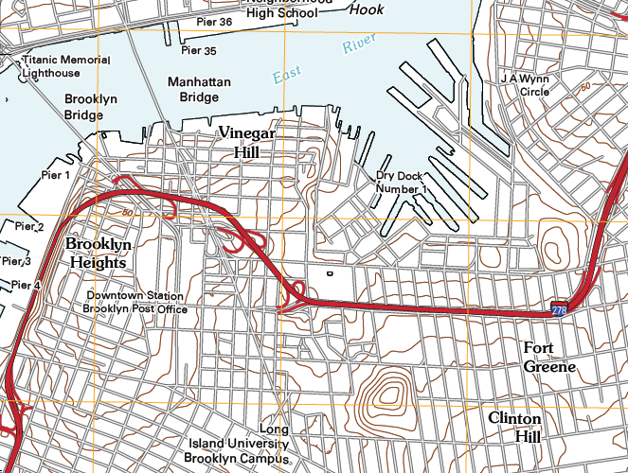
Downtown Brooklyn Study
Downtown Brooklyn Study

