Slide 1
Curtain walls
Lightweight wall system installed in the exterior of building structures
The name “curtain wall” derives from the idea that the wall is thin and “hangs” like a curtain on the structural frame
Designed to resist wind and rain
It also accommodate building drift and seismic movements
Separates Interior and exterior environment
Its available in three system types to include, 1.Stick built system, 2.Unitized or Panel system and 3.The Structural Glazing
Glass and Aluminum Curtain wall system being the most advanced exterior window wall system, is a Marvel of Engineering and architecture

Slide 2
Concept of Curtain wall

Slide 4
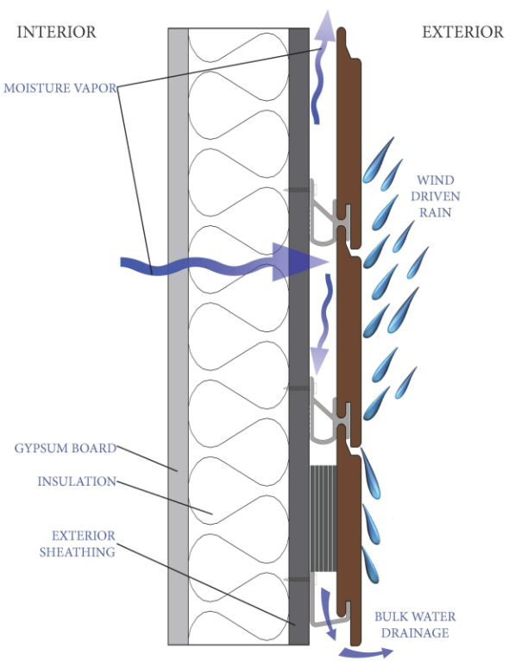
Rain screen Principle
Effective envelope solution to direct external moister penetration
Equilibrium of air pressure between exterior and interior of the curtain
Minimizes the force which drives moisture through outer wall using Pressure Equalization Chamber

Slide 5
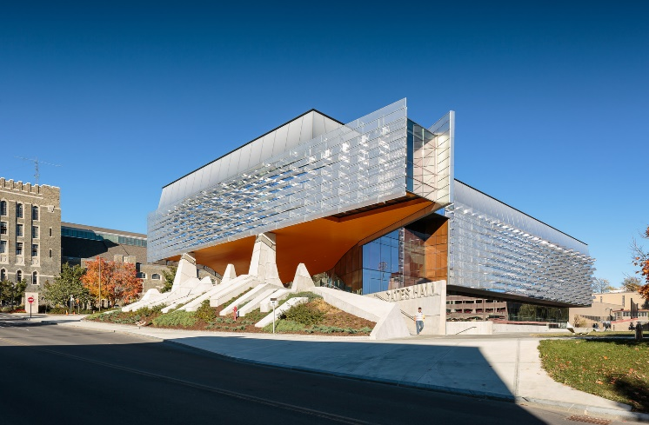
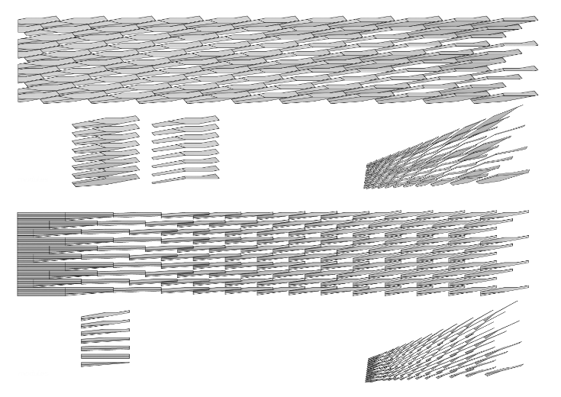
Case study Custom Unitized Curtain Wall used in Cornell NYC Tech University, designed by Morphosis located at Roosevelt Island

Slide 6
Structure Wall
Structural walls holds the structure and load of an entire building
There are three main types of Structural walls
1.Bearing wall- mainly takes the vertical loads
2.Shear wall- mainly takes the Horizontal load
3. Core Wall-the concrete part that goes vertically through the entire building that usually consists of elevator shafts, escape stair case or wash rooms

Slide 7
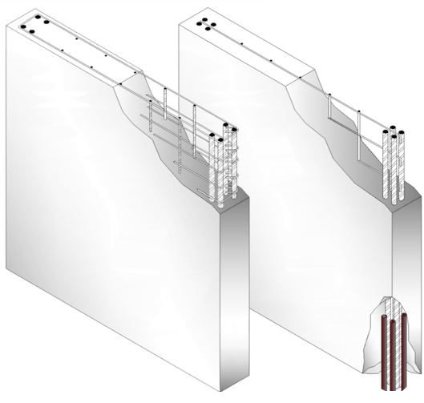
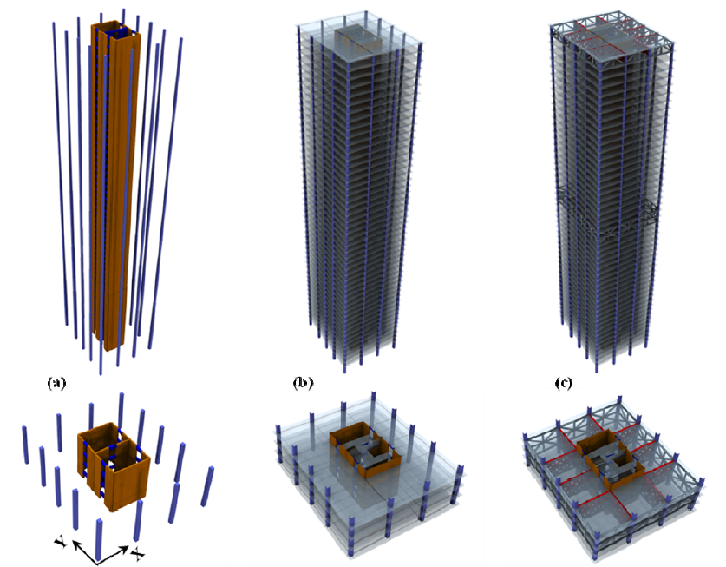
1.Core wall 2.Shearing wall 3. Bearing wall

Slide 8
Sketch

