Slide 1
The Americans with Disabilities Act
ADA
GROUP #3 Dominic Martinez -Introduction
Jia Rui Lin - Illustrations
Building Tech 3
Professor P. King

Slide 2
Protection Under the ADA
Protects individuals defined as disabled:
Physical or mental impairment that substantially impacts on one or more major life activities
Record of such impairment
Regarded as having such an impairment

Slide 3
Titles of the ADA
Divided into four categories:
Employment (Title I)
State & Local Government(Title II)
Public Accommodation and Commercial Facilities(Title III)

Slide 4
Title I: Employment
Applies to:
Employers with more than 15 employees (excluding federal government and private clubs)
Schools that have more than 50 employees
Employment agencies, labor organizations and labor-management committees
Qualified persons with a disability that are able to perform the essential functions of a job with or without reasonable accommodations

Slide 5
Title II: Public Services
Protects against discrimination in public transportation
Includes rail or bus services
Excludes air travel
Includes intercity or commuter rail services
Excludes public school transportation

Slide 6
Title III: Public Accommodations
Applies to:
Hotels and motels
Bars and restaurants
Theaters and museums
Stores and shopping centers
Hospitals and professional offices
Amusement parks and zoos
Nurseries and private schools
Day care centers and homeless shelters
Gyms and health clubs

Slide 7
What does the ADA require in new construction?
The ADA requires that all new construction of places of public accommodation, as well as of "commercial facilities" such as office buildings, be accessible. Elevators are generally not required in facilities under three stories or with fewer than 3,000 square feet per floor.
The 2010 ADA Standards for Accessible Design set minimum requirements – both scoping and technical -- for newly designed and constructed or altered public accommodations and commercial facilities to be readily accessible to and usable by individuals with disabilities.
Source: Title III 2010 ADA Standards

Slide 8
Section 1 : Outside Regulations
The section consists of regulations that would usually appear outside the structure

Slide 9
ADA Ramp Restrictions

Slide 10
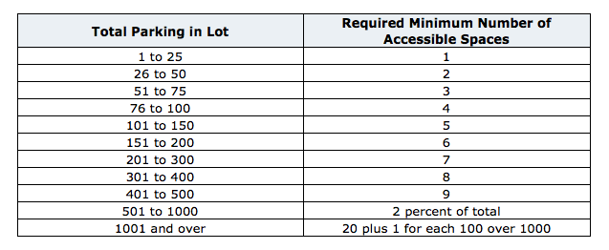
Accessible Vehicle Space

Slide 11
Access Path Width

Slide 12
Section 2 : Inside Regulations
The section consists of regulations that would usually appear inside the structure

Slide 13
Change in 180-degree Turn

Slide 14
Clear Space at Recessed Doors

Slide 15
Clarification of Consecutive Doors

Slide 16
Larger and Different Handrail Shapes Allowed

Slide 17
Pass Through Kitchens

Slide 18
Flexibility in Plumbing Location

Slide 19
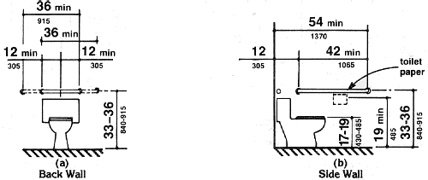
Overlapping Clearance in Residential Modification

Slide 20
Water Closet Specifications

Slide 21
Section 3 : Other Regulations
The section consists of regulations that would usually appear inside the structure

Slide 22
Specific Designs for Tubs and Showers

Slide 23
Appliance Requirements

Slide 24
U-Shaped Kitchens

Slide 25
Source
http://www.access-board.gov/guidelines-and-standards/buildings-and-sites/about-the-ada-standards/background/adaag#4.13

