Slide 1
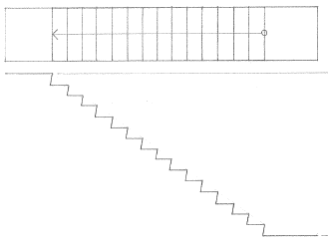
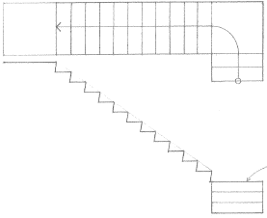
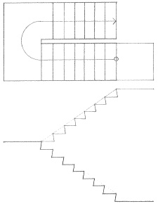
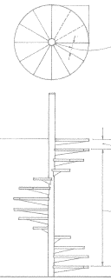
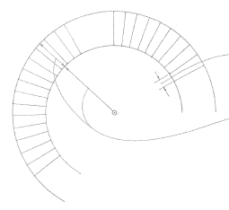
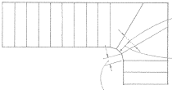
TYPE OF STAIRS
STRAIGHT-RUN STAIRS
QUARTER-TURN STAIR
HALF-TURN STAIR
SPIRAL STAIRS
WINDING STAIR
CIRCULAR STAIR
Building construction illustraded 4th edition (Chapter 9)

Slide 2
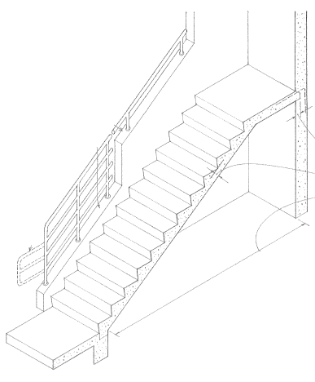
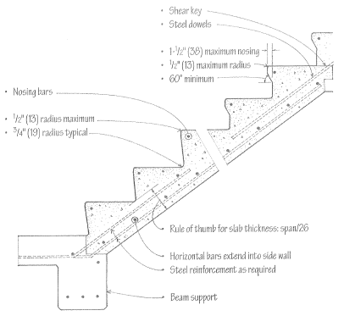
CONCRETE STAIRS
SIZE IS DETERMED ON DIVIDING THE TOTAL RISE OR FLOOR TO FLOOR HEIGHT BY THE RISER HEIGHT. (YOU ROUND THE RESULT TO THE WHOLE NUMBER)
DESIGNED AS A ONE WAY REINFORCED SLAB WITH THE UPPER SURFACES FORMED AS STEPS.
CAN BE DESIGNED TO ACT AS A SIMPLE BEAM IF DONE AFTER FLOOR OR BEAM SUPPORTS.
CAN BE DESIGN AS A CONTINUOUS BEAM IF ITS CAST WITH BEAM OR SLAB SUPPORT.
REQUIRE CAREFUL ANALYSIS OF LOADS, SPAN AND SUPPORT.
Building construction illustraded 4th edition (Chapter 9)

Slide 3
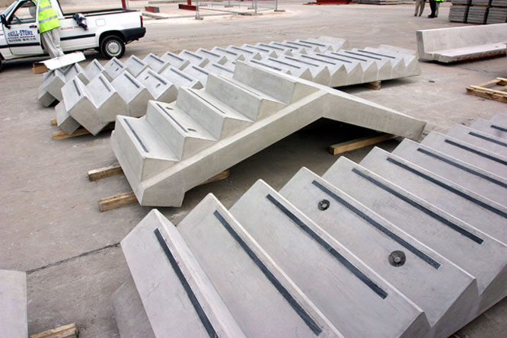
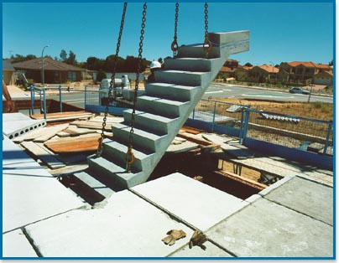
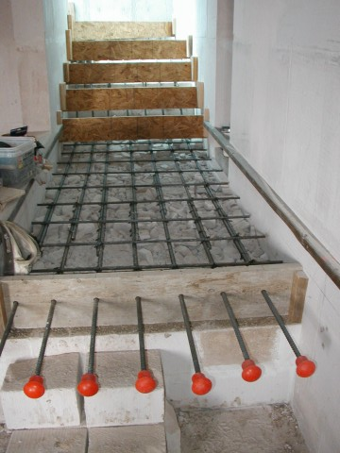
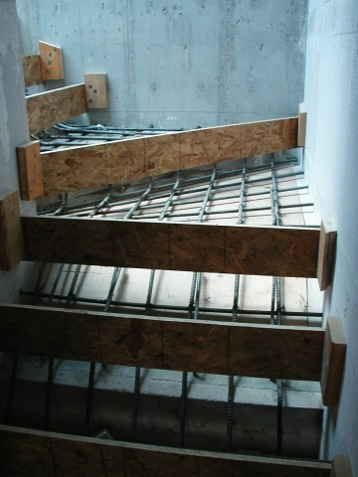
Precast Concrete Stairs
On Site Concrete Stairs
http://http://www.allenconcrete.co.uk/building_products_gallery.php
Fast installation (typically one day)
Immediate access
High quality smooth surfaces
Safe working area
Reduces mess and clean up during construction.
http://www.deltacorp.com.au/residential/product-stairs.html

