Slide 1
Elizabeth Hawes
By Kiara Martinez

Slide 2
Elizabeth Hawes
Born in 1903 in New Jersey
She was first generation Of American fashion designer to open the Parisian.
She graduated from Vassar college in 1925
She decided to go to Paris and to learned fashion design
Elizabeth and two other young designer got promoted lord and Taylor,then she published first book called fashion is spinach

Slide 3
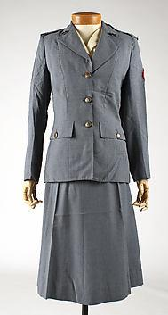
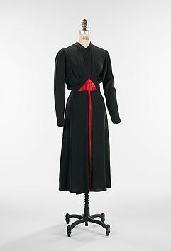
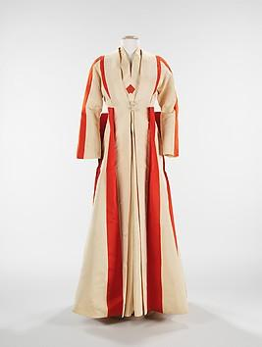
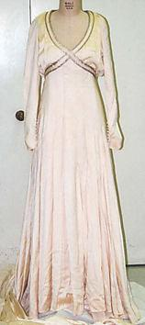
Her first
Pandora
The tarts
Uniform
Wedding dress

Slide 4
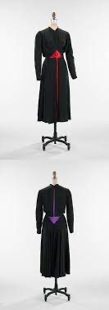
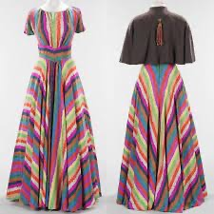
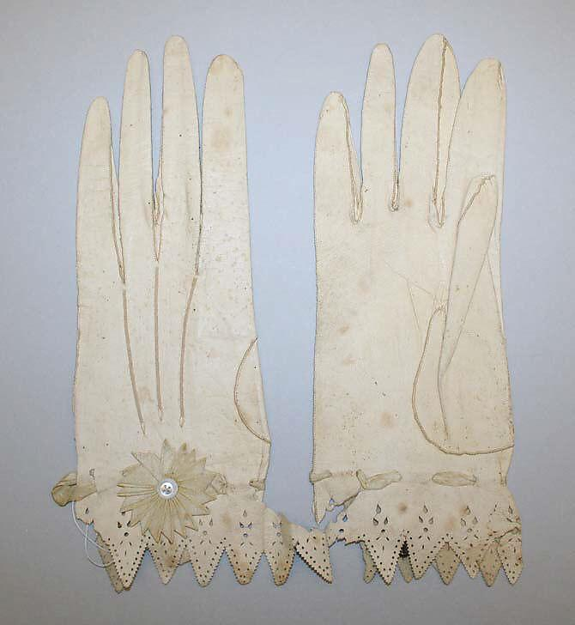
She was known for:
Alimony
The tarts
Guardsmen gloves

