Slide 1
Histology and Embryology DEN 1114 By: Kseniia Dymchenko
Tongue - Ankyloglossia &
Geographic Tongue &
Black hairy tongue

Slide 2
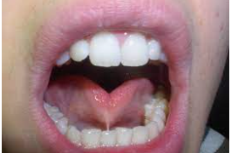
The frenulum of the tongue is the sublingual fold of the oral mucosa that connects the tongue to the bottom of the oral cavity. Its normal length in the stretched state of a 5-year old child is about 8 mm, but not less than 5 mm.
Tongue – Ankyloglossia

Slide 3
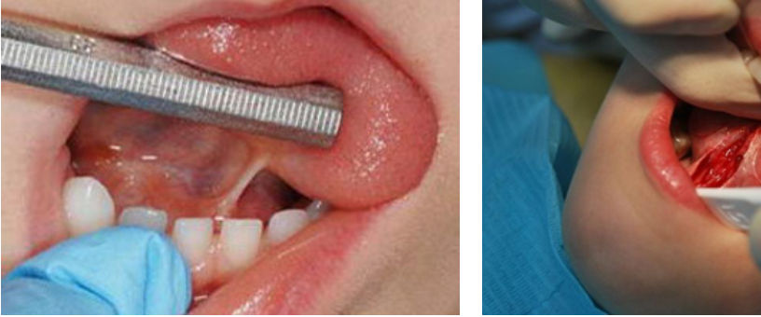
The condition is present at birth. This feature is inherited from the father or mother. However, its occurrence may be due to disorders of intrauterine fetal development.

Slide 4
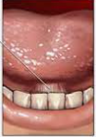
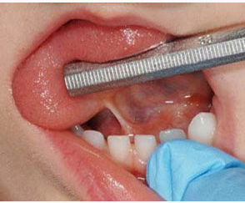
When the frenulum of the tongue is too short, the diagnosis is "ankyloglossia“. The tongue itself may also be shortened, thickened, and may have a central cleft at the tip. In very rare cases, it turns out to be fused with the bottom of the oral cavity.

Slide 5
Usually, doctors notice a short frenulum of tongue of the baby's tongue even in the maternity hospital at the first detailed examination of the newborn and immediately cut it with special scissors. Since the newly born baby has no nerve endings in this membrane, the child does not feel pain and the manipulation is carried out without anesthesia.

Slide 6
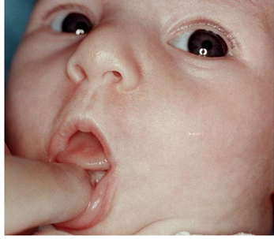
So, for example, with a short frenulum of tongue that interferes with the free movements of the tongue, the baby cannot hold the breast in his mouth for a long time, often interrupts, smacks his lips and gets tired quickly. Due to the fact that the tongue is not fully involved, the child tries to "extract" milk from the breast by pressing on the nipple with his lips and gums, and is very tense. For this reason, he sometimes even has a muscle tremor. And since the baby swallows a lot of air during sucking, he may begin to regurgitate profusely.

Slide 7
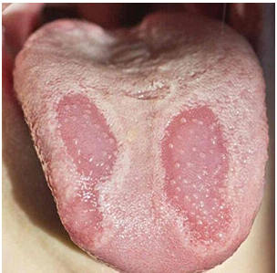
Also called “benign migratory glossitis” because the spots look like continents on a geographical map. Pinkish-red spots surrounded by a serpentine, raised, slightly discolored border. Treatment of desquamative glossitis in children is not required.
Geographic Tongue

Slide 8
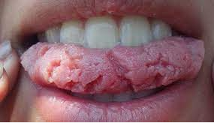
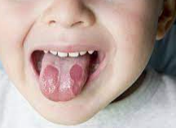
There are no pronounced symptoms in this case. The condition is usually diagnosed when the patient is examined for another pathology. In rare cases (especially when eating spicy, hot and salty food), the patient may complain of: a change in the sensitivity of the tongue; burning and tingling sensation; itching; unpleasant sensations while eating.

Slide 9
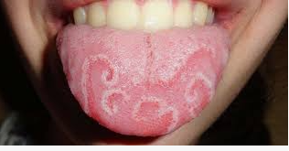
Geographic Tongue is not an independent disease, but its appearance signals serious disorders in the body. The sooner you contact a specialist, the sooner adequate treatment will be prescribed. Timely therapy is a guarantee of a qualitative cure from the disease.

Slide 10
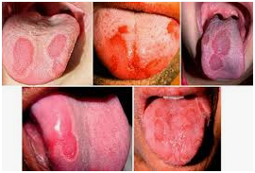
Periodic exacerbations are facilitated by frequent relapses of somatic diseases that occur against the background of gastrointestinal pathology and other systemic diseases. The duration of the disease is from 2 weeks to 10 years. Without causing concern to patients, sometimes disappears for a long time, then reappears in the same or other places.

Slide 11
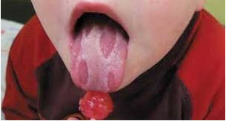
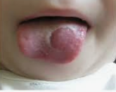
Preventive measures. Fighting bad habits, taking vitamins in the spring and autumn period, adequate treatment of gastrointestinal diseases and timely sanitation of the oral cavity will help to avoid this condition.

Slide 12
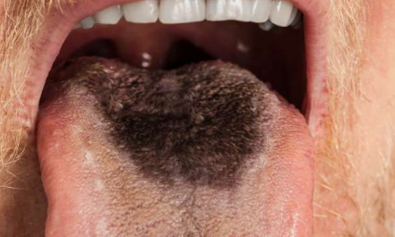
The term “Black hairy tongue” refers to an acquired benign neoplasm, which is characterized by the appearance of hypertrophied and elongated filamentous papillae on the dorsal surface of the tongue.

Slide 13
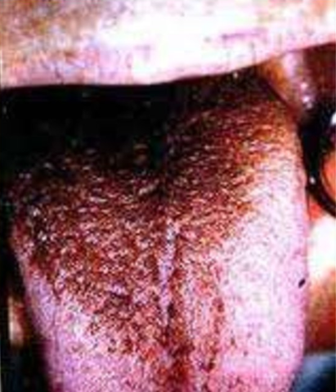
The exact causes of the pathology are not fully understood. The disease is not an independent disease, it appears against the background of other diseases. Most often, this phenomenon occurs in men over 40 years old, but it is sometimes observed in women. In children, this disease is very rare.

Slide 14
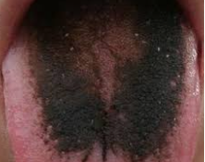
Pathology is most often observed in people with impaired gastrointestinal functions, ulcers and gastritis. Poor oral hygiene, addiction to smoking and excessive coffee consumption contribute significantly to the development of the disease.

Slide 15
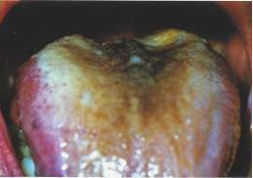
During the examination, the dentist identifies a section of pigmented filamentous papillae on the patient's tongue. They are less intensely colored at the base than at the periphery. When carrying out a special iron on the dorsal surface from the root to the tip of the tongue, the papillae are raised. In patients with a black hairy tongue, the hygienic condition of the oral cavity is always unsatisfactory. During an intraoral examination, dental deposits and carious defects are usually found.

Slide 16
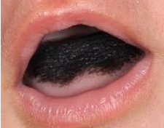
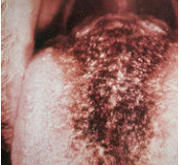
To eliminate an unpleasant defect, only the treatment of concomitant diseases, professional cleaning and treatment of the oral cavity, taking multivitamin complexes, antifungal drugs and, if necessary, sedatives will help.

