Slide 1
Hyperkeratinization in the mouth
Kaley Dignard October 2020

Slide 2
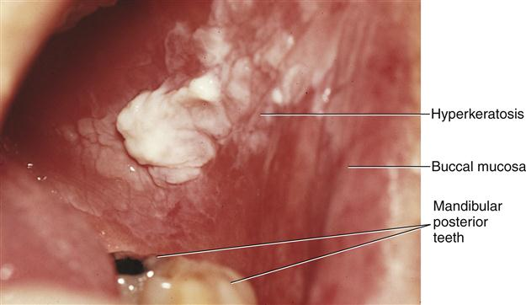
Hyperkeratinization
Keratin is a protein in the oral tissue cells that can give the mucosa a whiter appearance and a change in thickness.
The more trauma or constant irritation the oral mucosa receives activates the excessive production of keratin. This is a measure the cells undergo for protection.
Examples of trauma include: excessive friction, thermal, or chemical disturbance to the area.
If those factors are present, then the buccal mucosa will undergo hyperkeratinization.
Hyperkeratinized tissue on the buccal mucosa

Slide 3
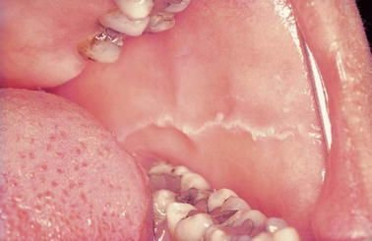
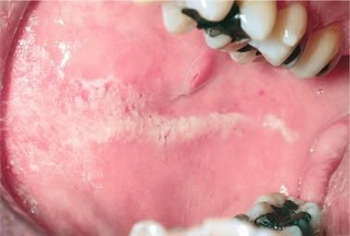
The change to hyperkeratization
In patients who have habits such as clenching or grinding (with bruxism), a larger area of the buccal mucosa rather than just the nearby linea alba becomes Hyperkeratinized.
Linea alba
Cheek biting

Slide 4
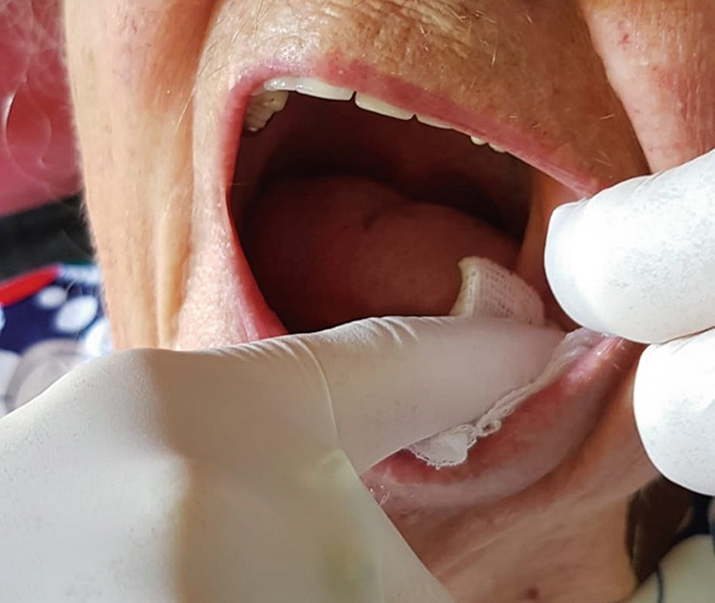
Identification
The first step in the identification of white patches suspected of being associated with physical trauma is to use a 2x2 square of gauze to try to wipe off the lesion.
If the patch is not easily wiped off,
this suggests the presence of hyperkeratization.

Slide 5
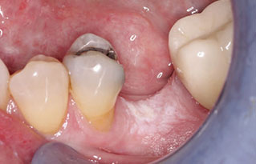
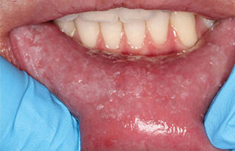
Causes & Types of hyperkeratization
Frictional Keratosis — Chronic rubbing.
Either from a fractured tooth or rough restoration.
Morsicatio — habitual chewing of the mucosal surfaces. This occurs in areas easily traumatized by the teeth which include:
buccal mucosa (morsicatio buccarum)
lower lip (morsicatio labiorum)
lateral tongue (morsicatio linguarum)
Frictional keratosis in the edentulous site of tooth #19
Morsicatio labiorum (lip nibbling)

Slide 6
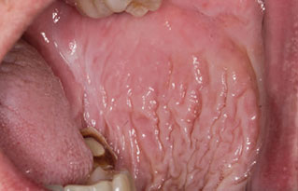
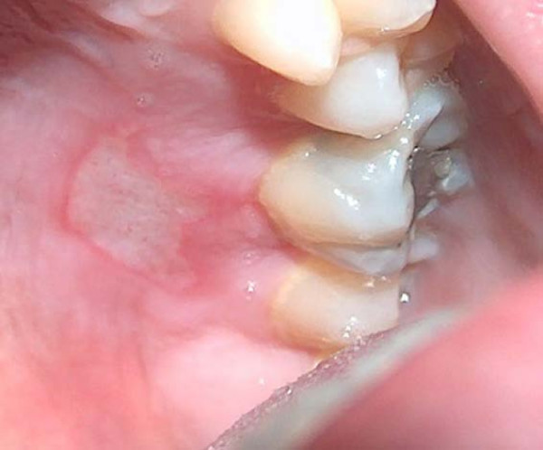
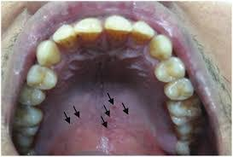
Causes & types of hyperkeratinization
Smokeless Tobacco Keratosis
(snuff dipper’s lesion) — Smokeless tobacco products can cause mucosal changes most often in the lower labial or buccal vestibule.
Characteristic smokeless tobacco keratosis
Stomatitis nicotinic
Hyperkeratinized tissue is also associated with the chronic heat production on the hard palate in the form of Stomatitis nicotinic (aka smoker’s palate) which is from smoking.
Thermal burns can also create hyperkeratization of the tissue while taking in hot fluids.
Thermal burn caused by food cooked in the microwave and consumed immediately

Slide 7
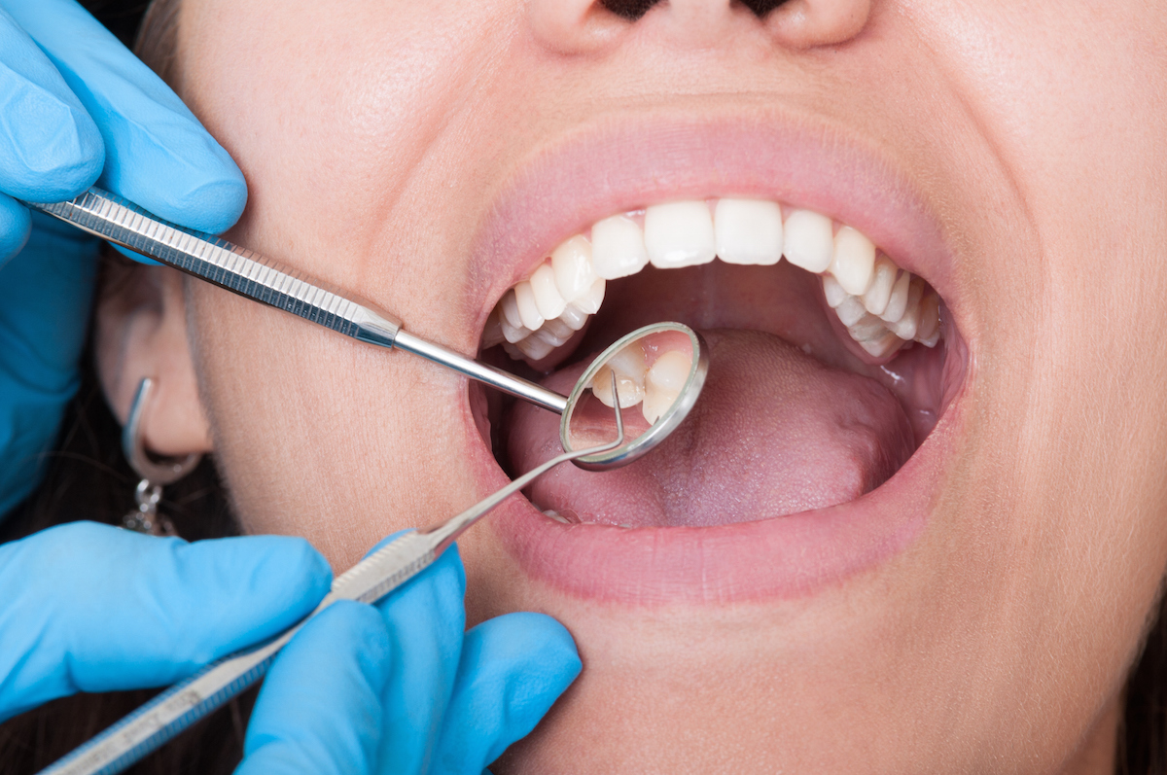
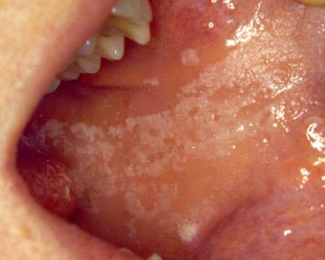
Role of the dental team & patient impact
It is important to record, monitor and bring awareness to the patient of any findings of Hyperkeratinized tissue.
These changes in the epithelium are reversible if the source of the injury is removed, but it can take time for the keratin to be shed by the tissue.
It is also important to follow through with any malignant changes seen. Especially for patients with a high-risk of cancer, history of chronic tobacco or alcohol use or those who are HPV (human papillomavirus) positive.

Slide 8
In summary
Hyperkeratinization of the oral mucosa occurs mainly due to trauma, chemical and frictional irritation, as well as grinding and clenching.
It commonly occurs in the buccal mucosa and is characterized by white rough calloused ridges.
Other causes of keratinization include smoking and drinking extremely hot liquids.
This is largely reversible once the offending agent(s) are removed and should be monitored during patient check ups.

Slide 9
The end

