Slide 1
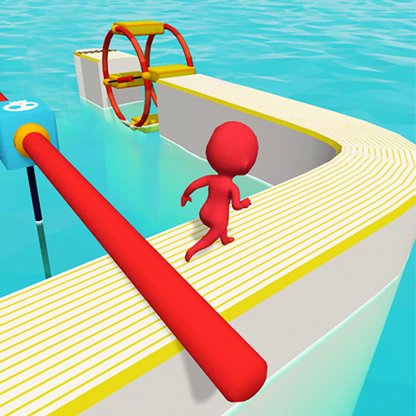
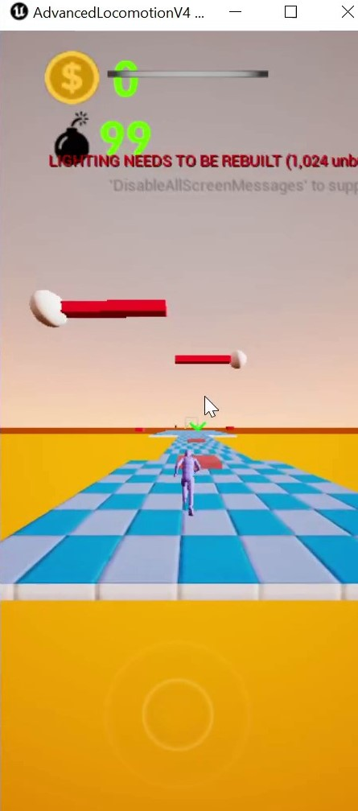
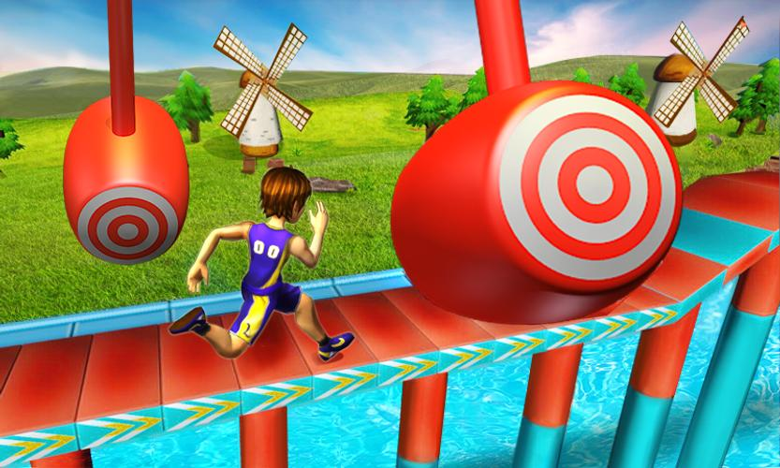
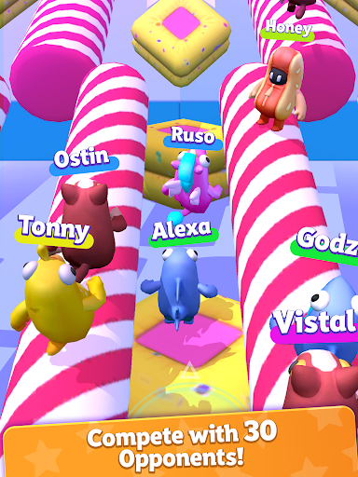
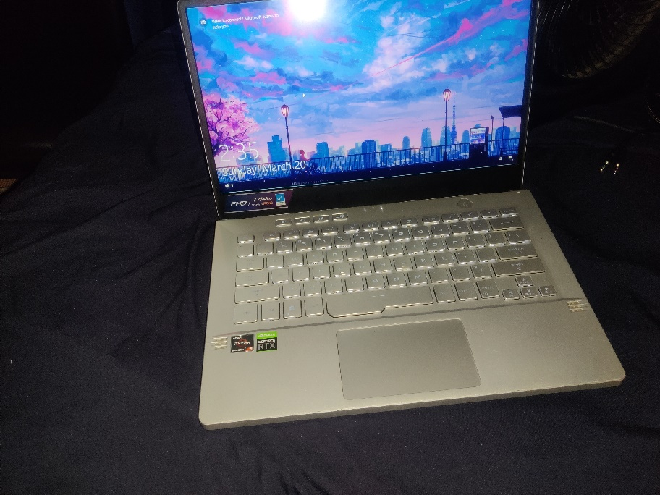
PROJ OBBY Keon: Game designer Department of Entertainment Technology
Introduction
Me and my friend has never made a game. Despite us studying it for years. We wanted to do something we can publish and feel proud off. So, we deiced on an Obstacle course for mobile Devices
Area of Study: Media Design
My role: Game designer, level designer, social media marketer, and sound designer. Any process that needs help I will be involved.
The skills include:
1. Unreal engine experience
Problem solving
Research and development
3d modeling experience
Audio experience
Overall goal: To make it to beta release by culmination presentation
The Process: Work remote in unreal engine with GitHub.
Method :
Google docs
GitHub
Facebook messenger
Results
What would show success is someone playing the game and Having fun
Hypothesis
Am I able to use what I learned in city tech the past 4 years to make a game.
Conclusion
We hope to conclude with our game being published to the google plays store. If everything goes according to plan, we will be able to make even more games and better
Inspiratio
fun race 3d
-Amazing run
-RUN GUYS
-wacky run
-Stickman parkour
-SMASHING RUSH
resources:
Unreal Engine
Google play store
asus zephyrus g14
Fl studio
Google ads
Mixamo
zasplat
Budget
Acknowledgement
CHRISTOPHER CHUNG

