Slide 1
Hyperkeratosis
By: Kristen Seiwell - Adams

Slide 2
What is Keratin?
Keratin is a tough, fibrous, opaque, water-proof protein that does not allow passage of pathogenic invasion. It is also resistant to friction.
Stratified Squamous epithelium can be Keratinized or Non-Keratinized

Slide 3
Oral Mucosa
The epithelium lining the floor of the mouth, the ventral side of the tongue, the buccal mucosa, and the soft palate is nonkeratinized.
The epithelium associated with the gingiva and hard palate is usually keratinized. The dorsal surface of the tongue is also keratinized, but it is referred to as specialized mucosa because of the presence of papillae.

Slide 4
So… What is Hyperkeratosis?
Hyperkeratosis: is a thickening of the outer layer of the oral mucosa.
This skin thickening is often part of the skin's normal protection against rubbing, pressure and other forms of local irritation.
Common Causes:
Examples: Bruxism, cheek biting, smoking, othodontic treatments and dentures.
It also causes calluses and corns on hands and feet. It can cause whitish areas inside the mouth

Slide 5
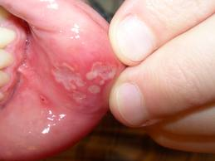
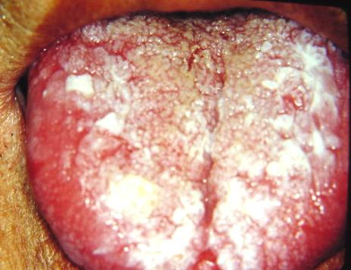
hyperkeratosis

Slide 6
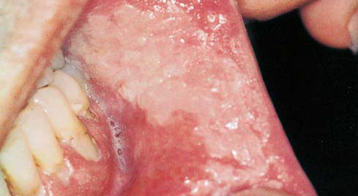
Chronic Cheek Biting of the Buccal Mucosa

Slide 7
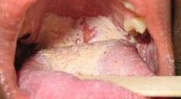
Caused by Dentures

Slide 8
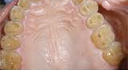
Severe Hyperkeratosis

Slide 9
How can Dental Hygienists help?
We can recommend:
Quitting smoking
Treatment for Bruxism, such as a bite plate
Brushing your tongue, during routine brushing of teeth
Refer to Dentist where the irritation of dentures or ortho appliances.
Example: give the patient wax where the ortho appliance may rub or filing down a part of a denture that may cause the irritation.

