Slide 1
Myasthenia gravis
By: Kristen Adams
Diana Betancourt-Arboleda
Francesca Messina

Slide 2
What is myasthenia gravis (MG)?
Greek and Latin origin meaning “grave muscular weakness”
MG is not however as fatal as the word grave implies
MG is a chronic autoimmune neuromuscular disorder that causes fluctuating muscle weakness and fatigue
The immune system attacks the body’s own tissues
interrupts the connection between nerve and voluntary muscles at the neuromuscular junction

Slide 3
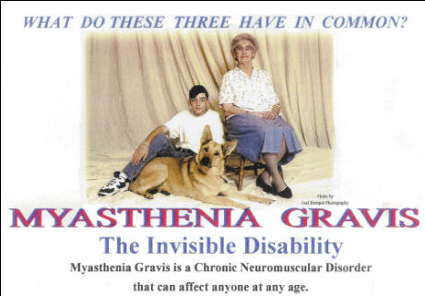
prevalence

Slide 4
The role of antibodies in MG
Antibodies are proteins that play an important role in the immune system
Antibodies usually protect us against foreign proteins known as antigens that are bad to have in your body such as bacteria and viruses
For reasons that have not yet been understood, when a person has MG, their immune system makes antibodies that fights against their own body
The antibodies destroy the receptor sites more rapidly than the body can replace them
Muscle weakness occurs when acetylcholine cannot activate (bind) to the receptor sites at the neuromuscular junction

Slide 5
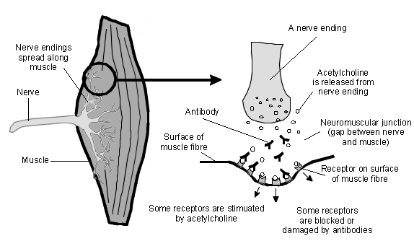

Slide 6
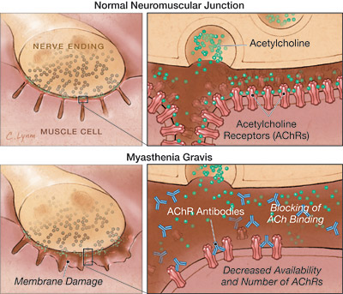

Slide 7
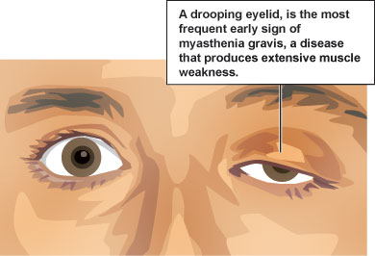
Symptoms
Symptoms may become more severe over time
Most Common Symptoms :
A drooping eyelid (ptosis)
Blurred or double vision (diplopia)
Slurred speech
Difficulty chewing and swallowing
Weakness in the arms and legs
Chronic muscle fatigue
Difficulty breathing

Slide 8
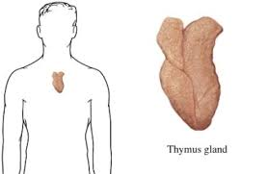
Thymus gland
The Thymus gland is located in the chest and lies beneath the breast bone
Scientists believe the thymus gland may give incorrect instructions to developing immune cells, ultimately resulting in autoimmunity and the production of the acetylcholine receptor antibodies, thereby setting the stage for the attack on neuromuscular transmission.

Slide 9
Diagnosis

Slide 10
Diagnosis
Most used tests to diagnose MG:
Blood Test
Electromyography (EMG) Test
Repetitive Nerve Stimulation
Imaging tests are used to see the Internal structures of the body:
CT scan
MRI

Slide 11
Treatment & Medications

Slide 12
anticholinesterase medications
First line of treatment and varies in effectiveness from
patient to patient
Acetylcholinestrase inhibitors work by increasing the amount of available acetylcholine at the neuromuscular junction by inhibiting the break down of acetylcholine
This drug only treats symptoms of MG
Pyridostigmine (Mestinon) is the most commonly used drug, up to 1500mg divided into 5-6 doses a day
Adverse side effects include abdominal cramping, diarrhea, increased salivation and bronchial secretions, nausea, sweating, and bradycardia

Slide 13
CORTICOSTEROIDS
Corticosteroids are used in addition to Pyridostigmine when it is not effective alone. They suppress the immune system by reducing activity and volume of lymphatic system
Corticosteroid therapy begins with initial high doses and then tapering it to the lowest dose to maintain the response
Prednisone is the most common Corticosteroid used today
General dosing range is 5-60mg a day
Patients on Prednisone are encouraged to eat a low sodium, calorie, and carbohydrate diet, and to take calcium and Vitamin D supplements in order to minimized side effects

Slide 14
azathioprine
Azathioprine (Azasan or Imuran) is an antimetabolite used to suppress cell proliferation
It is used in conjunction with Prednisone in order to suppress the immune system
The recommended starting does is 50mg per day and then after one week increase to 2-3 mg a day
Blood cell count and liver functions should be monitored monthly
Adverse side effects include hepatotoxicity and leukopenia

Slide 15
cyclosporin
Cyclosporin (Gengraf, Neoral, and, Sandimmune) is an immunosuppressant that inhibits T-helper cells
Recommended dosing is 1-3mg a day
Adverse effects include hypertension, hepatotoxicity, and nephrotoxicity, hair loss, nausea, vomiting, anorexia, and skin discoloration
Because of undesirable effect, this drug is limited to use in those not responding to other immunosuppressive treatments

Slide 16
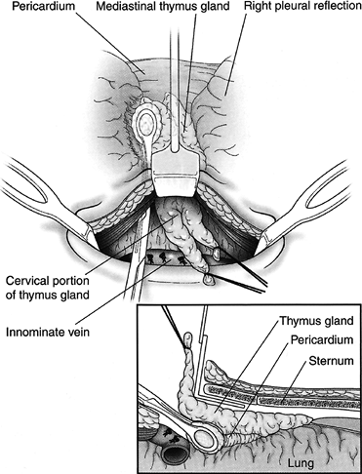
thymectomy
The Thymus gland is a source of AchR antibodies, therefore a Thymectomy is considered to be beneficial in patients with MG
Removal of the gland is beneficial in patients under the age of 60
Surgical treatment is strongly recommended for patients with thymoma
Risks exist as in all surgical procedures

Slide 17
Plasmapheresis
Plasmapheresis, also known as Plasma exchange, is the process of withdrawing whole blood from a person
With this procedure you are removing and replacing the liquid portion (plasma) from the blood and then transfusing the blood, with all its red and white blood cells back into the person
Plasmapheresis works by removing AchR antibodies from the circulating plasma of the patient
It is beneficial to patients experiencing MG crisis and also in patients about to undergo or have done a Thymectomy
A general course of plasmapheresis consists of removing 3-5 liters of plasma every session at up to 6 sessions
Side effect include dizziness, nausea, and cardiac arrhythmias

Slide 18
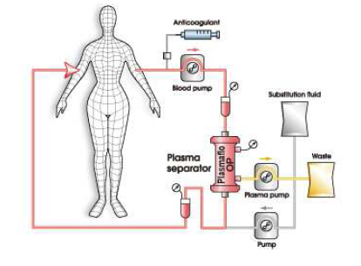

Slide 19
Iv immune globulin
Intravenous Immune Globulin therapy is an off labeled use
Dosing is 2000mg per treatment course over 2-5 days. The MOA of IVIg is complex, factors include inhibition of cytokines competition with autoantibodies, and inhibition of complement deposition
Interference with the binding of Fc receptor on macrophages, Ig receptor on B cells, and interference with antigen recognition by sensitized T cells are other mechanisms
IVIg is considered to be safe but rare cases of complications do occur such as thrombosis due to increased blood viscosity and other complications related to large volumes of the infused preparation
Compared to plasma exchange, IVIg is similar in terms of efficacy, mortality, and complications. However, plasma exchange has considerable cost advantages over IVIg

Slide 20
Physical therapy
A rehabilitation program in combination with other forms of medical treatment can help relieve symptoms and improve function in MG
The primary goal is to build the individual’s strength to facilitate activities of daily living and/or work related activities
The intensity and progression of the exercise depend on the stage of the disease and overall health
Physical therapy is beneficial for long-term restoration of muscle strength
Occupational therapy helps the individual adapt to new ways of performing daily living tasks using energy conservation and compensatory techniques
Speech therapy for training of esophageal speech following a tracheostomy
Psychological interventions to cope with the illness may be necessary

Slide 21
Case Study

Slide 22
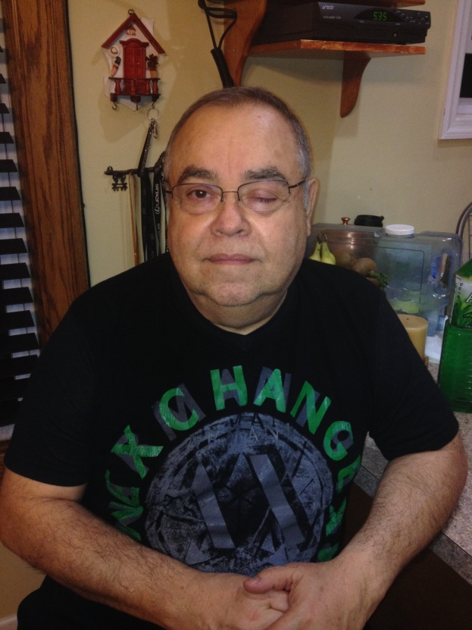
Male;64 yrs old; Hispanic
Diagnosed in 2002 (53 yrs old)
Initial symptoms included:
Drooping of left eyelid (ptosis)
Double vision (diplopia)
Difficulty in speaking
Difficulty in swallowing
He went undiagnosed for 1 yr until one of his passengers (MD from Argentina) recognized his symptoms and recommended he get tested for Acetylcholine Receptor Antibody
a blood test for the abnormal antibodies
Approximately 85% of MG patients have this antibody and, when detected with an elevated concentration the AChR antibody test strongly indicates MG
AChR antibody level was 3x than the normal count

Slide 23
Treatment & medications
Under the care of a Neurologist
In 2003, underwent a thymectomy to lessen the severity of the MG weakness
Medications include:
Pyridostigmine 60mg 5xday
Mestinon 180mg 1xday (at bedtime)
Under periods of crisis which include drooping of his left eyelid, weakness in arms and legs, and difficulty in speaking, he is prescribed Prednisone 50mg for 10 days
In 2010, he suffered his worse crisis to date, affecting his respiratory system
Due to the severity of the crisis, he underwent plasmapheresis
Typically his energy levels tends to diminish as the day goes on therefore most of his activities of the day must occur during the part of the day

Slide 24
Role of dental Hygienist
Review Medical history thoroughly
Become aware of adverse effects, drug interactions, and potential contraindications
Effects on Dental Treatment
Main effect under these medications is Dysphagia
Use caution when using the cavitron
Management in patient care

Slide 25
Q&A
Patients currently taking these medications are encouraged to eat a low sodium, calorie, and carbohydrate diet, and to take calcium and Vitamin D supplements.
Azathioprine
Corticosteroids
Anticholinesterase
NSAIDS

Slide 26
Q&a
2.

Slide 27
Q&A
3.

Slide 28
Q&A
4.

Slide 29
reference
Armstrong, S M. and Schumann, L. “Myasthenia Gravis: Diagnosis and Treatment.” Clinical Practice, Vol. 15, Issue 2, (Feb 2003): 72-78. Web. 2 Dec. 2013
Trouth, A J., Dabi, A, Solieman, N, Kurukumbi,M , and Kalyanam, J. “Myasthenia Gravis: A Review.” Autoimmune Diseases, Vol. 2012, Article ID 874680: 1-10. Web. 2 Dec. 2013
Wynn, R L., Meiller, T F., and Crossley, H L. Drug Information Handbook for Dentistry. 19th ed. Ohio: Lexicomp, 2013. Print
Barth, Jeffrey, MD. "Myasthenia Gravis." — UVA Health. N.p., n.d. Web. 08 Dec. 2013.
Myasthenia.org – Myasthenia Gravis Foundation of America, Inc.
Photo Credits:
http://www.nation.lk/2010/05/09/eyefea2.htm
http://www.patient.co.uk/health/Myasthenia-Gravis.htm
http://doubledoseradio.com/?p=180
http://alibi.com/blog/s/health/32123/Vitals-and-Bits-Inaugural-Entry-The-Thymus-Gland.html
http://www.asahi-kasei.co.jp/medical/en/personal/cure/img/cure01/image_01.gif
Hernan Betancourt

