Slide 1
Spina Bifida
By judy lam
Den 1114 d020

Slide 2
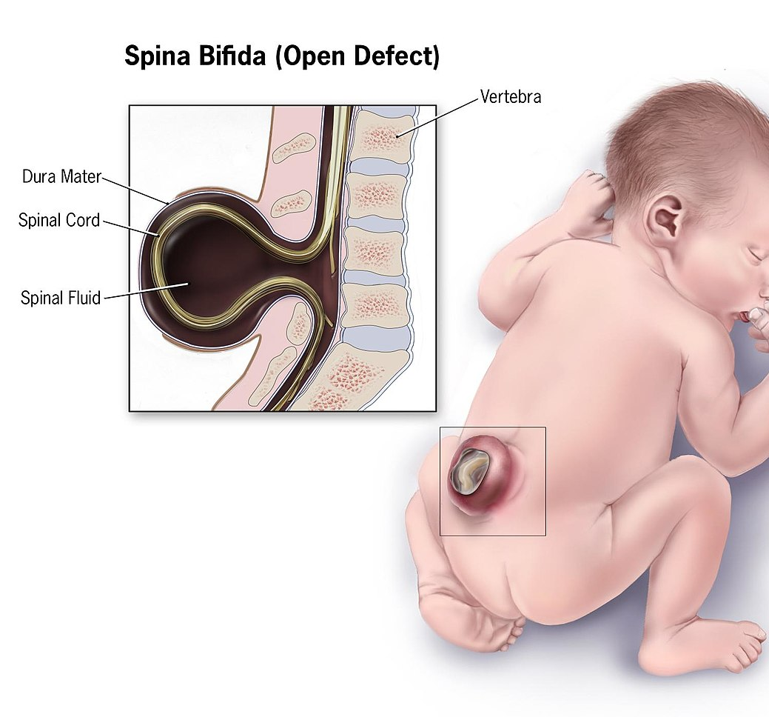
What is Spina Bifida?
Spina Bifida is a birth defect in which a developing baby’s spinal cord fails to develop properly during the first month of pregnancy.
It can occur anywhere along the spine if the neutral tube does not close all the way. If the neutral tube does not close all the way, the backbone of the spinal cord does not form and close as it should.

Slide 3
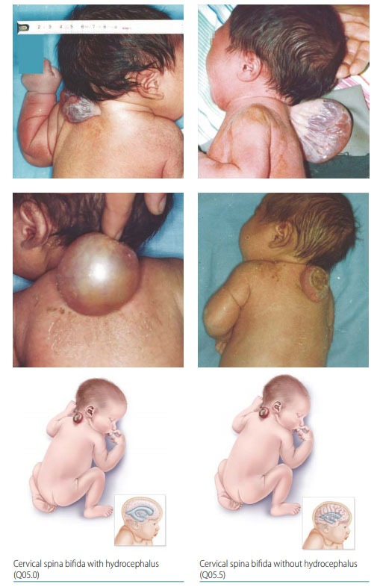

Slide 4
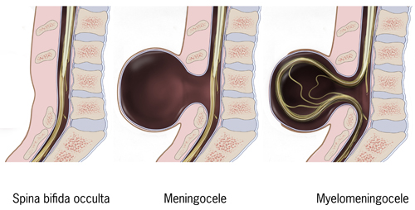
Types of Spina Bifida
Spina Bifida Occulta: is the mildest type of Spina Bifida. Also called “hidden” Spina Bifida. There is a small gap in the spine, but no opening or sac on the back.
Meningocele: a sac of fluid comes through an opening in the baby’s back, but the spinal cord is not in the sac.
Myelomeningocele: is the most serious type of Spina Bifida. A sac of fluid comes through an opening in the baby’s back and part of the spinal cord and nerves in this sac are damaged, causing moderate to severe disabilities, such as paralyzation of the legs or feet.

Slide 5
What causes Spina Bifida and how does it affect a person’s developmental process?
There is no real cause of Spina Bifida, but it is thought to result from a combination of genetic, nutritional and environmental risk factors, such as a family history of neutral tube defects and folate (vitamin B-9) deficiency.
Women who are obese (have a body mass index of 30 or more) are more likely to have a child with Spina Bifida that those of average weight.
Women with diabetes may also have an increased risk of having a child with Spina Bifida.
Spina Bifida can cause a wide range of symptoms, including problems with movement, bladder and bowel problems, and problems associated with hydrocephalus (excess fluid on the brain).
If the birth defect is higher up the spine, paralysis of the legs and lack of mobility is more likely to occur.

Slide 6
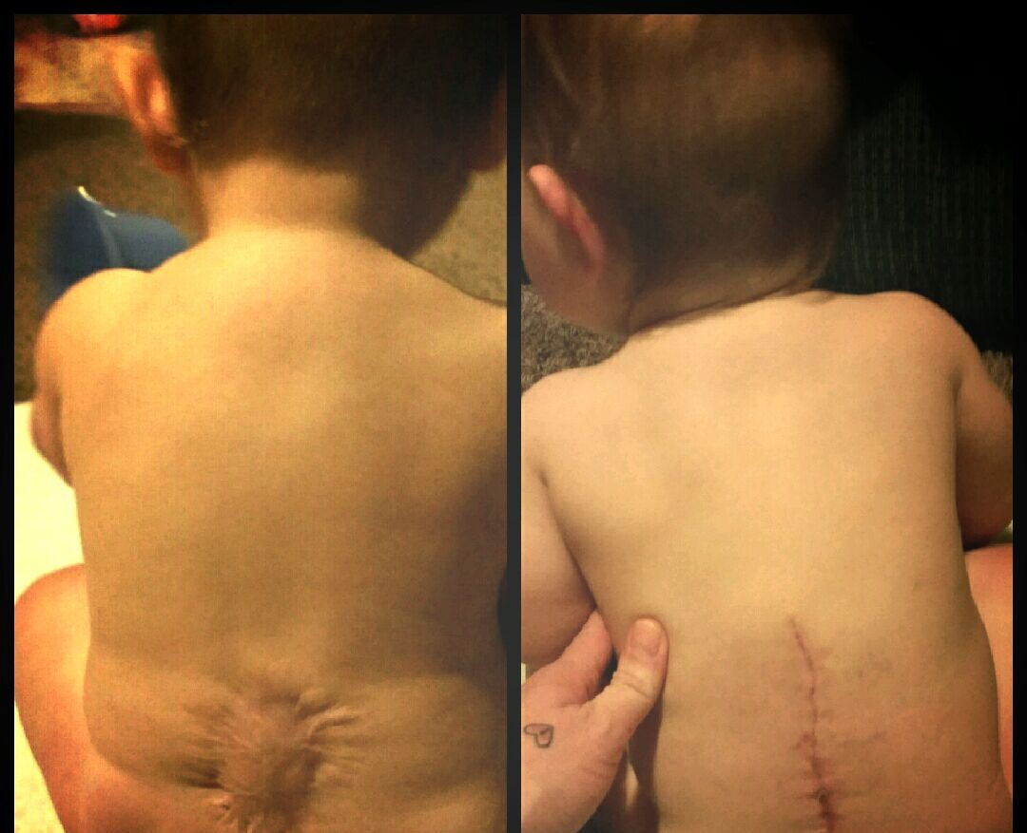
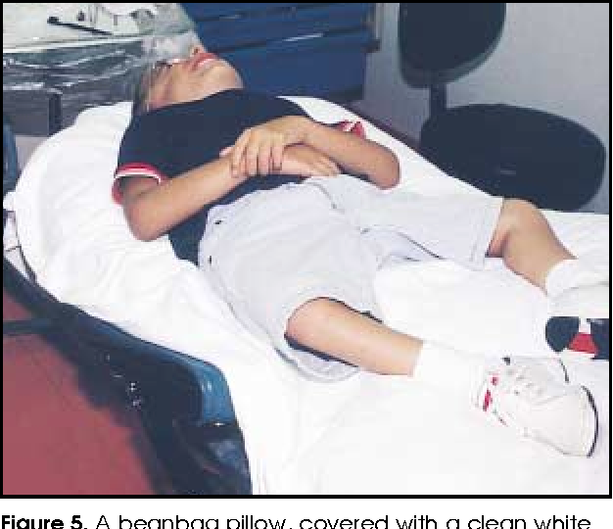
Treatments and the role of the dental team
Traditional Spina Bifida treatment takes the form of surgical repair 24 to 48 hours after birth.
Patients with Spina Bifida who have ventriculoatrial, ventriculocardiac, or ventriculovenus shunts for hydrocephalus are at risk of bacteremia due to their vascular access; therefore documentation of this on the medical history and premedication is required before the patient is seen by the oral healthcare provider.
Children with Spina Bifida are at increased risk of latex allergy, which is why the oral healthcare provider should have this documented down and make sure all disposable gloves are latex free.
Making any adjustments to the chair to make sure the patient feels comfortable and safe.
Bringing awareness to the patient with Spina Bifida is vital to every dental visit.

