Slide 1
Pink Matter
Julisa Tufino-Santos

Slide 2
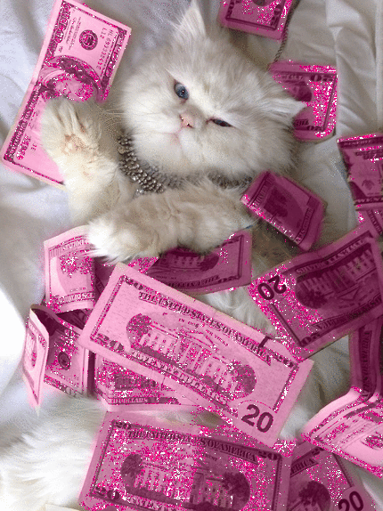
The Vision
“Welcome to Pink Matter. Here at Pink Matter we want everyone to feel confident and fabulous in their own unique way. We believe in bringing quality products while not breaking your bank. Everyone can be a baddie on a budget.”
Ready-To-Wear

Slide 3
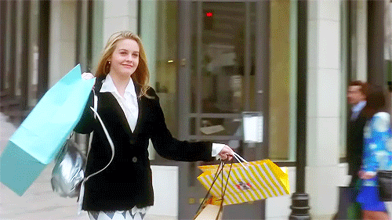
Demographics
Although we may be a clothing company that’s fun and flirty, Pink Matter is available for EVERYONE no MATTER age, race or sex.
We will not label our clothing based on gender.
16-25 year old gap

Slide 4
Psychographic
Customer is outgoing and always wearing what's trending
Goes to social events
High School – first years of College

Slide 5
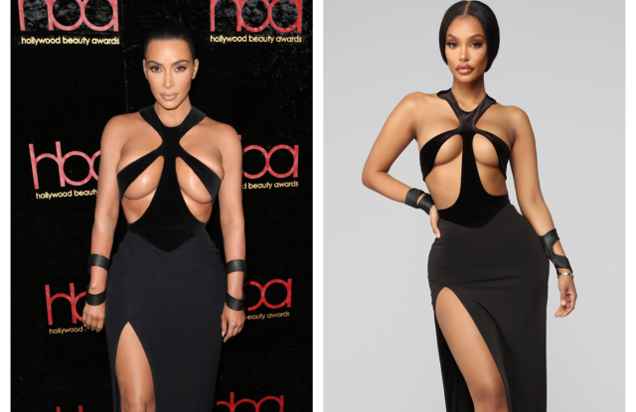
Competition
Pretty Little Thing
Missguided
Fashion Nova

Slide 6
Marketing
Real people Real bodies !!!
Small start influencers
Social media such as Instagram Tik Tok

Slide 7
FW/19
Doll Dress: Off the shoulder black dress
70% Rayon
30% Nylon
$70

Slide 8
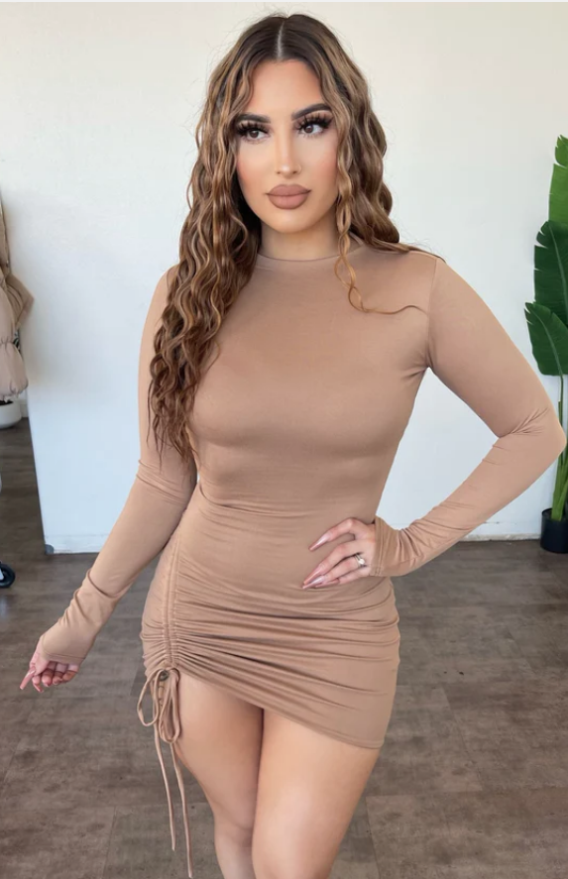
Lucy Dress
Lucy Dress in Beige
95% Nylon
5% Spandex
$40

Slide 9
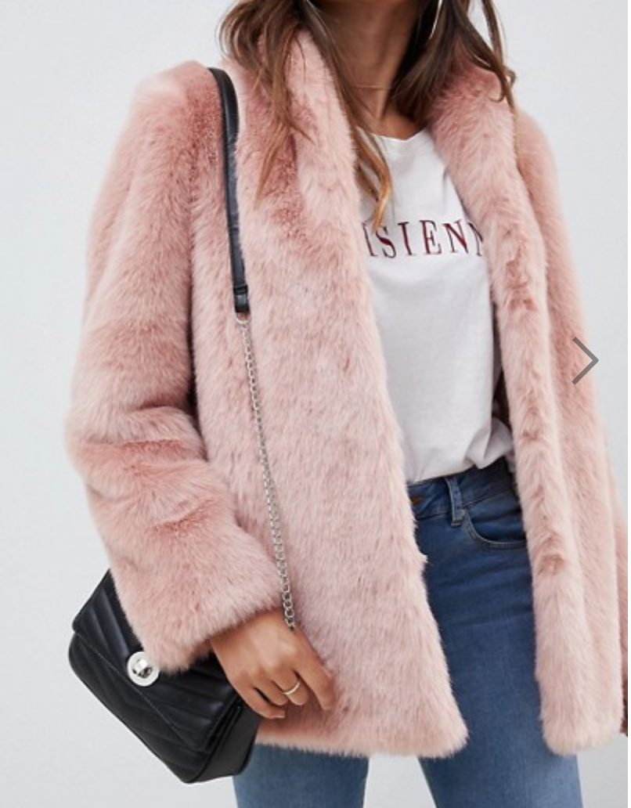
Barbie Dreams: Pink Faux Fur Coat
2 inside pockets
Made with Polyester
$95

Slide 10
Resources:
Giphy. (2019, April 30). Amy Poehler GIF - Find & Share on GIPHY. Retrieved May 10, 2019, from https://giphy.com/gifs/funny-amy-poehler-ad-YU1ju4T8uNfji
Ilchi, L. (2019, February 19). Kim Kardashian Calls Out Fast-fashion Brands for Designer Knock-offs. Retrieved May 10, 2019, from https://wwd.com/fashion-news/fashion-scoops/kim-kardashian-fashion-nova-mugler-knockoff-1203037428/
Black lace. (n.d.). Retrieved from https://www.ootdfash.com/search?q=black lace
ASOS DESIGN stand collar faux fur coat. (n.d.). Retrieved from https://us.asos.com/asos-design/asos-design-stand-collar-faux-fur-coat/prd/9441085
Glowin' Match My Drip Rhinestone Set. (n.d.). Retrieved from https://www.dollskill.com/neon-rhinestone-studded-crop-top-high-waist-skirt-set-lime-green.html

