Slide 1
Mastering storytelling in photojournalism The Multimodal Project
By: Jodieann J. Stephenson
Notes:
Mastering Storytelling in Photojournalism?
What is a Multimodal project ?

Slide 2
New technologies in digital media have changed the traditional ways of storytelling in photojournalism
Storytelling- is a method of explaining a series of events through narrative.
Photojournalism- is a particular form of journalism (the collecting, editing, and presenting of news material for publication or broadcast) that employs images in order to tell a news story.
Digital media- is any media that are encoded in a machine-readable format. Digital media can be created, viewed, distributed, modified and preserved on computers or smart phones.
Notes:
Storytelling- is a method of explaining a series of events through narrative
Photojournalism- is a particular form of journalism (the collecting, editing, and presenting of news material for publication or broadcast) that employs images in order to tell a news story.
Digital Media- are any media that are encoded in a machine-readable format. Digital media can be created, viewed, distributed, modified and preserved on computers.

Slide 3
The shift to digital media technologies
Claims
““The evolution of visual media is a drawn-out process, and only in the last few years has storytelling rapidly changes.” – Cohen & Kenny (143)
Affords individuals a chance to interact with stories in a more visceral way
Promotes user engagement in social platforms
These stories may appeal to a viewer’s emotions
Affect how a viewer responds to visual texts
The constraints of the shift minimizes certain stories from being told
Notes:
User engagement-is an assessment of an individual's response to some type of offering, such as a product, a service or a website.

Slide 4
The MEDIATED CONNECTION via Humans of new york
Humans of New York is a photo blog which shares stories via Facebook, Instagram, Twitter
The photo blog tackles questions such as sexism, freedom etc.
I gravitated to this photo because how explicit it spoke about loss
Many users engaged with the story which captured my attention
It is a unique platform to share your story
Anonymity
Notes:
A popular site that uses storytelling and visual rhetoric through various social media platform is Humans of New York, a photo blog by Brandon Stanton. The photo blog introduces viewers to various stories that explore issues such a sexism, freedom and loss just to name a few and in doing so has vastly changed storytelling.
is an assessment of an individual's response to some type of offering, such as a product, a service or a website.

Slide 5
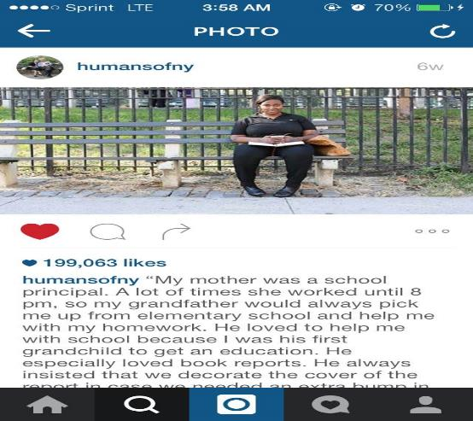
Humans of New york by Brandon Stanton
Photos from Human of New York

Slide 6
The GOAL
To create three images by using Humans of New York Best Practices and track the user engagement.
The Purpose
By understanding user engagement on different social media sites, one can tailor the message for a specific audience which can contribute to a more successful story delivery.
Deliverables
A Word Document on Humans of New York (HONY) 10 Best Practices
Three images that successfully mirrors HONY. The images will be located on Facebook, Instagram, Twitter and my personal blog Black Attire Aficionado

Slide 7
how to define success?
Deliverables
Elements to consider
Likes
Favorites
Views
Comments
Authentic

Slide 8
top 10 Humans of new York best practices
Deliverables
1. INTERVIEW ANYONE (regardless of age, race, sex, classism etc.)
2. POST CONTENT DAILY to all social media sites
3. BREAK UP Content to parts (1/2) (2/2)
4. Does Not chime in on user comments or geopolitical issues
5. Maintain anonymity
6. Transparency
7. Share original photos
8. Curate content for specific social media site
9. Stay true to the brands’ identity
10. Does not accept sponsorship

Slide 9
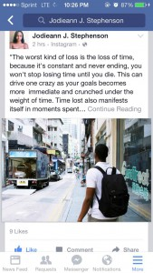
IMAGE 1: The Loss of Time
Deliverables
Quote “The worst kind of loss is the loss of time, because it's constant and never ending, you won't stop losing time until you die. This can drive one crazy as your goals becomes more immediate and crunched under the weight of time.” READ MORE
Notes:
The worst kind of loss is the loss of time, because it's constant and never ending, you won't stop losing time until you die. This can drive one crazy as your goals becomes more immediate and crunched under the weight of time. Time lost also manifests itself in moments spent with others, it's a little scary how long we can go without seeing someone or doing something and be instantly reminded of that once we see the person or participate in that activity again. Our memories remind us of how fast time flies and how if we don't use it responsibly we can waste a lot of time, as time waits for no one” #Humans of NY

Slide 10
Image 1: the loss of time
Deliverables
Analytics and information/ User Engagement
Facebook: 10 likes, 3 comments
Twitter: 262 engagements
Instagram: 20 likes, 3 comments
Black Attire Aficionado: 13 views
Popular response: “So true”

Slide 11
IMAGE 2: The Loss of Laughter
Deliverables
Quote "I'm afraid of losing my ability to laugh during moments of hard times. My laugh is what I cherish most of all. Sometimes there are people who come into your life whose purpose is to destroy you and by some miracle it changes you. Often times this can make you a better person and other times it can make you bitter.” READ MORE
Notes:
"I'm afraid of losing my ability to laugh during moments of hard times. My laugh is what I cherish most of all. Sometimes there are people who come into your life whose purpose is to destroy you and by some miracle it changes you. Often times this can make you a better person and other times it can make you bitter. My laugh is infectious and youthful and losing it is a constant fear of mine. . ."

Slide 12
Image 2: the loss of laughter
Deliverables
Analytics and information/ User Engagement
Facebook: 36 likes, 3 comments
Twitter: 190 engagements
Instagram: 35 likes, 1 comment
Black Attire Aficionado: 11 views

Slide 13
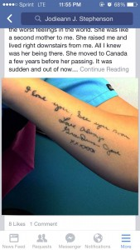
IMAGE 3: A Granddaughters Loss
Deliverables
Quote “Losing my grandmother was one of the worst feelings in the world. She was like a second mother to me. She raised me and lived right downstairs from me. All I knew was her being there. She moved to Canada a few years before her passing.” READ MORE
Notes:
Losing my grandmother was one of the worst feelings in the world. She was like a second mother to me. She raised me and lived right downstairs from me. All I knew was her being there. She moved to Canada a few years before her passing.

Slide 14
Image 3: the loss of a grandmother
Deliverables
Analytics and information/ User Engagement
Facebook: 10 likes, 1 comment
Twitter: 160 engagements
Instagram: 33 likes
Black Attire Aficionado: 4 views

Slide 15
What if the numbers don’t matter?

Slide 16
conclusion
Mastering storytelling in photojournalism is NOT about the amount of likes or comments the image receives but about the story having a platform to be shared on
It’s not about the analytics but about the story
Each of our stories matter and the structures that places a limitation on what stories are shared need to be destroyed

Slide 17
Q&A Session
Out of the three stories I created, which resonated the most to you and why?
Do you prefer to WATCH a story on the TV or do you prefer to READ a story via social media sites?
What is your favorite best practices for social media engagement?

Slide 18
Works Cited
Hariman, Robert and Louis, John. “Visual Rhetoric, Photojournalism, and Democratic Public Culture” Rhetoric Review. Web. Indiana, 2001.
Abbott, Tristan. “The Importance of Storytelling, Big and Small.” Econtentmag. Web. August 2014.
Riesland, Erin. “Visual Literacy and the Classroom.” John Hopkins School of Education. Web. http://education.jhu.edu/PD/newhorizons/strategies/topics/literacy/articles/visual-literacy-and-the-classroom/
“What is Photojournalism?”wiseGEEK. Web http://www.wisegeek.org/what-is-photojournalism.htm
Jones, Corrine. “Brandon Stanton’s New York Stories.” The Guardian. Web. November 213.http://www.theguardian.com/artanddesign/2013/nov/03/brandon-stanton-humans-of-new-york-pictures
Choi, Amy. “The Art of Storytelling According to the Founders of Human’s of New York and StoryCorp.” Ideas.TED. Web. July 2015.
http://ideas.ted.com/the-art-of-storytelling-according-to-the-founders-of-storycorps-and-humans-of-new-york/
Cohen, James and Kenny, Thomas “Producing New and Digital Media- Your Guide to Savvy Use of the Web.” Chapter 6: Multimedia Storytelling. Focal Press Taylor and Francis Group 2016
Blais, Caroline, Caldara, Roberto, Fiset, Daniel, Jack E., Rachael, and Scheepers Christoph. “Culture Shapes How We Look at Faces” Plos. Web. August 2008 http://journals.plos.org/plosone/article?id=10.1371/journal.pone.0003022
Forant, Trish, “10 Social Media Best Practices for Brand Engagement” December 2013 http://www.exacttarget.com/blog/social-media-best-practices-for-brand-engagement/

