Slide 1
Cristobal Balenciaga (21st Century)
Jasmilex Sanchez Guzman
Research Paper
20th Century Dress and Culture
ARTH 1204

Slide 2
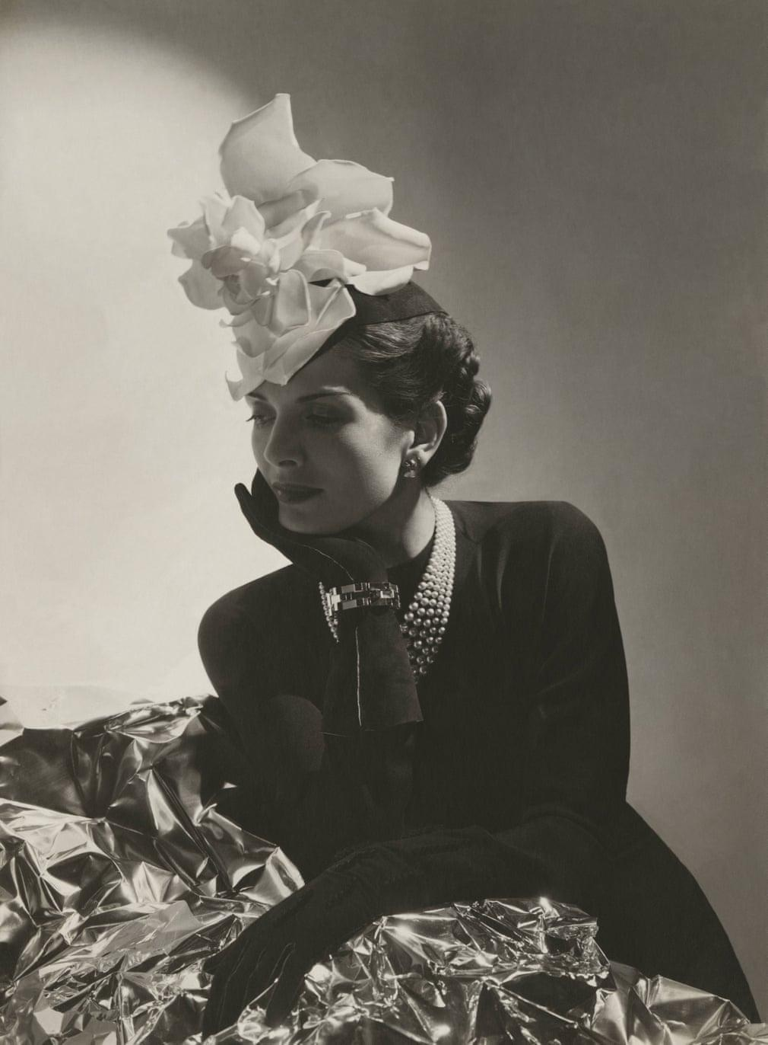
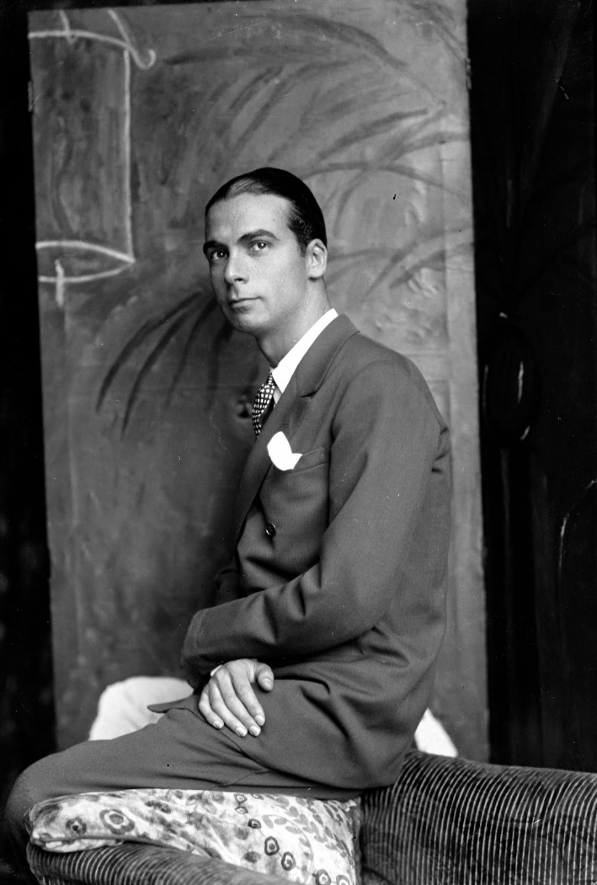
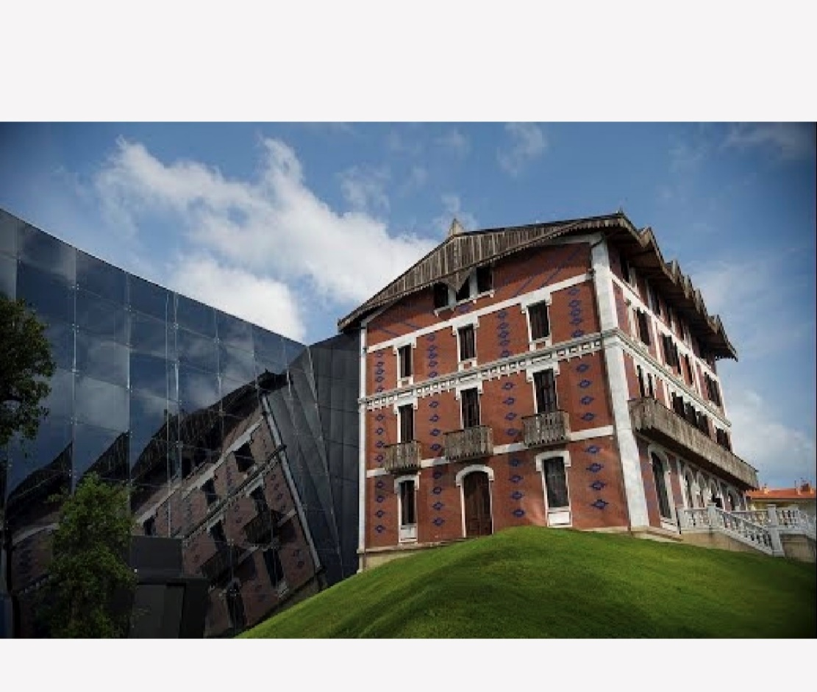
History: Cristobal Balenciaga (1895-1972)
Figure 2. Cristobal Balenciaga Museum, First House, Getaria, Spain, 2011
Figure 1. Photographer Boris Lipnitzki : Cristobal Balenciaga, 1927
Figure 3. Photographer Andre Durst, Vogue Magazine; Balenciaga Crepe Dress, 1937
Notes:
Cristobal Balenciaga was born in Getaria, Spain. At the age of 10, Balenciaga began to study dressmaking. Later on his father passed and away which led to Balenciaga to sew and make money from . 1 Cristobal Balenciaga, Britannica https://www.britannica.com/biography/Cristobal-Balenciaga, November 30, 2018
At a young age Balenciaga knew what he wanted to be in life which was a couturier and his dream true by the age of 20
In1917, Cristobal opened his own house in San Sebastian, Spain where he trained and had his garments.
His main inspiration for his love of dressmaking was his mother Martina Eizaguirre, she herself was a seamstress for the Marquesses of Casa Torres.2 Cristobal Balenciaga: The Early Years, Google Arts and Culture https://artsandculture.google.com/exhibit/VALimB4lq04sLg, November 30, 2018
He was never into letting public press into his showcase because he didn’t care much about there opinions
After finishing his collection, Balenciaga would then work right away on his next collection and would work for hours in his House in Getaria, Spain. 3 Mcdowell,Colin, Business of Fashion https://www.businessoffashion.com/articles/education/cristobal-balenciaga-1895-1972, November 30, 2018
Balenciaga created evening gowns, his main outstanding technique would be tailoring this garments
He admired great artist such as Givenchy, Diana Vreeland; Harper’s Bazaar editor and Christian Dior
1930’s Balenciaga showcased his first collection in Paris located at 10 Ave George Saint.
In his collection the dress that was featured on Vogue’s Magazine was the crepe dress 1937, but his Vogue cover wasn’t until 1950.3 Jones, Jo, The Guardian https://www.theguardian.com/fashion/gallery/2017/may/25/a-century-of-balenciaga-the-10-defining-moments-in-pictures#img-1, Decemeber 1, 2018
Balenciaga used fabrics such as taffeta ( a fine silk), silk gazar (plain woven sheer; matte finish), mohair, and wool.4 Colette, Blog Colette https://blog.colettehq.com/inspiration/cristobal-balenciaga-the-purist, December 2, 2018
Figure 1. Photographer Boris Lipnitzki : Cristobal Balenciaga, 1927
Figure 2. Cristobal Balenciaga Museum, First House, Getaria, Spain, 2011
Figure 3. Photographer Andre Durst, Vogue Magazine; Balenciaga Crepe Dress, 1937

Slide 3
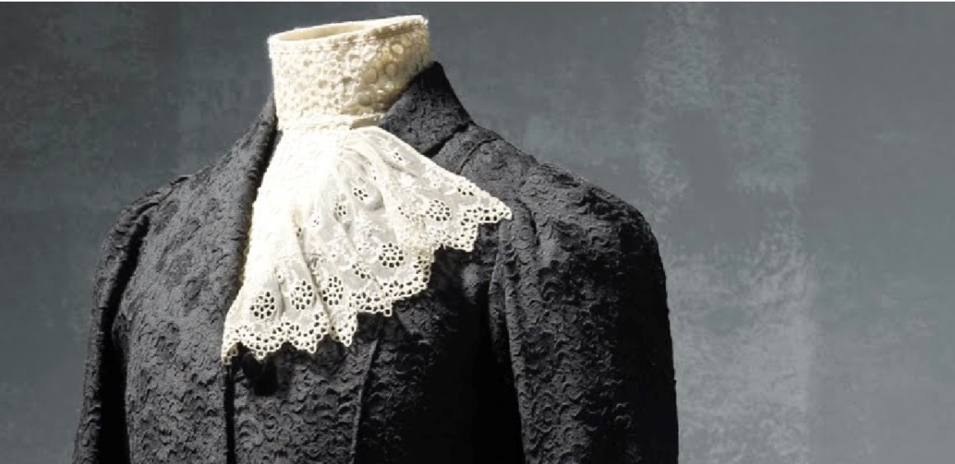
Balenciaga First Suit
Designer: Cristobal Balenciaga
Title: Tailored Suit
Date: 1912
Material: Black Woolen Bengaline (handmade)
Located: Cristobal Balenciaga Museoa, Spain
Notes:
This was Cristobal Balenciaga first suit that he had created in 1912
This dress was worn by Salvadora Egana Balenciaga for her honeymoon. 5Cristobal Balenciaga: The Early Years, Google Arts and
Culture https://artsandculture.google.com/exhibit/VALimB4lq04sLg, November 30, 2018
This suit consist of a jacket, bodice, skirt and a boned colored collar lace
The jacket can extend to the hips, it’s long sleeve arms
The collar of the neck has a V-cut that’s long and has cuffs in pleats.
The blouse that’s inside is made of black silk crepe.
This has a representation of how stiff collar were worn during the 20th century and how he constructed his first handmade suit like this around the neck.
Balenciaga suit later on became to a fashion trend in England where women would this suit for morning walks, and used for entering work
Figure 1 & 2: Cristobal Balenciaga Tailored Suit Black Woolen Bengaline (1912)

Slide 4
20th Century Balenciaga
Cocktail Dress
Designer House: House of Balenciaga ( Founded 1937
Designer: Cristobal Balenciaga
Date: Spring/ Summer 1948
Culture: French
Material: Silk and suede
Accession Number: C.I.58.34.28a, b
Notes:
The era of cocktail dress, this was Balenciaga take that was made of silk and suede.
Large poppy print in different shades of red, as well as green stem almost representing a rose.
The neckline is shaped into a V-cut, the bodice part is one-piece back and a two-side front.
One can put on this dress with fastened snaps and hook located in the front area of the dress.
Cocktail origin was around late 1929, where cocktail were hosted around 6-8p. ⁶ Toney, Bernard, Bring on the thirst https://bringonthethirst.wordpress.com/2013/12/02/the-origin-of-the-cocktail-dress/, November 30, 2018
Figure 1: Cristobal Balenciaga Cocktail Dress Satin and Suede 1948

Slide 5
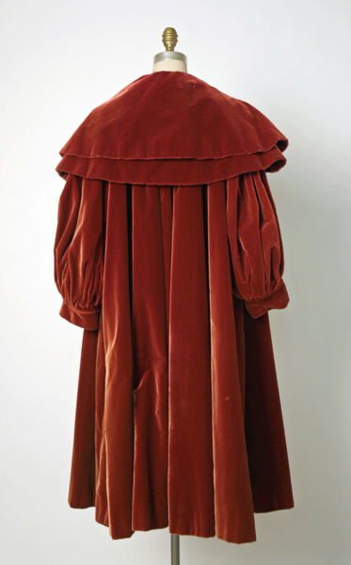
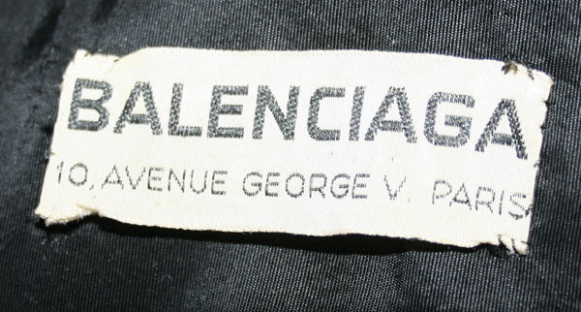
20th Century Balenciaga : Cont’d
Evening Coat
Designer House: House of Balenciaga ( Founded 1937
Designer: Cristobal Balenciaga
Date: Fall/ Winter 1950/51
Culture: French
Material: Silk
Accession Number: C.I.55.76.26
Notes:
His designs are pretty much French inspired.
This coat would be worn in the evening hence the name.
This coat has two circular cape collar that covers the front area, you can see the huge arms that resembles a puffed up balloon.
This type of coat would be worn by women with extreme wealth, which was Balenciaga's clients. 7 Cristobal Balenciaga, The Metropolitan Museum of Art https://www.metmuseum.org/art/collection/search/95477, December 2, 2018
This coat around Balenciaga era would cost a client roughly around $800
Figure 1, 2 & 3 Cristobal Balenciaga Evening Coat Silk 1950/51

Slide 6
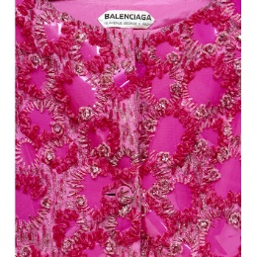
20th Century Balenciaga: Cont’d
Coat
Designer: Cristobal Balenciaga
Date: August 1961
Culture: French
Material: Faille embroidered with melanex, crystal beads, chenille and silk thread, and lined with silk
Accession Number: T.24-1974
Notes:
Around this time Cristobal popularized capes and oversized clothing
In the 60’s he started to use plastic in which he used plastic disc to form this garment
During the 20th century Balenciaga was known as the “ Father of late 20th century fashion”. 8 Mcdowell,Colin, Business of Fashion https://www.businessoffashion.com/articles/education/cristobal-balenciaga-1895-1972, November 30, 2018
Balenciaga would dress any women such as the Duchess of Windsor to Marella Agnelli
All his designs and life had to come to an end. January 1968 was Balenciaga last show in Paris
Balenciaga suddenly closes his house May 1968, which Diana Vreeland his most loyal client didn’t leave her room for three days according to WWD
March 25, 1972 the death of a living legend. Balenciaga passed away in Spain. Diane Vreeland who attended his funeral stated “ Balenciaga gave the world fashion, he was the beginning of everything”. 8 Park ,Jina, Koski, Lorna, WWD https://wwd.com/fashion-news/designer-luxury/a-balenciaga-timeline-10256184/, November 30, 2018

Slide 7
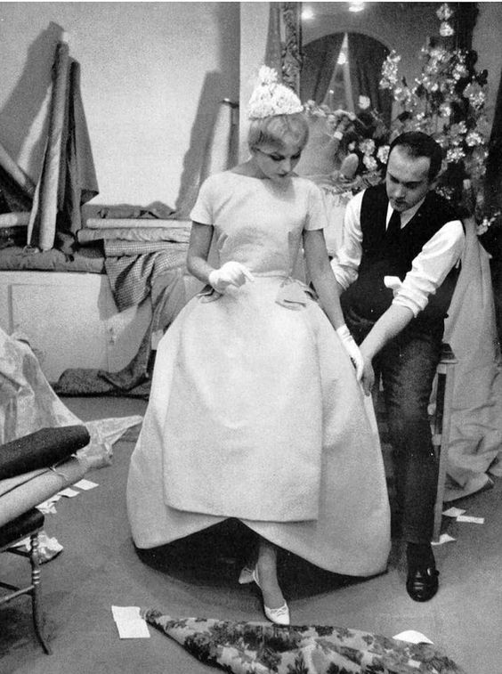
21st Century Balenciaga
Michel Goma : French Designer
Figure 1: Michel Goma Balenciaga Spring/Summer 91
Figure 2: Photographer Willy Maywald, Michel Goma in his atelier,1959
Notes:
Michel Goma a French designer born in 1932.
He had his own couture house in Paris during 1958-1963.
He later acquired Balenciaga during 1987-1992, in which he design ready-to-wear collection in October 1987. 9Park ,Jina, Koski, Lorna, WWD https://wwd.com/fashion-news/designer-luxury/a-balenciaga-timeline-10256184/, November 30, 2018
He bought color to his designs, he made the hem shorter, and chemise ( hanging straight, loose-fitting)
Then in 1992, Balenciaga was in hands of another designer Josephus Thimister
Figure 1: Michel Goma Balenciaga Spring/Summer 91
Figure 2: Photographer Willy Maywald, Michel Goma in his atelier,1959
Thimister reign didn’t last long, Nicolas Ghesquière took over from 1997-2012

Slide 8
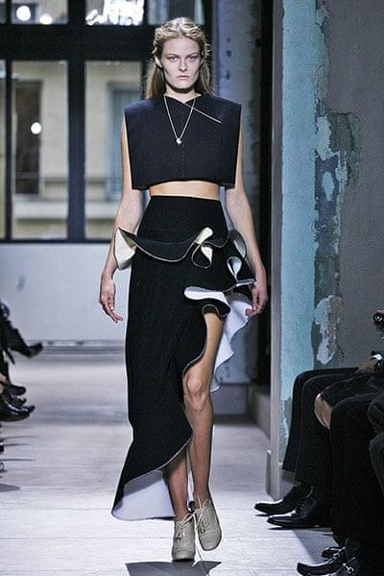
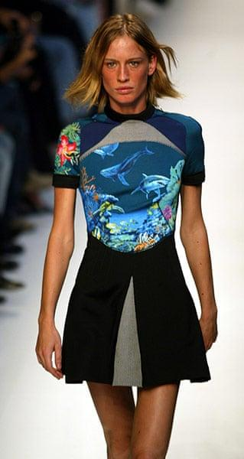
21th Century Balenciaga : Cont’d
Nicolas Ghesquiere: French Designer
Figure 1: Spring/ Summer Surf Scuba Collection, 2013
Figure 2. Photographer Juergen Teller, Nicolas Ghesquière, 2013
Figure 3. Spring/ Summer collection, Ghesquiere last show, 2013
Notes:
Nicolas Ghesquière born May 9, 1971, French was an assistant for Jean Paul Gaultier before he went to Balenciaga
He design clothes for the Japanese market which were suits and funeral clothing
In 1997 he was appointed to be the new creative director with a fresh new idea for Balenciaga
He had a unique style which consist of all about proportion and cuts, to slim tailored pants and cinched blazers.
Kering acquire Balenciaga house in 2001, in which they kept Nicolas.
The early 2000’s was a breaking point for his career and for Balenciaga he designed the Neoprene Dress
His inspiration for his designs especially the Neoprene dress were from Bowie, and Yamamoto
After 15 years of working in the house of Balenciaga he left the house and then became the creative director LV ( women)
2011 the Museum of Balenciaga opened their doors to showcase Balenciaga in Spain
Alexander Wang took over for three years December 2012 to July 2015. Wang bought minimalism and playfulness just like Cristobal.
The company owner and Wang decided to part way because they believed Wang wasn’t a good fit. 10 Sunnucks, Jack, Dazed http://www.dazeddigital.com/fashion/article/36080/1/balenciaga-designers-nicolas-ghesquiere-alexander-wang-demna-gvasalia, December 4, 2018
Figure 1: Spring/ Summer Surf Scuba Collection, 2013
Figure 2. Photographer Juergen Teller, Nicolas Ghesquière, 2013
Figure 3. Spring/ Summer collection, Ghesquiere last show, 2013

Slide 9
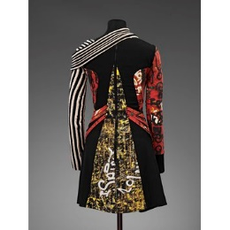
21th Century Balenciaga : Cont’d
Dress
Designer: Nicolas Ghesquière ( Balenciaga)
Date: 2004
Culture: French
Material: Rubberized and printed neoprene and wool
Accession Number:T.113-2011

Slide 10
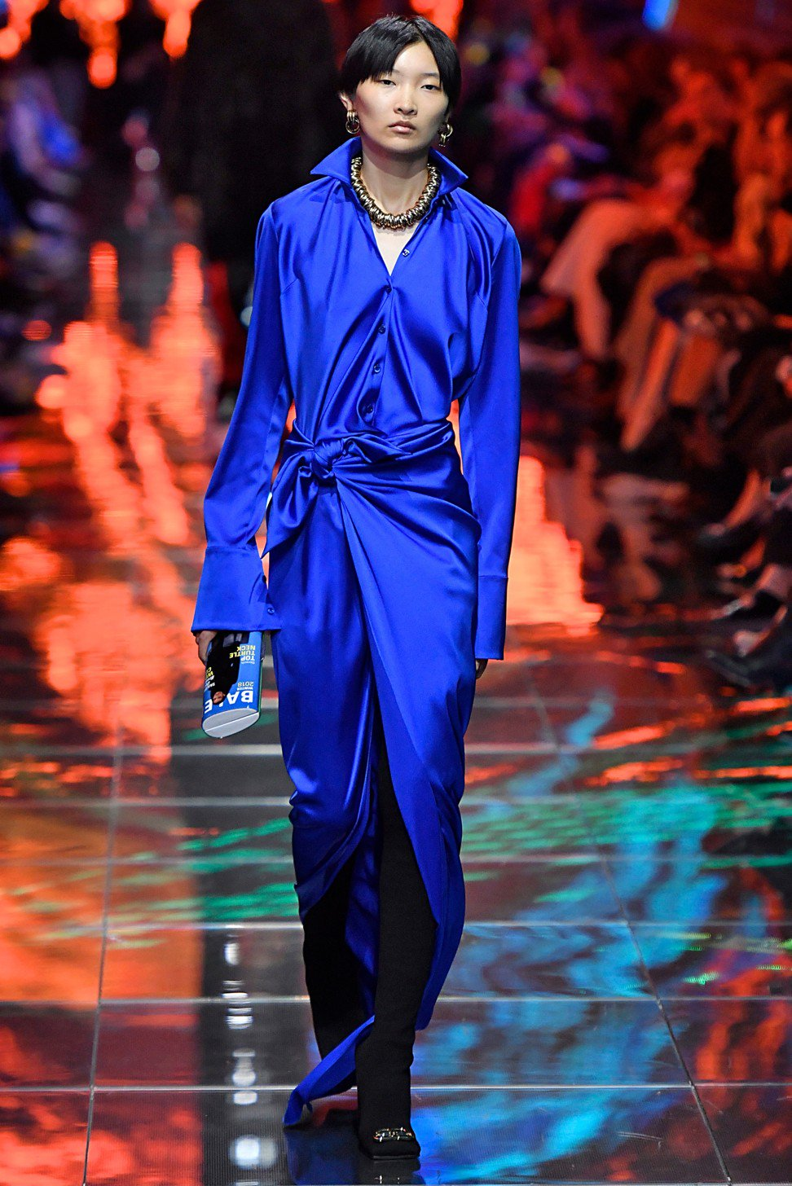
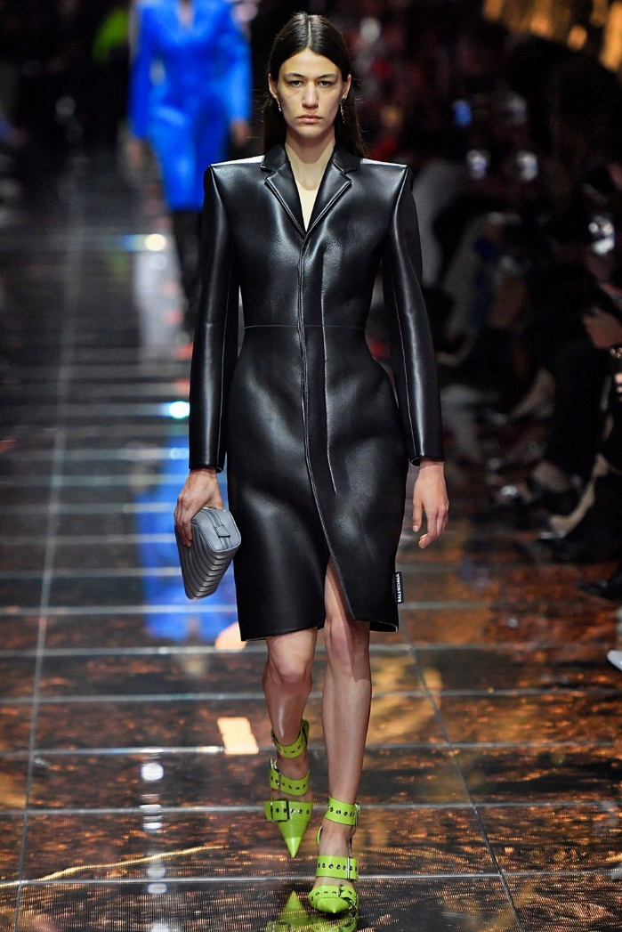
21th Century Balenciaga
Demna Gvasalia: Balenciaga Current Director
Figure 2. Photographed by Annie Leibovitz, Vogue, September 2016
Figure 1. Demna Gvasalia, Balenciaga Spring /Summer 2019, 2018
https://www.highsnobiety.com/p/denma-gvasalia-everything-you-need-to-know/
Figure 3. Demna Gvasalia, Balenciaga Spring/ Summer 2019, 2018
Notes:
The latest Balenciaga creative director Demna Gvasalia, March 25, 1981, Sukhumi
Before Balenciaga, Gvasalia was in LV in 2015, but before that he had founded his own fashion label Vetements, which was known for it unorthodox designs. 11 Nembhard, Candice, Highsnobiety
https://www.highsnobiety.com/p/denma-gvasalia-everything-you-need-to-know/, December 3, 2018
In is current Spring/Summer collection for 2019, Gvasalia show cased a fire and ice theme to showcase is troubled past.
He studied finance before attending Antwerp Academy of Fine Art.
For this collection he was inspired by the 80’s; a shirt jacket, matching fluid pants and over exaggerated flows and cuts.

Slide 11
Bibliography
BoF Exclusive | Nicolas Ghesquière Finally Speaks On Why He Left Balenciaga." The Business of Fashion. April 28, 2013. Accessed December 05, 2018. https://www.businessoffashion.com/articles/bof-exclusive/bof-exclusive-nicolas-ghesquiere-finally-speaks-on-why-he-left-balenciaga.
Britannica, The Editors of Encyclopaedia. "Cristóbal Balenciaga." Encyclopædia Britannica. June 01, 2018. Accessed December 05, 2018. https://www.britannica.com/biography/Cristobal-Balenciaga.
Bringonthethirst. "The Origin of The Cocktail Dress." The Thirst. December 03, 2013. Accessed December 05, 2018. https://bringonthethirst.wordpress.com/2013/12/02/the-origin-of-the-cocktail-dress/.
"Coat | Balenciaga, Cristóbal." V&A Search the Collections. Accessed December 05, 2018. http://collections.vam.ac.uk/item/O109487/coat-balenciaga-cristobal/.
Cochrane, Lauren. "Nicolas Ghesquière's Top Five Collections for Balenciaga." The Guardian. November 04, 2013. Accessed December 05, 2018. https://www.theguardian.com/fashion/gallery/2013/nov/04/nicolas-ghesquiere-top-five-collections-balenciaga.
"Cristobal Balenciaga – The Purist." 21 Sewing Terms Every Beginner Should Know | Colette Blog. Accessed December 05, 2018. https://blog.colettehq.com/inspiration/cristobal-balenciaga-the-purist.
"Cristóbal Balenciaga (1895-1972)." The Business of Fashion. August 21, 2015. Accessed December 05, 2018. https://www.businessoffashion.com/articles/education/cristobal-balenciaga-1895-1972.
Dazed. "Breaking down Balenciaga, Era by Influential Era." Dazed. May 26, 2017. Accessed December 5, 2018. http://www.dazeddigital.com/fashion/article/36080/1/balenciaga-designers-nicolas-ghesquiere-alexander-wang-demna-gvasalia.
Dress | Ghesquière, Nicolas." V&A Search the Collections. Accessed December 05, 2018. https://collections.vam.ac.uk/item/O1242046/dress-ghesquiere-nicolas/
"Evening Coat - Cristóbal Balenciaga - Google Arts & Culture." Google. Accessed December 05, 2018. https://artsandculture.google.com/asset/_/OAGkHLjr2xhyug.
"Forgotten Designer Michel Goma." Couture Allure Vintage Fashion. Accessed December 05, 2018. http://coutureallure.blogspot.com/2012/11/forgotten-designer-michel-goma.html.
France-Presse, Agence. "Balenciaga's PFW Show Reflects Demna Gvasalia's Troubled past." South China Morning Post. October 02, 2018. Accessed December 05, 2018. https://www.scmp.com/magazines/style/fashion-beauty/article/2166650/balenciagas-paris-fashion-week-show-reflects-designer.
JGreer, Jessica-Belle GreerJessica-Belle. "A Short History Of: Balenciaga." Fashion Quarterly. June 18, 2018. Accessed December 05, 2018. https://www.fq.co.nz/fashion/short-history-balenciaga.ones, Jo. "A Century of Balenciaga: The 10 Defining Moments – in Pictures." The Guardian. May 25, 2017. Accessed December 05, 2018. https://www.theguardian.com/fashion/gallery/2017/may/25/a-century-of-balenciaga-the-10-defining-moments-in-pictures#img-3.
Lornakoski17. "Looking Back at Balenciaga's Storied Past." WWD. October 07, 2015. Accessed December 05, 2018. https://wwd.com/fashion-news/designer-luxury/a-balenciaga-timeline-10256184/.

Slide 12
Bibliography
Mower, Sarah. "How Demna Gvasalia Is Revolutionizing Balenciaga From the Inside Out." Vogue. May 26, 2017. Accessed December 05, 2018. https://www.vogue.com/article/demna-gvasalia-balenciaga-artistic-director-vetements-cofounder-designer.
Nembhard, Candice. "Here's Everything You Need to Know About Demna Gvasalia." Highsnobiety. March 28, 2018. Accessed December 05, 2018. https://www.highsnobiety.com/p/denma-gvasalia-everything-you-need-to-know/.
The Met's Heilbrunn Timeline of Art History. Accessed December 05, 2018. https://www.metmuseum.org/art/collection/search/95477
Tailored Suit - Cristóbal Balenciaga - Google Arts & Culture." Google. Accessed December 05, 2018. https://artsandculture.google.com/asset/tailored-suit/1AEDVczS2YPKEg.

