Slide 1
Teaching Citation Structure
By: Anderson Uribe, Jamika Russell, and Miles Litteral

Slide 2
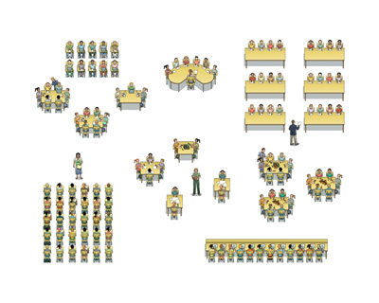
Blended Learning

Slide 3
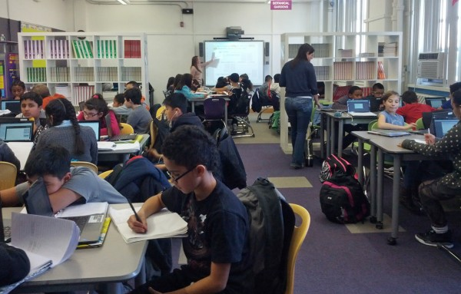
School of One

Slide 4
What is MLA Master?
A game for college students.
Test players on how to cite correctly.
Played in group form.
Has three levels of difficulty (Easy, Medium, and Hard)

Slide 5
How is MLA Master Played?
First Find a group (whether the professor arranges the group or the students)
Complete the Easy Level
Players will learn how to cite in correct order.
Complete Medium Level
Players will apply their knowledge from the Easy Level then fix the errors on the remaining cards.
Complete Challenging Level
Players will have the same 7 cards but will now have to incorporate their learnings from level one and two to complete this level.

Slide 6
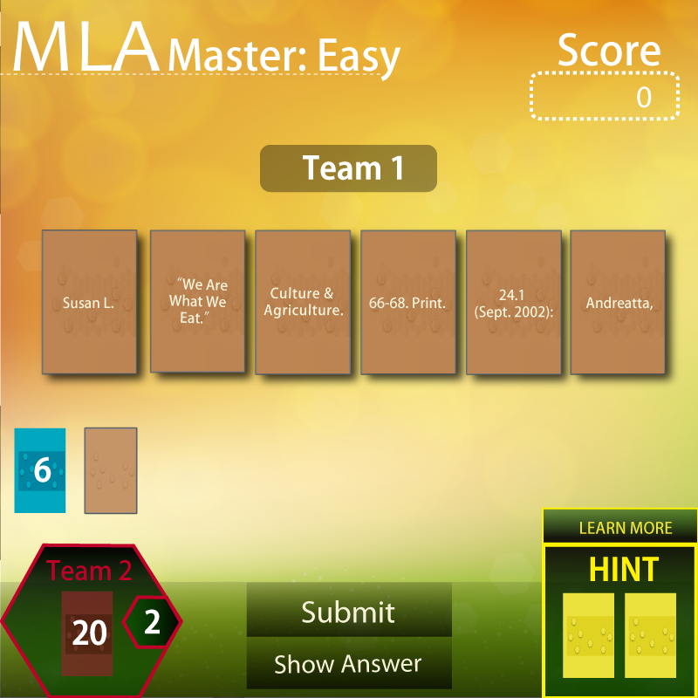

Slide 7
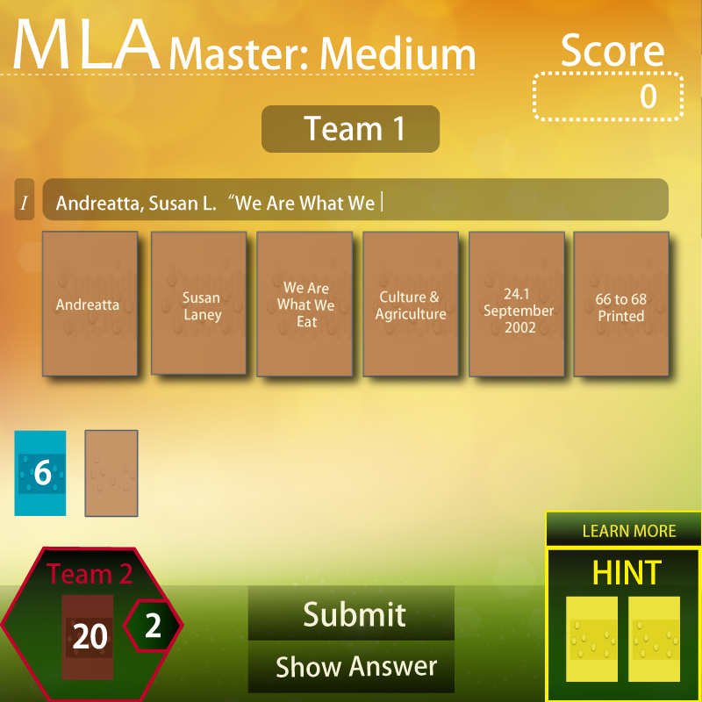

Slide 8
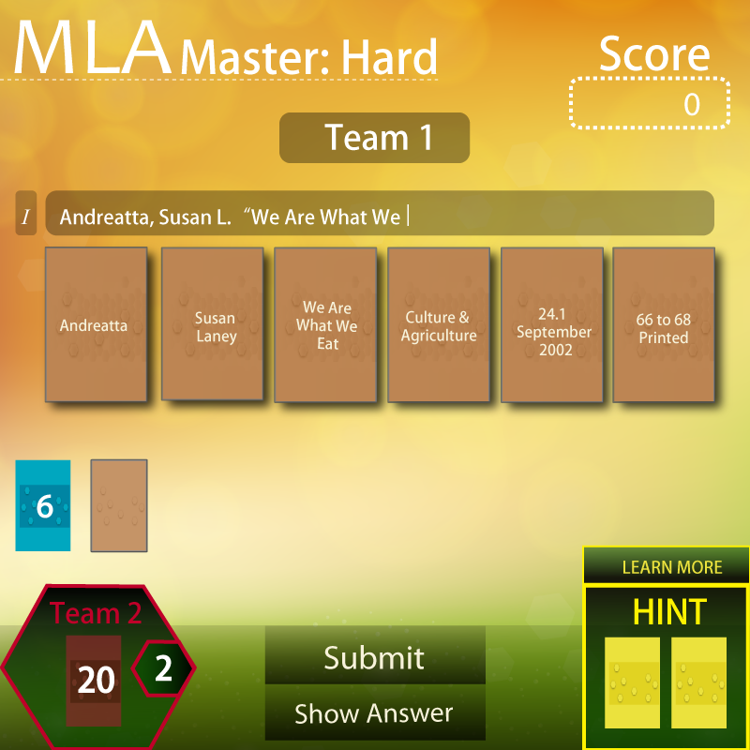

Slide 9
Looking Ahead...
and more...

Slide 10
Works Cited
Academic Styles And Their Significance: Meet MLA,
APA, Chicago And IEEE. Digital Image. Student Share. Student Share. 22 Apr. 2015. 15 May 2015.
Digital Image. New Classrooms. New Classrooms
Innovation Partners. Web. 14 May 2015.
Dobo, Nichole. Digital Image. Hechingerreport.org. Teachers College at Columbia University. 19 Feb. 2015. Web. 14 May 2015.

