Slide 1
The Short-Term Marriage Plot: Narratives of Serial Monogamy
Jody R. Rosen
New York City College of Technology
@jrrnyc #issn2016

Slide 2
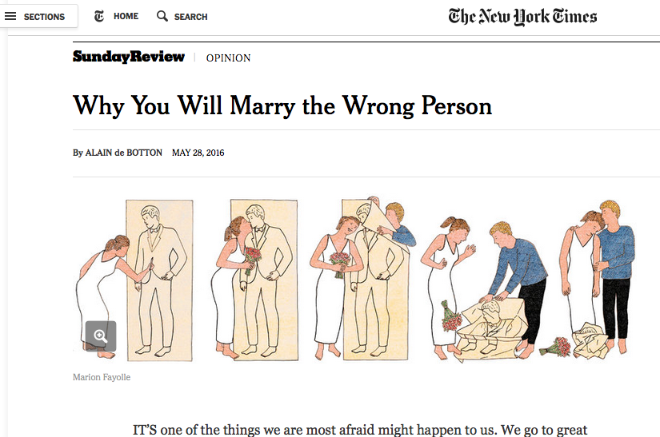

Slide 3
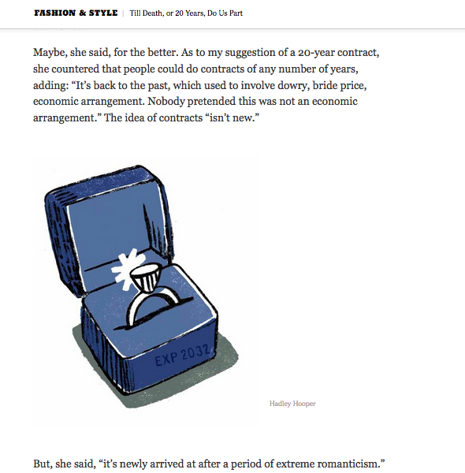

Slide 4
“The Other Two”
Narrative order:
Waythorn → Haskett → Varick
Chronological order:
Haskett → Varick → Waythorn

Slide 5
“The Other Two”
“Her pliancy was beginning to sicken him. Had she really no will of her own—no theory about her relation to these men? She had accepted Haskett—did she mean to accept Varick? It was ‘less awkward,’ as she had said, and her instinct was to evade difficulties or to circumvent them. With sudden vividness Waythorn saw how the instinct had developed…

Slide 6
“The Other Two”
She was ‘as easy as an old shoe’—a shoe that too many feet had worn. Her elasticity was the result of tension in too many different directions. Alice Haskett—Alice Varick—Alice Waythorn—she had been each in turn, and had left hanging to each name a little of her privacy, a little of her personality, a little of the inmost self where the unknown god abides.”

Slide 7
“The Other Two”
“He perceived that Haskett’s liberal commonness had made Alice worship good breeding, while Varick’s liberal construction of the marriage bond had taught her to value the conjugal virtues; so that he was directly indebted to his predecessors for the devotion which made his life easy if not inspiring.”

Slide 8
“The Other Two”
“He held so many shares in his wife’s personality and his predecessors were his partners in the business….He even began to reckon up on the advantages which accrued from it, to ask himself if it were not better to own a third of a wife who knew how to make a man happy than a whole one who had lacked opportunity to acquire the art.”

Slide 9
The Custom of the Country
“‘I guess Mabel’ll get a divorce pretty soon…they like each other well enough. But he’s been a disappointment to her. He isn’t in the right set, and I think Mabel realizes she’ll never really get anywhere till she gets rid of him”

Slide 10
The Custom of the Country
“that wouldn’t be the reason given, of course. Any lawyer could fix it up for them. Don’t they generally call it desertion?”

Slide 11
The Custom of the Country
“‘Oh, it all depends on you! Out in Apex, if a girl marries a man who doesn’t come up to what she expected, people consider it’s to her credit to want to change. You’d better think twice of that!’”

Slide 12
The Glimpses of the Moon
“‘But you simply don’t know what you’re talking about. As if anybody ever had all the money they wanted!’”

Slide 13
The Glimpses of the Moon
“that squirrel-wheel of a world of his and Susy’s you had to keep going or drop out”
“the queer social whirligig from which she had so lately fled”
“turned and turned about in her agony like a trapped animal in a cramping cage”

Slide 14
Thank you!
Jody R. Rosen
New York City College of Technology
@jrrnyc #issn2016

