Slide 1
Dilaceration and accessory roots
By Jorge Robles

Slide 2
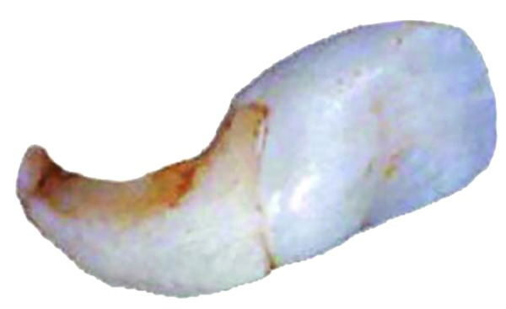
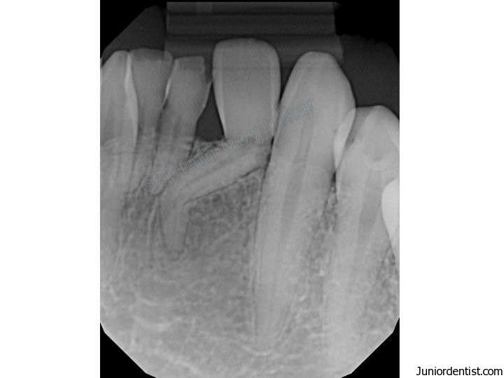
Dilaceration
a developmental problem which involves the malformation of the tooth
results in either distorted root or severe associated crown angulation in a formed tooth.
is manifested as extreme bends or curves in an otherwise straight tooth.
Can cause complications in extraction and endodotic therapy.

Slide 3
Accessory Roots
also known as supernumerary roots.
a condition which refers to the development of an increased number of roots on a tooth compared with that described in a normal dental anatomy.

Slide 4
What Are The CAUSES?
DILACERATION
Can be caused by a distortion of Hertwig epithelial root sheath (responsible for the shape of the roots and induction of root dentin), due to pressure or injury.
Injury can displace the calcified portion of the tooth germ, resulting in the remainder of the tooth forming at an abnormal angle.
Damage usually follows avulsion or intrusion of the overlying primary predecessor.
The bend can also occur due to the presence of an adjacent cyst or tumor.
Common causes include crowding, trauma, adjacent bony lesions, and Orthodontic traction
Can occur in any tooth or group of teeth during development.
Very pronounced bend can prevent tooth eruption.

Slide 5
CAUSEs Cont’d
ACCESSORY ROOTS
Extra roots may be due to trauma, pressure, or metabolic disease that affects Hertwig epithelial root sheath.
most common teeth affected are mandibular canines, premolars, and molars, especially third molars.
Can affect any tooth
Rarely affects incisors

Slide 6
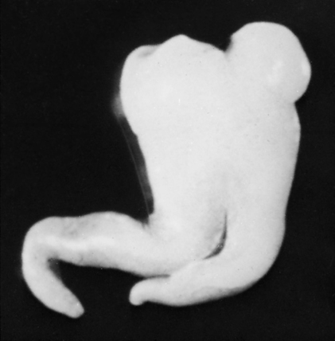
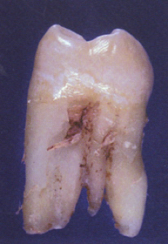
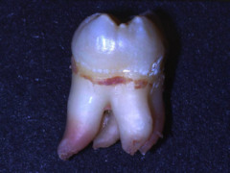

Slide 7
DENTAL treatment
DILACERATION
Extraction is necessary of primary deciduous teeth, if they demonstrate undesired resorption, which can result in delayed eruption.
Surgical Extraction is required of grossly deformed teeth due to the repositioning and perforation of the buccal alveolar ridge by the mispositioned root.
No treatment required for mild cases.
ACCESSORY ROOT
No treatment necessary, but detection of the extra root is critical for endodontic therapy and tooth extraction.

Slide 8
ROLE OF THE HYGIENIST
Thorough intraoral examination is necessary as dilacerations are usually accidental findings during routine oral examination.
Radiograph examination is necessary before treatment to detect dilaceration or accessory roots.
Document and report any findings on the patient’s chart.
Educate patient on radiograph findings.

