Slide 1
Systemic and topical antifungal medications
Justine Renneker
Androf Whyte
Mercedes Gutierrez

Slide 2
What are Antifungal ?
Antifungal agents selectively eliminate fungal pathogens from a host. Fungi are eukaryotic cells, and grow at a very slow pace in multicellular forms. This makes studying them and creating antifungals more complicated. Infections occuring in humans are called mycosis. Mycosis may be categorized as superficial, cutaneous, subcutaneous, systemic, and oppurtunistic infection. Most agents toxic to fungi are toxic to the host as well. They are known to have multidrug interactions, and severe adverse effects. Three common group of antifungals are :
Polyene agents- these antifungals are a product of the streptomyces species. They interact with sterols in cells to form channels through the membrance. This group includes your nystatin, amphotericin B, and pimaricin.
Azole agents- these agents inhibit cytochrome p 450 hepatic enzymes responsible for the biosynthesis of membrane sterols.
Antimetabolites- there are far less agents in this group. They generally inhibit DNA and RNA sysnthesis.

Slide 3
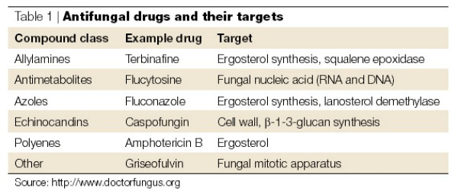
Antifungal interactions

Slide 4
Antifungal treatment
Antifungals are used to treat a variety of conditions of the skin, oral cavity, nails, and genital areas. Due to the variety of possible infections, drugs may be administered as a topical, systemic, or combination form. Systemic antifungals are highly toxic to the body, and are used sparingly. They may be administered when initial therapy with topical agents prove ineffective, or if the infection is too widespread throughout the body. Systemic antifungals are often used to treat
Onyochomycosis
Superficial and systemic candidasis
Invasive fungal infections
Yeast infections in genital areas
Tinea barbae (hair)
Tinea ungium
Tinea capitis

Slide 5
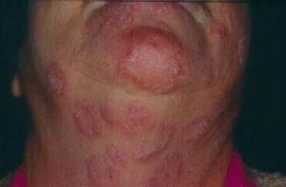
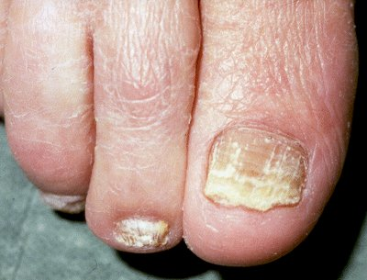
Antifungal treatment
Topical antifungals are usually reserved for superficial infections. They may be replaced with systemic agents if necessary. These agents are usually unable to penetrate hair or nails. They come in forms of soap, ointment,lacquer, and shampoos. Superficial infections that respond well to topical antifungals include:
Tinea- fungal infections caused by a species called dermatophytes.
Tinea corporis (skin)
Tinea cruris (groin)
Tinea pedis(feet)

Slide 6
Systemic antifungal drugs
Ketoconazole ( Apo-Ketoconazole; Novo-Keetoconazole)- Use: Treatment of susceptible fungal infections in the oral cavity including candidiasis, oral thrush, and chronic mucocutaneous. MOA: Alters the permeability of the cell wall by blocking fungal cytochrome P450. Adverse effect: peripheral edema, fatigue, insomnia, skin rash, xerostomia, hot flash, dyspepsia, nausea, vomiting, abdominal pain, anorexia, constipation and tongue discoloration.
Terbinafine ( LamilSIL; Terbinex) - Use: Treatment for onychomycosis of the toenail or fingernail caused by dermatophytes. MOA: deficiency in ergosterol within the fungal cell wall and results in fungal cell death. Adverse effect: headaches, skin rash, diarrhea, dyspepsia, vomiting, nausea, abdominal pain, sore throat, cough and upper respiratory tract infection.

Slide 7
Topical antifungal drugs
Clotrimiazole (Clotrimiazole anti-fungal) - Use: Treatment of susceptible fungal infections, including dermatophytes, superficial mycoses, and cutaneous candidiasis, as well as vulvovaginal candidiasis. MOA: binds to phospholipids in the fungal cell membrane altering cell wall permeability resulting in loss of essential intracellular elements. Adverse effect: vaginal burning.
Miconazole (Litrimin powder; Vagistat-3) - Use: Treatment of vulvovaginal candidiasis and variety of skin and mucous membrane fungal infections. MOA: inhibits biosynthesis of ergosterol, damaging the fungal cell wall membrane, which increases permeability causing leaking of nutrients. Adverse effect: allergic contact dermatitis, burning, irritation, and itching.
Nystatin ( Nyamyc, Nystop, Pedi-dri, PediadermAF complete)- Use: Treatment of susceptible cutaneous and mucocutaneous fungal infections normally caused by the Candida species MOA: binds to sterols in fungal wall membrane, changing the cell wall permeability allowing for leakage of cellular contents. Adverse effect: contact dermatitis, and Stevens-Johnson syndrome.

Slide 8
Side effects and Oral considerations
Topical fungal infections are superficial and are usually treated with creams or ointments. While some systemic fungal infections, such as candidiasis if entered through the blood stream, are treated with anti-fungal medications. There are no side effects exclusive to the oral cavity as it pertains to anti fungal medication. Though there are some side effects to take in consideration when treating such patients:
Some side effects from using systemic anti fungal may include
loss of appetite
nausea or vomiting
yellow skin or eyes
dark urine
skin rash or itching
pain redness or swelling at site of application
High blood pressure
serious side effects are not common, but may include
fever and chills
Liver damage
Kidney damage

Slide 9
Overview of systems
Treatment of these infections may affect certain systems in the body. Some examples include…
The treatment of a vaginal yeasting infection, affecting the excretory and reproductive systems in the body.
In the the treatment of candida esophagitis the digestive system is affected by making it painful for a person to swallow their food.
The circulatory system may also be affected by anti fungal therapy in the unfortunate event that a yeast infection enters the blood stream.

Slide 10
Refrences
“Topical Treatment of Common Superficial Tinea Infections." - American Family Physician. N.p., n.d. Web. 02 Aug. 2015.
"Result Filters." National Center for Biotechnology Information. U.S. National Library of Medicine, n.d. Web. 02 Aug. 2015
Dixon, Dennis M. Antifungal Agents. U.S. National Library of Medicine, n.d. Web. 02 Aug. 2015
Wynn, Richard L., Timothy F. Meiller, and Harold L. Crossley. Drug Information Handbook for Dentistry: Including Oral Medicine for Medically-compromised Patients & Specific Oral Conditions. Hudson, OH: Lexcomp, 2013. Print.
http://wi.mit.edu/files/wi/cfile/programs/teacher/presentations/antifungal_drugs.pdf

