Slide 1
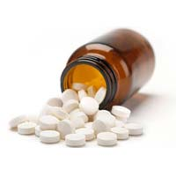
Antineoplastic drugs
Justine Renneker
Mercedes Gutierrez
Androf Whyte

Slide 2
antineoplastic drugs
Antineoplastic drugs inhibit the maturation and proliferation of malignant cells. They may be referred to as either cytotoxic or cytostatic agents. These drugs are highly destructive due to their unselective nature. They have a very narrow therapeutic index. These drugs are not only toxic to the consumer, but to the operator as well. They are divided into different groups, each serving a specific purpose. For example :
Alkalyting agent- damage the DNA of cells and interfere with replication.
Antimetabolites- replace metabolites without performing their function.
Alkaloids- lead to metaphase(third stage of mitosis) arrest.
Anti tumor antibiotics- affect synthesis of nucleic acid.

Slide 3
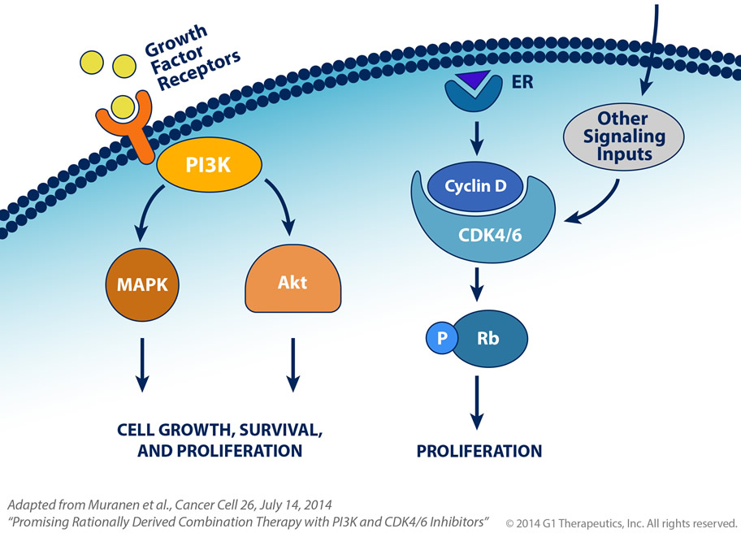
purpose of antineoplastics
Antineoplastics are often referred to as the anti cancer drug. It is almost always found in chemotherapy regimans for a variety of different cancers. The drug proliferates tumors and prevent further growth. It is often used in combination with other treatments such as radiation and surgery, which increase the hazardous risk of this drug. It is extremely toxic to the body, and is used only when a physcian believes it has a greater benefit than risk. Factors to consider before adminstering the drug are:
Body surface area of patient
Type of malignancy
Stage of development
Other treatments being rendered

Slide 4
Antineoplastic drugs
Bortezomib (Velcade)- Use: treatment of relapsed or refractory mantle cell lymphoma; treatment for multiple myeloma. MOA: inhibits proteasomes, enzymes complexes which regulates protein homeostasis within cells. ADVERSE EFFECTS: fatigue, fever, headache, dizziness, rash, diarrhea, nausea, constipation, vomiting, anorexia, abdominal pain, decreased of appetite, anemia and dyspnea.
Ibrutinib (Imbruvica)-Use: treatment of patient with chronic lymphocytic leukemia with 1yr of prior treatment; treatment for multiple myeloma with 1yr of prior treatment. MOA: potent and irreversible inhibitor of Bruton’s tyrosine kinase and cytokine receptor pathway ADVERSE EFFECTS: peripheral edema, hypertension, fatigue, dizziness, headache, chills, skin rash and infection, diarrhea, constipation, abdominal pain, decrease appetite and platelet, fever and upper respiratory tract infection.

Slide 5
Antineoplastic drugs cont’d
Lenalidomide (Revlimid)- Use: treatment for mantle cell lymphoma relapsed o progress after 2 prior treatments; treatment for multiple myeloma who recieved1 prior therapy; treatment with transfusion-dependent anemia. MOA: inhibits secretion of pro-inflammatory cytokines; inhibits the growth of myeloma cells by inducing cell cycle arrest and cell death. ADVERSE EFFECTS: peripheral edema, hyper and hypotension, fatigue, fever, headache, diarrhea, constipation, nausea, anorexia, blurred vision, dyspnea, erectile dysfunction and renal failure.
Pomalidomide (Pomalyst)- Use: treatment for multiple myeloma who have received 2 prior therapies and 60 days of completion of the last therapy. MOA: enhance t-cells and natural killer cell-mediated cytotoxicity; inhibits production of pro-inflammatory cytokines. ADVERSE EFFECTS: peripheral edema, hypertension, fatigue, dizziness, headache, skin rash, diarrhea, nausea, constipation, vomiting, anorexia, anemia and dyspnea.

Slide 6
Antineoplastic drugs Cont’d
Thalidomide (Thalomid)- Use: acute treatment of cutaneous manifestations of moderate to severe erythema nodosum leprosum; treatment of newly diagnosed multiple myeloma . MOA: may suppress excessive tumor necrosis in ENL patient; may increase plasma tumor necrosis in HIV –positive patient. . ADVERSE EFFECTS: edema, fatigue, dizziness, fever, headache, nausea, constipation, anorexia, xerostomia, anemia and dyspnea.
Ziv-Aflibercept systemic (Zaltrap)- Use: treatment of metastatic colorectal cancer with fluorouracil, leucovorin, and irinotecan in patient who are resistant to oxaliplatin-based regimen. MOA: known as VEGF-TRap; recombinant fusion protein which is comprised of portion of binding domain for vascular receptor 1 and 2. ADVERSE EFFECTS: fatigue, headache, diarrhea, upper abdominal pain, hyperpigmentation, dehydration, neutropenic fever, hemorrhoids and dyspnea

Slide 7
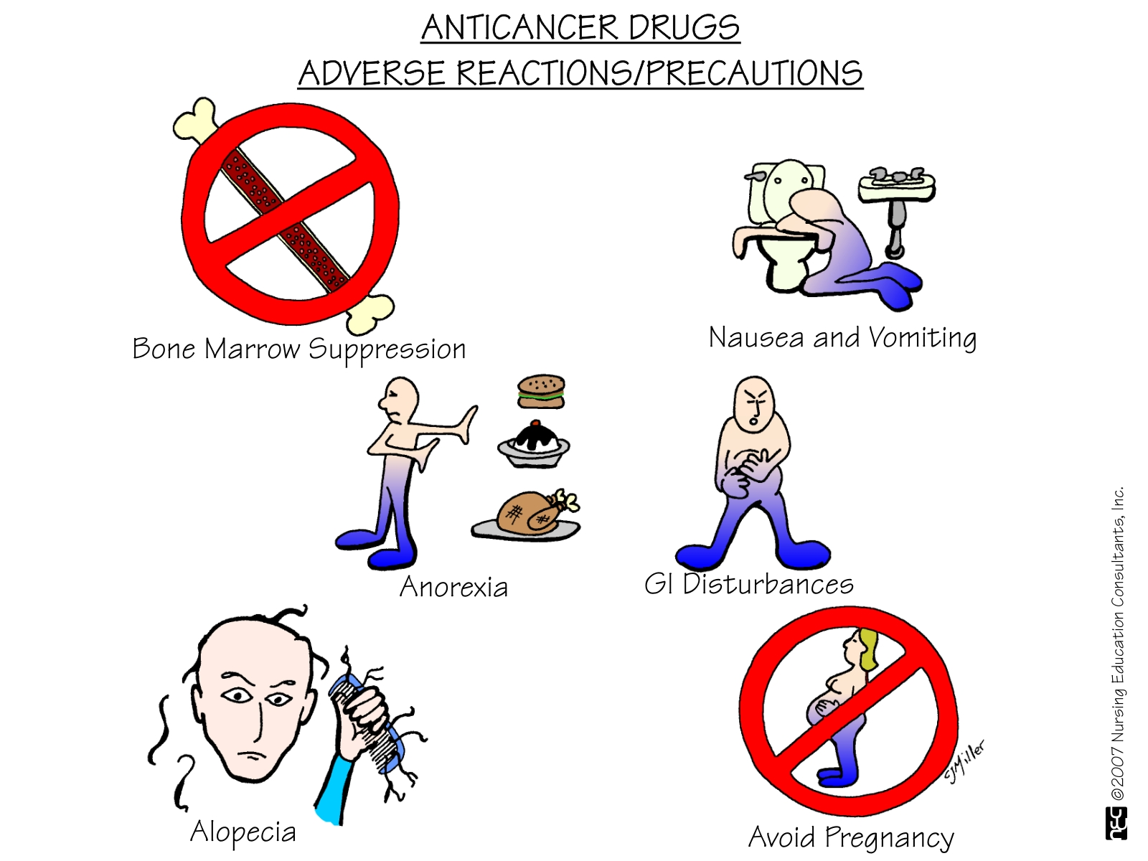
effects on our system
Antineoplastic drugs affect many different systems within the body. These systems vary based on the origin of the cancerous site being treated.
Reproductive System
Some antineoplastic drugs such as Altretamine (Hexalen), Carboplatin (Paraplatin), and Cisplatin (Platinol), are used in treatment of ovarian cancer, the use of these drugs would then have a direct affect on the reproductive system.
Lymphatic System
Asparaginase (Elspar), Chlorambucil (Leukeran), and Teniposide (Vumon) are a few drugs used to treat lymphocytic leukemia. Directly impacting the lymphatic system.
Excretory System
Mitomycin is a drug used to treat cancer originating in the bladder. Thus impacting the excretory system of the body.
Loss of hair is a huge complication that damages a person’s self esteem and leads to depression.

Slide 8
Oral / dentAL considerations
A dental professional must be aware when dealing with a patient who is currently using antineoplastic drugs.
Some side effects that may occur due to dental treatment include:
susceptibility to infections- sores offer an entryway for bacteria to accumulate.
dental, salivary, and taste alterations
oral mucositis- most common complication. May lead to pain, nutrional problems, and increased risk of infection due to open sores in mucosa.
Normally during chemotherapy dental treatments should be limited to emergency procedures, with the exception being patients receiving treatment with intravenous bisphosphonates.
Bone marrow suppresion

