Slide 1
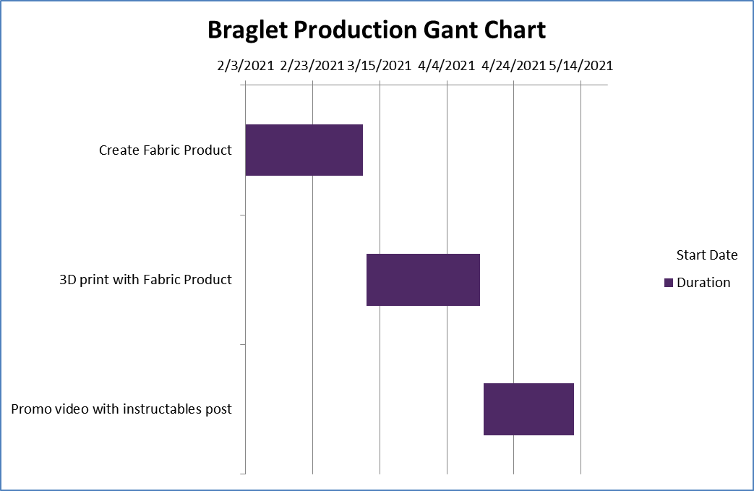
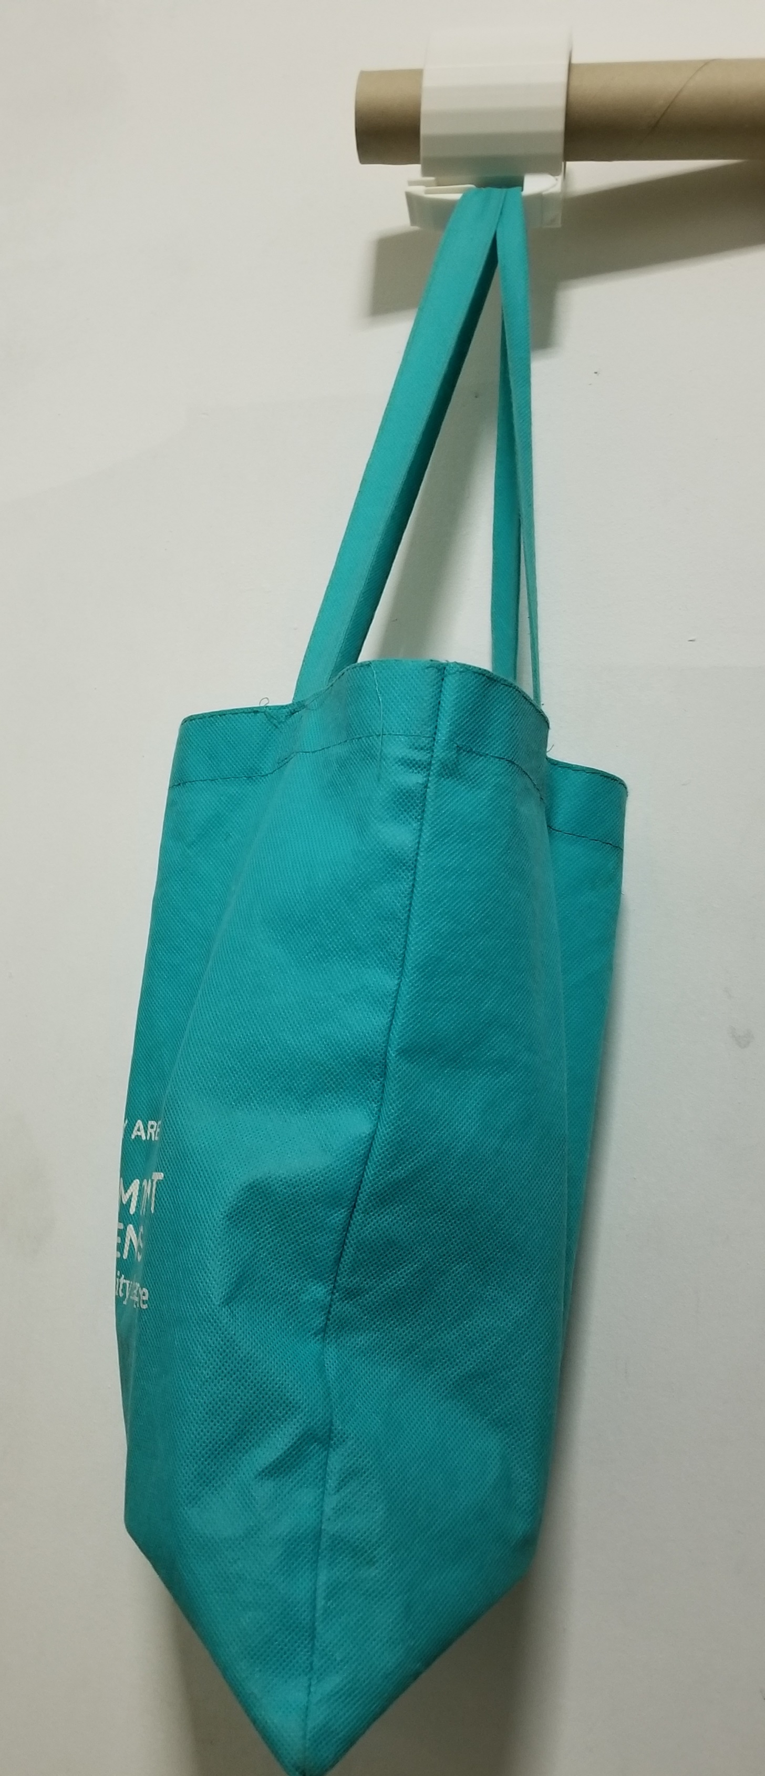
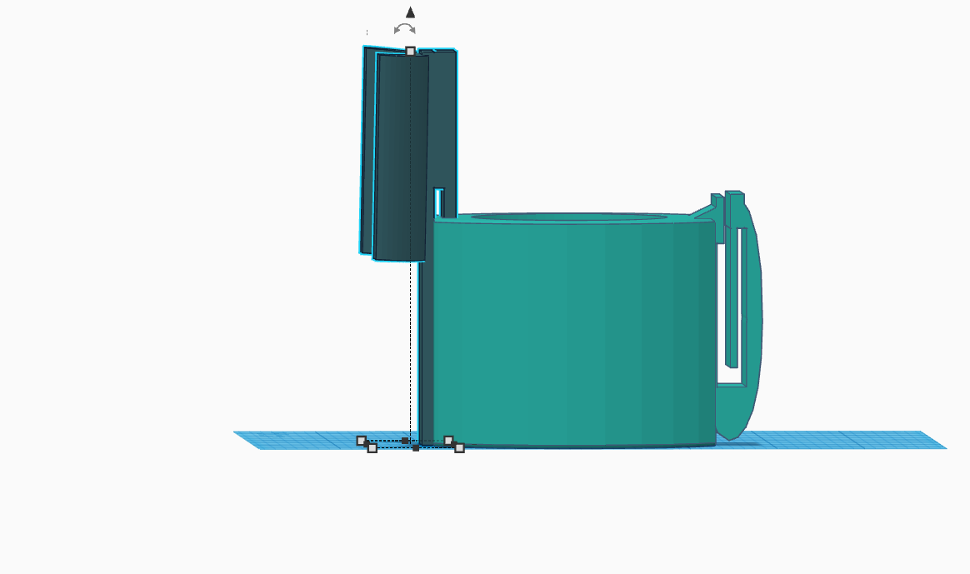
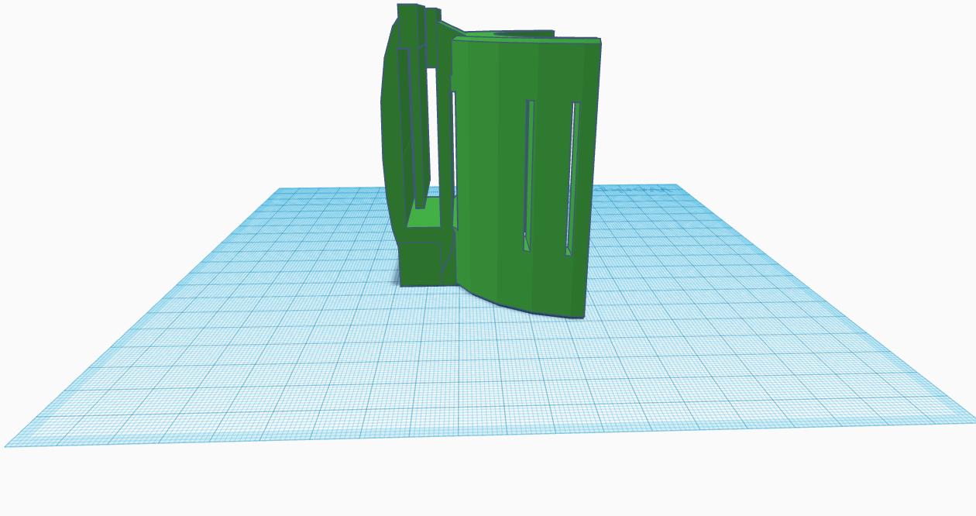
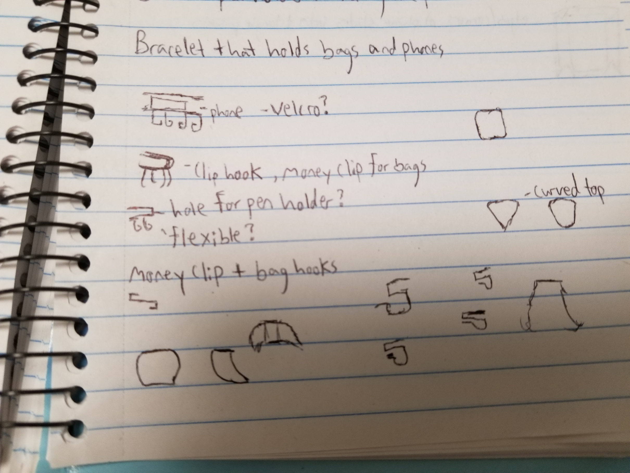
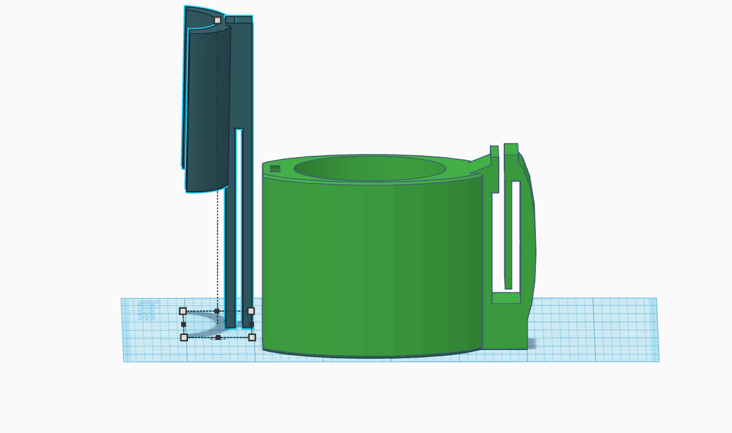
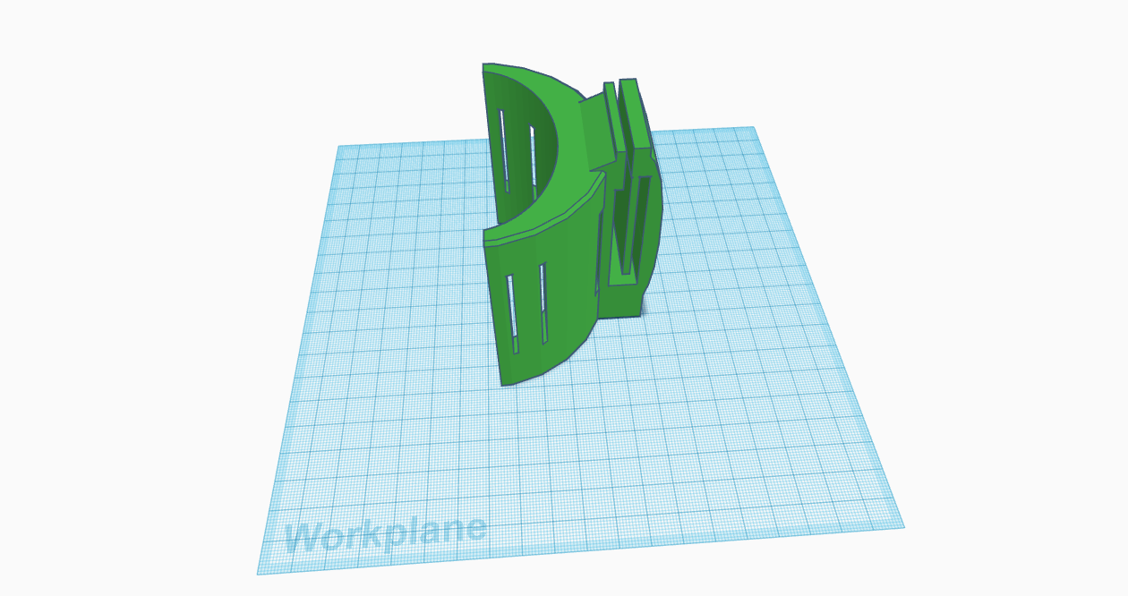
Braglet Justin Philip - Creator/Designer 3/10/21
Summary
The Braglet was created to help people keep their hands free from holding bags. Its meant to be worn on the wrist like a bracelet. No more having to put your bags on the floor while using your phone or drinking a beverage. Just hook your bags onto the Braglet, and enjoy life. The pictures at the bottom were rendered with an optional phone holder that can be inserted into the Braglet. The pictures to the right show the Braglet in action. The 3D printed prototype was strong enough to hold a 10lb bag. My end goal is to get the final product created and into peoples hands.
Schedule
Budget
I received an estimated budget from a product design firm called KICKR DESIGNS. They estimated the total number of engineering hours to be 130. The total cost of engineering plus prototype comes out to around $35,000.
New budget comes out to around $100
Deliverables
Research of product development
Designing final design
Creating promotional video
Pricing the Braglet
Required Resources
Laptop
Wifi Router
3D Printer

