Slide 1
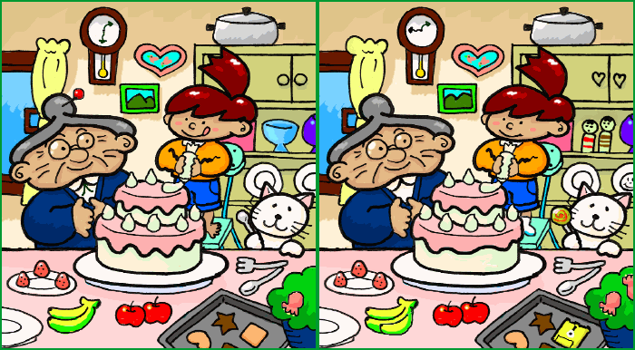
Is There a Difference?
Group: D.J.P.J

Slide 2
Introduction
Designing a game, based on a well known compare & contrast game, “Spot The Differences”
Wanted to create something fun and enjoyable.
Great for young toddlers.

Slide 3
How to play
User will be given two random images, and determine if they have a difference between the two.
After getting more than 10 points, the game will end and the user can start again

Slide 4
Design Details
Game shows two pictures and asks the user if there is a difference.
The original source code was a “High-Low” game, which we edited to create our version of “Is There a Difference Game”
Our Version of the “Is There a Difference Game?” is a “Yes or No” targeted towards young children learning color, shapes, and sizes.

Slide 5
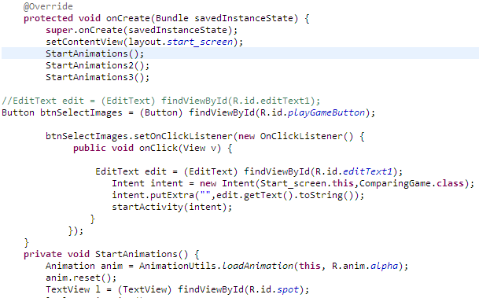
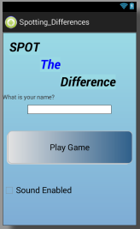
Design Details Cont…
Start Screen

Slide 6
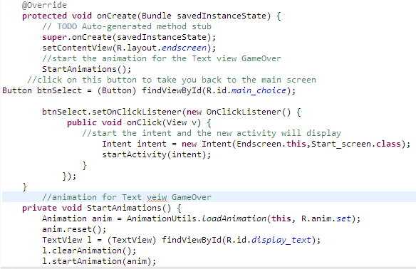
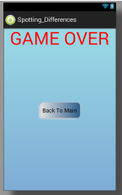
Design Details Cont…
End Screen

Slide 7
Test & Results
During the research phase, there was difficulty finding a source code for “Find the Difference”
We used the source code for the “High-Low” game and modified it to a simple “Is there a Difference?” game.

Slide 8
Test & Results Cont…
Ran a few tests while changing, the “Yes” or “No” buttons, and had some issues displaying which answer was the correct answer.
We decided to use an If statement inside the On Click Listener, in order for there to be more than one option.

Slide 9
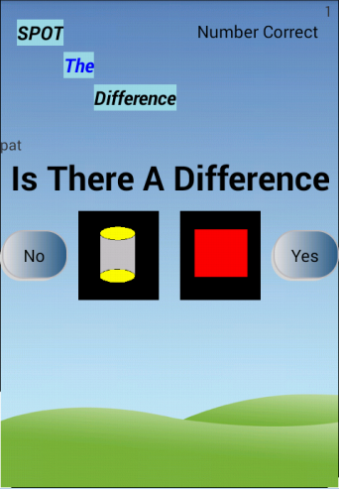
Test & Results Cont…
In the end, the app is completed and works. Minor details can be changed that can be included in updates that may be released in the future.

Slide 10
Conclusion
In conclusion, it taught us how to implement our programming skill to manipulate code and make it do different techniques.
We were able to take things that we were taught in class and incorporate it into our project.

Slide 11
References
Programming Exercises | Programmr." Java Programming. Rajesh Moorjani, 2011. Web. 19 Sept. 2014.
Wanstrath, Chris, and PJ Hyett. "Marbaumgart/ImageTwins." GitHub. Marbaumgart, 10 Apr. 2008. Web. 19 Sept. 2014.
Book, David. "Buzztouch | FREE IOS and Android App Maker." Buzztouch | FREE Android App Maker. David Book, 2009. Web. 01 Dec. 2014.

